Slide 1
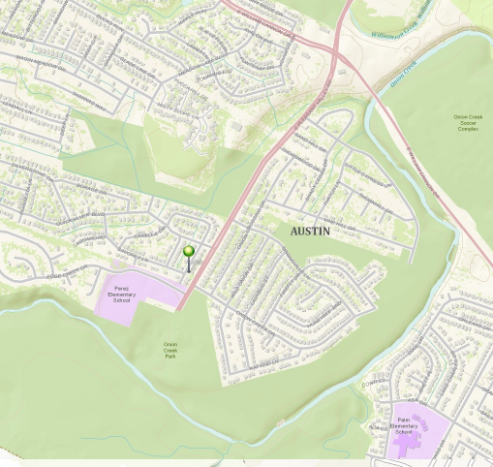
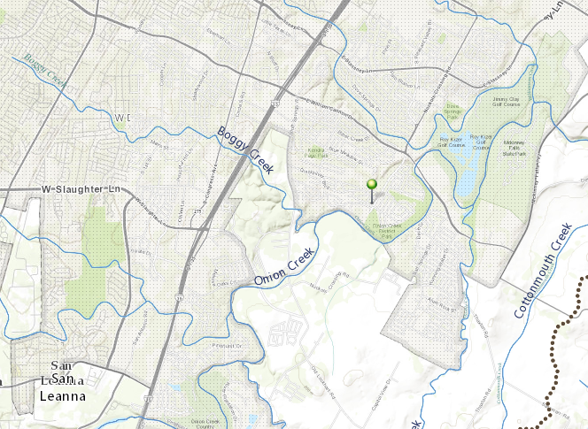
Onion Creek Flooding, 30 October 2013
Number of buyouts by the City of Austin in the Onion Creek area – 323 homes
Approximate amount spent on buyouts - $36 million
($8M of this from FEMA grant funding)
A flooded home location

Slide 2
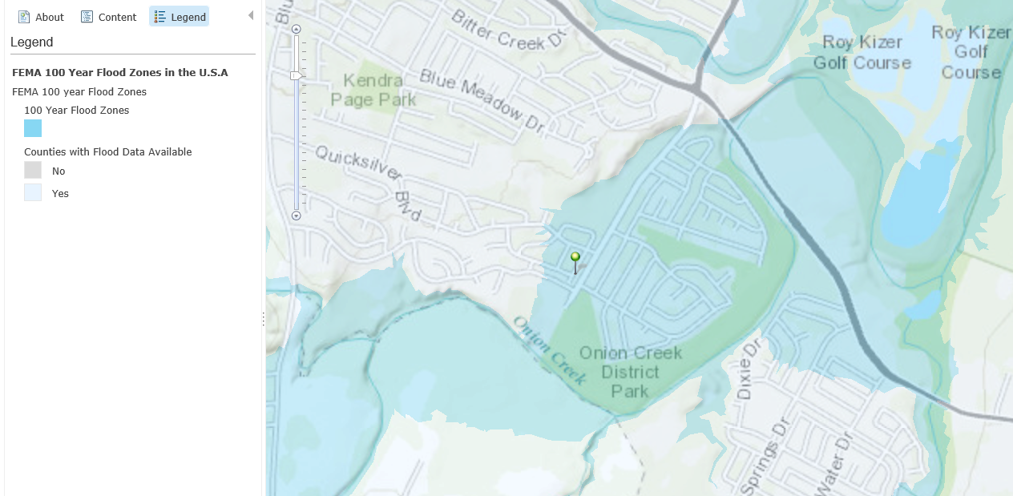
FEMA Flood Hazard Zone

Slide 3
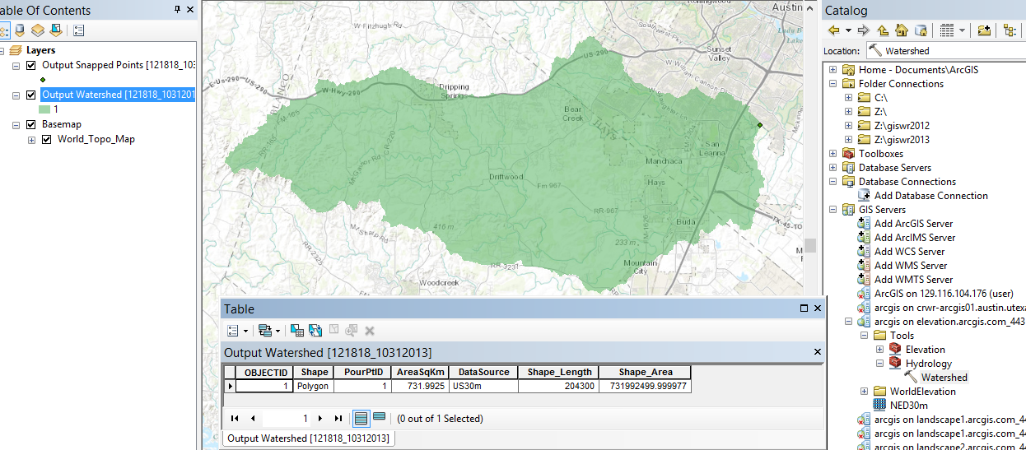
Drainage Area above Home
Drainage area = 732 km², or 282 miles²

Slide 4
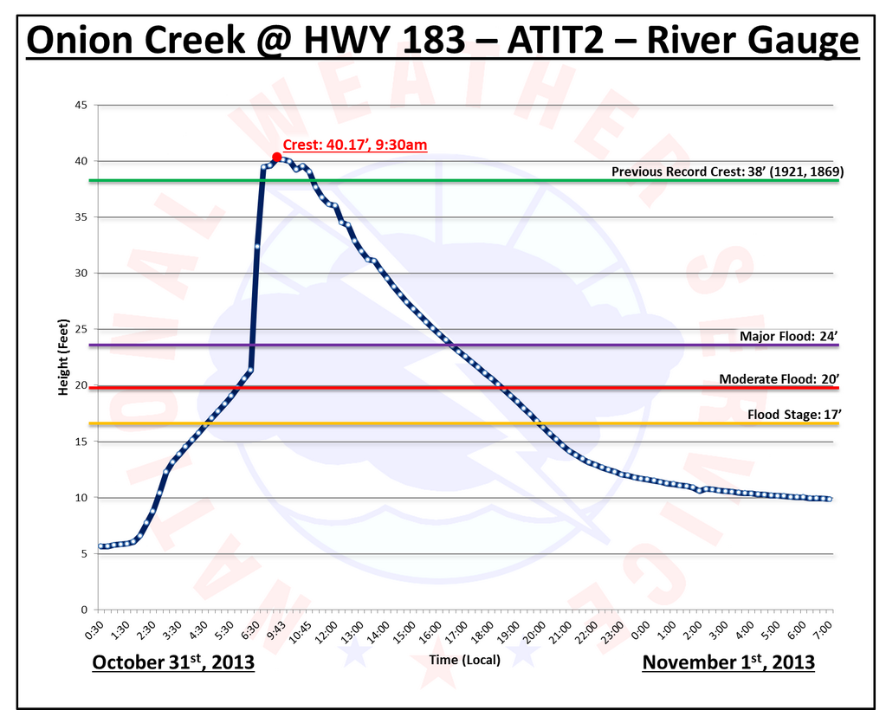
Flood Water Elevations
Halloween Flood on Onion Creek
Expected Hurricane Storm Surge Heights on Gulf Coast

Slide 5
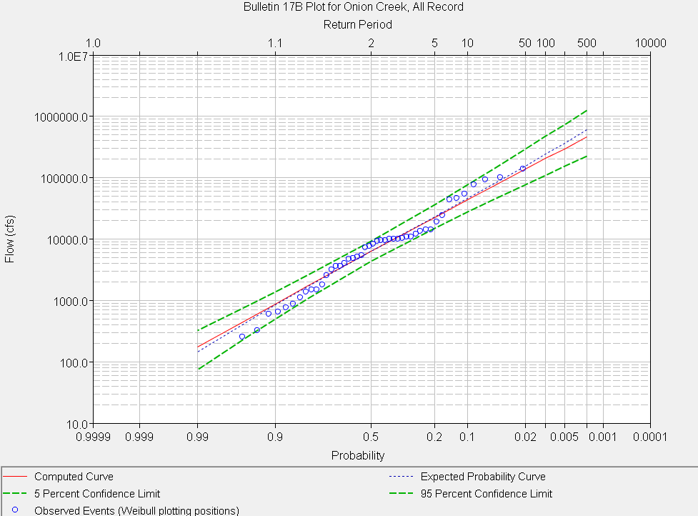
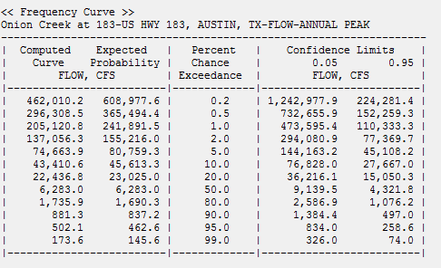
Halloween Flood ~ 120,000 cfs
Somewhere between 20 yr and 100 yr
return period, perhaps 50 yrs
Halloween Flood
HEC-SSP Flood Frequency Analysis
full flood record

Slide 6
http://crhphotos.com/2013/10/halloween-2013-flood/

