Slide 1
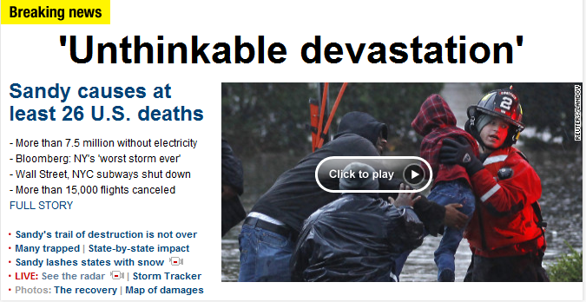
Flooding in New York City 30 October 2012

Slide 2
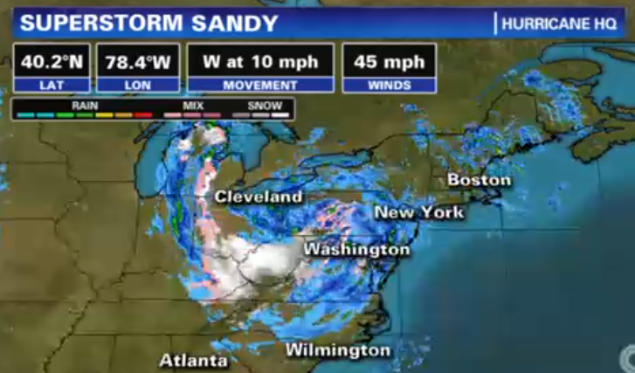
Current Conditions

Slide 3
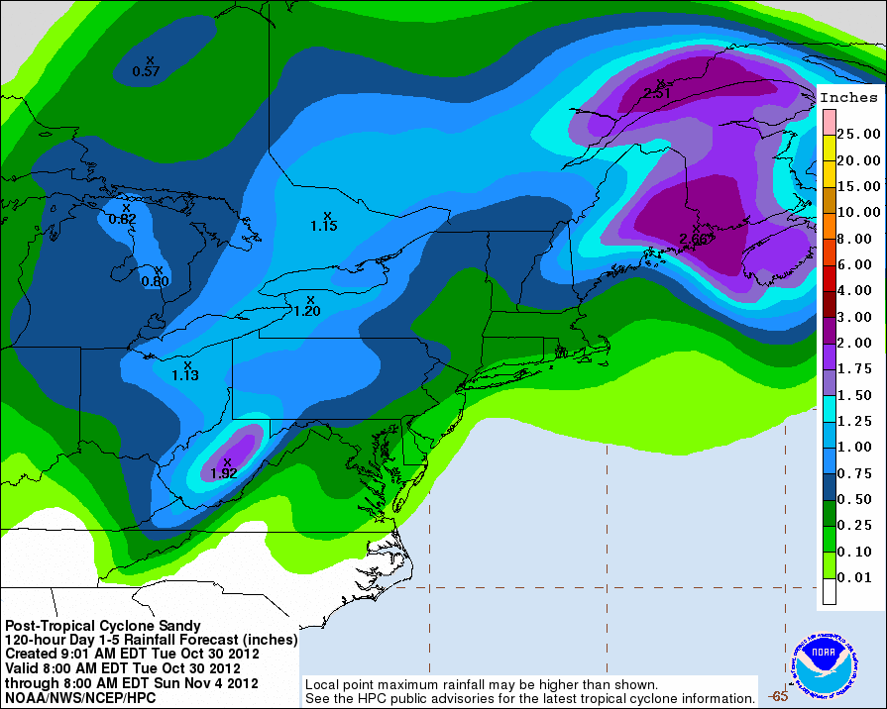
Projected 5-day Rainfall from Sandy

Slide 4
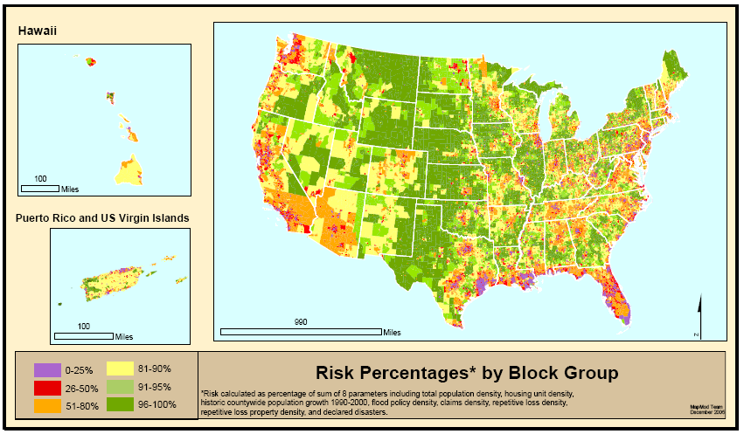
Where is Risk the Greatest?
Source: Scott Edelman (Watershed Concepts)
Notes:
Risk here is where floods and people are in general proximity (or will be)
Risk parameters for block groups
Population, population growth, housing units
Claims, repetitive losses, policies
Flood Disaster declarations (From county distribution)
We aggregate this information to a FEMA Regional level and allocate the majority of the appropriated map mod funding to the Regions who work with their state and local partners to develop flood production schedules at the county level.
All of this is explained in great detail in the Multi-Year Flood Hazard Identification Plan, which is published at least once a year.
Hard around the edges and somewhat softer in the middle.

Slide 5
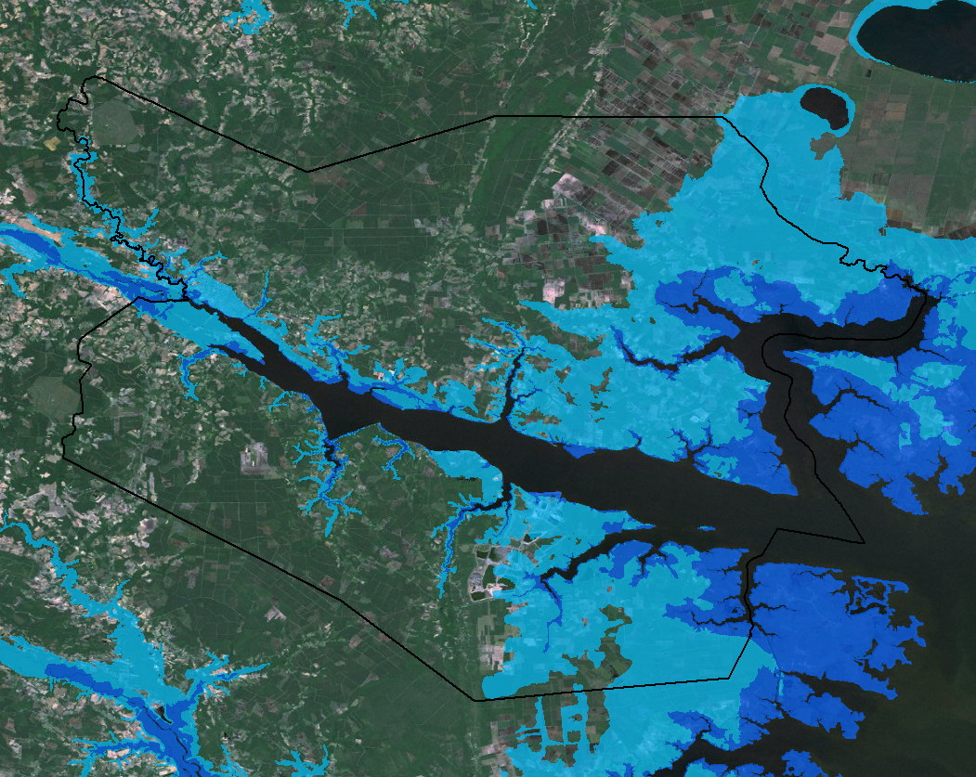
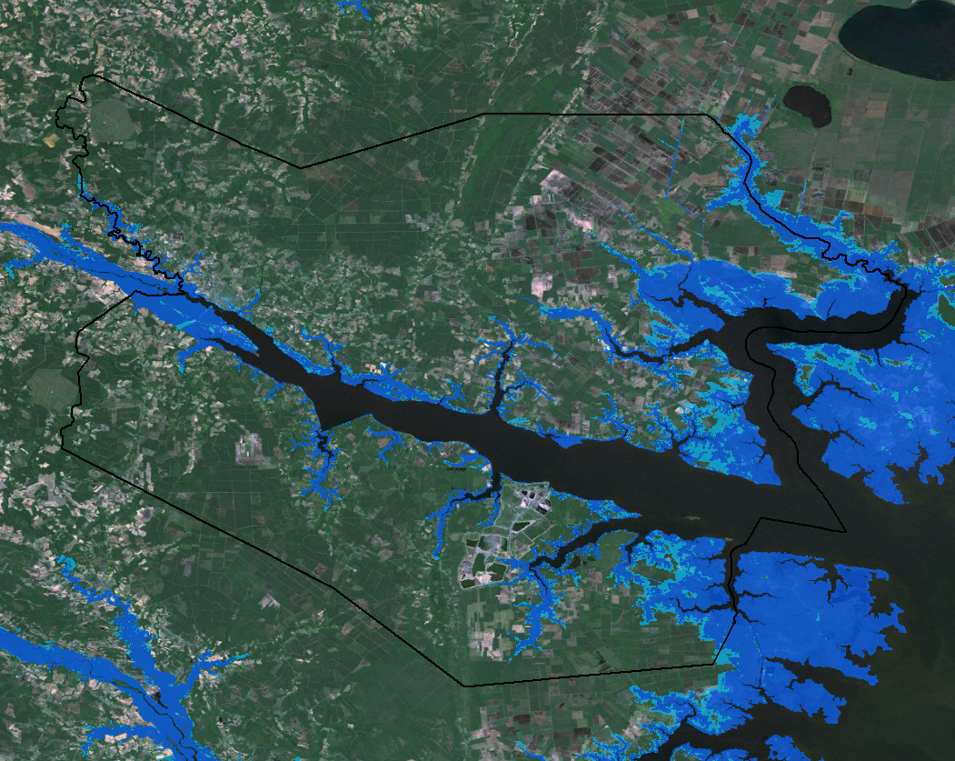
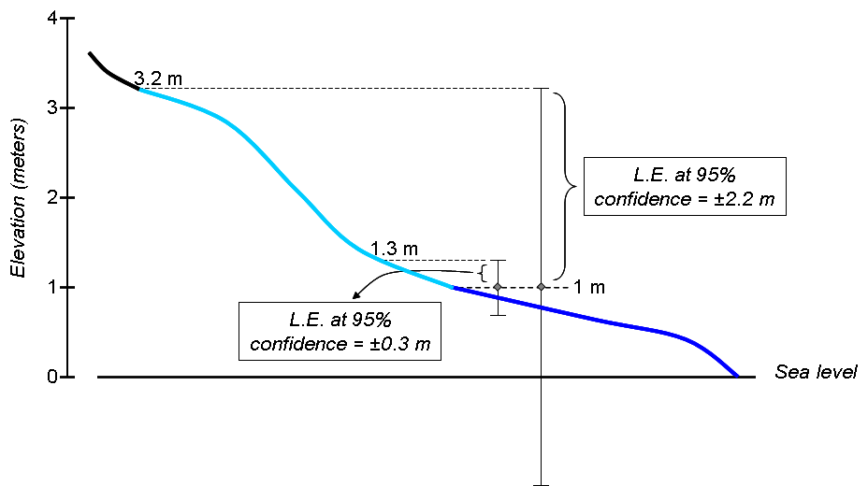
Beaufort County, North Carolina
Elevation source for SLR mapping: 30-m DEM
Elevation source for SLR mapping: 3-m lidar data
Darker blue tint: Land ≤ 1 meter in elevation
Lighter blue tint: Area of uncertainty associated with 1 meter elevation

Slide 6
WHEN STORM SURGE REACHES THE COAST
Spencer Rogers
North Carolina Sea Grant
UNC-Wilmington Center for Marine Science
NCSU Dept. of Civil Engineering

Slide 7
Storm Surge
STEEP OFFSHORE
SMALL STORM SURGE

Slide 8
Storm Surge
FLAT OFFSHORE
HIGH STORM SURGE

Slide 9
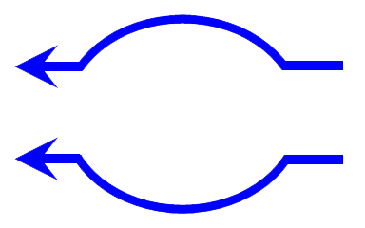
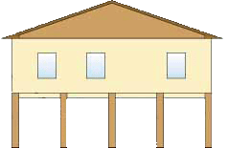
Storm Surge
ISLAND
SMALL STORM SURGE

Slide 10
Storm Surge
Straight Shoreline
MODERATE STORM SURGE

Slide 11
Storm Surge
Bay
HIGHEST STORM SURGE

Slide 12
Storm Surge – Camille & Katrina

Slide 13
TX
LA
MS
AL
FL

Slide 14
Dune Myth
MYTH: Dunes provide protection from chronic erosion
FACT: Dunes provide little or no protection from chronic erosion

Slide 15
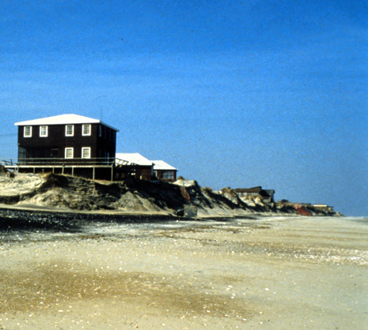

Slide 16
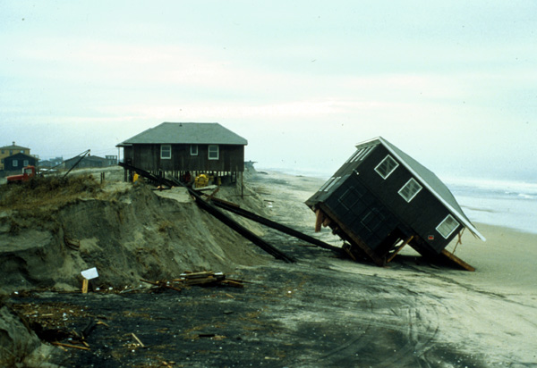

Slide 17
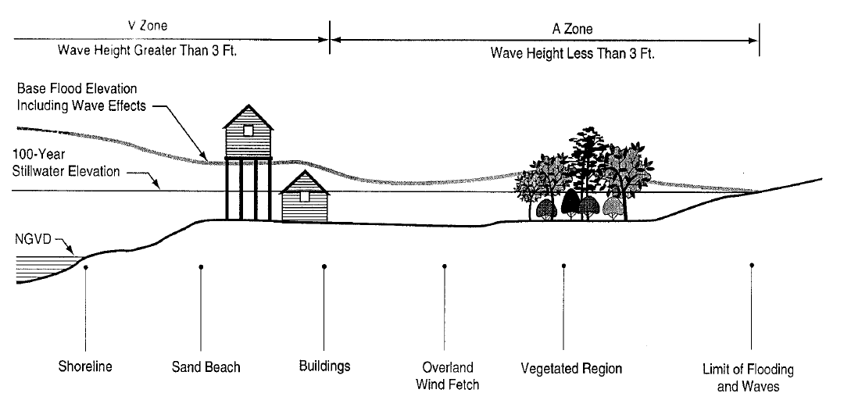
Base Flood Elevation
Figure D-21, p. D-69 of “Guidelines and Specifications
For Flood Hazard Mapping Partners, Appendix D,
Coastal Flooding Analysis and Mapping, FEMA, April 2003

Slide 18
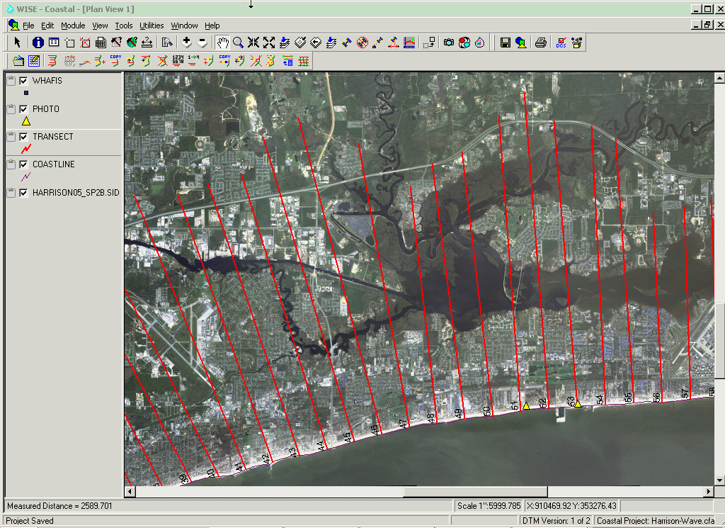

Slide 19
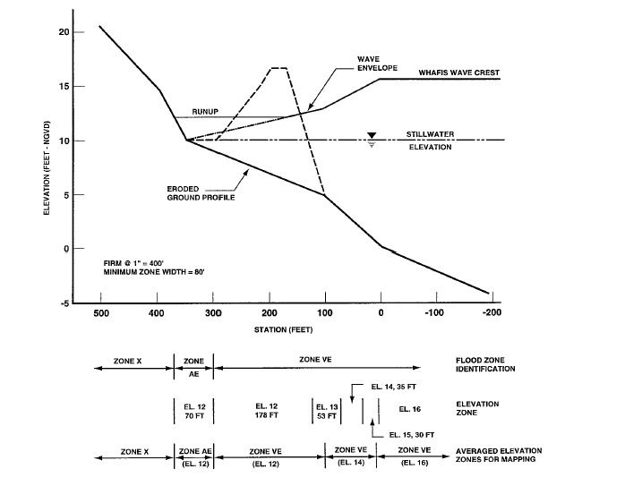
Typical Transect
Figure D-27, p. D-95 of FEMA Appendix D

Slide 20
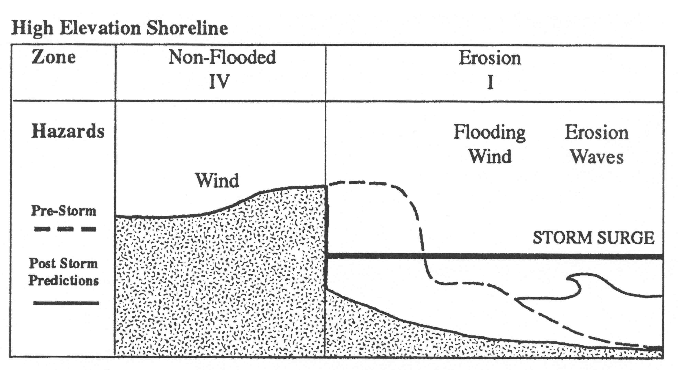

Slide 21
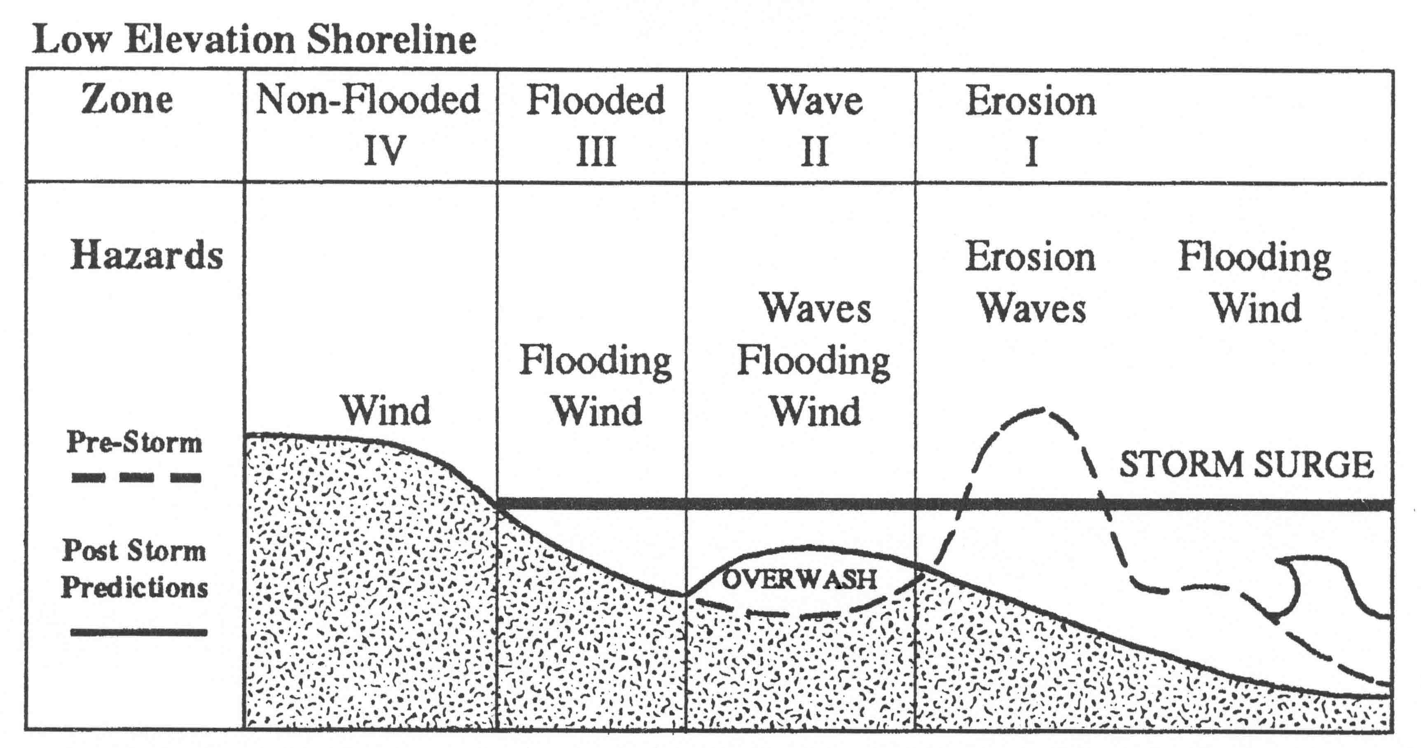

Slide 22
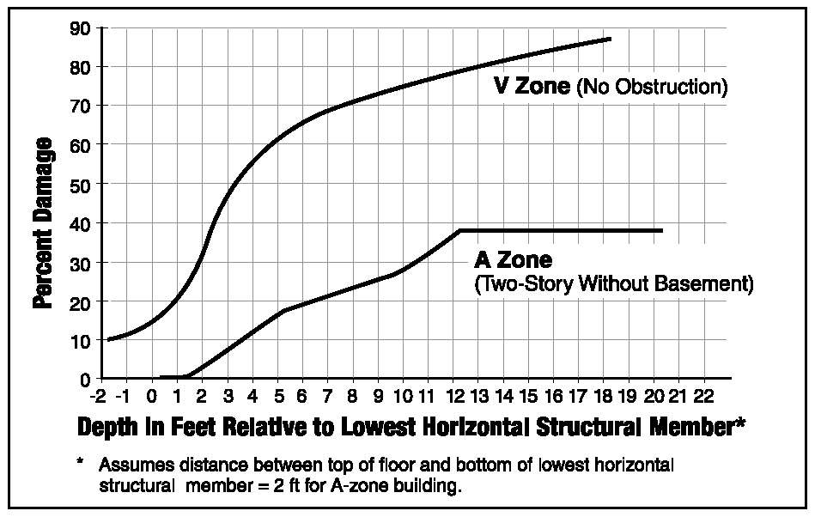
Comparison of FIA depth-damage functions, V zones and A zones

Slide 23
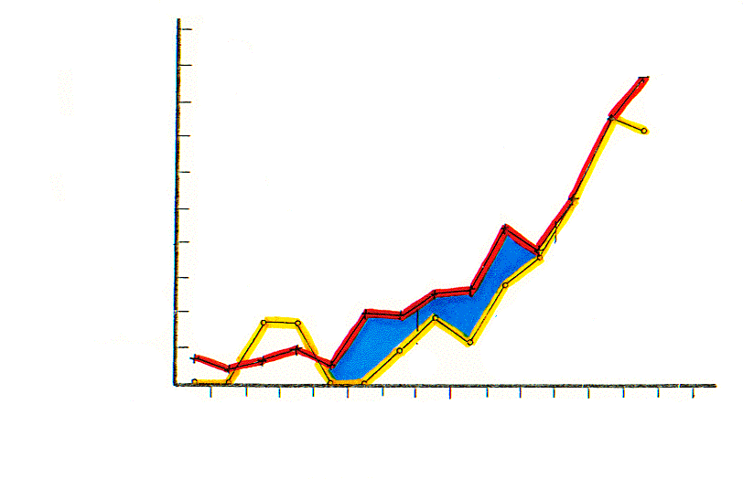
100%
Coastal A Zone
A Zone
V Zone
DESTROYED
50%
GULF of Mexico
HURRICANE FREDRIC
GULF SHORES AL
1979, NO MAINTENANCE
0%
1000’
0
Fig 2. Unmapped Coastal A-zones
DISTANCE FROM GULF

Slide 24
Uncertainties in Coastal Flood Mapping -with a focus on the models
Peter Sheng
Review science and definitions
Review methods for calculating BFE
Identify sources of uncertainty for BFE
Input data, models, zone mapping
Recommend ways to improve uncertainty

Slide 25
Storm Surge and Coastal Flooding
High wind and low pressure create a large bulge of water, which has no place to go over shallow water. It spills onto the coastline and floods the beach and properties, often extending many miles inland. Flood Elevation is:
FE = surge + tide + wave setup + precipitation + river flow
FEMA Base Flood Elevation:
BFE = 100-year SWL* + wave setup + 0.6 * controlling wave height
http://www.usatoday.com/graphics/weather/gra/gsurge/flash.htm

Slide 26
Tropical Cyclones (Hurricanes, Typhoons)

Slide 27
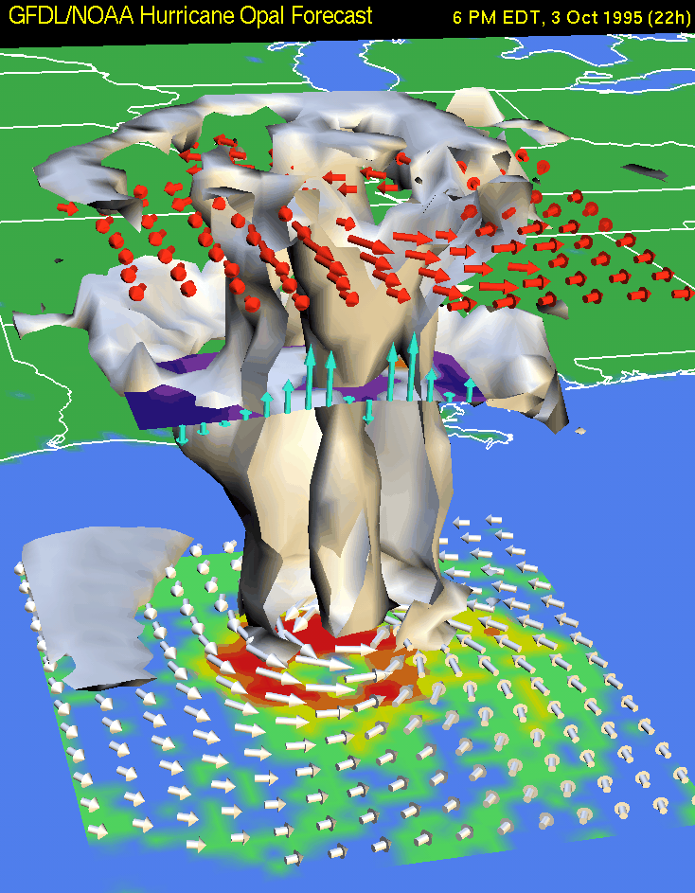
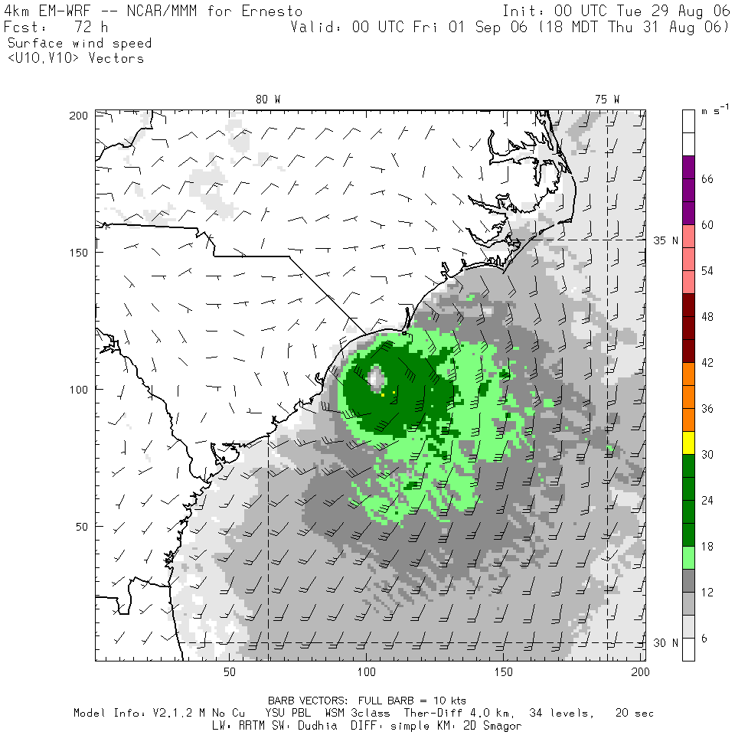
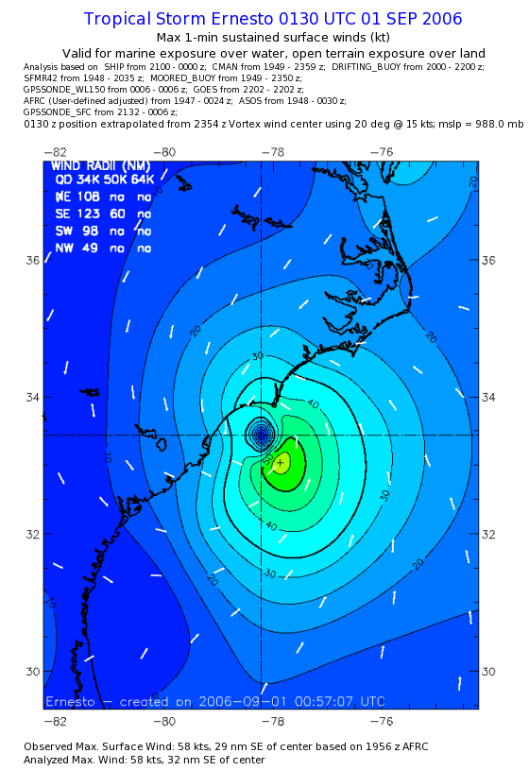
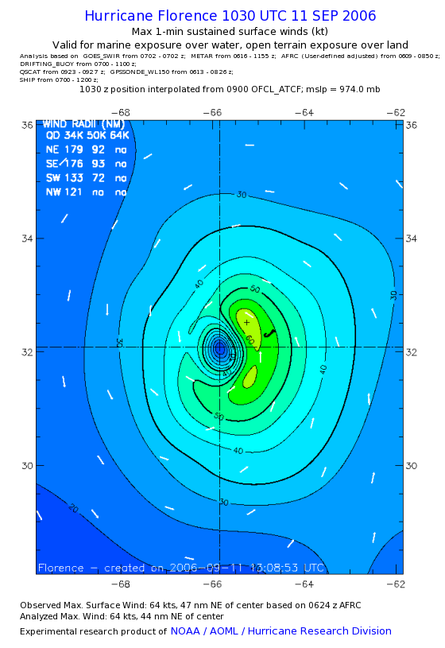
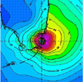
Current Hurricane Wind Models
Realtime Models –
High-Resolution WRF/HWRF (NCAR, NCEP)
MM5 (FSU, UM, etc.)
GFDL
PBL, Windgen
Analysis Wind Models –
H* Wind (NOAA/HRD)
Analytical Model (Holland, NHC)
H*wind is the best analysis wind, including some land effect

Slide 28
SLOSH

Slide 29
ADCIRC (Advanced CIRCulation) Model
Finite element model, used by USACE for the IPET study
How much resolution is absolutely necessary???

Slide 30
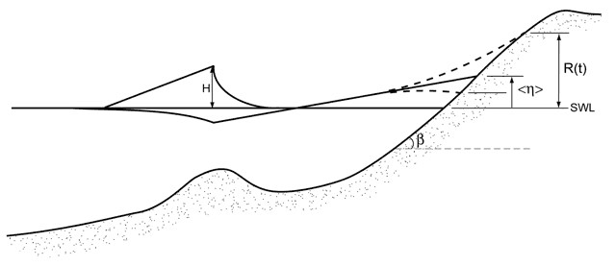
Wave Setup and Runup
Wave runup (R(t)) is the time-varying fluctuation of water-level elevation at the shoreline due to wave breaking.
Wave setup (η), the time-averaged water level, is the super-elevation of still water at the shoreline, again due to wave breaking.
The magnitude of both runup and setup are related to offshore wave period, wave height (H), and foreshore beach slope (β). The elevation of wave runup and setup are often calculated from modeled offshore wave conditions using field-data-based empirical parameterizations.
During storm conditions, the wave runup and setup can double the elevation of water levels at the coast beyond that due to storm surge alone.

Slide 31
FIRM - UF uses coupled surge model (CH3D) and wave model (SWAN) to produce wave setup and wave crest which are then added to the 100-yr still water level (SWL) to produce flood elevation.

