Slide 1


Hydrologic Information System for
North Texas
John A. McEnery, University of Texas at Arlington
Paul W. McKee, National Weather Service
Gregory P. Shelton, National Weather Service
LCRA: October 8, 2010

Slide 2

CUAHSI
A consortium of 145 research universities, 7 affiliate members, and 16 international affiliates
The University of Texas at Arlington is a member of the Consortium of Universities for the Advancement of Hydrologic Science (CUAHSI).

Slide 3
CUAHSI
UCAR
NSF supports CUAHSI to develop infrastructure and services to advance hydrologic science in US universities
Unidata
Atmospheric
Sciences
Earth
Sciences
Ocean
Sciences
CUAHSI
National Science Foundation
Geosciences Directorate
HIS

Slide 4
CUAHSI HIS
The CUAHSI Hydrologic Information System (HIS) is an internet based system for sharing hydrologic data.
Comprised of hydro-databases and servers connected through web services as well as software for data publication, discovery and access.

Slide 5
Flood Hazard:
Key Hydrologic Data
Precipitation
Soil Moisture
Water Quantity (Surface Flow)
Reservoir Gains/Releases
Meteorology
Groundwater Flux

Slide 6
WORKFLOW DIAGRAM OF HIS SYSTEM
Data Discovery and Integration platform
HIS Central
Like search portals Google, Yahoo, Bing
Metadata Services
Metadata Search
Service registration
Service and data theme metadata
Catalog harvesting
Data carts
HydroServer
Data Services
HydroDesktop
Data Publication platform
Water Data Services
Data Synthesis and Research platform
Spatial Data Services
Like web servers
Like HTML
Like browsers
UTA / NWS FOCUS

Slide 7
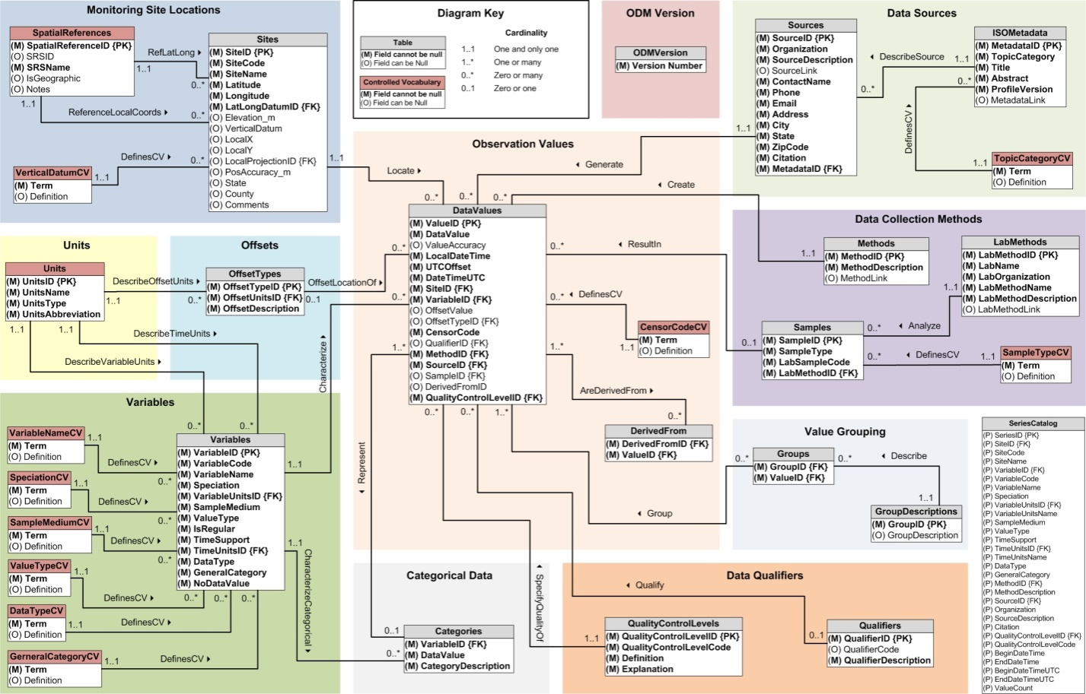
Publication of Point Observations
Observations Data Model (ODM)
  Stores Hydrologic Observations along with Ancillary Information (Metadata) about the Observations
  Designed to Optimize Data Retrieval
  Standardized Format for Sharing Information
  ODM Controlled Vocabularies
  Ontology Includes
    Biota
    Chemical / Geo
    Hydrologic

Slide 8
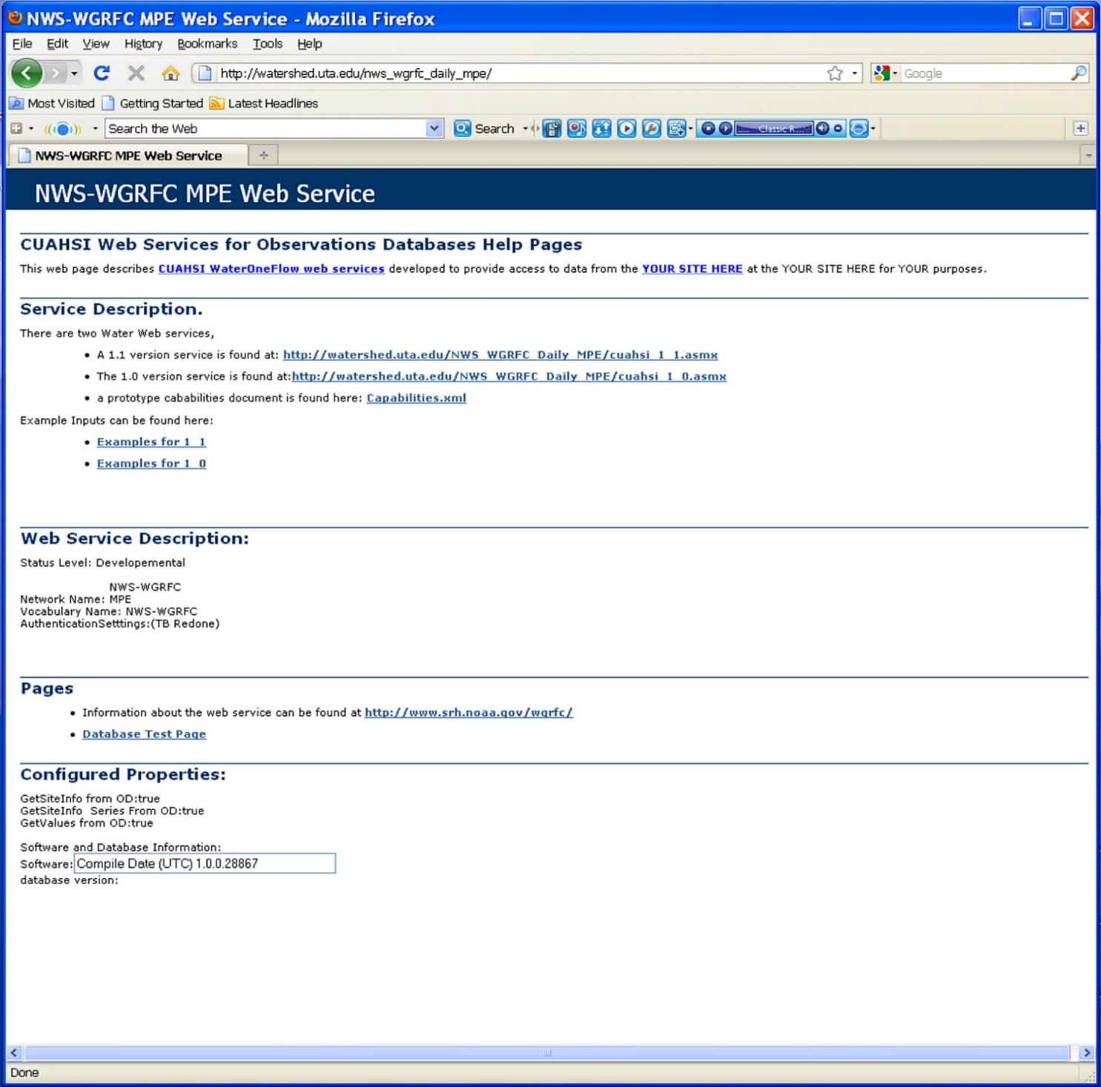
Publication of Point Observations
WaterOneFlow web services
  Data are transmitted in WaterML format
  Generic across different data providers

Slide 9
WaterOneFlow Service Descriptions
GetSiteInfo
Given a site number, this method returns the site's metadata.
GetSiteInfoMultpleObject
Given a site number, this method returns the site's metadata.
GetSiteInfoObject
Given a site number, this method returns the site's metadata.
GetSites
Given an array of site numbers, this method returns the site metadata for each one.
GetSitesByBoxObject
Given a site number, this method returns the site's metadata.
GetSitesObject
Given an array of site numbers, this method returns the site metadata for each one.
GetValues
Given a site number, a variable, a start date, and an end date, this method returns a time series.
GetValuesForASiteObject
Given a site number, this method returns the site's metadata.
GetValuesObject
Given a site number, a variable, a start date, and an end date, this method returns a time series.
GetVariableInfo
Given a variable code, this method returns the variable's name.
GetVariableInfoObject
Given a variable code, this method returns the variable's siteName.
GetVariables
Given a variable code, this method returns the variable's name.
GetVariablesObject
Given a variable code, this method returns the variable's siteName.

Slide 10


COMET Pilot Project
Collaboration of…
  University of Texas at Arlington
  National Weather Service - West Gulf River Forecast Center (NWS – Fort Worth, TX)
Funded through…
  University Corporation for Atmospheric Research (UCAR) COMET Partners Program with support from the National Science Foundation

Slide 11
Pilot Project Background
Project Objective
  Develop server system for distribution of rainfall information from the National Weather Service – West Gulf River Forecast Center (WGRFC).
  Target dataset –
    Daily precipitation (MPE values) for the Dallas and Fort Worth metroplex.

Slide 12
Objective Expanded
Increase data coverage
  Daily and Hourly MPE values
  Entire WGRFC Service Area
  Current and Archived Values
    Hourly extending to 1997
    Daily extending to 1995

Slide 13
MPE
Multi-sensor Precipitation Estimate
Forecasters use gauge and radar estimated precipitation to produce a “best estimate” hourly product
QA/QC product generated at the RFC

Slide 14
MPE
Based upon the Nexrad WSR-88D hourly digital preciptiation array.
Multi-level processing sequences which also incorporates satellite, rain gauge and even CoCoRaHS information.
Seo, D.-J., et.al., 2010. Radar and multisensor rainfall estimation for hydrologic applications. in “Physical Rainfall”, M. Gebremichael and F. Testik, Editors., AGU

Slide 15
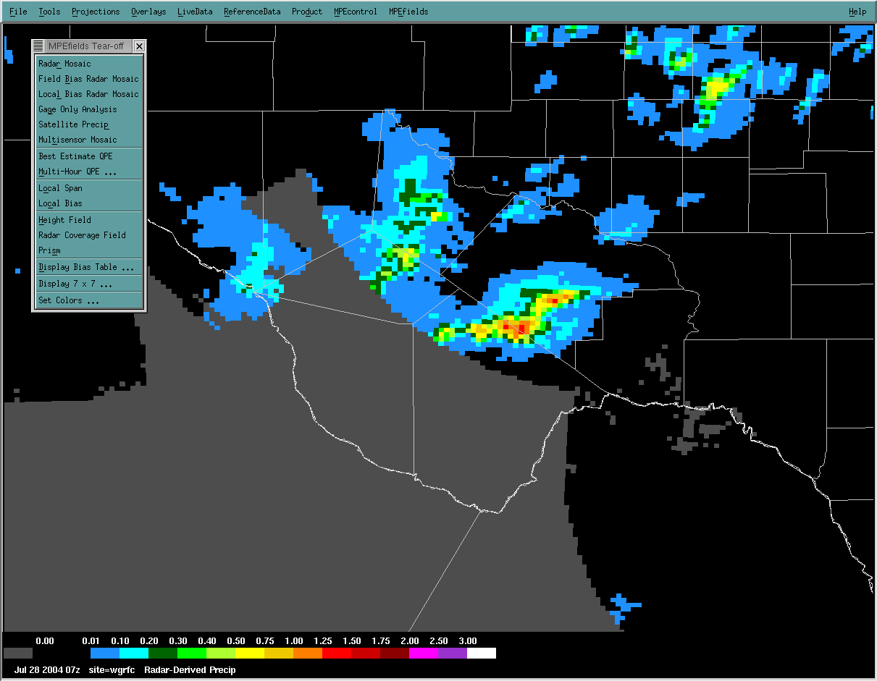
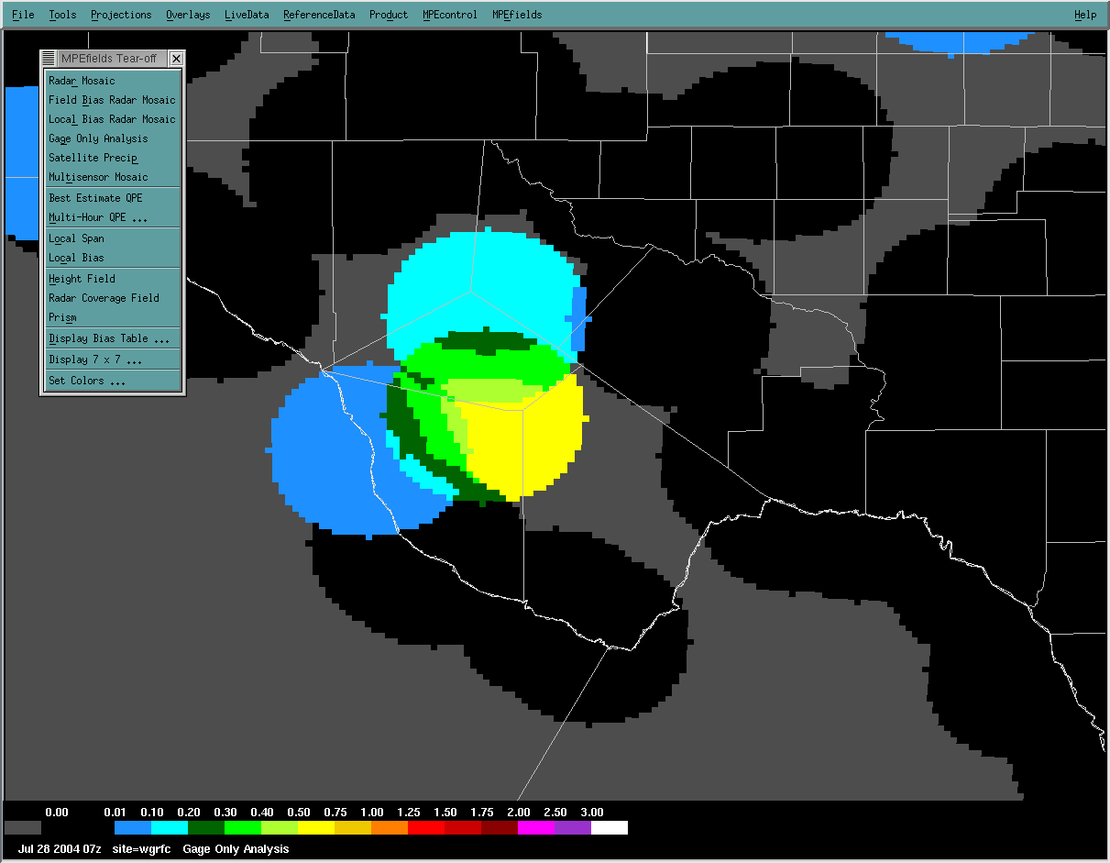
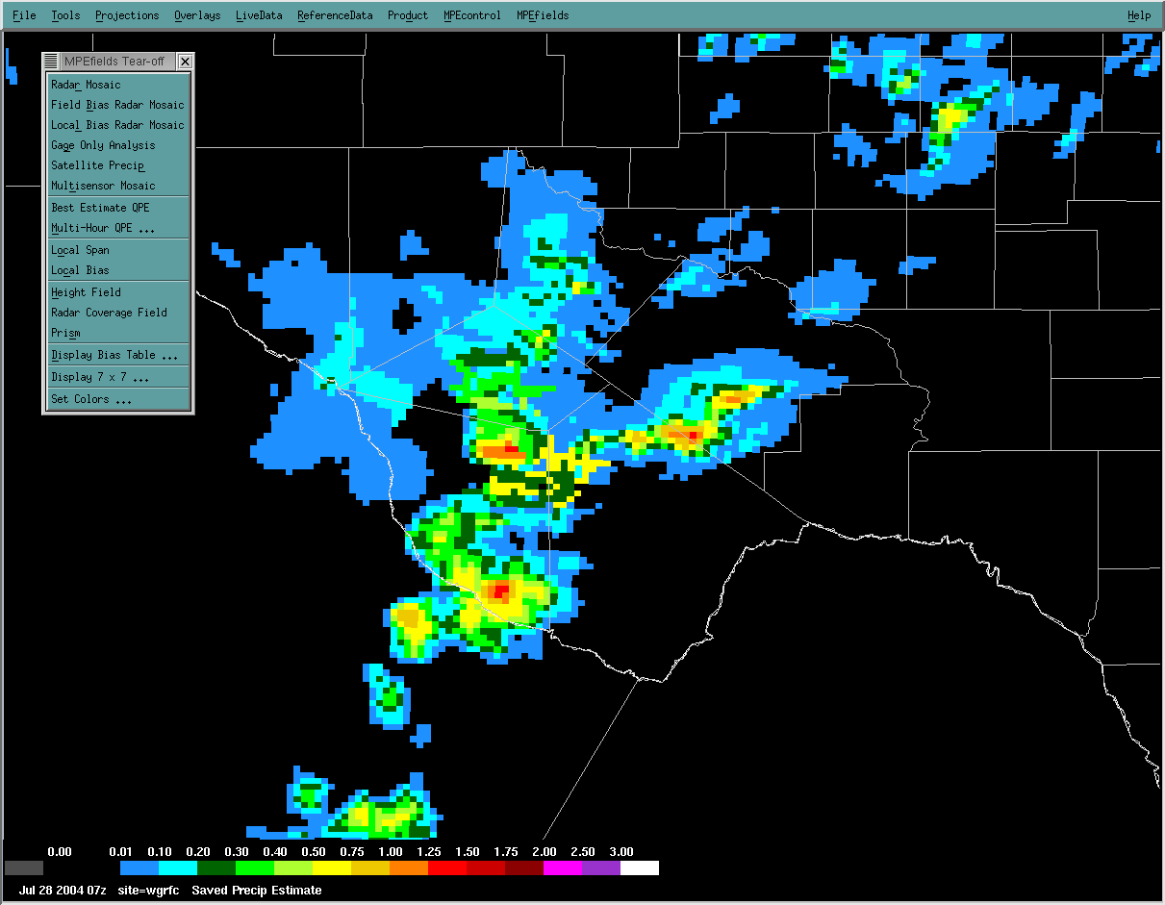
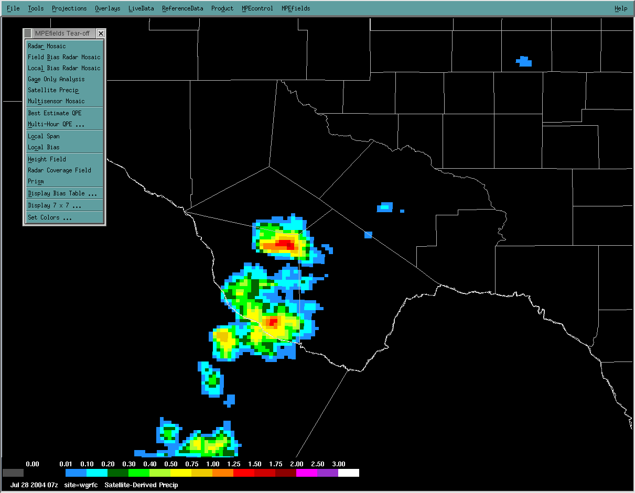
Precipitation Best Estimate
“Best Estimate” of past precipitation
Gridded hourly estimates
Human quality control of data inputs
Radar
Gauge
Satellite
Best Estimate (Multi-sensor Field)

Slide 16
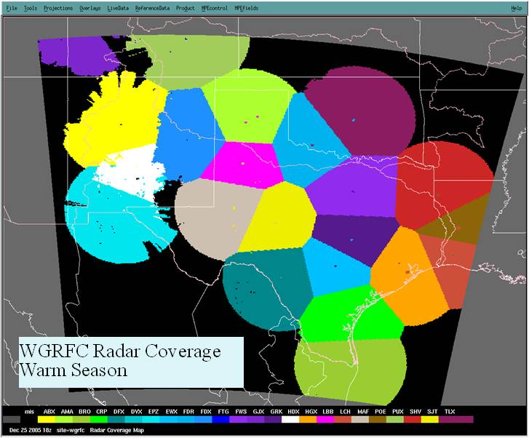
West Gulf River Forecast Center (WGRFC)
Radar Coverage Map

Slide 17

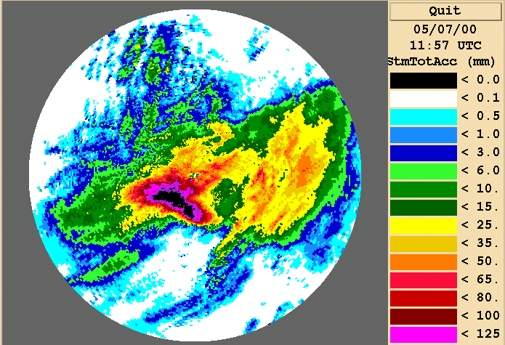
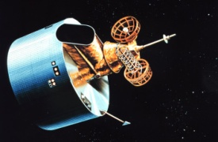
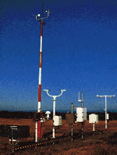
WSR-88D
DHR
DPA
Hydro-Estimator
Rain Gauges
Multi-Sensor Precipitation
Estimator (MPE)
Lightning
NWP
model
output
RFC

Slide 18
HRAP Universal Grid System
NWS Hydrologic Rainfall Analysis Project (HRAP) grid coordinate system.
Developed to make it feasible to mosaic coverage between several radars.
It is a projection like other projections used in GIS, but assumes a spheroid rather than an ellipsoid.
Approximately 4 km x 4 km grid with centers located by latitude, longitude and also HRAP x- and HRAP y-coordinates.
MPE values are cataloged in XMRG files based upon the HRAP grid system

Slide 19
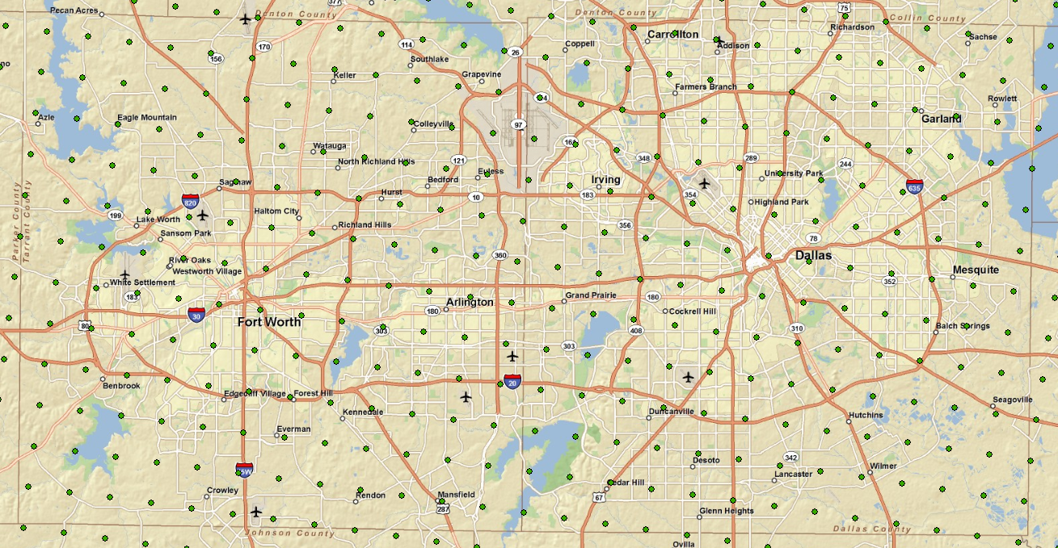
HRAP Centers DFW

Slide 20
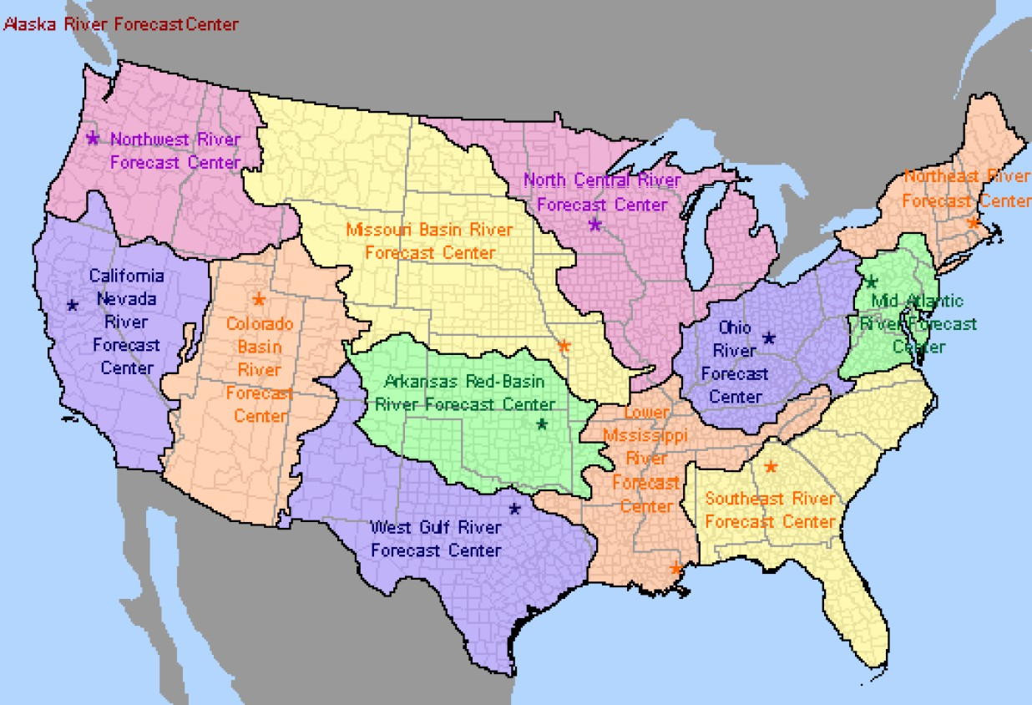
WGRFC Service Area

Slide 21
UTA HIS Architecture
NWS WGRFC / SRH
CUAHSI Central
XMRG Content
WaterML
WaterDrop
WaterShed
Java Script
Microsoft Server 2008
MS SQL Server 2008
CUAHSI ODM
WaterOneFlow Services
(2.83Ghz IC7 – 20 Gb SDRAM)
Linux Red Hat 5.0
LDM 6.8 Data Manager
Reservoir
QNAP NAS
16Tb External Storage

Slide 22
Project Status
Archived Daily MPE (1995- Sept. 2010) available
Archived Hourly MPE (1997- Sept. 2010) being registered.
Update stream via Unidata Local Data Manager (LDM)
  Routed through NWS Southern Region Headquarters.
  LDM connection being configured.

Slide 23
Project Status
SQL Scalability Considerations
Archived Hourly MPE (1997- Sept. 2010)
  Registration may be handled in sections

Slide 24
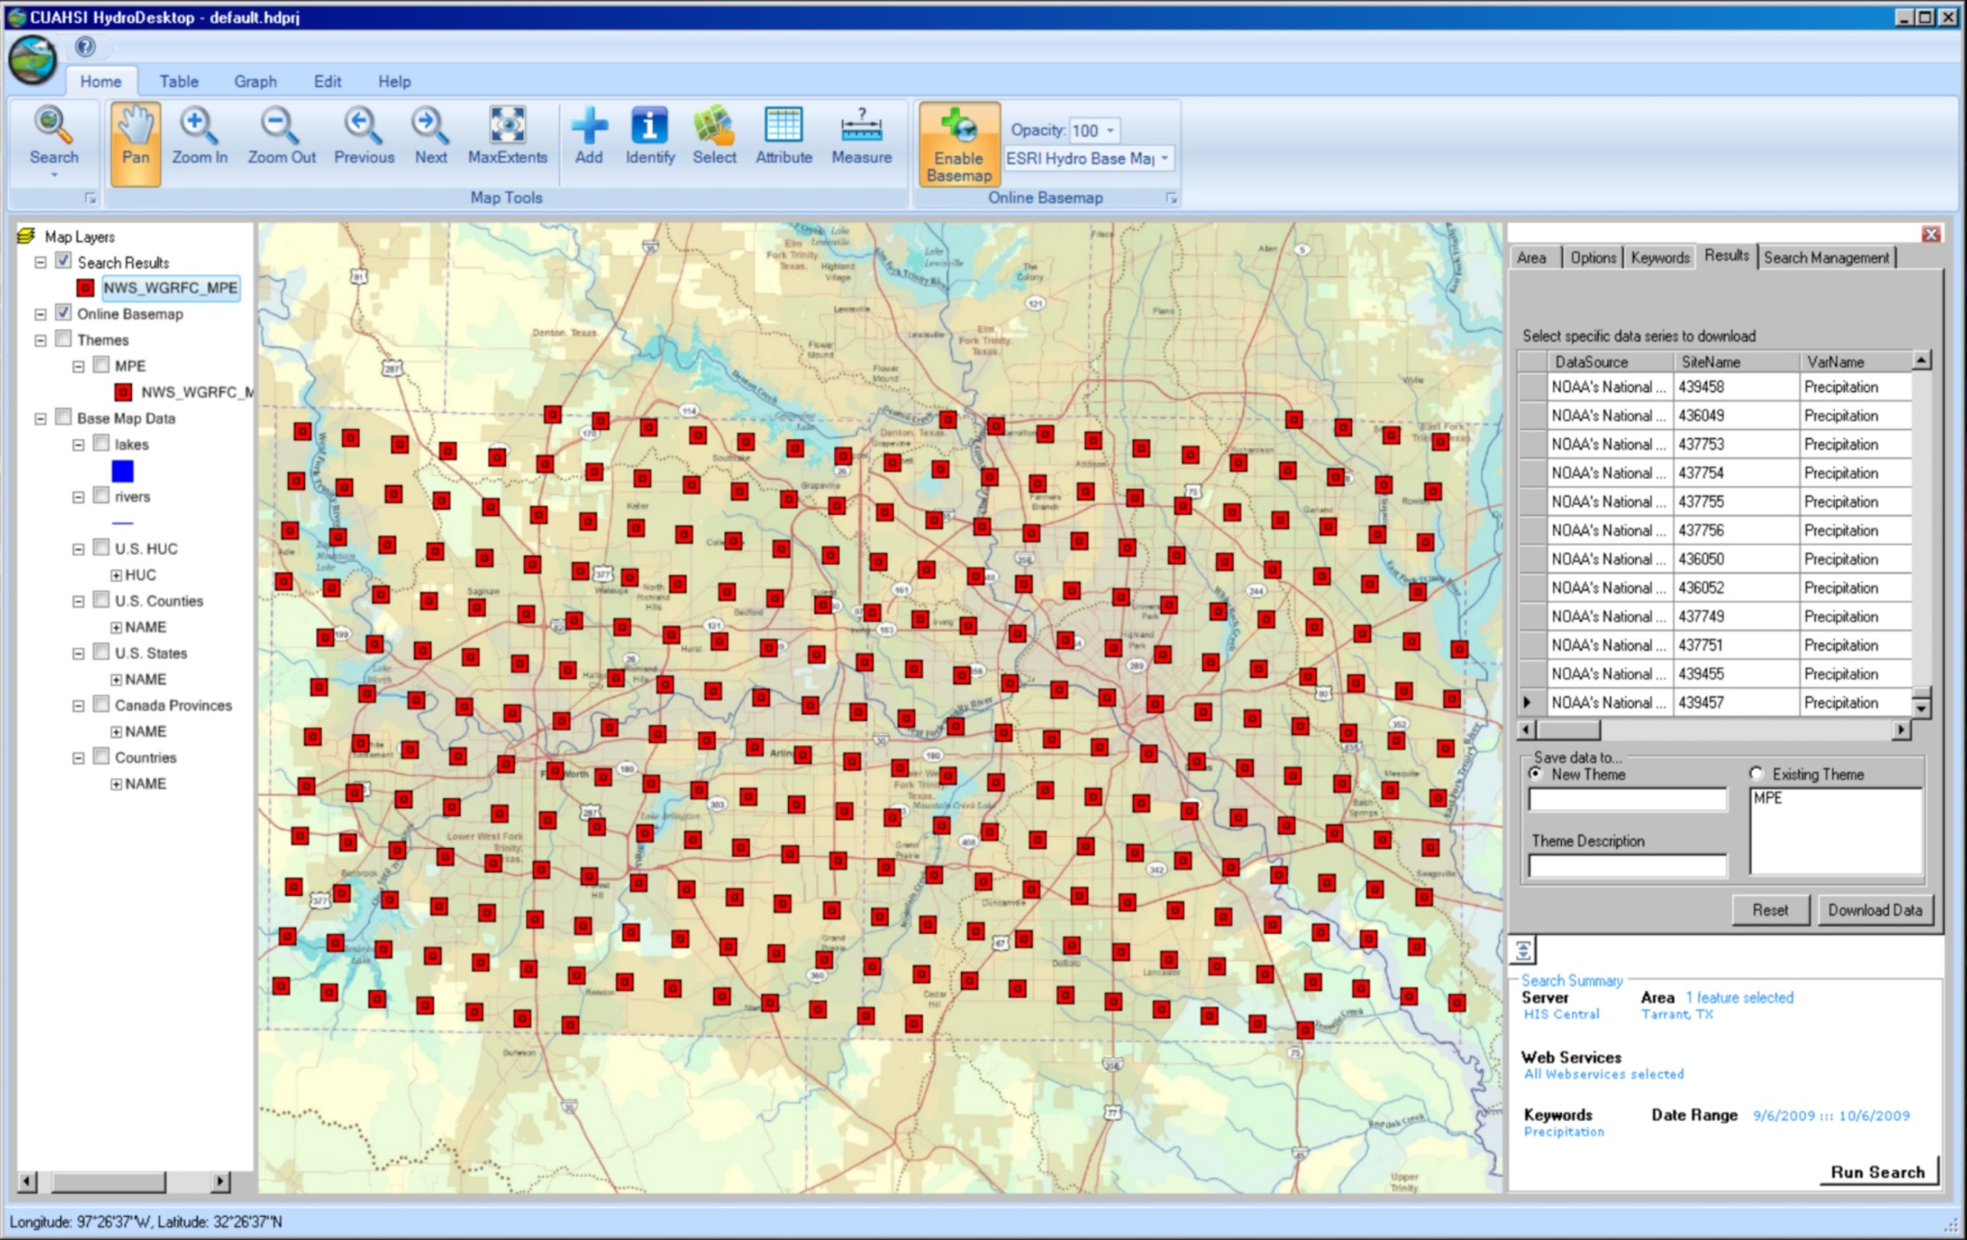
Daily dataset within Tarrant / Dallas Counties

Slide 25
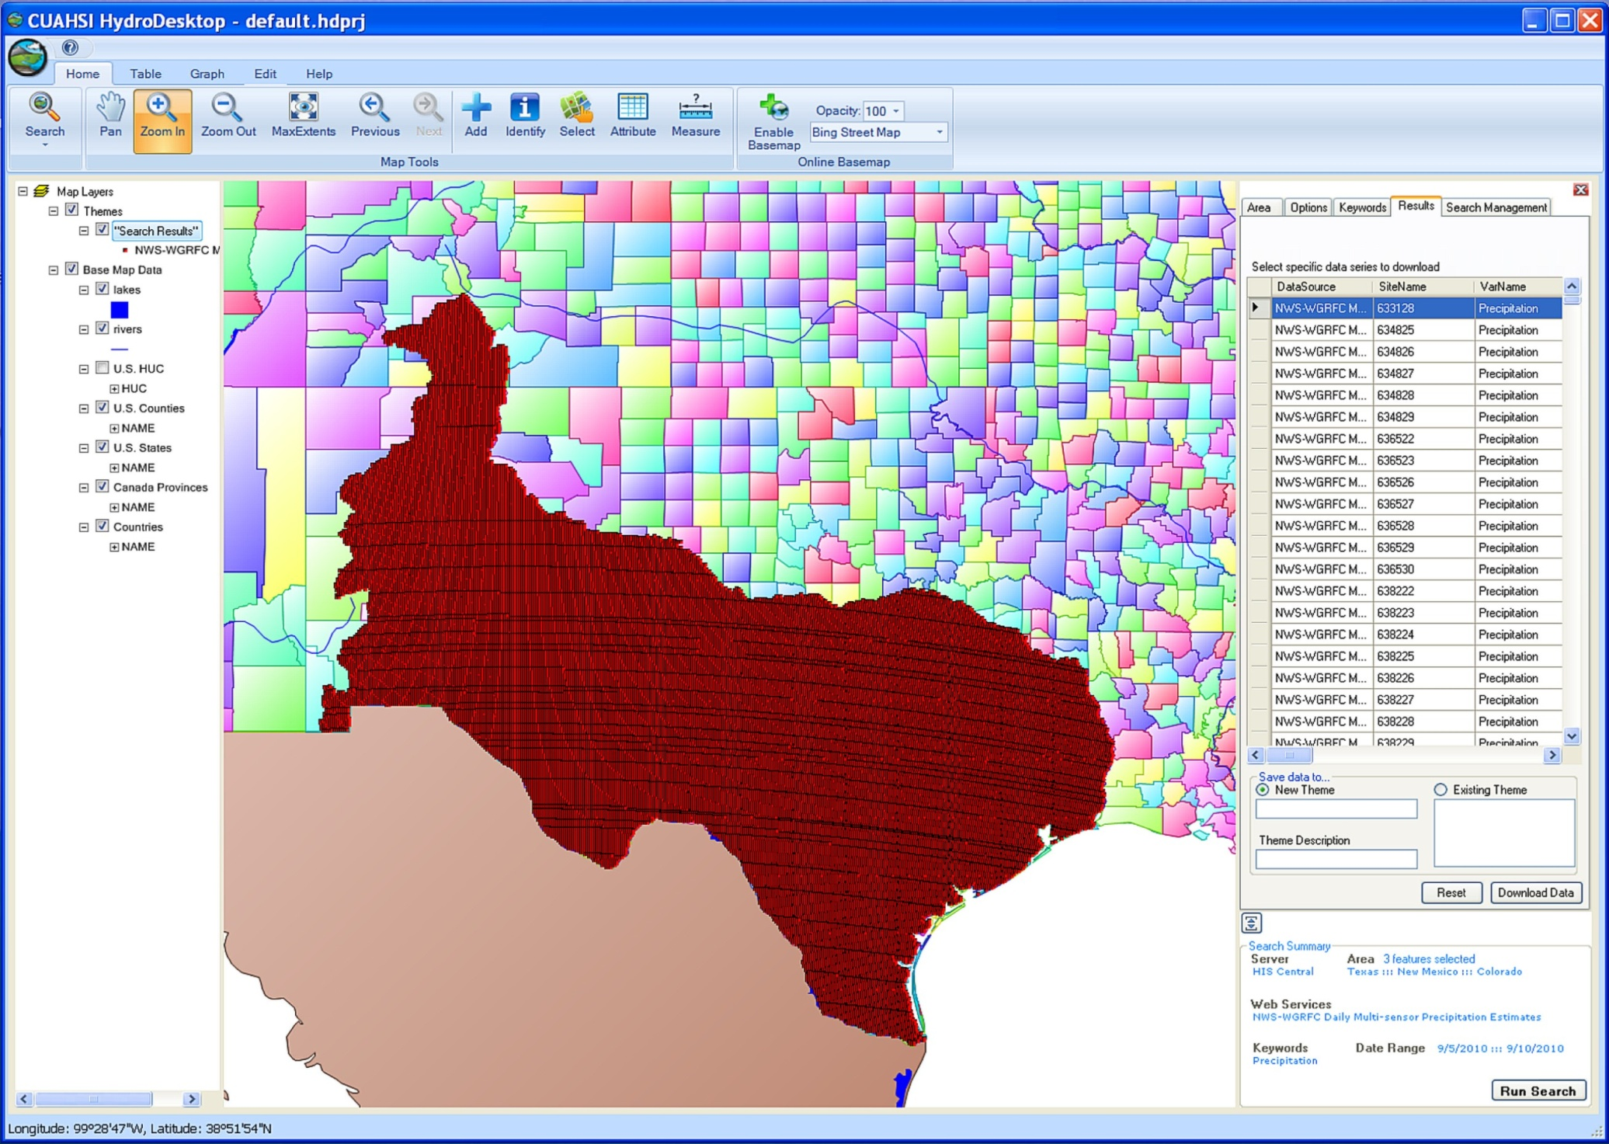
Daily dataset within U.S.

Slide 26
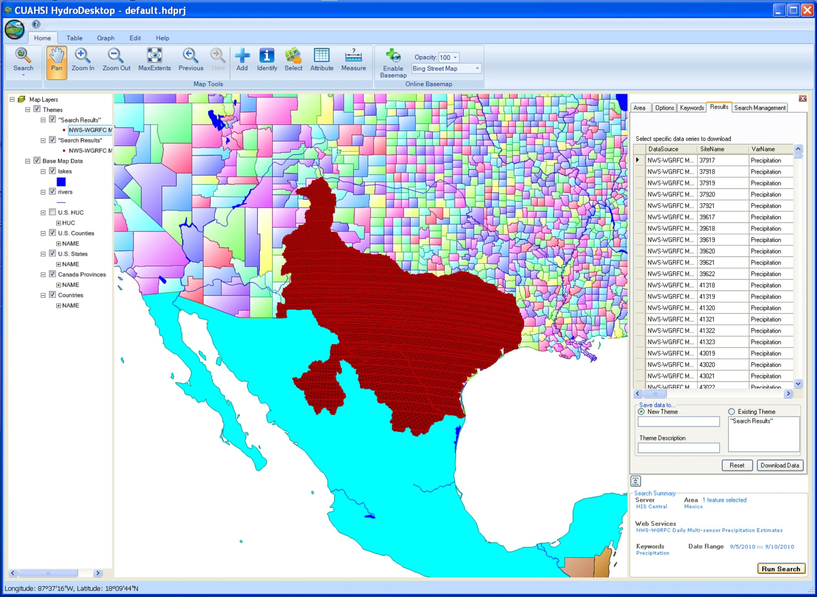
Daily dataset within U.S. & Mexico

Slide 27
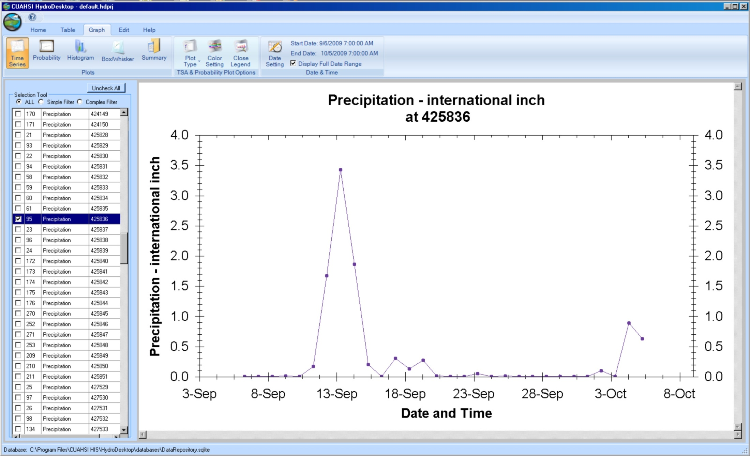
Time Series Graph – Daily Data – Tarrant County, TX

Slide 28
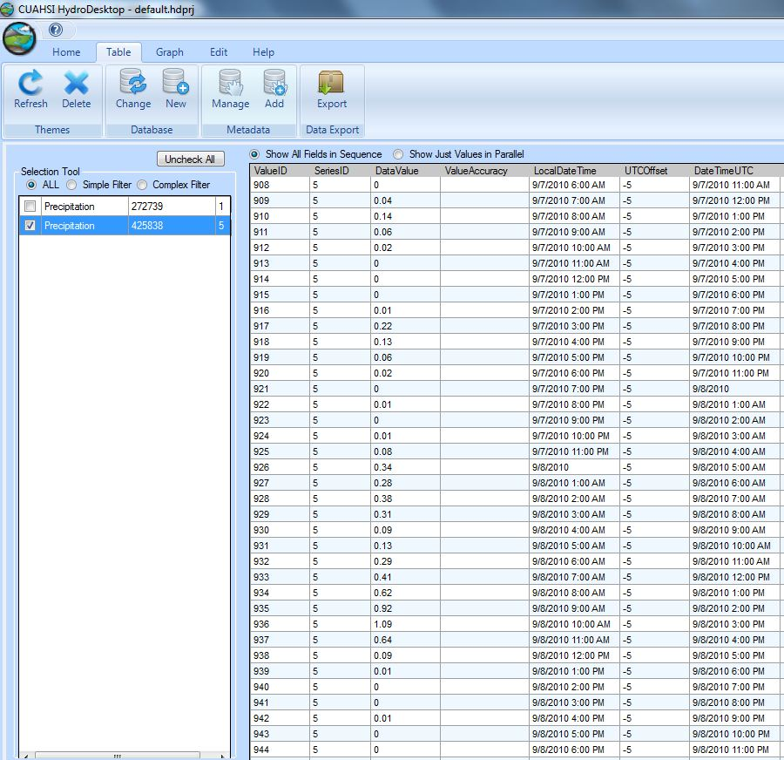
Tropical Storm Hermine
Hourly Time Series
Arlington, TX

Slide 29
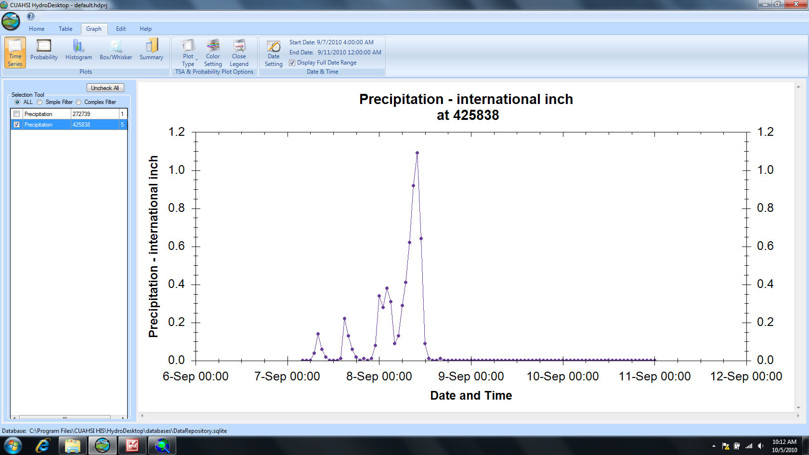
Tropical Storm Hermine
Hourly Time Series –– Arlington, TX

Slide 30
Broader Impacts
Integrated Water Resources Science & Services (IWRSS)
Provide the Nation with a seamless suite of consistent water resources monitoring and forecast information – summit to sea.
Federation of Central Servers

Slide 31
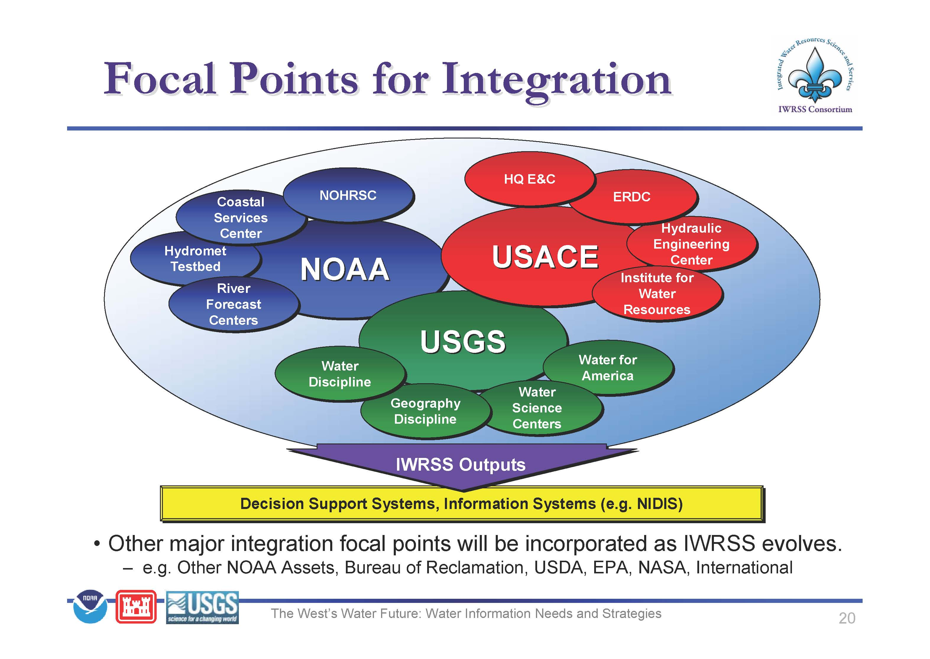

Slide 32
Broader Impacts
U.S. Army Corps of Engineers
"Building Strong Collaborative Relationships for a Sustainable Water Resources Future"
Building the "Federal Tool Box"
  A data and products warehouse for all federal water resources information.
  IWRSS is seen as a component of this larger USACE initiative
National Report: Responding to National Water Resources Challenges, August, 2010

Slide 33
NATIONAL REPORT: STATES’ TOP NEEDS
Create an information hub for access to more comprehensive and accurate data and information, including GIS-based and risk-informed maps, in support of water resources management. Share data and information more widely and readily.
Use comprehensive, holistic and systems-oriented planning processes for integrated water resources management within a sustainability paradigm.
Attend to water infrastructure by ensuring its operation and maintenance, rehabilitation, removal or replacement with new infrastructure.
Promote greater collaboration, coordination and communication among water resources stakeholders to derive agreed-upon plans and management decisions.
Seek to balance competing water uses and to avoid or resolve conflicts over water use.
Seek technical planning assistance and expertise to improve water resources assessments, planning and management within a holistic systems perspective that aims to balance objectives.
 Improve regulatory processes to streamline permitting and reduce regulatory burdens.
Practice and reinforce adaptive management in collecting and analyzing water resources information to understand what is working or not working and why, and to improve performance.
 Improve water quality in rivers, streams, tributaries, lakes, reservoirs, oceans and other water bodies.
Explore developing a unifying national water direction with guiding principles.

Slide 34
Broader Impacts
North Texas Hydrologic Information System.
  Corps of Engineers,
  NCTCOG
  Municipal Governments
Collaboration with TNRIS / TWDB.
  UTA HIS gateway to deliver MPE to TNRIS

Slide 35
Broader Impacts
Collaboration with Tarrant Regional Water District.
Developing Hydrologic Information System for Tarrant Regional Water District.
To support operation of the Fort Worth Floodway Rainfall-Runoff Model (FWFRRM).
Partners include TRWD, NWS, USGS & USACE.

Slide 36
Broader Impacts
Arlington Regional Data Center (ARDC).
Originally a component of UTA prior to being elevated by the UT-System as regional center.
Tier III facility available to provide fail proof capabilities for mission critical operations.
State-of-the-art data and high performance computing center.
24/7 sysop / uninterruptable power / security.

Slide 37

Questions?

