Slide 1
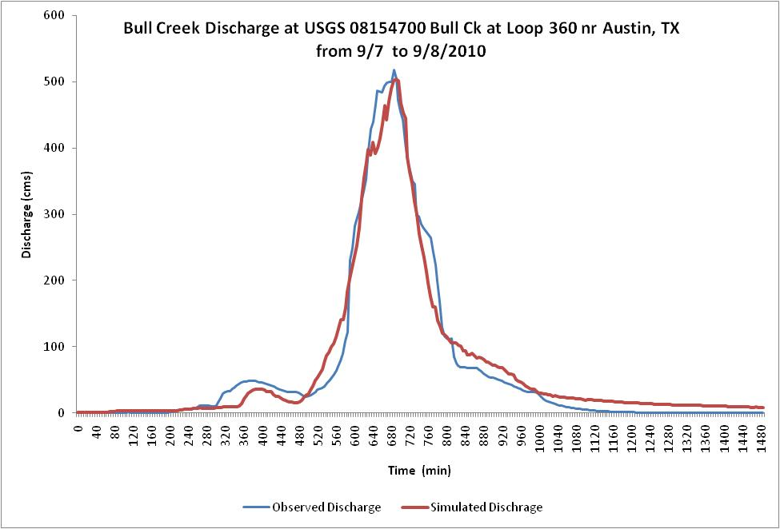
Hatim Sharif
University of Texas San Antonio

Slide 2
R

