Slide 1
CE 397 Flood Forecasting
Assignment to review Conceptual Framework for the NFIE
What are the strengths of the methology?
What are its weaknesses?
How can the paper be improved?
If you had to pose one research question to be answered during the NFIE, what would it be?

Slide 3
Update on the NFIE
Presentation to the Subcommittee on Spatial Water Data
By David R. Maidment
Center for Research in Water Resources
University of Texas at Austin
23 January 2015

Slide 4
A summary of recent progress….
Established a web site http://www.cuahsi.org/NFIE
Conducted three national webinars to provide information (Dec 10, Jan 7, Jan 21) – recorded on web site. About 60-80 participants in each webinar.
Established a NFIE conceptual framework with five components: NFIE-Geo, Hydro, River, Response, Services
Published a first version of NFIE-Geo through AGOL web map and CUAHSI HydroShare data repository
Succeeded in computing NFIE-Hydro flows for 2.67 million NHDPlus reaches over CONUS for a 14-day historical period
Produced at BYU an ECMWF-RAPID operating prototype with 15-day ahead ensemble forecasts in Texas Gulf Region.
Learned from experience in North Carolina about how to represent river channels for real-time flood mapping
  Will request one more data layer from SSWD (24K NHD Flowlines) to support NFIE-River

Slide 5

CUAHSI Web Site for the NFIE
http://www.cuahsi.org/NFIE
Description of the project
Past Webinars
Map access to
NFIE-Geo data
through HydroShare
Call for applications
coming soon!

Slide 6
National Flood Interoperability Experiment (NFIE):
Five Components
NFIE-Geo: National geospatial framework for hydrology
NFIE-Response: Wide area planning for flood emergency response
NFIE-Hydro: National high spatial resolution hydrologic forecasting
NFIE-River: River channel information and real-time flood inundation mapping
NFIE-Services: Web services for flood information

Slide 7
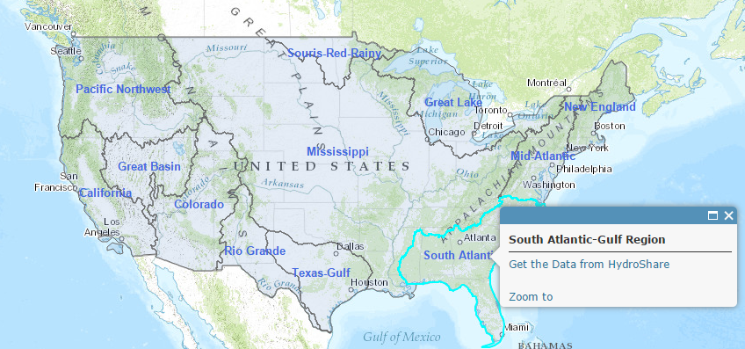
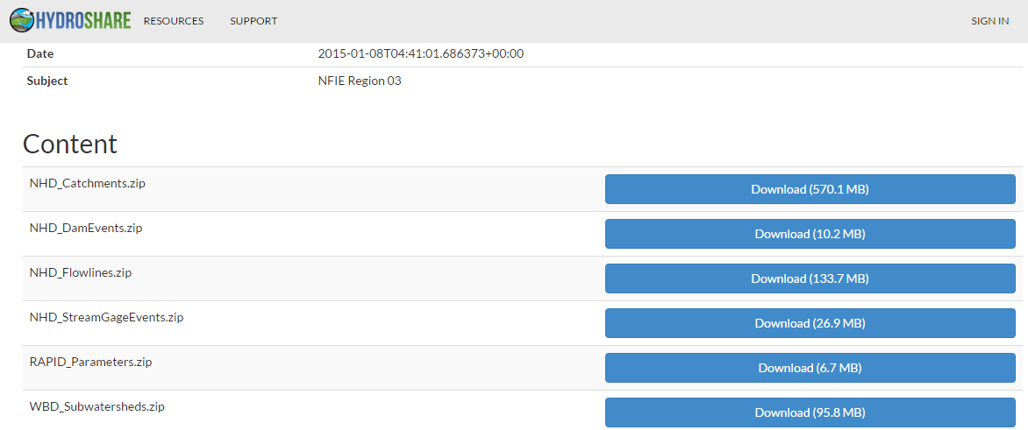
Draft NFIE-Geo in HydroShare
https://www.arcgis.com/home/webmap/viewer.html?webmap=2c30160429984a59873f26b9d118dbfe
Accessible through http://www.cuahsi.org/NFIE
David Tarboton, Utah State Univ.
and Ray Idaszak, RENCI

Slide 8
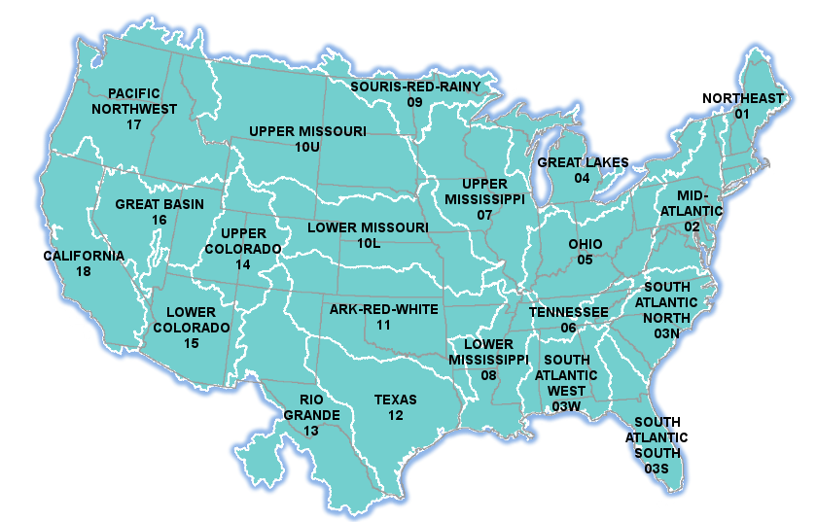


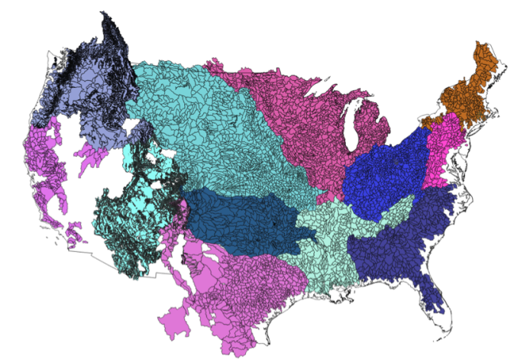
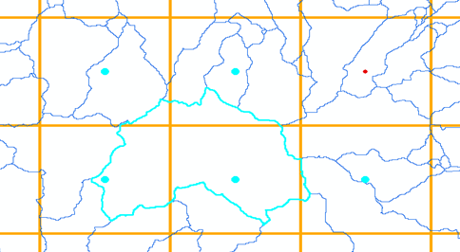
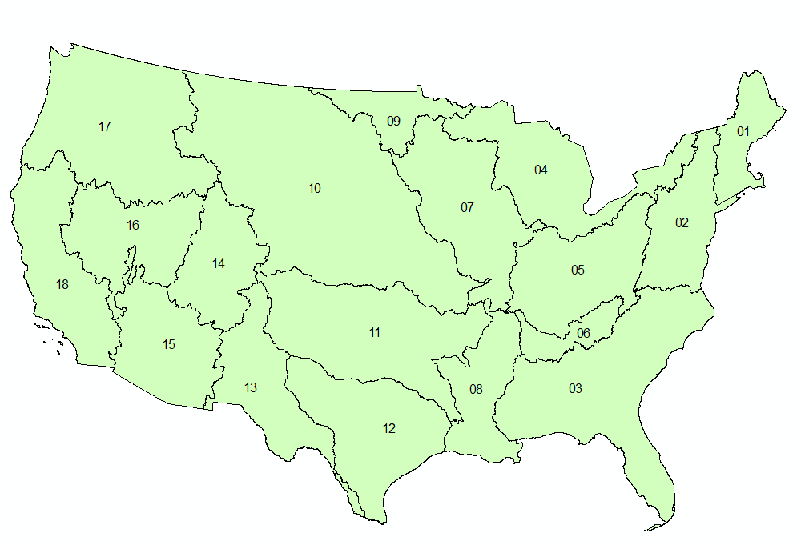
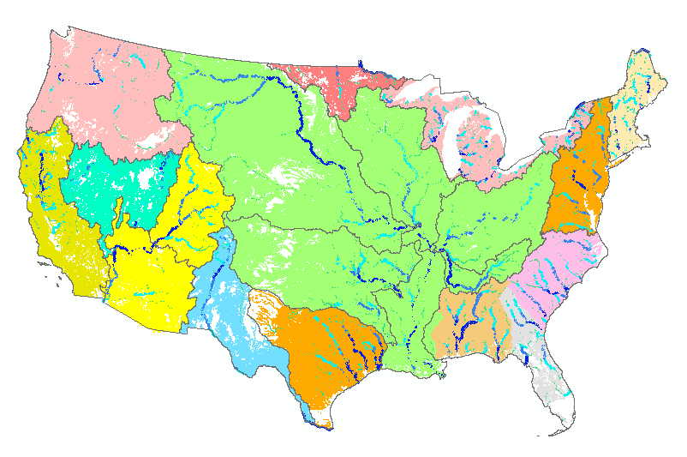
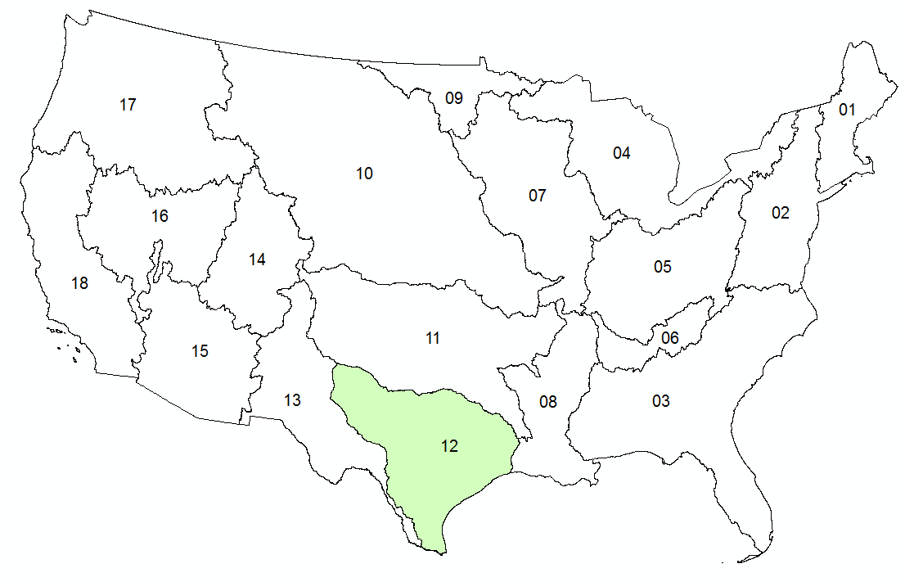


NFIE-Hydro: flow computation over CONUS
14-day historical period, 2.67 million reaches
NWS River Forecasts
WRF-Hydro Model
NHDPlus to
RAPID Conversion
Grid to Catchment Linking
Forecast services
Deltares and
University of Alabama
Pending
NFIE-Hydro
Completed

Slide 9
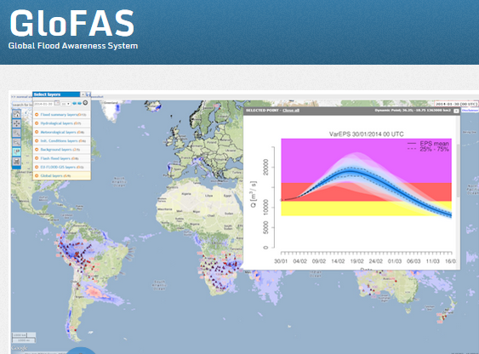
European Center for Medium Range Weather Forecasting and European Joint Research Commission
15 Day ahead forecast ensemble (50 hydrographs) at each location

Slide 10
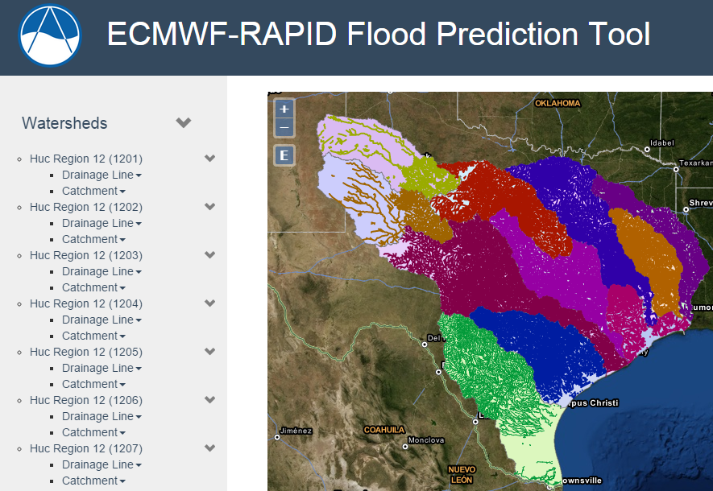
Hydrologic Forecasting for the Texas-Gulf Region
(from Brigham Young University)
(67,313 NHDPlus reaches)
Source: Jim Nelson, Nathan Swain, BYU
http://demo.tethys.ci-water.org/

Slide 11
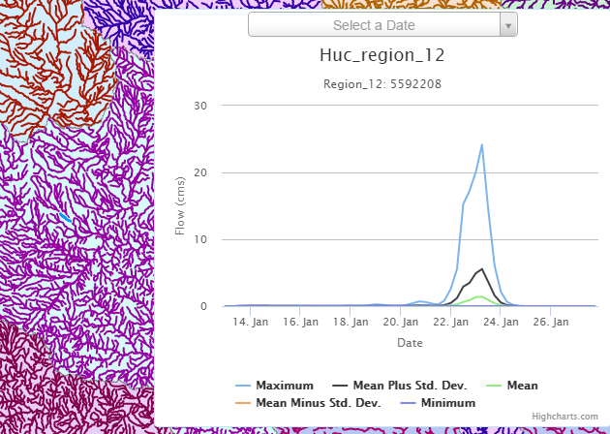
Ensemble Flow Forecast for Reach Catchment 5592208 made on Jan 13, 2015 (15 day horizon)
Weather information source: European Center for Medium Range Weather Forecasting (ECMWF). Summary statistics compiled from 50 forecast hydrographs
Source: Jim Nelson, Alan Snow BYU

Slide 12
North Carolina Floodplain Mapping Program HEC- RAS Models
  5 Recurrence Intervals: 10, 25, 50, 100, 500
  300,000 cross-sections
  Each cross-section has a rating curve
Slide: Ken Ashe, NCFMP

Slide 13
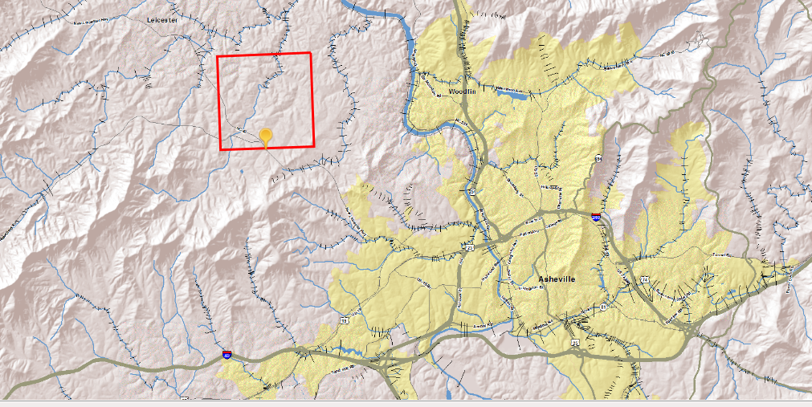
Our cross-sections give the ability to interpolate between gages expanding the real time information from ~200 locations to 10s of thousands to 100s of thousand of locations
Slide: Ken Ashe, NCFMP

Slide 14
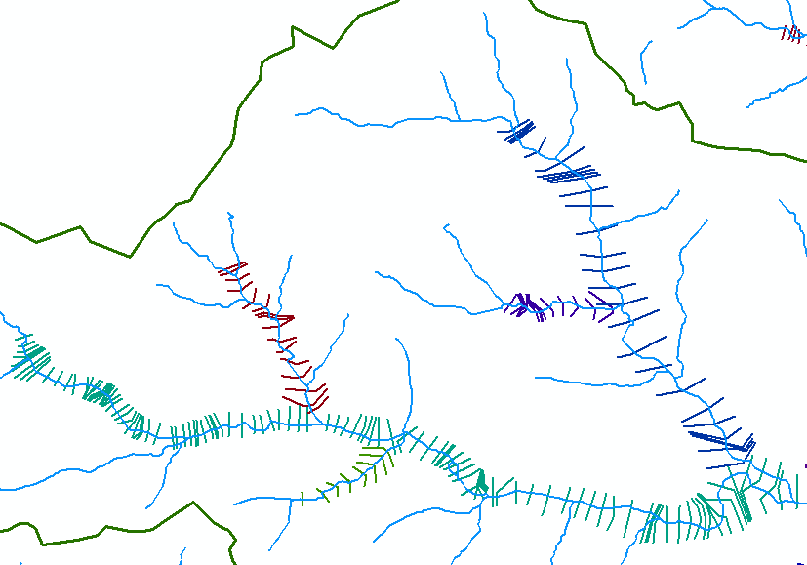
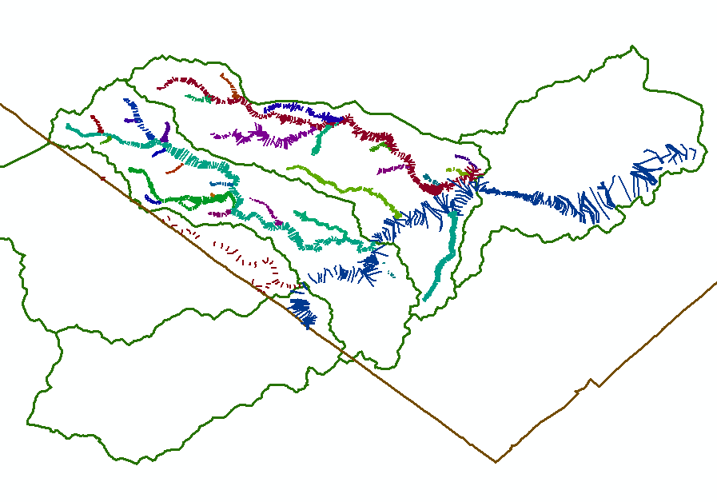
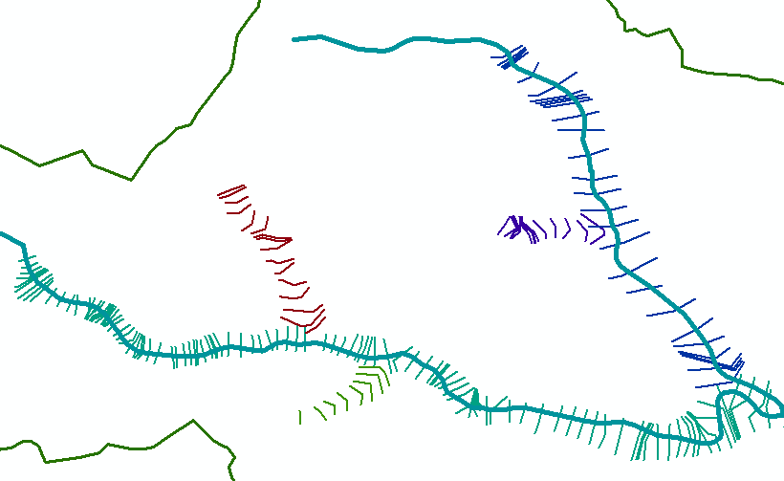
HEC-RAS CrossSections
(from 31 separate models on parts of Onion Creek, Austin, Texas)
Conclusion: We need 24K NHD flow lines to link cross-sections
Some cross-sections are on tributaries not in 100K NHD
24K NHD (High res)
Onion Creek watershed
100K NHD (Med res)
Travis County
Hays County

Slide 15
Conclusion
NFIE is making excellent progress, more rapidly than I anticipated when I proposed it last May
Academic engagement of other universities is growing
NFIE requests from SSWD one more geospatial layer: a national coverage of high resolution NHD Flowlines
  NFIE-Hydro is supported by Medium Res NHDPlus nationally
  NFIE-River is supported by High Res NHD locally

