Slide 1
CE 374K Hydrology
Lecture 5: Precipitation
Precipitation mechanisms
Rainall maps
Rainfall hyetographs
Nexrad measurement of rainfall
Reading for today – Applied Hydrology, Sec 3.3 and 3.4
Reading for Thursday – Applied Hydrology, Sec 3.5 and 3.6

Slide 2
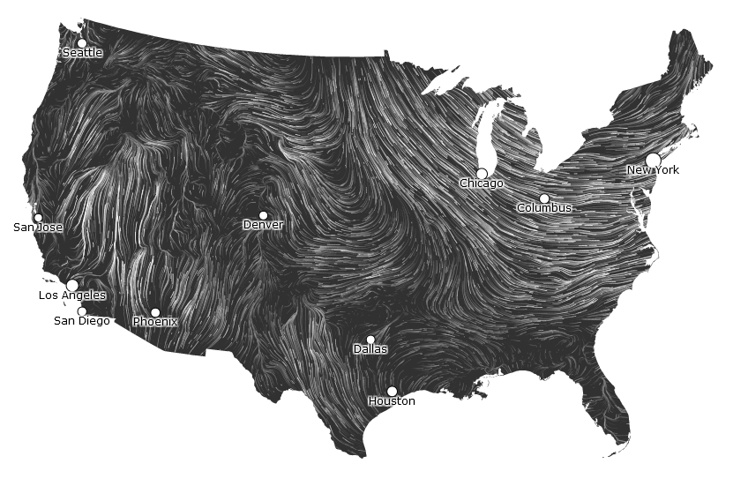
Wind Map
http://hint.fm/wind/gallery/

Slide 3
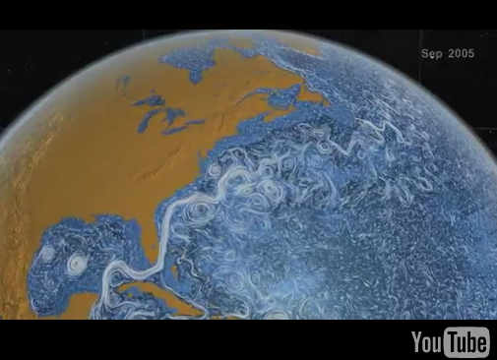
Ocean Currents
http://www.youtube.com/watch?v=oNppEPKt52E

Slide 4
Precipitation
Precipitation: water falling from the atmosphere to the earth.
  Rainfall
  Snowfall
  Hail, sleet
Requires lifting of air mass so that it cools and condenses.

Slide 5
Mechanisms for air lifting
Frontal lifting
Orographic lifting
Convective lifting

Slide 6
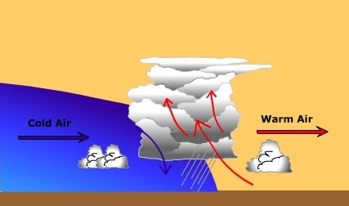
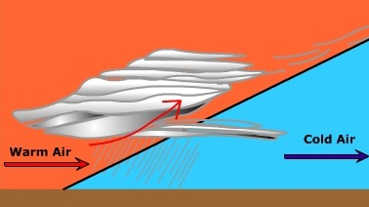
Frontal Lifting
Boundary between air masses with different properties is called a front
Cold front occurs when cold air advances towards warm air
Warm front occurs when warm air overrides cold air
Cold front (produces cumulus cloud)
Warm front (produces stratus cloud)

Slide 7
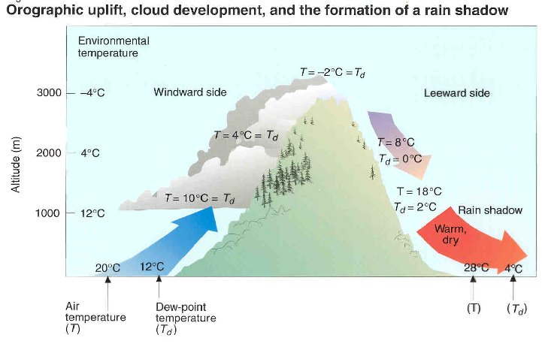
Orographic lifting
Orographic uplift occurs when air is forced to rise because of the physical presence of elevated land.

Slide 8
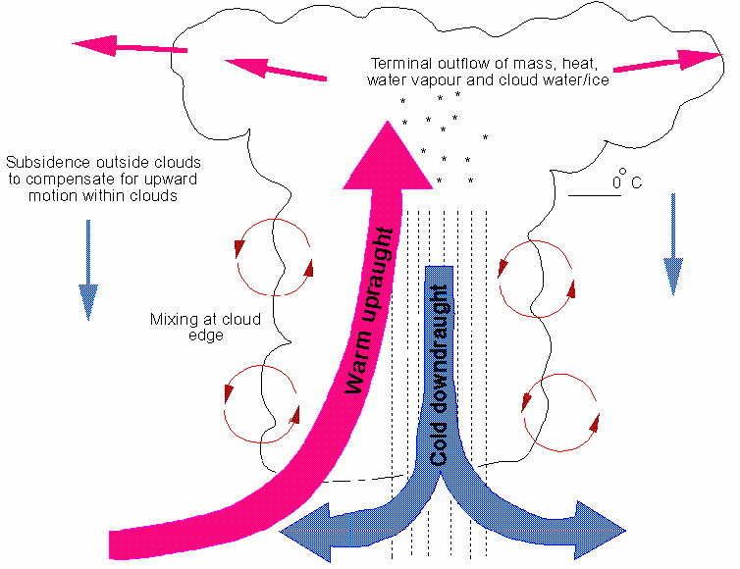
Convective lifting
Convective precipitation occurs when the air near the ground is heated by the earth’s warm surface. This warm air rises, cools and creates precipitation.
Hot earth surface

Slide 9
Condensation
Condensation is the change of water vapor into a liquid. For condensation to occur, the air must be at or near saturation in the presence of condensation nuclei.
Condensation nuclei are small particles or aerosol upon which water vapor attaches to initiate condensation. Dust particulates, sea salt, sulfur and nitrogen oxide aerosols serve as common condensation nuclei.
Size of aerosols range from 10⁻³ to 10 μm.

Slide 10

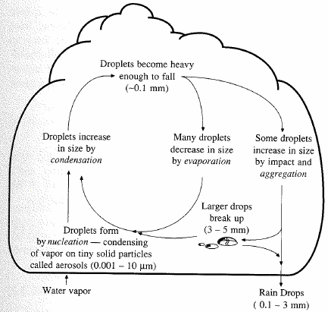
Precipitation formation
Lifting cools air masses so moisture condenses
Condensation nuclei
  Aerosols
  water molecules attach
Rising & growing
  0.5 cm/s sufficient to carry 10 μm droplet
  Critical size (~0.1 mm)
  Gravity overcomes and drop falls

Slide 11
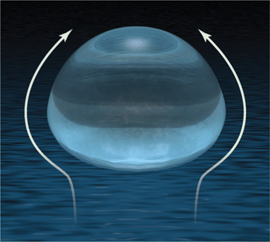
Shape of a Falling Raindrop
http://www.sciencemag.org/content/335/6071/925/F1.large.jpg

Slide 12
Forces acting on rain drop
Three forces acting on rain drop
  Gravity force due to weight
  Buoyancy force due to displacement of air
  Drag force due to friction with surrounding air
D
F_{b}
F_{d}
F_{d}
F_{g}

Slide 13
Terminal Velocity
Terminal velocity: velocity at which the forces acting on the raindrop are in equilibrium.
If released from rest, the raindrop will accelerate until it reaches its terminal velocity
D
F_{b}
F_{d}
F_{d}
F_{g}
At standard atmospheric pressure (101.3 kpa) and temperature (20ºC), ρ_{w} = 998 kg/m3 and ρ_{a} = 1.20 kg/m3
V
Raindrops are spherical up to a diameter of 1 mm
For tiny drops up to 0.1 mm diameter, the drag force is specified by Stokes law

Slide 14
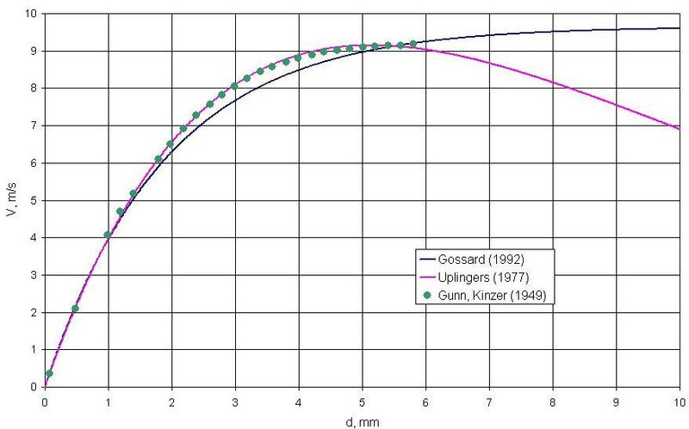
Terminal Velocity of a Raindrop
http://commons.wikimedia.org/?title=File:Rain_drop_terminal_velocity_chart.jpg

Slide 15
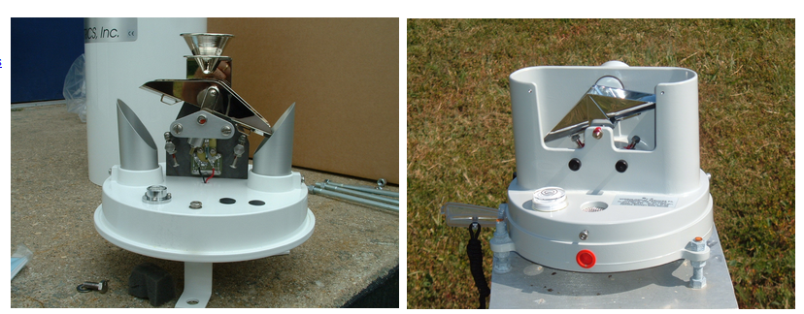
Rainfall Measurement – Tipping Bucket
Bucket tips for each 0.01 inches of rain
http://meiyu.atmphys.howard.edu/instru.htm#

Slide 16
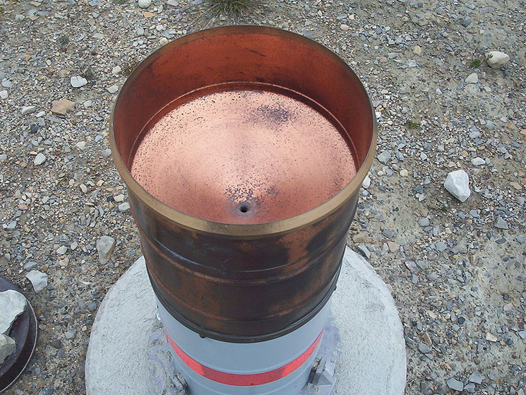
Exterior of a tipping bucket gage
20 cm diameter
http://en.wikipedia.org/wiki/File:Exterior_tipping_bucket.JPG

Slide 17
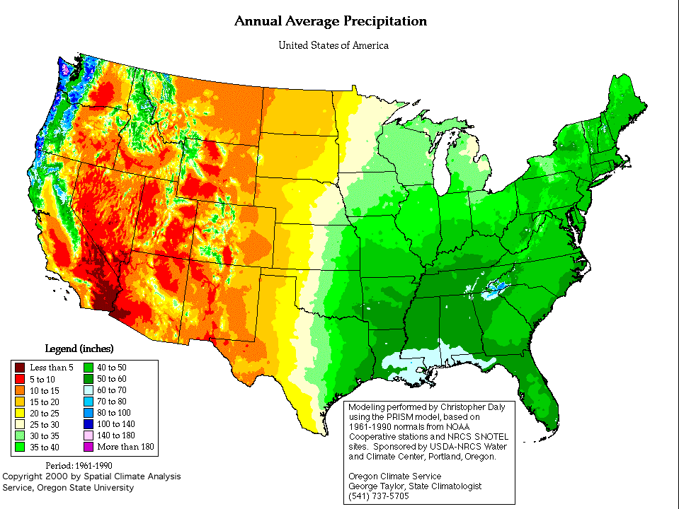
Rainfall patterns in the US

Slide 18
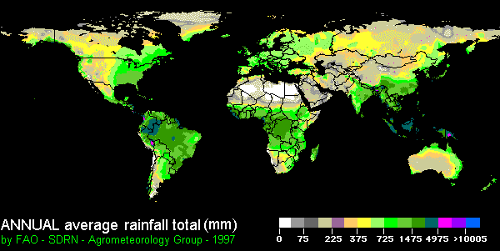
Global precipitation pattern

Slide 19
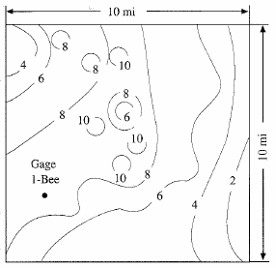
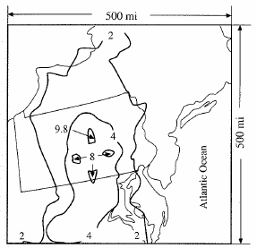
Spatial Representation
Isohyet – contour of constant rainfall
Isohyetal maps are prepared by interpolating rainfall data at gaged points.
Austin, May 1981
Wellsboro, PA 1889

Slide 20
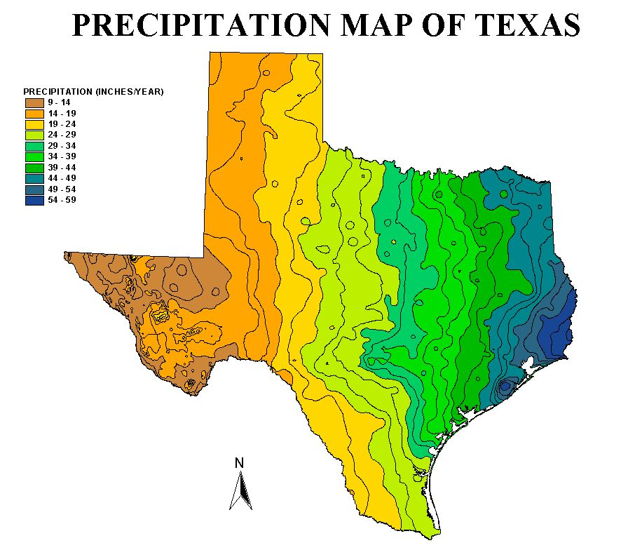
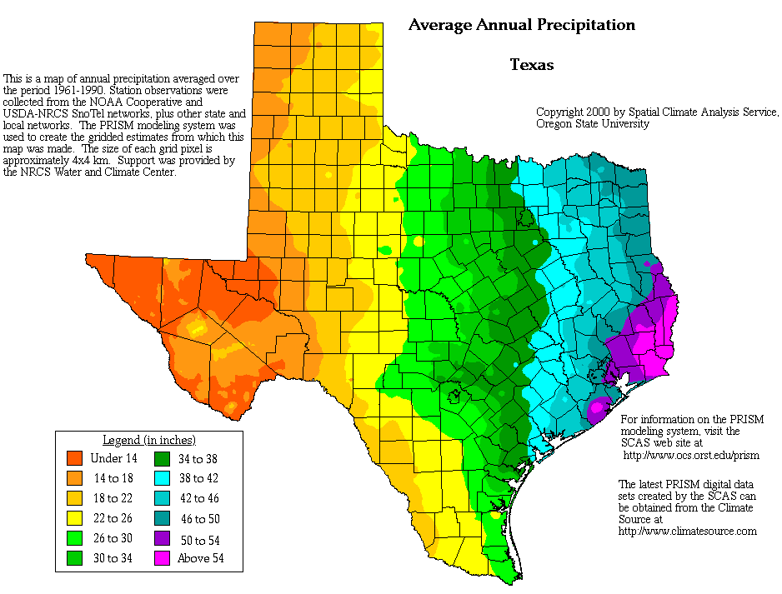
Texas Rainfall Maps

Slide 21
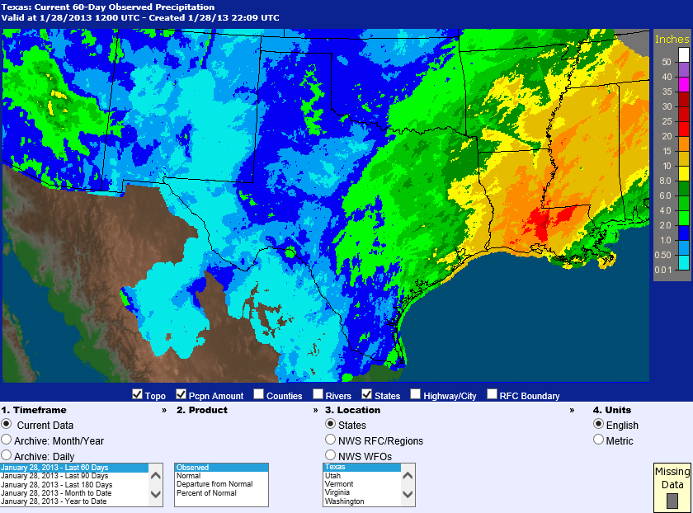
Current Rainfall in Texas
http://water.weather.gov/precip/index.php?yday=1359331200&yday_analysis=0&layer%5B%5D=0&layer%5B%5D=1&layer%5B%5D=4&timetype=RECENT&loctype=STATE&units=engl&timeframe=last60days&product=observed&loc=stateTX

Slide 22
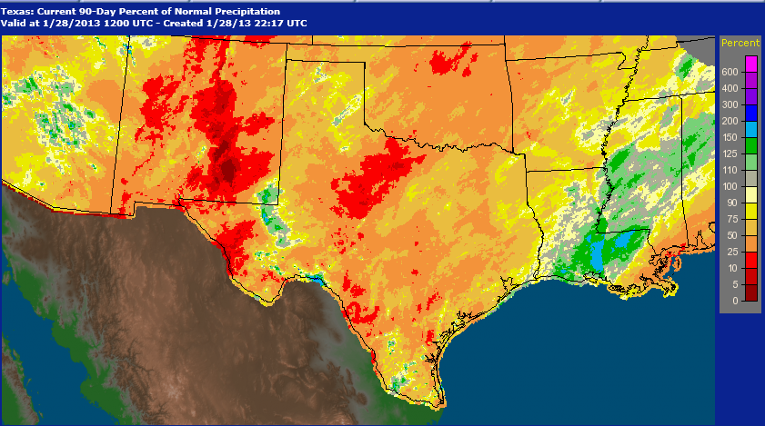
Percent of Normal Rainfall in Texas
http://water.weather.gov/precip/index.php?yday=1359331200&yday_analysis=0&layer%5B%5D=0&layer%5B%5D=1&layer%5B%5D=4&timetype=RECENT&loctype=STATE&units=engl&timeframe=last60days&product=observed&loc=stateTX

Slide 23
Temporal Representation
Rainfall hyetograph – plot of rainfall depth or intensity as a function of time
Cumulative rainfall hyetograph or rainfall mass curve – plot of summation of rainfall increments as a function of time
Rainfall intensity – depth of rainfall per unit time

Slide 24
Rainfall Depth and Intensity

Slide 25
Incremental Rainfall
Rainfall Hyetograph

Slide 26
Cumulative Rainfall
Rainfall Mass Curve

Slide 27
Arithmetic Mean Method
Simplest method for determining areal average
P₁ = 10 mm
P₂ = 20 mm
P₃ = 30 mm
P₁
P₂
P₃
Gages must be uniformly distributed
Gage measurements should not vary greatly about the mean

Slide 28
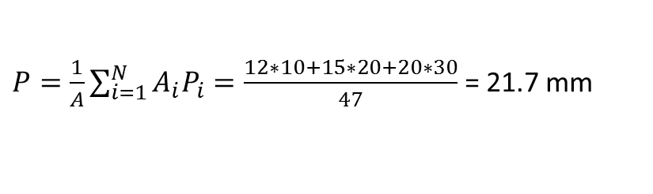
Thiessen polygon method
Any point in the watershed receives the same amount of rainfall as that at the nearest gage
Rainfall recorded at a gage can be applied to any point at a distance halfway to the next station in any direction
Steps in Thiessen polygon method
  Draw lines joining adjacent gages
  Draw perpendicular bisectors to the lines created in step 1
  Extend the lines created in step 2 in both directions to form representative areas for gages
  Compute representative area for each gage
  Compute the areal average using the following formula
P₁
A₁
P₂
A₂
P₃
A₃
P₁ = 10 mm, A₁ = 12 Km²
P₂ = 20 mm, A₂ = 15 Km²
P₃ = 30 mm, A₃ = 20 km²
$P=\frac{1}{A}\sum_{i=1}^{N}{A_{i}P_{i}}=\frac{12∗10+15∗20+20∗30}{47}$ = 21.7 mm

Slide 29
Isohyetal method
Steps
  Construct isohyets (rainfall contours)
  Compute area between each pair of adjacent isohyets (A_{i})
  Compute average precipitation for each pair of adjacent isohyets (p_{i})
  Compute areal average using the following formula
10
20
P₁
A₁=5 , p₁ = 5
A₂=18 , p₂ = 15
P₂
A₃=12 , p₃ = 25
P₃
30
A₄=12 , p₃ = 35

Slide 30
Inverse distance weighting
Prediction at a point is more influenced by nearby measurements than that by distant measurements
The prediction at an ungaged point is inversely proportional to the distance to the measurement points
Steps
  Compute distance (d_{i}) from ungaged point to all measurement points.
  Compute the precipitation at the ungaged point using the following formula
P₁=10
P₂= 20
d₁=25
d₂=15
P₃=30
d₃=10
p

Slide 31
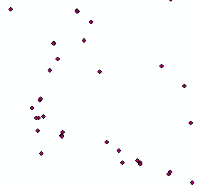
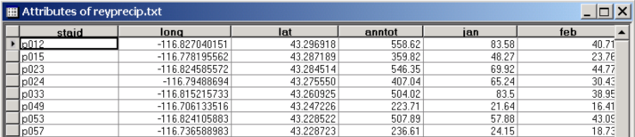
Rainfall interpolation in GIS
Data are generally available as points with precipitation stored in attribute table.

Slide 32
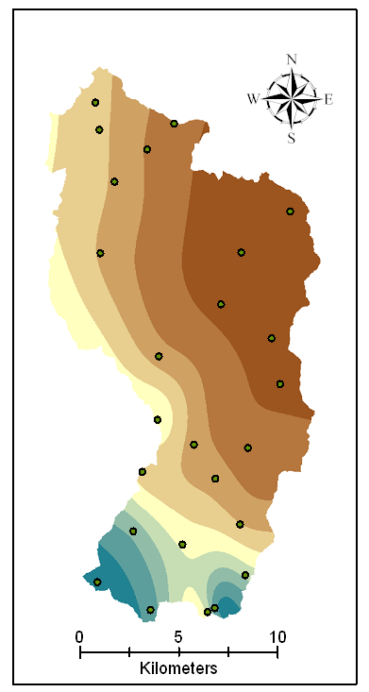
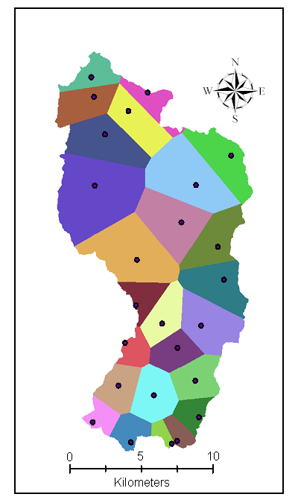
Rainfall maps in GIS
Nearest Neighbor “Thiessen” Polygon Interpolation
Spline Interpolation

Slide 33
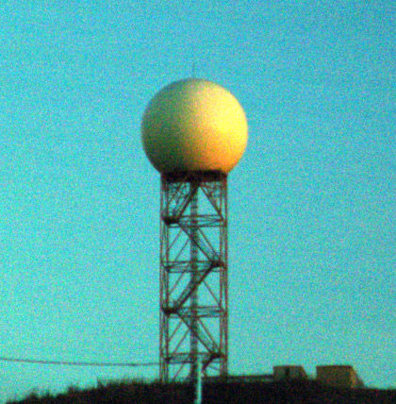

NEXRAD
NEXt generation RADar: is a doppler radar used for obtaining weather information
A signal is emitted from the radar which returns after striking a rainfall drop
Returned signals from the radar are analyzed to compute the rainfall intensity and integrated over time to get the precipitation
NEXRAD Tower
Working of NEXRAD

Slide 34
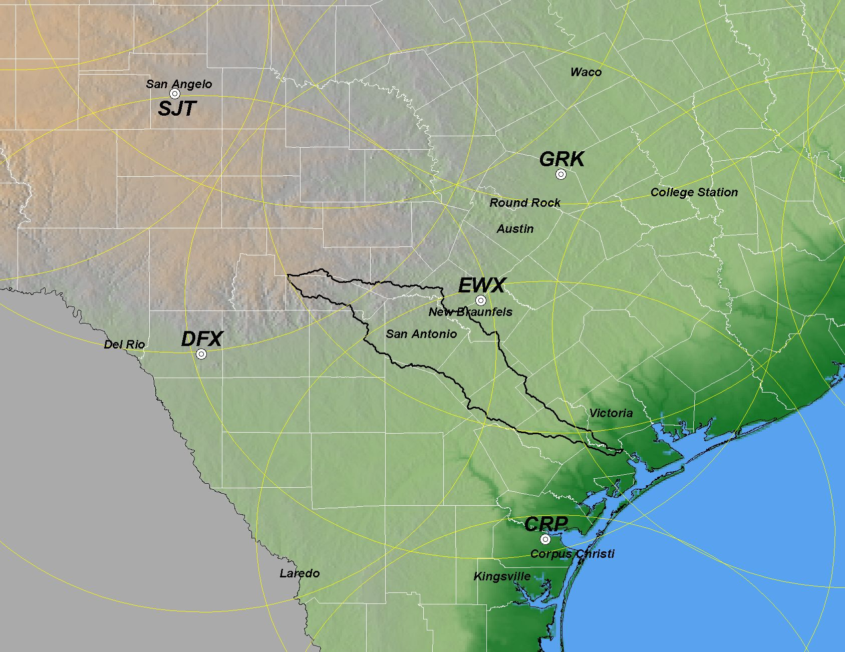
NEXRAD WSR-88D Radars in Central Texas
(Weather Surveillance Radar-1988 Doppler) scanning range = 230 km
NEXRAD Products:
Stage I: Just Radar
Stage II: gages, satellite, and surface temperature
Stage III: Continuous mosaic from radar overlaps
EWX – NEXRAD Radar in New Braunfels
Source: PBS&J, 2003
Notes:
One of the strong motivation points for integration is the availability of
good quality precipitation estimates at higher temporal and spatial resolutions to feed engineering models!!
In particular the NEXRAD products of the NWS that now provide “true spatial realizations of rainfall fields”
With historical and real time sources

Slide 35
NEXRAD data
NOAA’s Weather and Climate Toolkit (JAVA viewer)
  http://www.ncdc.noaa.gov/oa/wct/
West Gulf River Forecast Center
  http://www.srh.noaa.gov/wgrfc/
National Weather Service Precipitation Analysis
  http://www.srh.noaa.gov/rfcshare/precip_analysis_new.php

