Slide 1

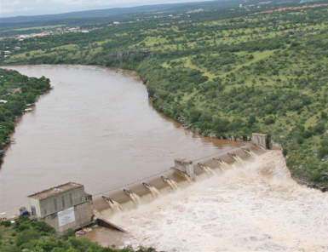
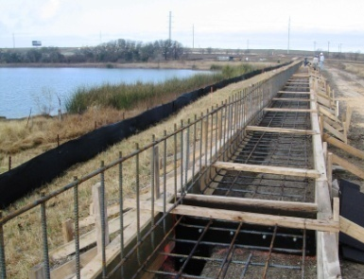
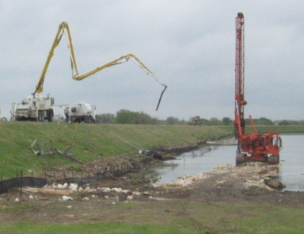
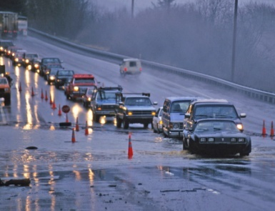
Upper Brushy Creek Water Control & Improvement District
Ruth Haberman, General Manager, UBCWCID
March 21, 2013

Slide 2
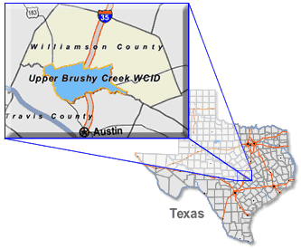
DISTRICT OVERVIEW
Original District was formed by the Texas Legislature in 1956 for flood and erosion control within the Brushy Creek watershed
Primary focus has been operation and maintenance of 23 dams constructed by the SCS (now NRCS) in the 1950s and 1960s

Slide 3
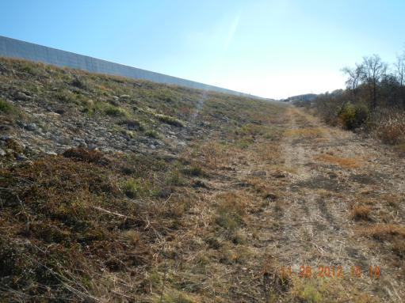
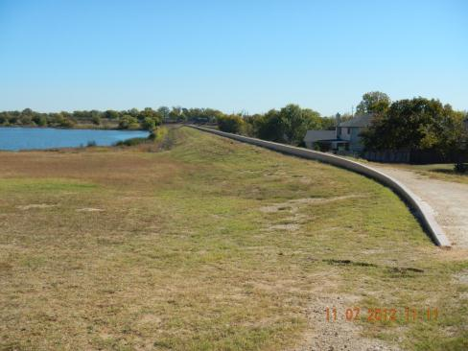
DAM MODERNIZATION
DAM 11
Since 2003, over $15M in tax revenue have been spent to modernize 21 dams.
DAM 14
Two dams remain to be modernized;
Dams 7 and 8.

Slide 4
MISSION STATEMENT
The mission of the Upper Brushy Creek Water Control and Improvement District is to maintain and improve flood control structures and take appropriate measures to protect public safety as well as economic infrastructure of the District, in consultation and cooperation with other governmental entities. The District will actively foster a regional perspective and will encourage cooperation among governmental entities. We will accomplish these tasks utilizing cost-effective methods, minimizing the impact to the environment, considering the community values of our stakeholders, and conducting our business with openness, honesty and integrity.

Slide 5
JURISDICTIONAL BOUNDARIES

Slide 6
DRAINAGE AREAS

Slide 7
MAJOR CHANGES IN THE COUNTY
 | 1960 | 1970 | 1980 | 1990 | 2000 | 2010
Williamson County | 35,044 | 37,305 | 76,521 | 139,551 | 249,967 | 422,679
http://www.census.gov/population/cencounts/tx190090.txt
http://www.txcip.org/tac/census/profile.php?FIPS=48491

Slide 8
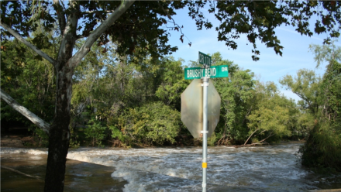
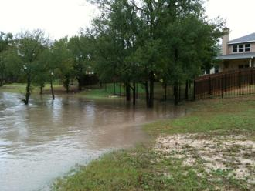
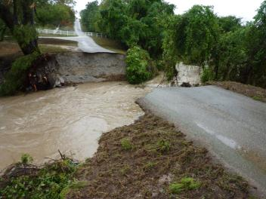
TS HERMINE FLOODING – September 8-9, 2010

Slide 9
FLOODING ISSUES IN THE DISTRICT
Tropical Storm Hermine
Even with the dams operating as expected, there were still threats to public safety and risk of property damage.
District Infrastructure:
The dams functioned as designed, constructed and maintained.
The dams experienced only minor damage from the flooding.
The web-based Flood Monitoring System allowed District engineers, elected officials, and both City and County emergency managers to monitor the rainfall in the area.

Slide 10


UPPER BRUSHY CREEK WATERSHED STUDY
Purpose:
Analyze watershed hydrology and hydraulics.
  Identify potential flood hazard areas.
Propose alternative solutions for regional flood hazard mitigation.
  Provide final report, models and documentation to all participants.
  Coordinate with FEMA and local government entities to incorporate study results into new regulatory FEMA Risk Maps (floodplain maps) for the entire watershed.

Slide 11
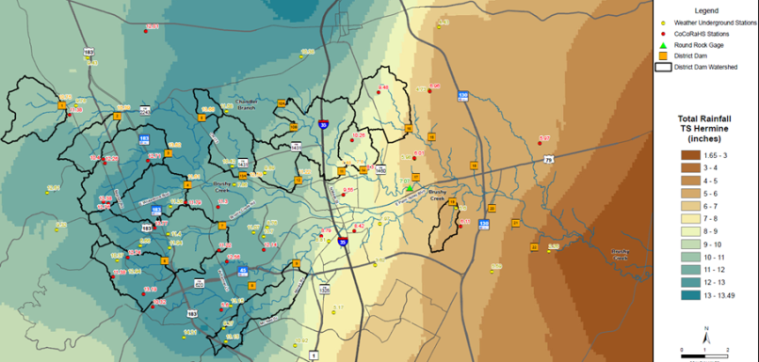
Upper Brushy Creek Hydrologic Model
Jeff Irvin, URS

Slide 12
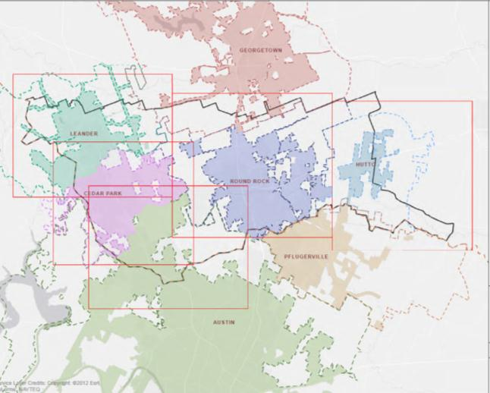
Study Area

Slide 13
Getting on Same Sheet of Music

Slide 14
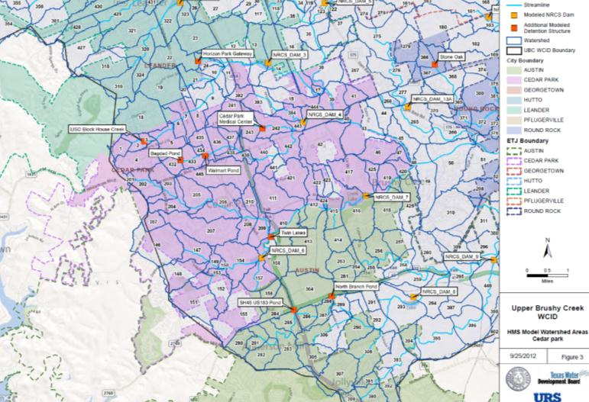
449 Watersheds

Slide 15
Hydrology: the Mindset
Hydrology = Data (Rainfall, Runoff, Land Use)
Data bad = Hydrology bad
Data good = Hydrology good
How do you test data?

Slide 16
Hydrology: the Mindset
The data test:
Representative?
in place (where data taken)
in time period (same as application time period)
in amount of data?
Homogeneous? – applied on any data to be aggregated/ averaged
in place
in time
in collection method and accuracy

Slide 17
Hydrology: the Mindset
The most representative and homogeneous data set is the best data set

Slide 18
Hydrologic Model Calibration Data
Rainfall
  Sources of rainfall data?
  Which storms?
Runoff (flow or stage plus hydraulics)
  Sources?

Slide 19
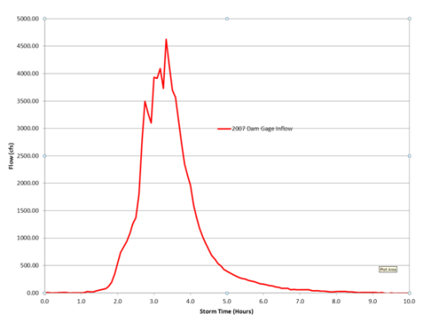
Choice of Calibration storms
The runoff hydrograph has two main parameters that define shape:
A parameter that defines how much rain runs off (runoff volume)
A parameter that defines time of peak (runoff temporal shape)

Slide 20
Choice of Calibration Storms
Runoff volume (for a given rainfall) is a function of:

Slide 21
Choice of Calibration Storms
Runoff volume (for a given rainfall) is a function of:
Rainfall
Land Use
Soil Type
% Impervious
Antecedent Runoff Condition

Slide 22
Choice of Calibration Storms
What are data validity tests for a calibration storm used to calibrate a model rainfall/runoff relationship?
Rainfall

Slide 23
Choice of Calibration Storms
What are data validity tests for a calibration storm for a model rainfall/runoff relationship?
Rainfall
  Representative
    In location and time
    In temporal shape
    In size
    Are there enough data?
      Spatially vs storm shape
      Temporally versus storm shape

Slide 24
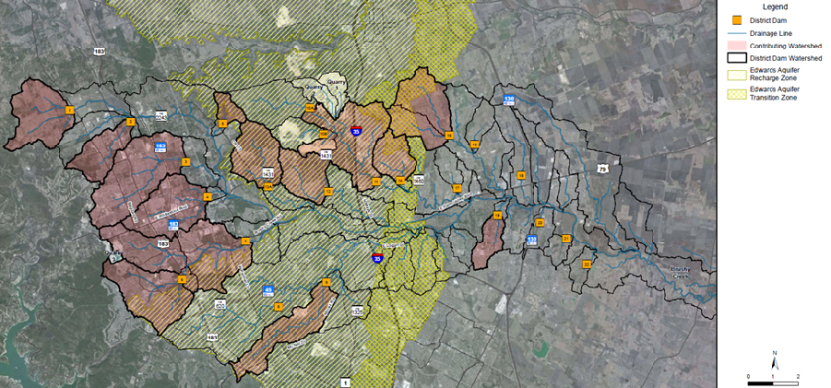
Upper Brushy WCID Dams

Slide 25
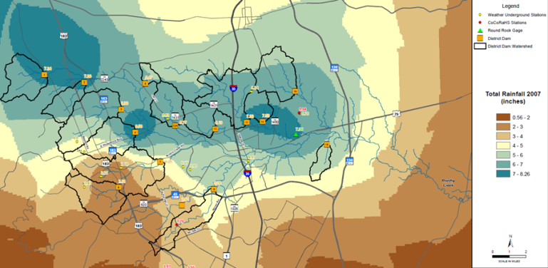
Choice of Calibration Storms
    Representative in location and time?
    Are there enough data?
      Spatially vs storm shape

Slide 26
Choice of Calibration Storms
    Are there enough data?
      Spatially vs storm shape

Slide 27
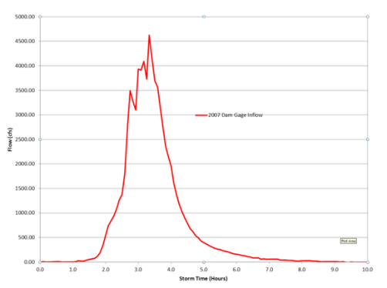
Choice of Calibration Storms
    Are there enough data?
      Temporally versus storm shape

Slide 28
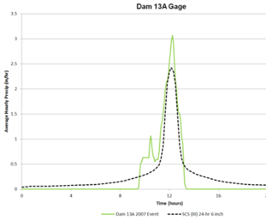
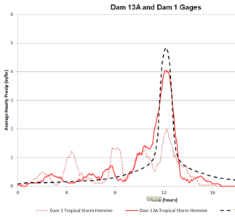
Choice of Calibration Storms
    Representative?
      In temporal shape

Slide 29
Choice of Calibration Storms

Slide 30
Results of Rainfall/Runoff Calibration

Slide 31
Why are results inconsistent?
Can we compare 2007 storm runoff results to 2012 storm runoff results?
Are the conditions that affect runoff homogeneous between the two storms?
Rainfall
Land Use
Soil Type
% Impervious
Antecedent Runoff Condition

Slide 32
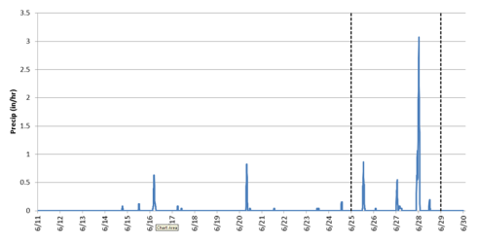
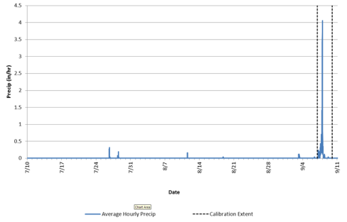
Antecedent Runoff
Are the two storms homogeneous in terms of antecedent conditions?
2007 Rainfall
2010 Rainfall

Slide 33
Results of Rainfall/Runoff Calibration

Slide 34
Results of Rainfall/Runoff Calibration

Slide 35


Upper Brushy Creek
Water Control and Improvement District
Dam 7 Modernization
CE 374K Hydrology
Dustin Mortensen, Freese and Nichols
March 21, 2013

Slide 36
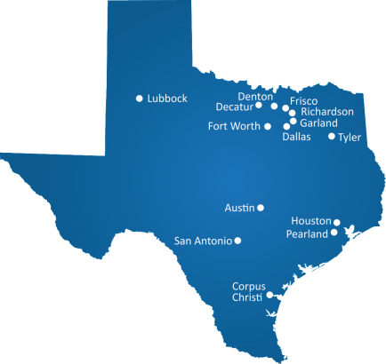

FNI OVERVIEW
Multi-service engineering,
architecture and
environmental science firm
118-year history
520+ employees across
14 offices throughout Texas
Client satisfaction is our
top priority
We offer cost-effective
solutions

Slide 37
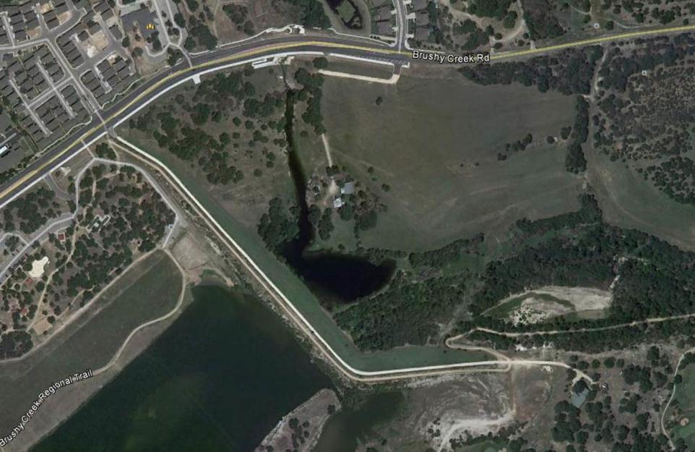
Dam 7 OVERVIEW
Intermediate Sized, High Hazard
Completed in 1965
Hydraulic Capacity - Passes 46% PMF
Drawdown Time
(Auxiliary Spillway-Normal Pool)
Notes:
Existing Dam stats:
Intermediate Size
Completed in 1965

Slide 38
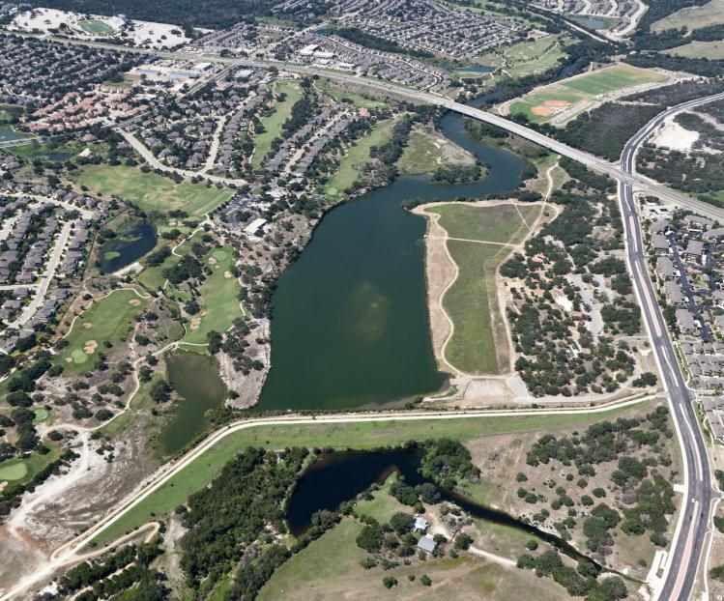
Normal Level

Slide 39
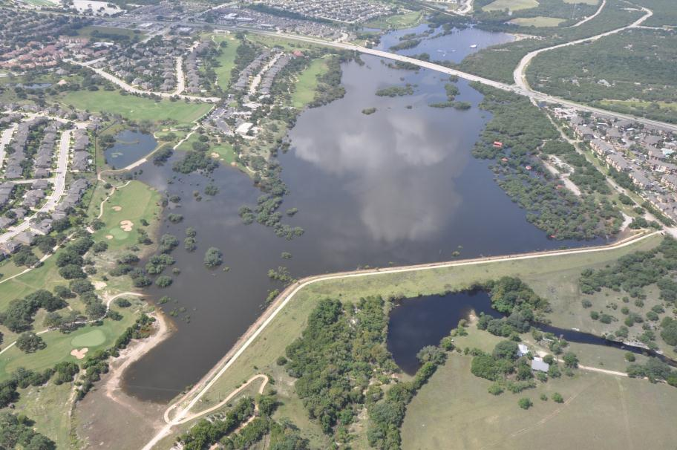
Flood Level

Slide 40
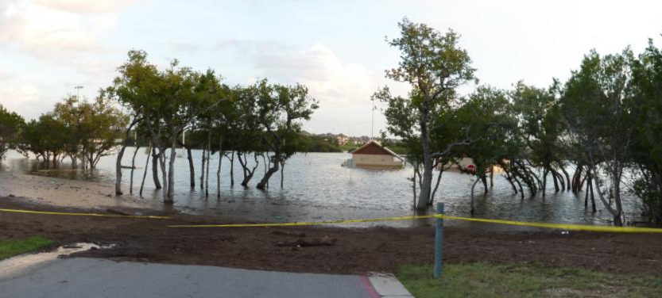
Flooded Park

Slide 41
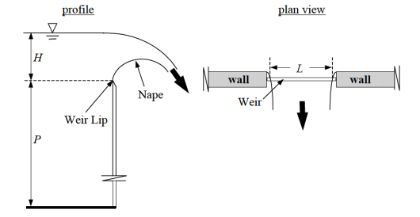
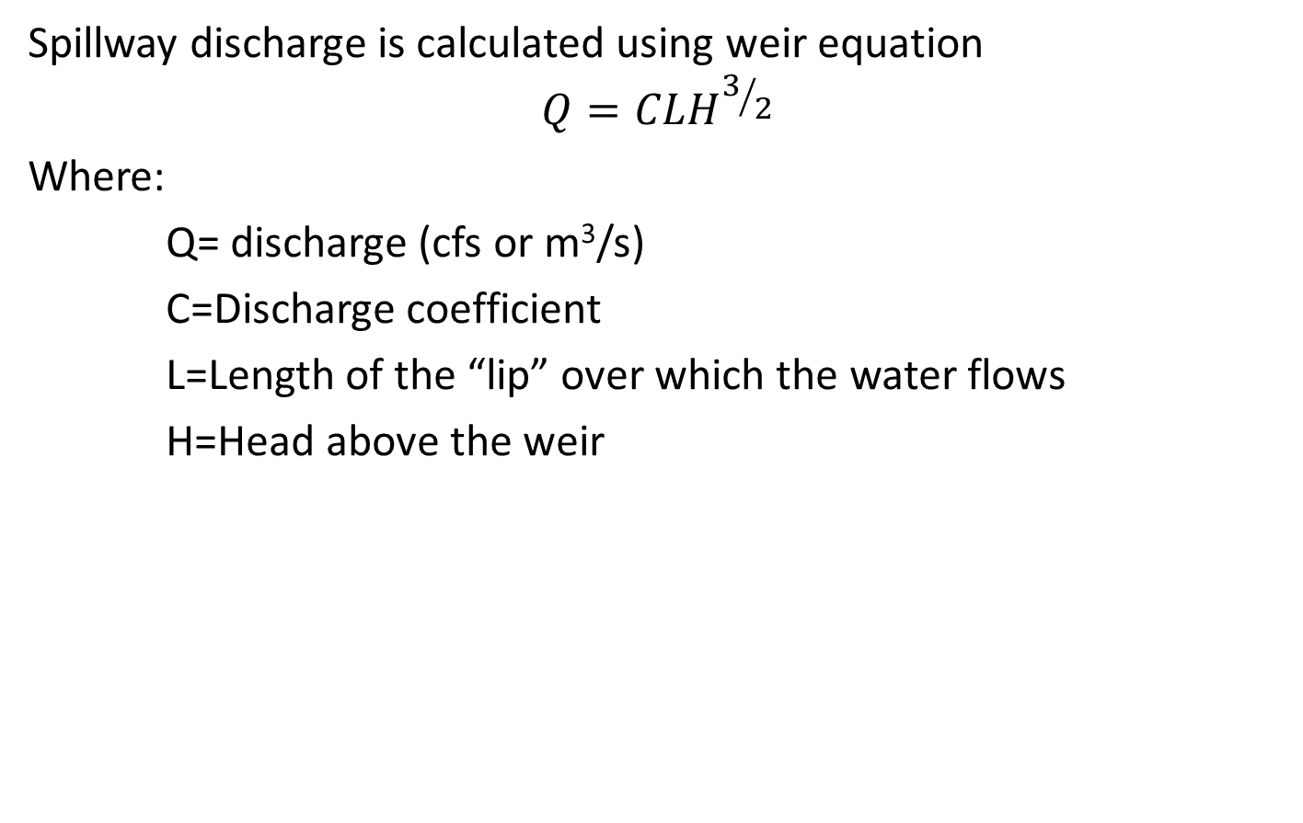
Spillway Hydraulics
Spillway discharge is calculated using weir equation
$$Q=CLH^{3/2}$$
Where:
Q= discharge (cfs or m³/s)
C=Discharge coefficient
L=Length of the “lip” over which the water flows
H=Head above the weir

Slide 42
Increase Capacity
Existing dam
Notes:
The first question we need to answer is about capacity.
In the schematic design we looked at a range of options that included a, b, c
Schematic Design Concepts
Meet dam safety Criteria (75% and 100% PMF)
Incorporate the trail
Consider regulatory floodplains
sent this slide.

Slide 43
Increase H
Raising the dam
Notes:
The first question we need to answer is about capacity.
In the schematic design we looked at a range of options that included a, b, c
Schematic Design Concepts
Meet dam safety Criteria (75% and 100% PMF)
Incorporate the trail
Consider regulatory floodplains
sent this slide.

Slide 44
Increase L
Widening the spillway

Slide 45
Increase L and H
Range of options…

Slide 46
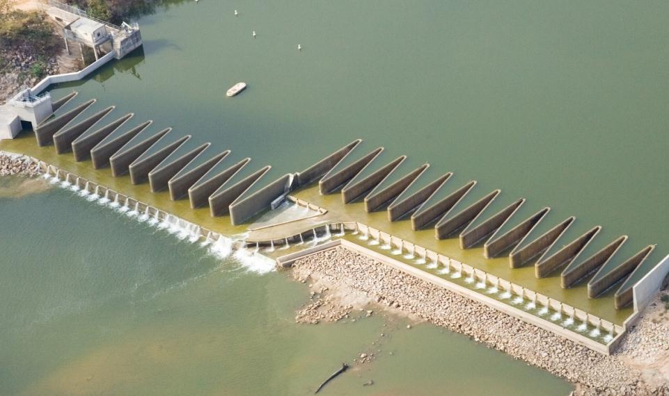
Increase L

Slide 47
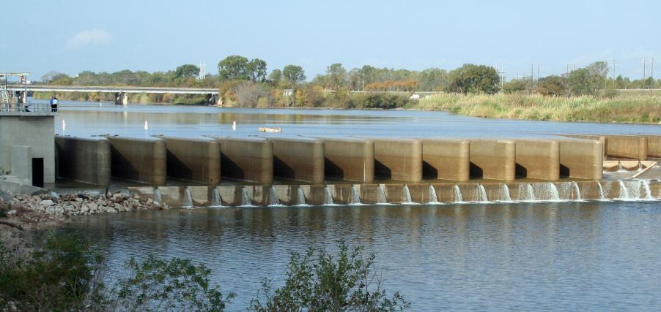
Labyrinth Weir
Increases L without increases spillway footprint width
Dam 7 alternative has 1,800 feet of weir in 300 foot wide footprint
C is dependent on wall angles, wall height, head and crest shape

Slide 48
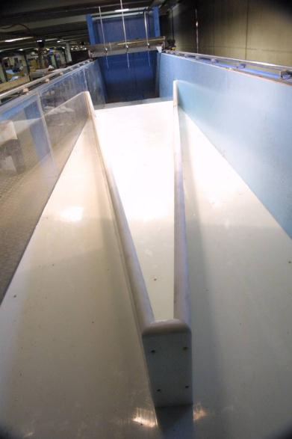
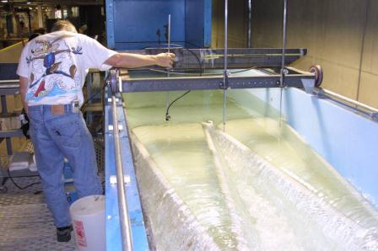
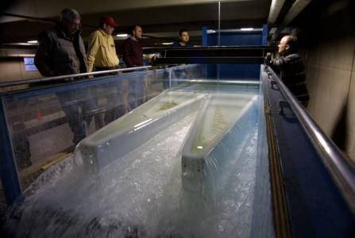
Model Studies

Slide 49
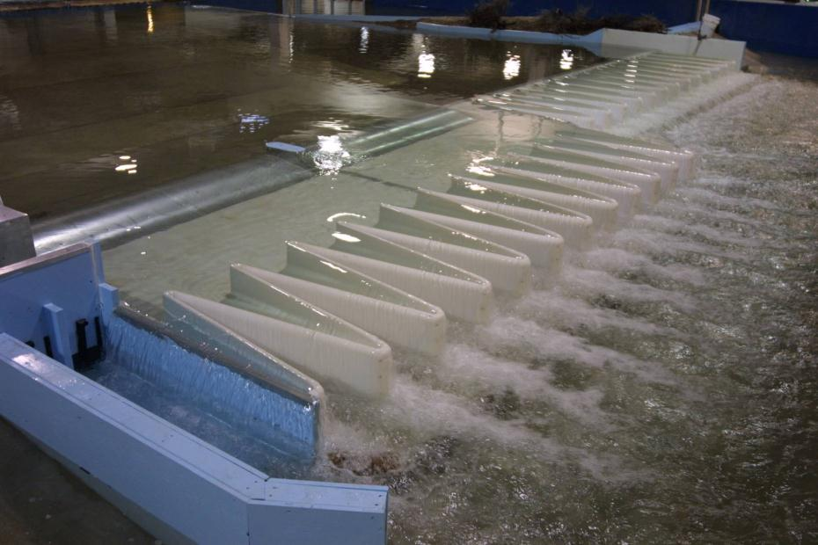
Model Studies

Slide 50
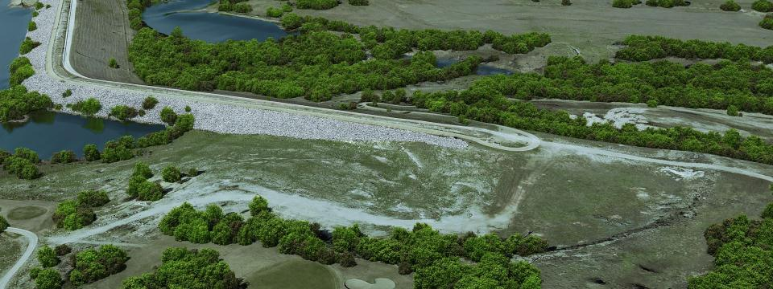
Dam 7 Upstream

Slide 51
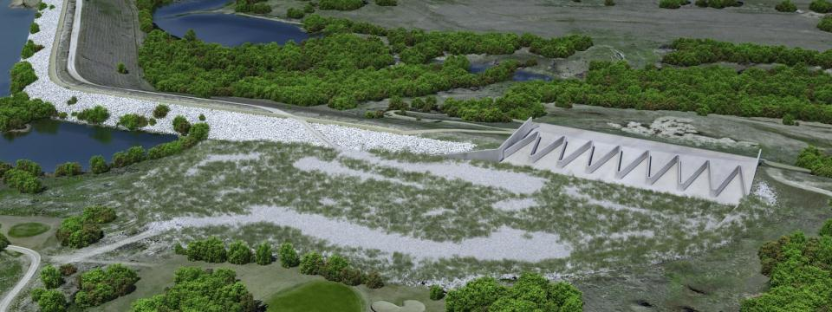
Dam 7 Upstream

Slide 52
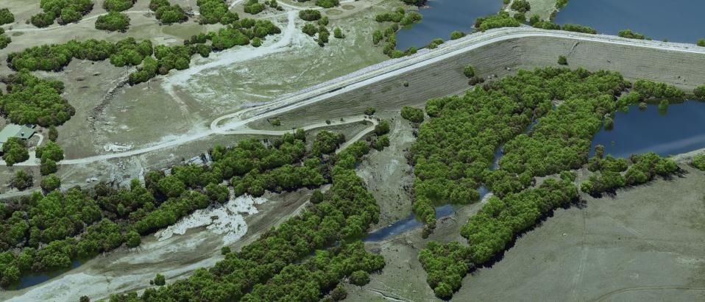
Dam 7 Downstream

Slide 53
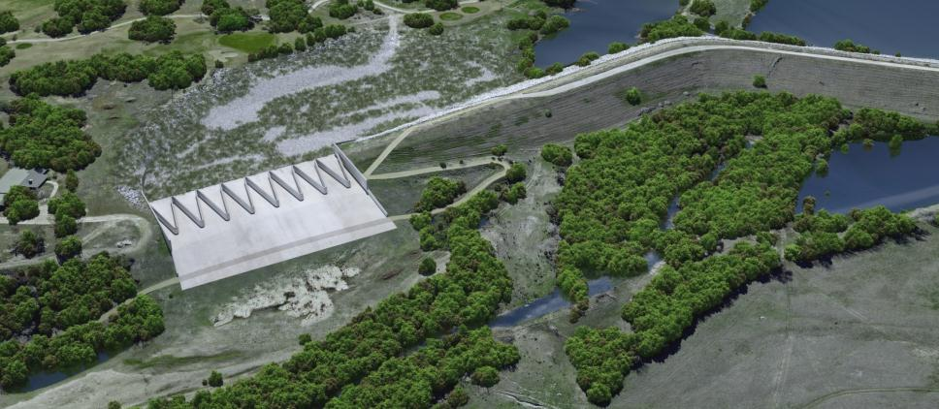
Dam 7 Downstream

Slide 54
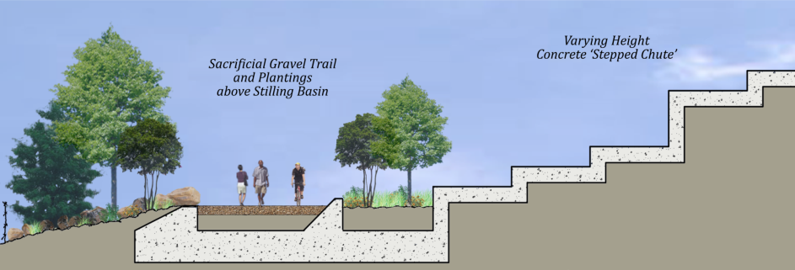
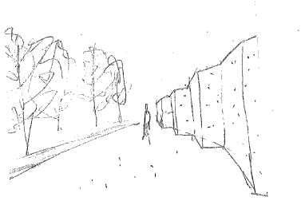
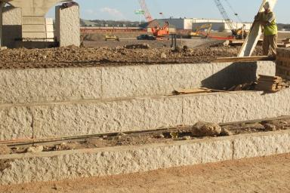
Downstream
Wall Shape and Layout Options

Slide 55
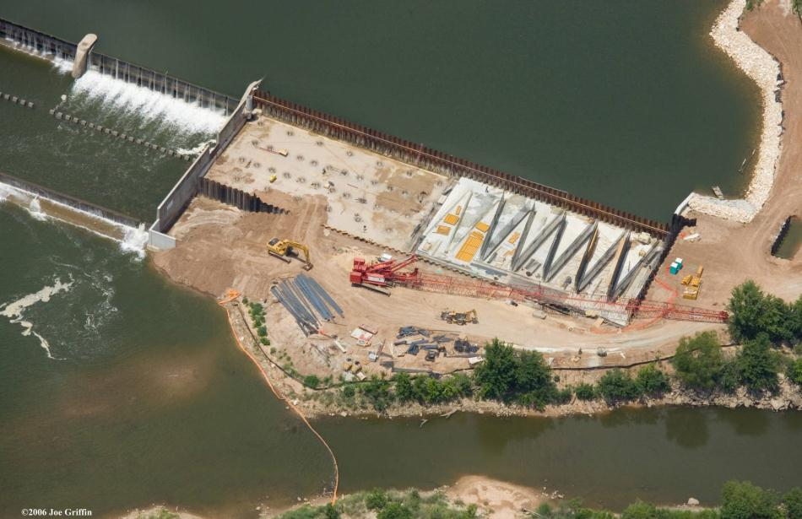
Labyrinth Weir Construction

Slide 56
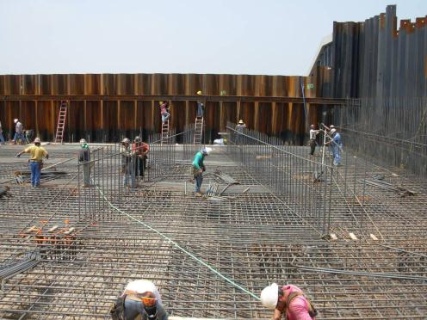
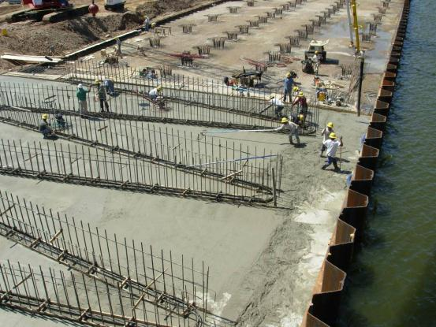
Platform Slab Construction

Slide 57
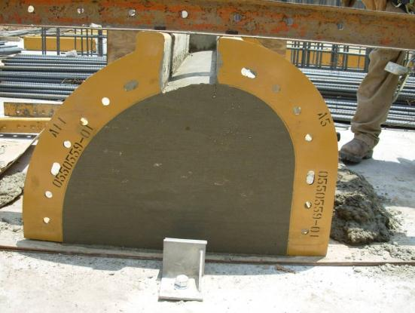
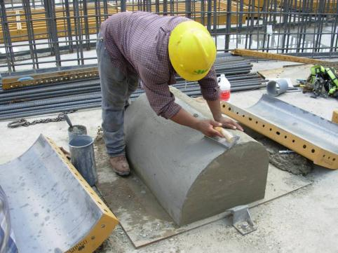
Crest Shape

Slide 58
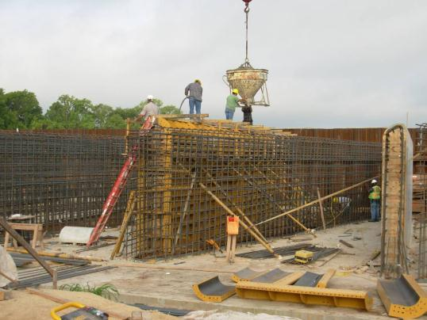
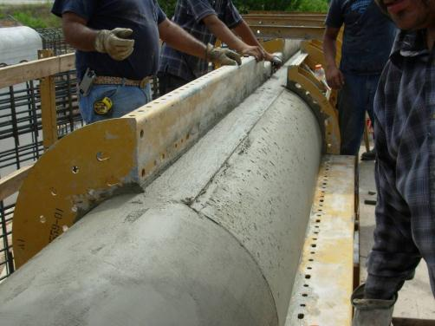
Labyrinth Wall Construction

Slide 59
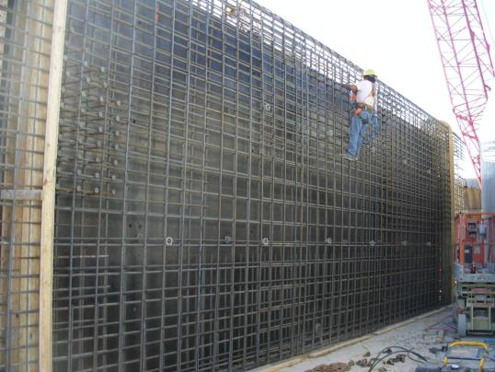
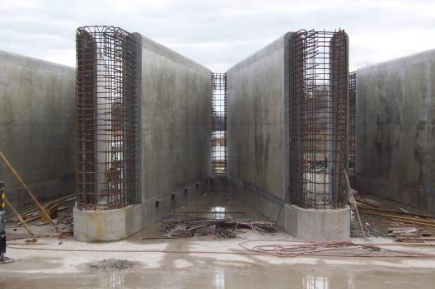
Labyrinth Wall Construction

Slide 60

Discussion / Q&A

Slide 61
THANK YOU

