Slide 1
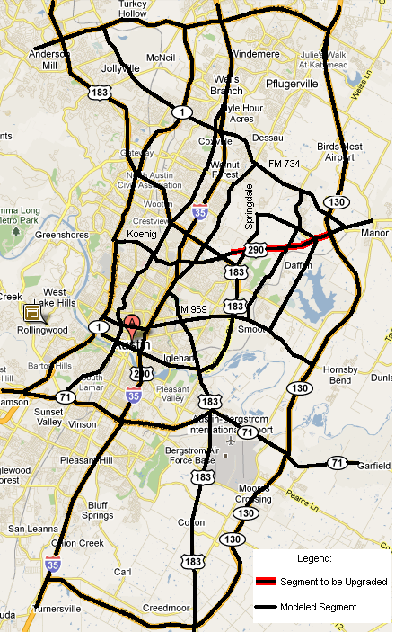
51
52
53
Austin Network
2
3
1
4
5
54
TOD Reference Stations:
1: IH-35, S of FM 1626
2: US 290, 4.2 mi. W of FM 1826
3: SH 71, 3.6 mi. E of 183
4: US 183, 3 mi S. of SH 71
5: IH 35, N of Town Lake Br.
6: Loop 1, under 35 St overpass
6
7
8
9
11
10
12
62
55
15
23
61
26
56
13
16
18
21
24
25
14
17
20
22
6
27
19
29
28
30
31
36
39
33
32
34
35
37
5
40
41
38
2
43
42
57
45
44
46
3
47
58
4
48
1
49
59
50
60

Slide 2
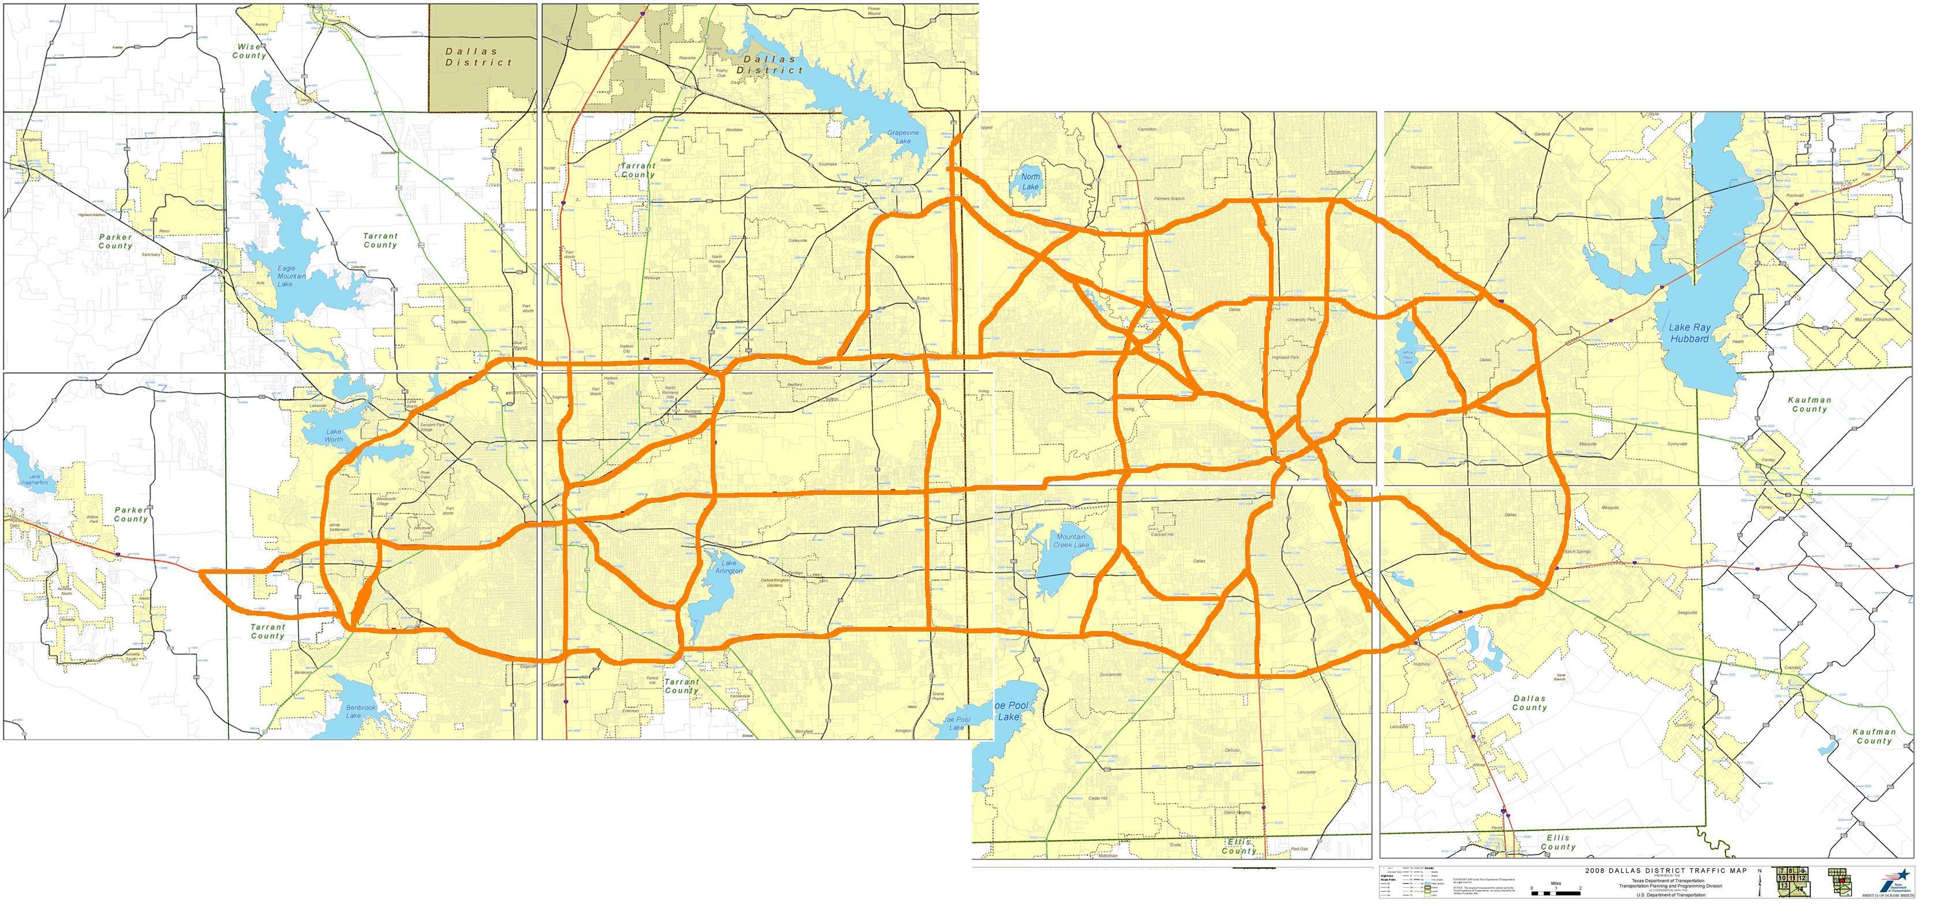
Dallas-Ft Worth Network
24
23
25
TX-121
46
I-635
54
26
TX-114
I-635
31
33
30
TX-161
Dallas N Tollway
I-45
I-635
TX-121
TX-97
32
I-35E
61
TX-348
34
47
55
60
TX-161
41
TX-12
E NW Hwy
TX-114
35
42
28
TX-12
TX-12
6
I-820
12
TX-183
TX-183
TX-183
36
TX-482
Dallas N Tollway
I-45
TX-12
63
19
20
27
43
I-35E
I-30
TX-183
I-35E
62
I-635
I-820
37
TX-356
45
64
13
44
TX-366
56
I-30
US-80
I-35W
7
TX-360
TX-12
48
57
TX-121
14
38
I-30
I-45
8
I-820
15
21
29
I-30
49
58
I-30
9
11
TX-12
I-35E
US-175
2
4
I-30
16
39
I-635
1
I-30
TX-360
50
I-45
65
I-820
US-287
I-820
US-67
US-377
I-35W
17
TX-12
I-20
22
TX-408
51
I-20
3
5
10
I-20
I-20
40
US-67
I-20
18
I-35E
I-20
59
52
53

Slide 3
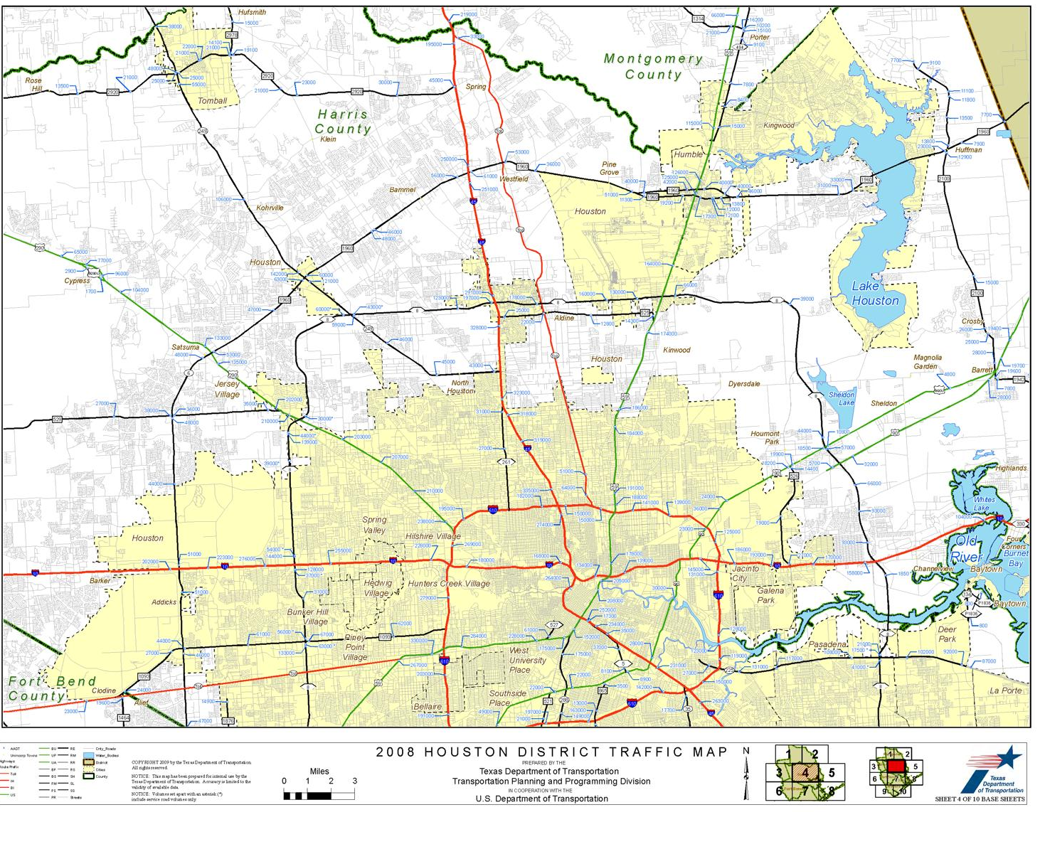
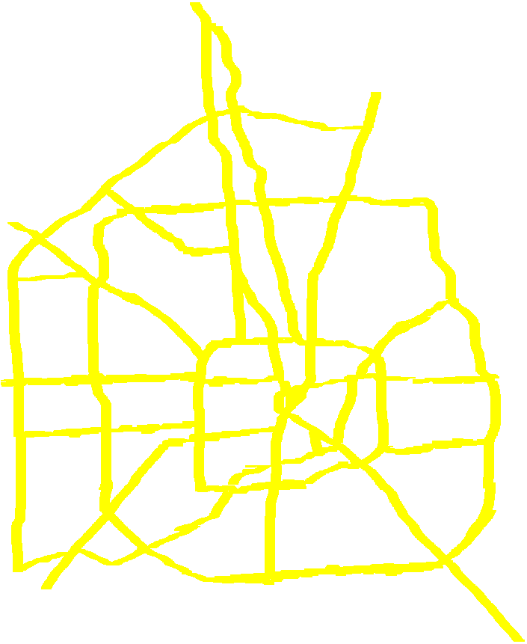
1
4
2
3
5
Houston Network
21
22
23
24
6
20
47
46
19
45
49
7
57
50
51
25
26
27
48
55
52
29
44
42
28
8
18
56
30
Tuesday, June 29, 2010
10:23 AM
53
59
60
57
43
41
54
33
17
32
9
40
34
31
37
35
38
36
39
58
15
13
11
16
12
14
10

