Slide 1
Hydrologic Responses to Draught in the
Barton Creek Segment of the Edwards Aquifer
Peter Carlson

Slide 2
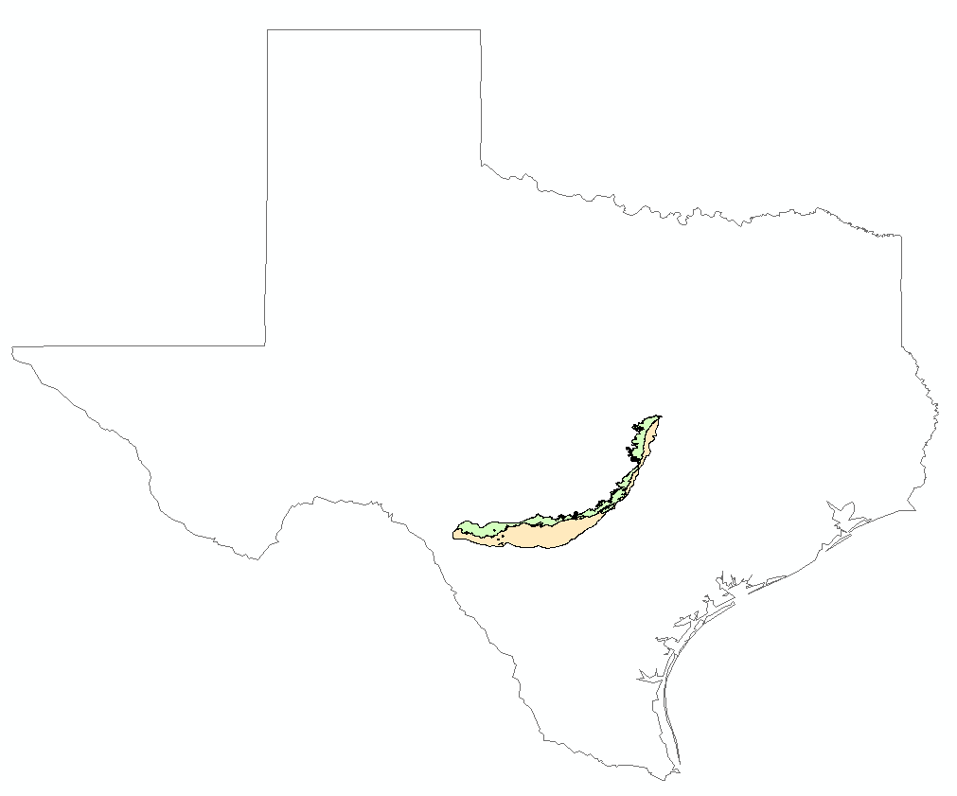
Edwards Aquifer
Includes contributing, recharge, and artesian zones
Provides drinking water for 2 million people.

Slide 3
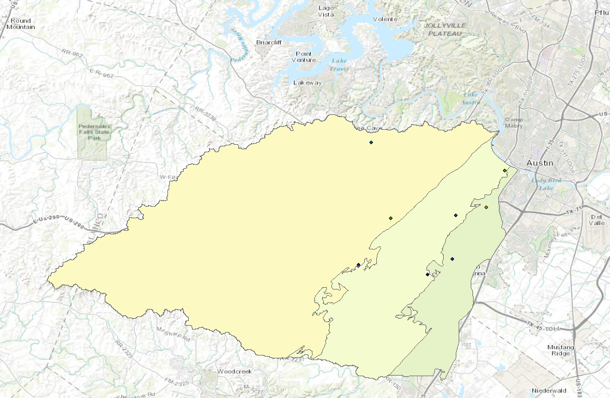
Barton Springs Segment
South of Austin: highly visible segment of the Edwards Aquifer.

Slide 4
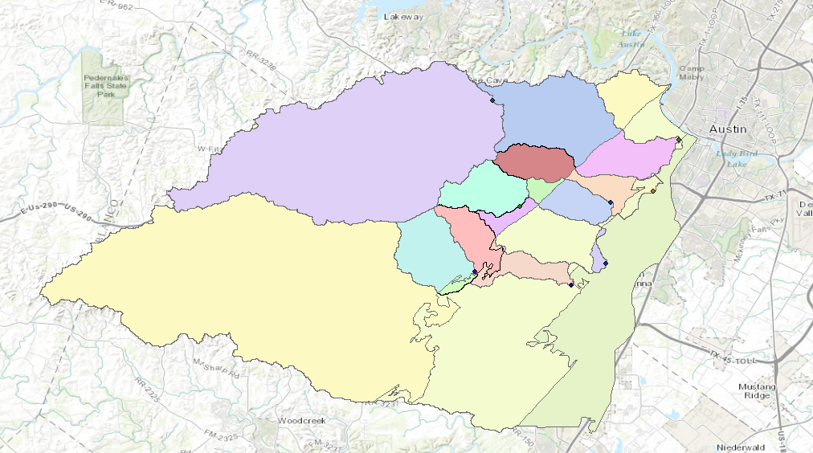
Watersheds for Stream Gages
Generated watersheds using NED30 data and with the zones of the aquifer.
Downloaded NLADS data from NOAH.

Slide 5
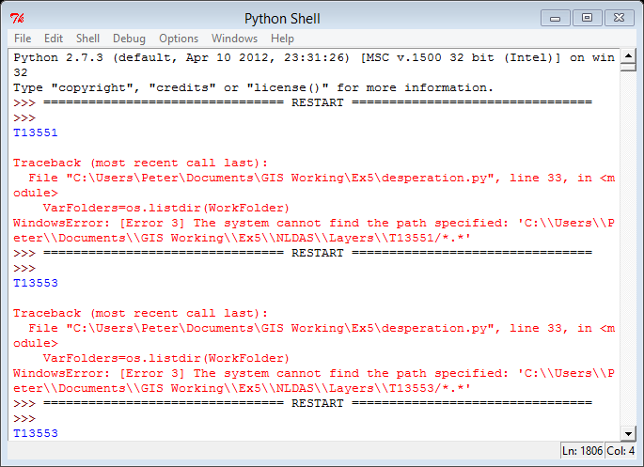
Python Problems
Could not perform zonal averaging reliably.

Slide 6
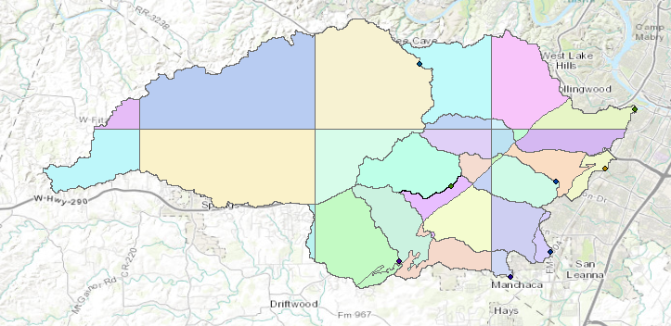
1/8 degree grid intersections
Intersected the watersheds and aquifer zones with a 1/8° grid corresponding with the NLADS data.
Area weighting coefficients for zonal averaging.
Python program to interpret *.asc files without using ArcMap.

Slide 7
Palmer Draught Severity Index
PDSI uses temperature and precipitation to estimate soil water supply and demand.

Slide 8
Gage Flow vs Precipition:
Separated by PDSI
Low correlations between precipitation and gage flow may be due to poor accounting for storm events in precipitation data.
Higher correlation between gage flow and precipitation suggest that some buffer diminishes the effects of storms on gage flow.

Slide 9
Conclusions
In draught conditions, the recharge zone and the contributing zone respond similarly to precipitation events.
In non-draught conditions, flow through the contributing zone does not reflect calculated precipitation.

