Slide 1
Publishing and Accessing Services using ArcGIS for Flood Analysis
Harish Sangireddy
The University of Texas at Austin

Slide 2
Outline
Organizing data for capturing flood events.
Publishing map services to ArcGIS online.
Accessing time series data in ArcMap.

Slide 3
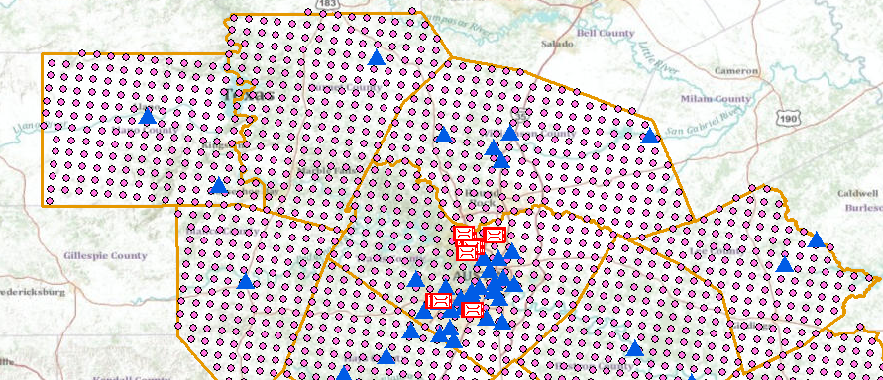
Organizing data for Flood events
Create an observation datacart to organize the data required for flood analysis.
The observation time series datacart could be about
  Area of study
  Precipitation
  Stream flow
  Gage height
  Radar images
  and many more data sets

Slide 4
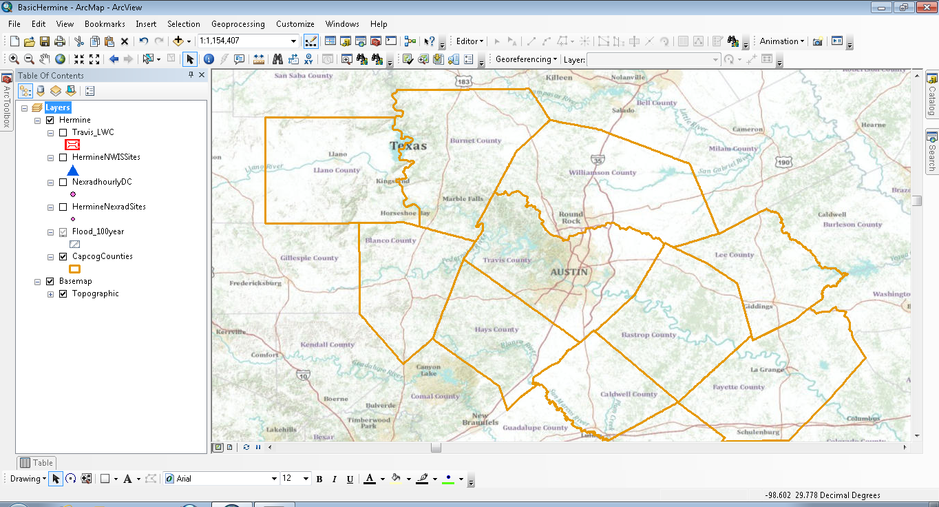
Area of study
The CAPCOG counties have been chosen as the area of study for analyzing flash flood conditions during the Tropical Storm Hermine that occurred in September 2010.

Slide 5
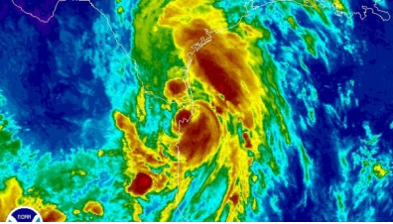
Precipitation data
To capture precipitation data for the CAPCOG region, hourly and daily NEXRAD data was used. The daily and hourly NEXRAD data was obtained from The University of Texas at Arlington , where the NEXRAD data is received from NWS and served as a Web service in WaterML format.

Slide 6
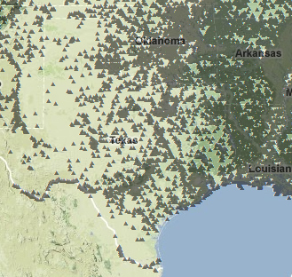
Stream flow data
The stream flow is obtained from the USGS stations.
USGS exposes a rest service that returns a WaterML file for a given station and parameter. These are instantaneous values measured at every 5 minute intervals.

Slide 7

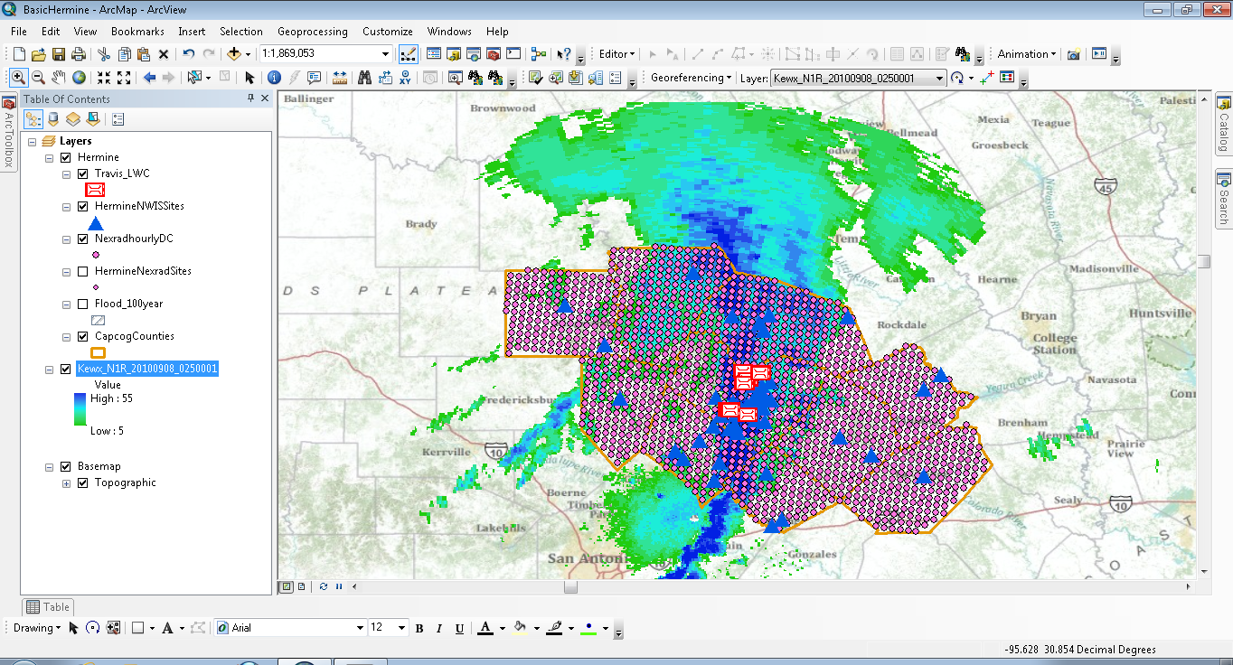
All other data sets that we think are necessary for floods

Slide 8
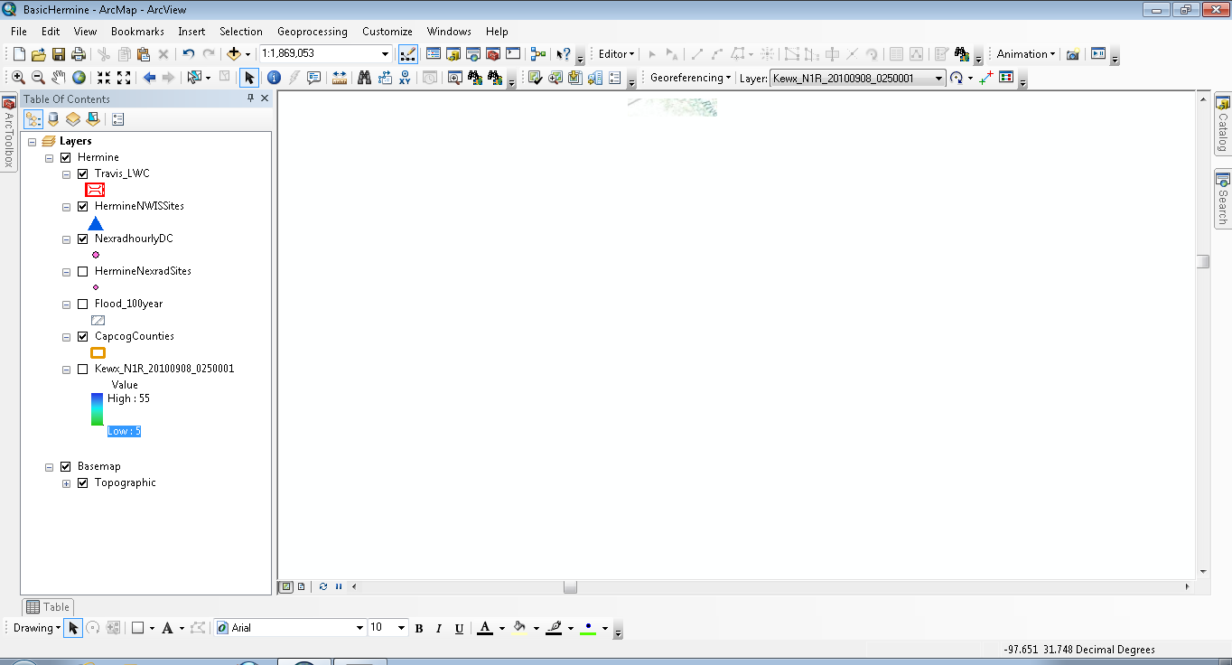

Publishing data to ArcGIS Online
Create your flood map.
Use the Arc GIS map service publishing tool to publish map service on your Arc Server.
Open http://www.arcgis.com/home/ and login using your ArcGIS global account.

Slide 9
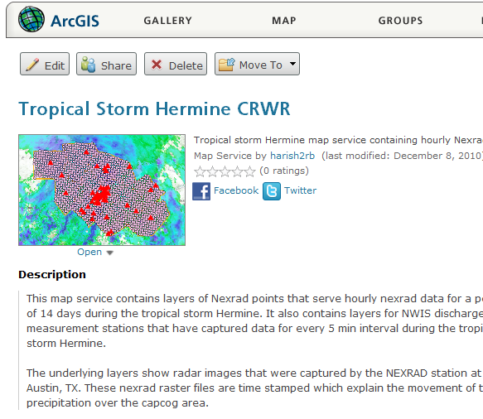
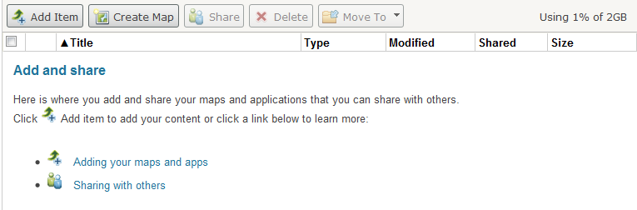
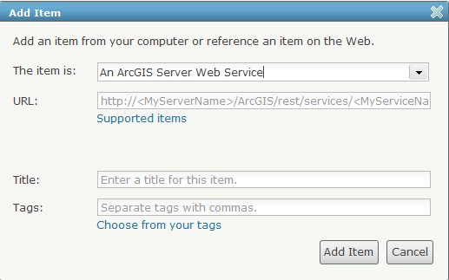
Preparing data on ArcGIS Online

Slide 10
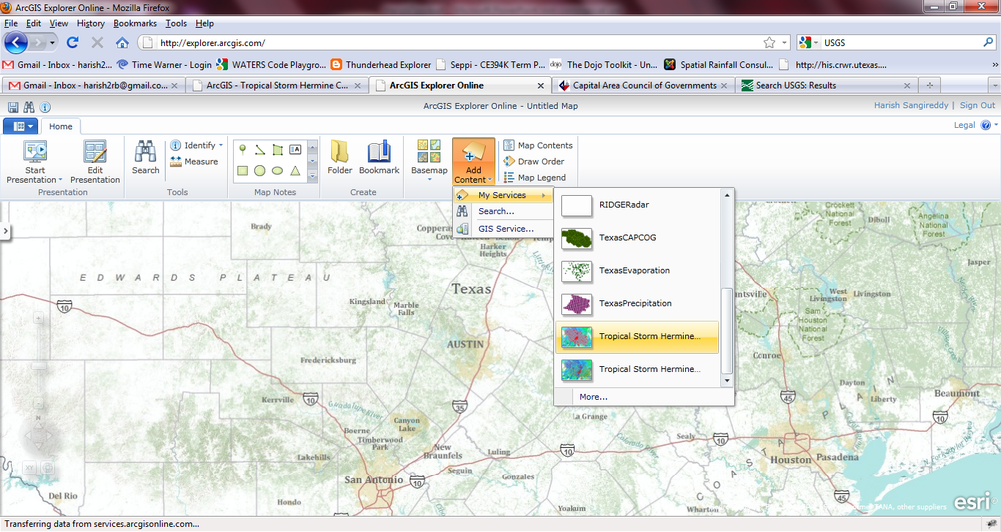
Accessing maps on ArcGIS Explorer Online
http://explorer.arcgis.com/

Slide 11
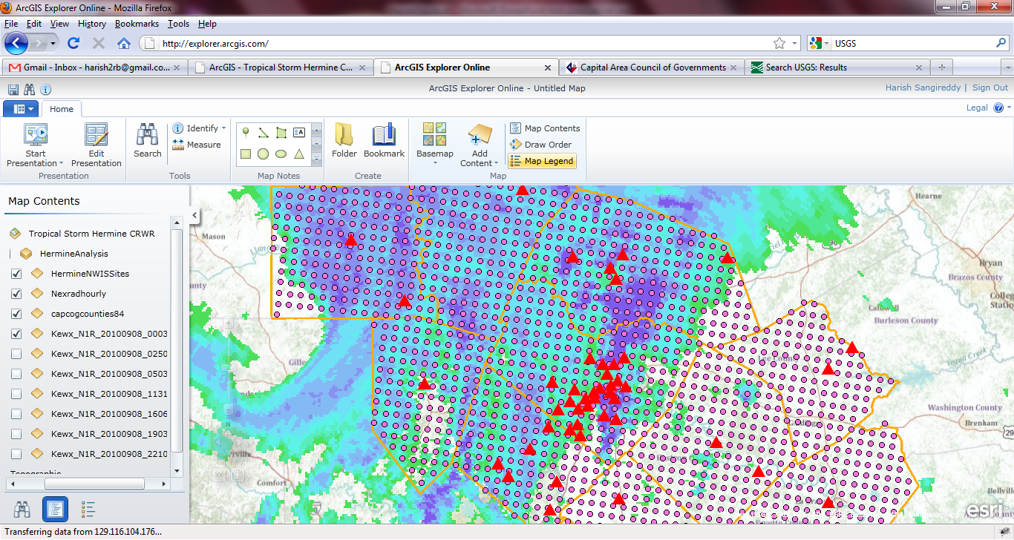

Slide 12
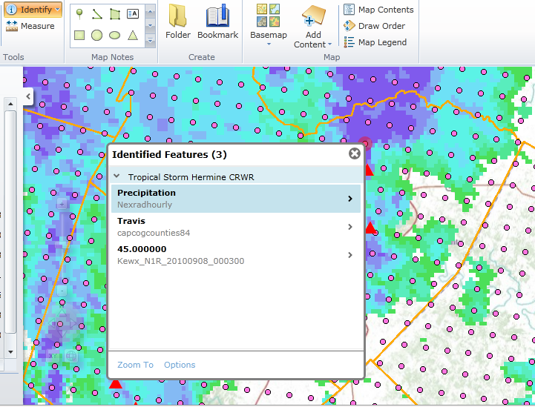
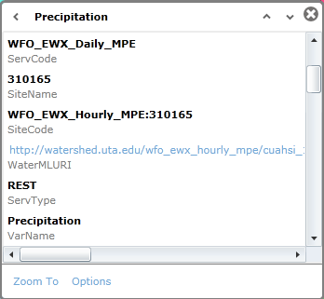

Slide 13
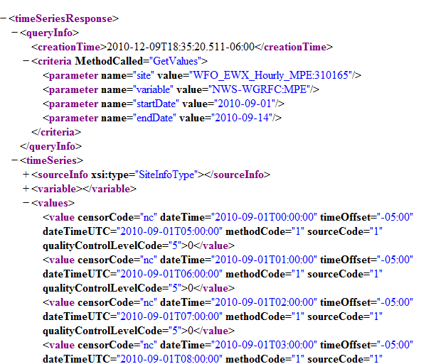
The time series response
http://watershed.uta.edu/wfo_ewx_hourly_mpe/cuahsi_1_1.asmx/GetValuesObject?location=WFO_EWX_Hourly_MPE:310165&variable=NWS-WGRFC:MPE&startDate=2010-09-01&endDate=2010-09-14&authToken=

Slide 14
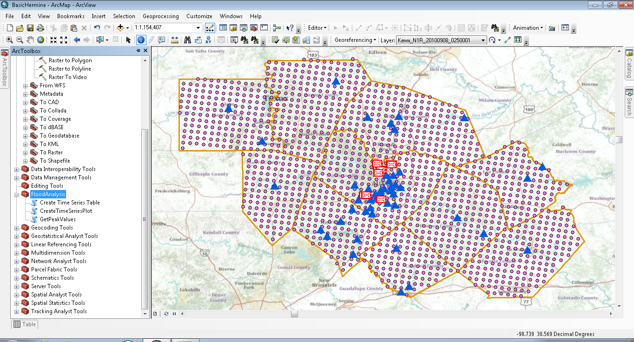
Accessing data from ArcMap
Lets have a live demo on how we can access data within arc view by making REST calls and reading data on the fly.

Slide 15
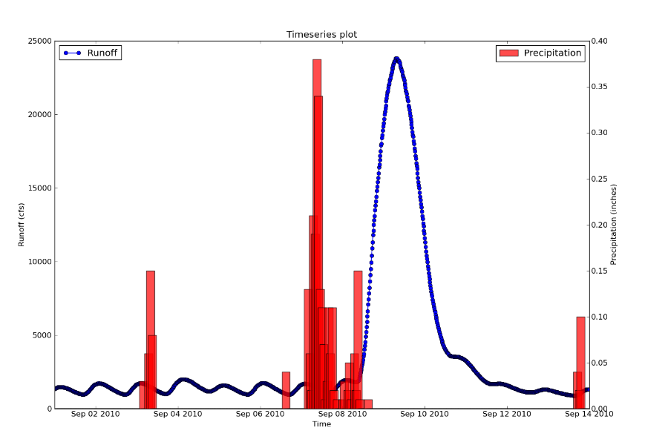
Time series Plot

Slide 16
Conclusions
Making and publishing maps with ArcGIS is a fast process.
We can bring together a variety of data to make better maps increasing our understanding about floods and its spatial variability.
A tool box for various flood analyses methods can be constructed inside ArcMap.
Web services help us to read data directly from servers located at different locations. We can make various analyses by accessing the data on the fly without downloading the actual data.
These web services can be used to create virtual datasets inside Arcmap by using python.
The analysis can be extended by using Rpy a python module for “R” and we can build various mathematical models for dealing with Flood analysis.

Slide 17
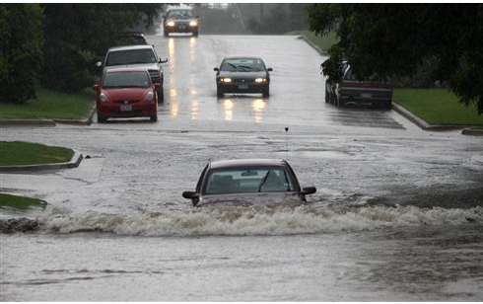
Being brave does not help!

