Slide 1
CE 397 Flood Forecasting
Lecture 3: Review of Concepts and Definitions

Slide 2
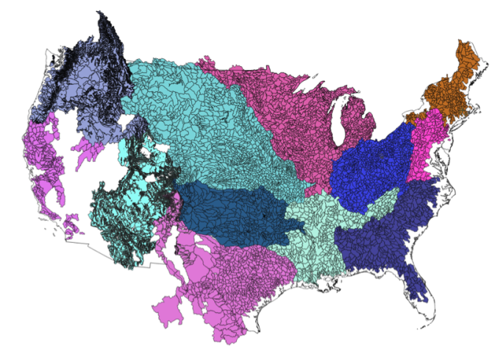


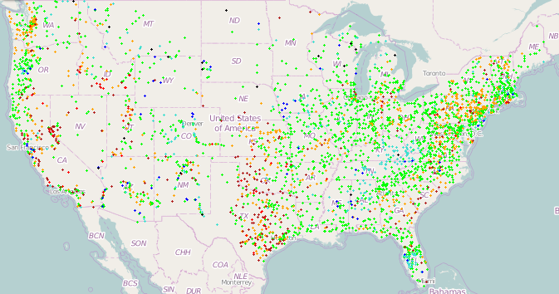
National Water Data Infrastructure for the NFIE
Enhanced geospatial database for a national water data infrastructure
NWS Basins and
Forecast Points
USGS Water Watch
Points
National Flood
Hazard Layer
Feature classes:
Subwatershed
Catchment
Flowline (Medium and High Resolution)
Waterbody
Dam
NFIE-Geo
9 feature classes
5 from NHDPlus
4 from IWRSS
NHDPlus

Slide 3
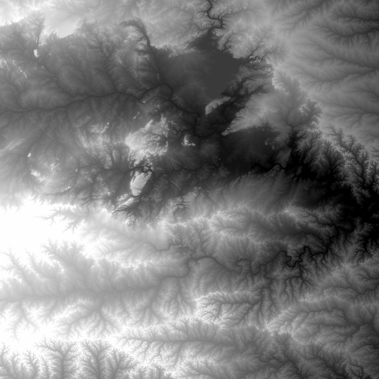
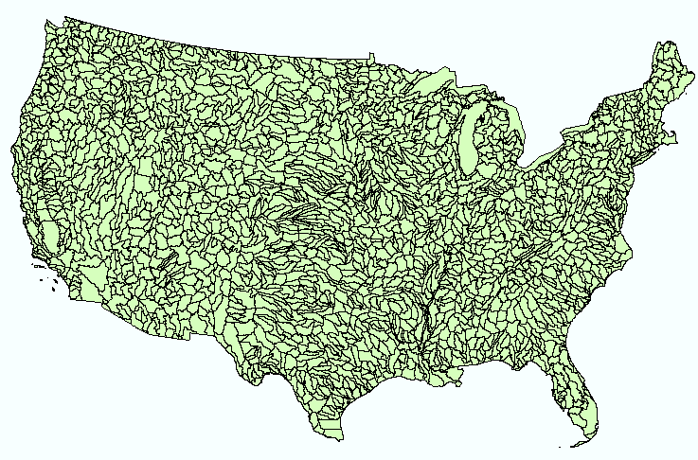
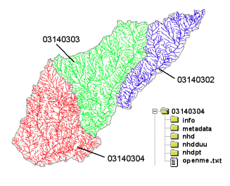
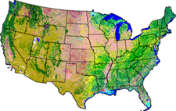
NHDPlus Version 2
Geospatial foundation for a national water data infrastructure
NHDPlus
(built 2004-2014)
National Elevation Dataset
Watershed Boundary Dataset
National Hydrography Dataset
National Land Cover Dataset
2.67 million catchments average area 3 km²,
reach length 2 km

Slide 4
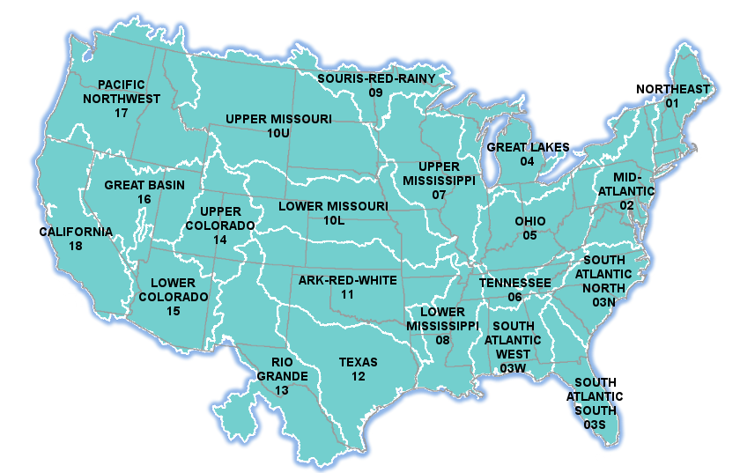

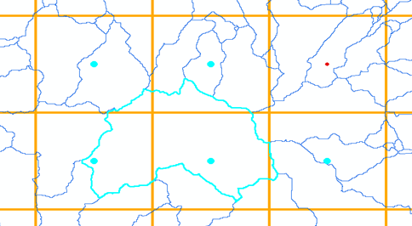
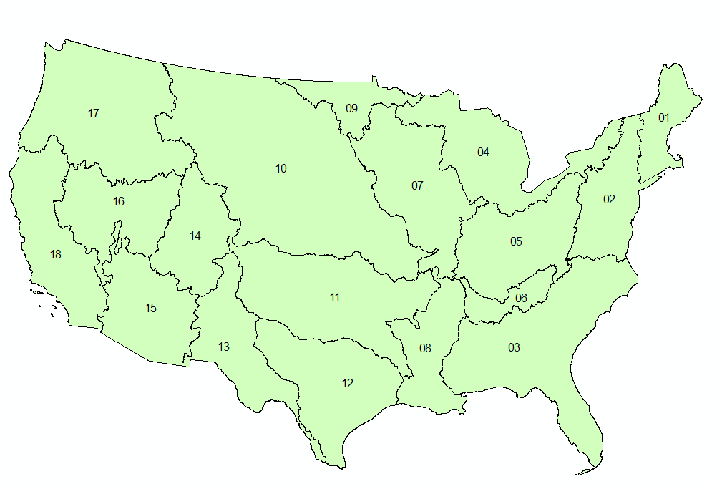
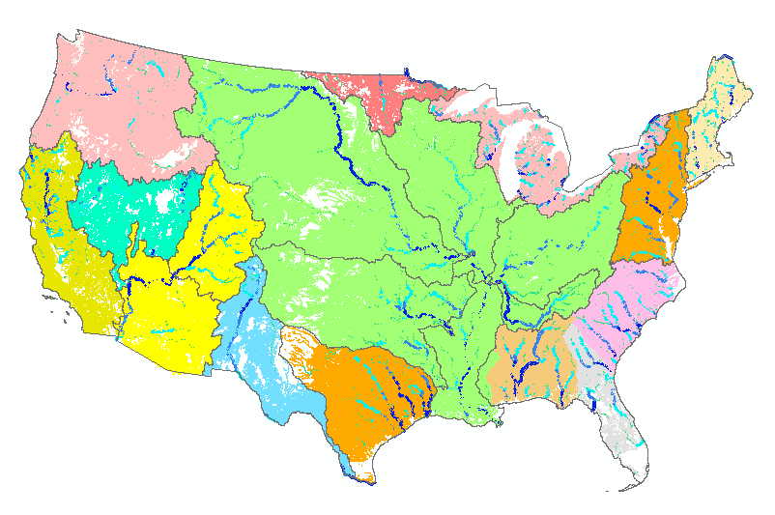
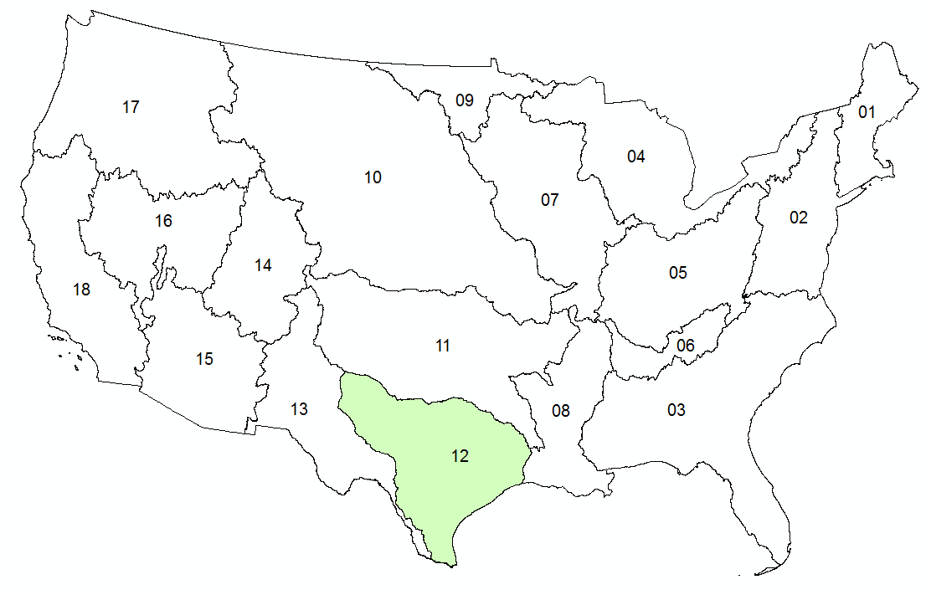


NFIE-Hydro: flow computation over CONUS
14-day historical period, 2.67 million reaches
NWS River Forecasts
WRF-Hydro Model
NHDPlus to
RAPID Conversion
Grid to Catchment Linking
Forecast services
Deltares and
University of Alabama
Pending
NFIE-Hydro
Completed

Slide 5
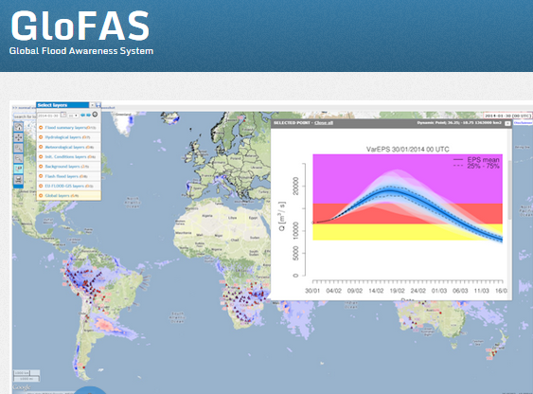
European Center for Medium Range Weather Forecasting and European Joint Research Commission
15 Day ahead forecast ensemble (50 hydrographs) at each location

Slide 6
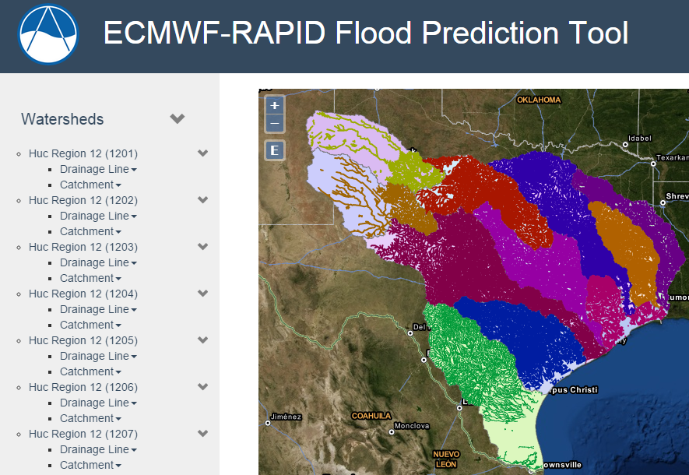
Hydrologic Forecasting for the Texas-Gulf Region
(from Brigham Young University)
(67,313 NHDPlus reaches)
Source: Jim Nelson, Nathan Swain, BYU
http://demo.tethys.ci-water.org/

Slide 7
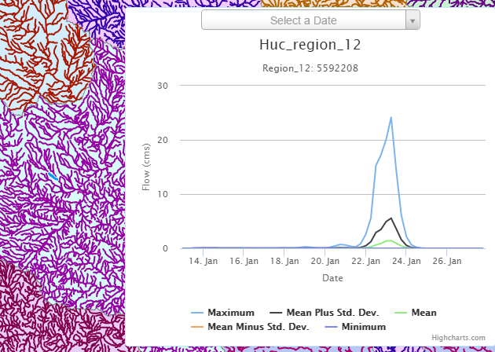
Ensemble Flow Forecast for Reach Catchment 5592208 made on Jan 13, 2015 (15 day horizon)
Weather information source: European Center for Medium Range Weather Forecasting (ECMWF). Summary statistics compiled from 50 forecast hydrographs
Source: Jim Nelson, Alan Snow BYU

Slide 8
North Carolina Floodplain Mapping Program HEC- RAS Models
  5 Recurrence Intervals: 10, 25, 50, 100, 500
  300,000 cross-sections
  Each cross-section has a rating curve
Slide: Ken Ashe, NCFMP

Slide 9
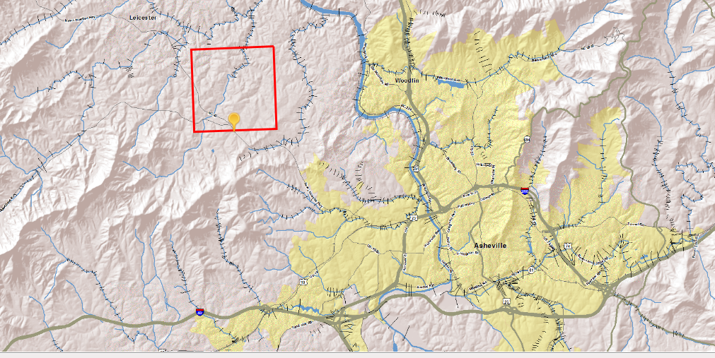
Our cross-sections give the ability to interpolate between gages expanding the real time information from ~200 locations to 10s of thousands to 100s of thousand of locations
Slide: Ken Ashe, NCFMP

Slide 10
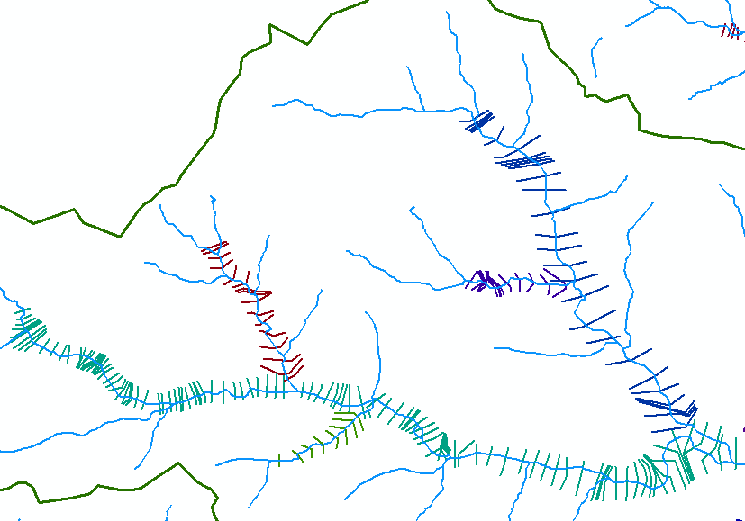
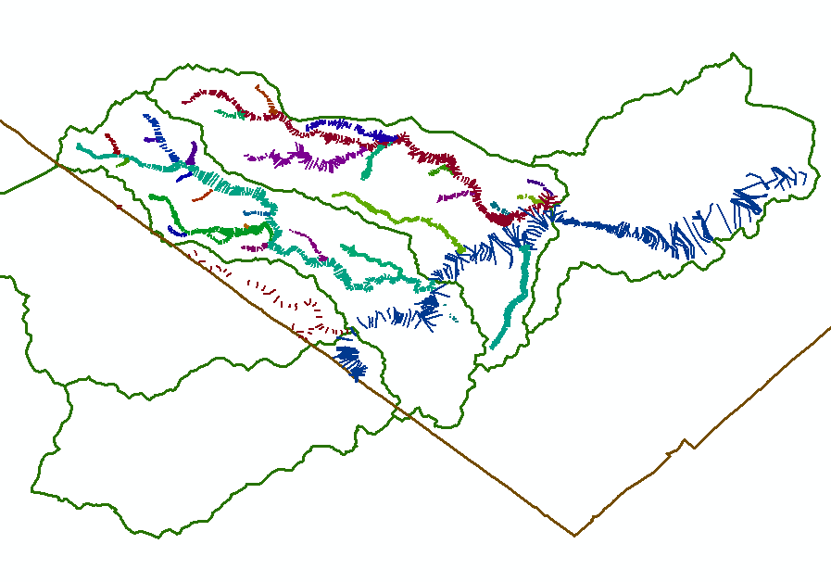
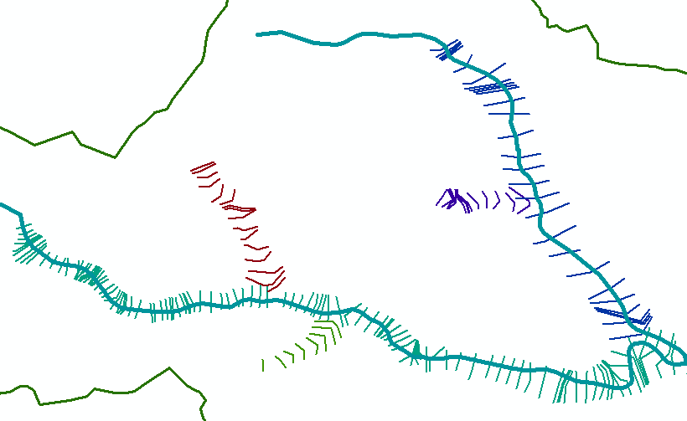
HEC-RAS CrossSections
(from 31 separate models on parts of Onion Creek, Austin, Texas)
Conclusion: We need 24K NHD flow lines to link cross-sections
Some cross-sections are on tributaries not in 100K NHD
24K NHD (High res)
Onion Creek watershed
100K NHD (Med res)
Travis County
Hays County

Slide 11
Conclusion
NFIE is making excellent progress, more rapidly than I anticipated when I proposed it last May
Academic engagement of other universities is growing
NFIE requests from SSWD one more geospatial layer: a national coverage of high resolution NHD Flowlines
  NFIE-Hydro is supported by Medium Res NHDPlus nationally
  NFIE-River is supported by High Res NHD locally

Slide 12
NFIE Conceptual Framework (modified)
NWDI: National water data infrastructure for hydrology
NFIE-Response: Wide area planning for flood emergency response
NFIE-Hydro: National high spatial resolution hydrologic forecasting
NFIE-River: River channel information and real-time flood inundation mapping
NFIE-Geo: Geospatial database for local application of NFIE
NFIE-Services : Web services for flood information

Slide 13
NFIE Conceptual Framework (modified)
National High Spatial
Resolution Hydrology
NWDI: National water data infrastructure for hydrology
NFIE-Response: Wide area planning for flood emergency response
NFIE-Hydro: National high spatial resolution hydrologic forecasting
NFIE-River: River channel information and real-time flood inundation mapping
NFIE-Geo: Geospatial database for local application of NFIE
NFIE-Services : Web services for flood information

Slide 14
NFIE Conceptual Framework (modified)
Local, Regional River Hydraulics
and Flood Response Planning
NWDI: National water data infrastructure for hydrology
NFIE-Response: Wide area planning for flood emergency response
NFIE-Hydro: National high spatial resolution hydrologic forecasting
NFIE-River: River channel information and real-time flood inundation mapping
NFIE-Geo: Geospatial database for local application of NFIE
NFIE-Services : Web services for flood information

Slide 15
NFIE Goal
Connect “National” flood forecasting with “local” flood emergency response
National Water Data Infrastructure
National
Weather and Hydrology
NFIE-Hydro
NFIE-Geo
Local and regional GIS information
River Hydraulics and flood emergency response
Local
NFIE-River and Response

Slide 16
National Water Data Infrastructure for the NFIE
Enhanced geospatial database for a national water data infrastructure
NWS Basins and
Forecast Points
USGS Water Watch
Points
National Flood
Hazard Layer
Feature classes:
Subwatershed
Catchment
Flowline (Medium and High Resolution)
Waterbody
Dam
NFIE-Geo
9 feature classes
5 from NHDPlus
4 from IWRSS
NHDPlus

Slide 17
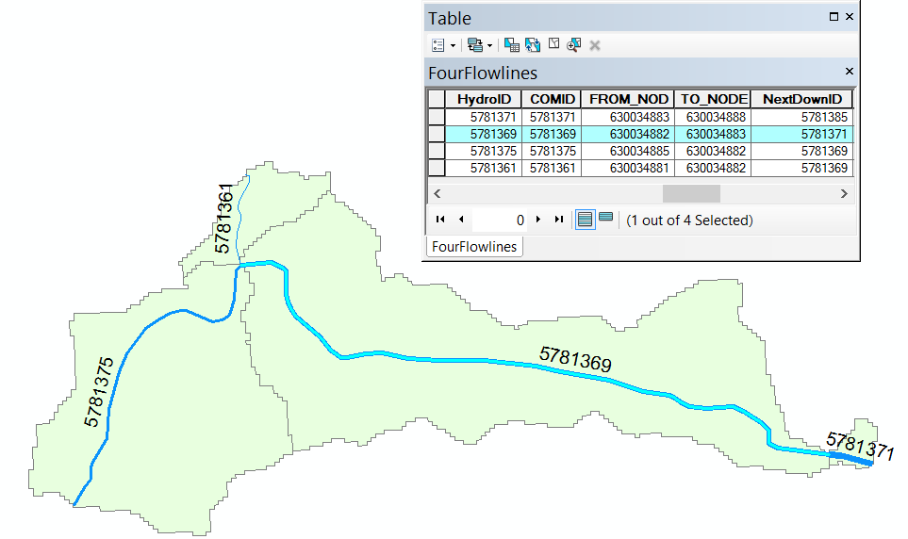
Reach Connectivity (100K NHD)
All flowlines have a From_Node and a To_Node in the downhill flow direction
These node numbers are attributes of the flowline and not actual points in the database
81
82
83
All node numbers are preceded by 6300348
So Node 81 is actually 630034881
88
85

Slide 18
Line-Node Topology
B
3
1
Converging reaches
D
A
Diverging reaches
2
4
C
Line | FromNode | ToNode
1 | A | B
2 | A | C
3 | B | D
4 | C | D
Flow Direction

Slide 19
Line-Node Topology for a loop
1
A
B
This means that there is a flow split
Each reach has its own local reach catchment
2
Line | FromNode | ToNode
1 | A | B
2 | A | B
Flow Direction

Slide 20
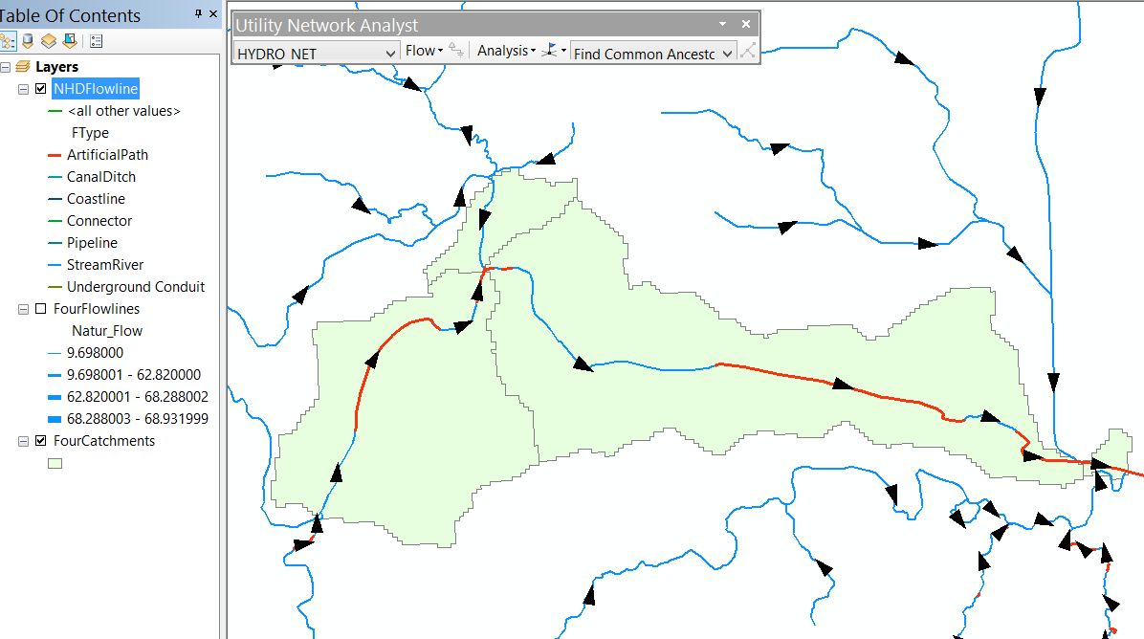
24K National Hydrography Dataset – Connectivity by geometric network
Feature Types
Geometric network
No FromNode and ToNode as attributes on the lines
No catchment associated with each individual line

Slide 21
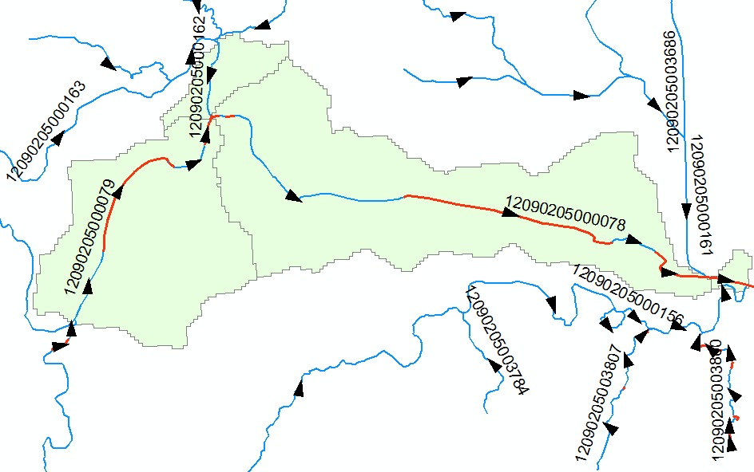
In 24K NHD, each reach is made up of “features” Indexed by a “ReachCode”
ReachCode 12090205000078 means that this is segment 78 in HUC8 Subbasin 12090205

