Slide 1
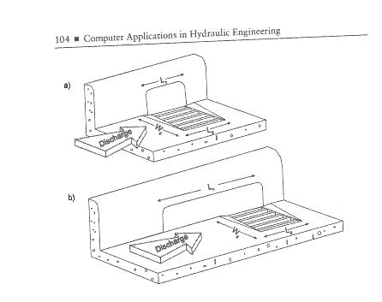
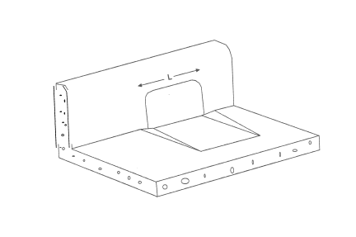
Curb Inlets
Inlet with Depression
Combination Inlet
Haested Methods Water Solutions “Computer Applications in Hydraulic Engineering, 8th Edition, Figure 3-3, 3-5

Slide 2
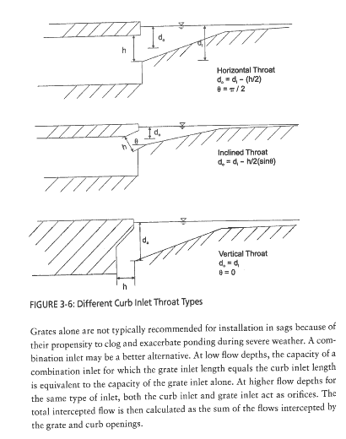
Inlet Throats

