Slide 1
Design for Water Quality
CE 365K Hydraulic Engineering Design Spring 2015
David R. Maidment

Slide 2
Water Quality

Slide 3
Background of Clean Water Act
1972 Clean Water Act prohibits any discharge of pollutants without NPDES permit - (fishable and swimmable)
1987 Clean Water Act amended to require NPDES permits for stormwater discharges
Permits require implementation of Best Management Practices (BMPs) to reduce pollutant discharges to “Maximum Extent Practicable”

Slide 4
Location of Impaired Waters

Slide 5
What can we do about water quality?
Water quality enhancement structures
Sand filters, wet ponds
Screening inlets to storm sewers
Low Impact Development
Total maximum daily load (TMDL)
Comes from Clean Water Act
Pollution load that a water body can accept and still maintain its beneficial uses (aquatic life support, recreation, water supply)

Slide 6
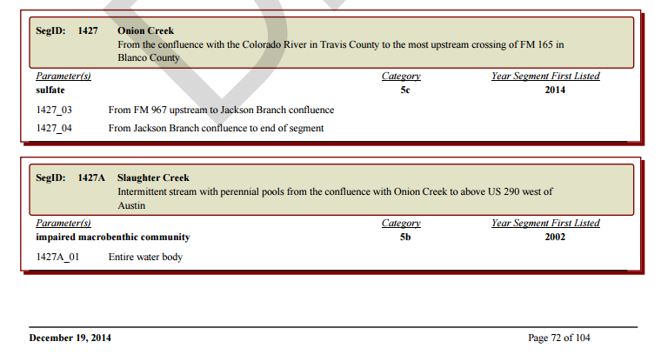
Water Body Impairments on the 303(d) list for Austin area
https://www.tceq.texas.gov/assets/public/waterquality/swqm/assess/14txir/2014_303d.pdf

Slide 7
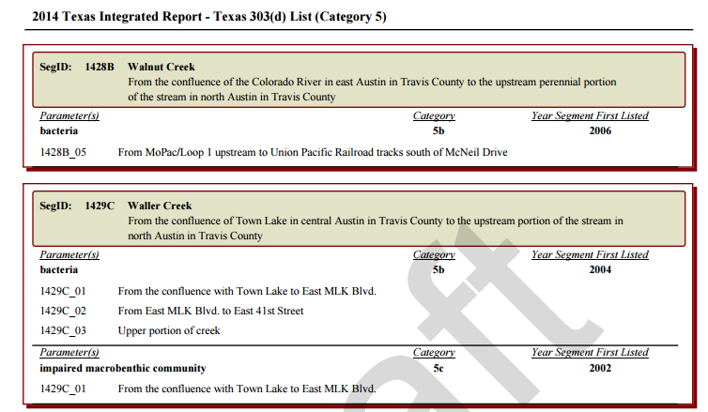
Water Body Impairments on the 303(d) list for Austin area
https://www.tceq.texas.gov/assets/public/waterquality/swqm/assess/14txir/2014_303d.pdf

Slide 8
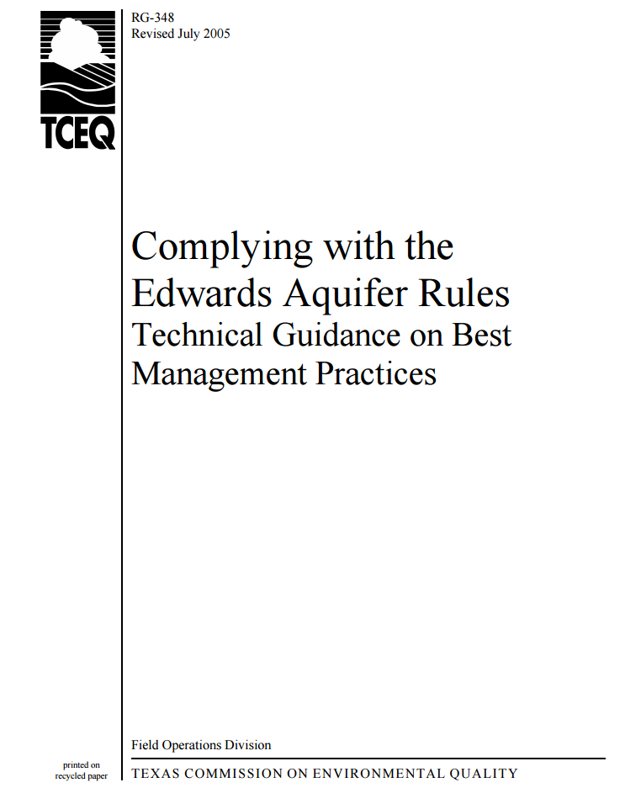
Sediment control over Edwards Aquifer
Edwards Aquifer rules are part of the water quality standards in Title 30 of the Texas Administrative Code and are set out by TCEQ to help protect water quality in the Edwards Aquifer
Chapter 3 has design guidance
http://www.tceq.state.tx.us/publications/rg/rg-348/rg-348.html

Slide 9
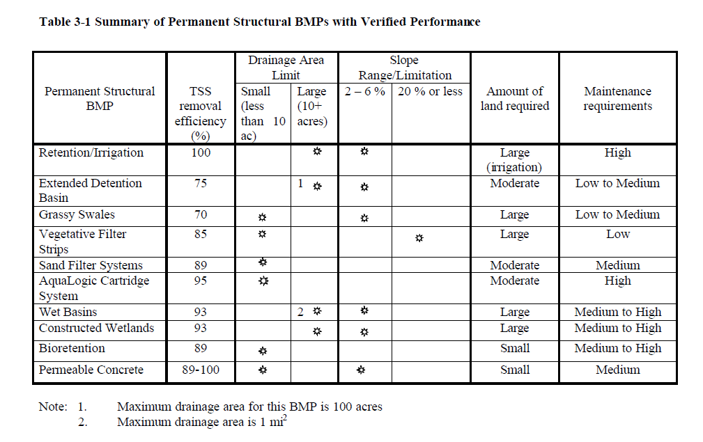
Best Management Practices for Sediment Control

Slide 10
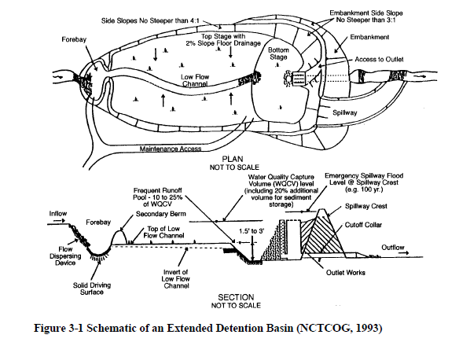
Extended Detention Basin

Slide 11
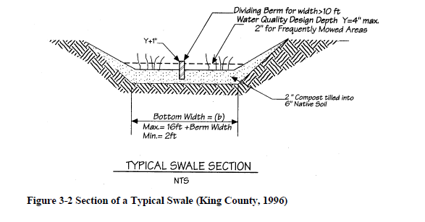
Grassy Swale

Slide 12
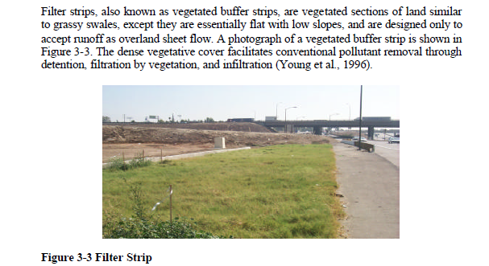
Vegetative Filter Strips

Slide 13
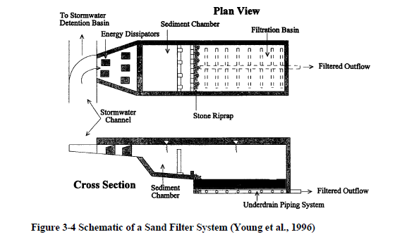
Sand Filters

Slide 14
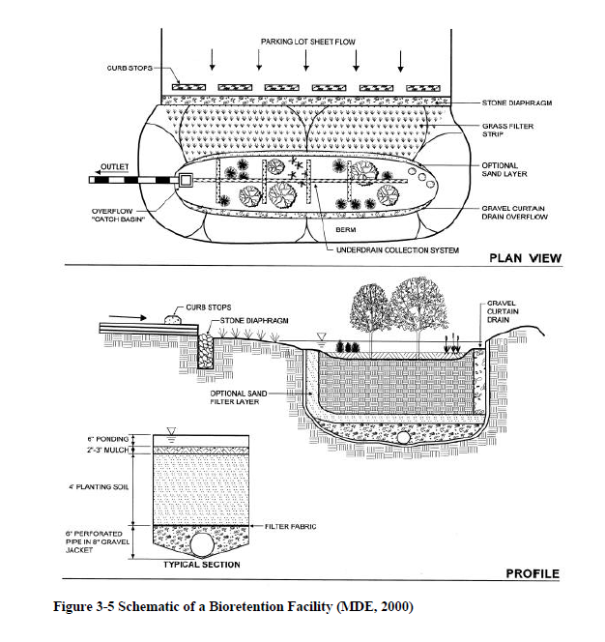
Bioretention

Slide 15
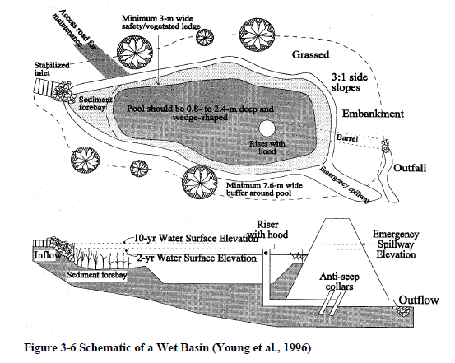
Wet Basin

Slide 16
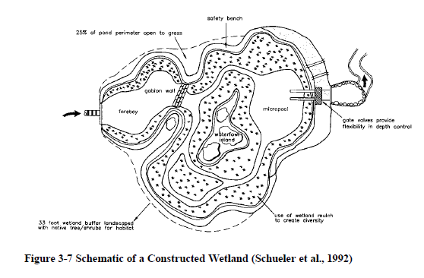
Constructed Wetland

Slide 17
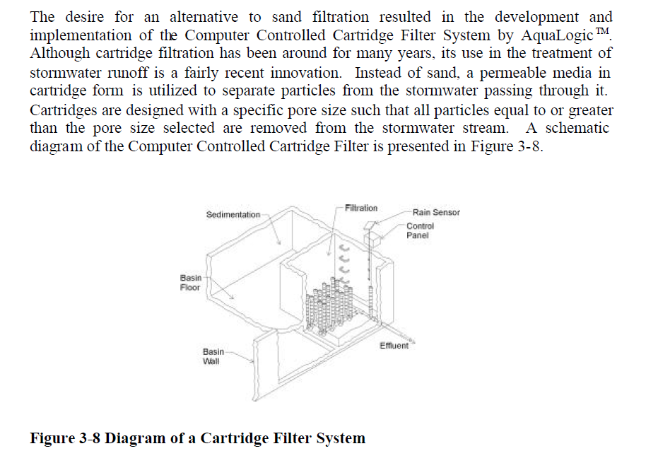
Cartridge Filter System

Slide 18
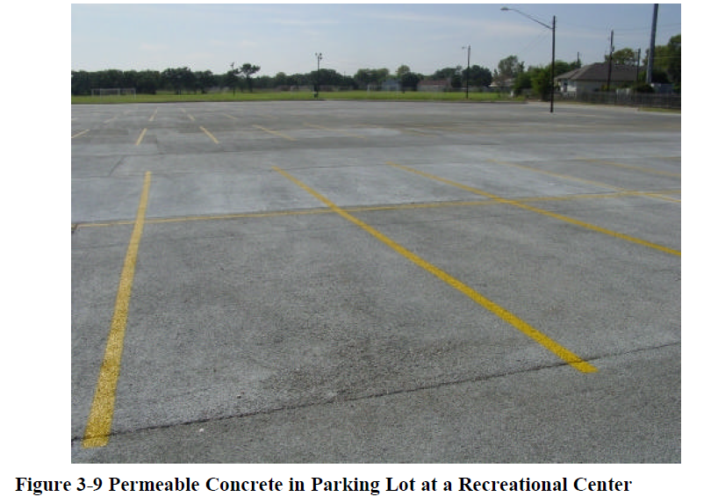
Permeable Pavement

