Slide 1
Open Channel Flow in Pipes
CE 365K Hydraulic Engineering Design
Reading: “Stormwater Conveyance..” Sec 7.1, pp. 218-223

Slide 2
“Modeling Stormwater Sewer Systems using High Resolution Data”
Hydraulic Engineering Design
Carlos Galdeano
Austin, Texas Spring 2014

Slide 3
Introduction and Scope

Slide 4
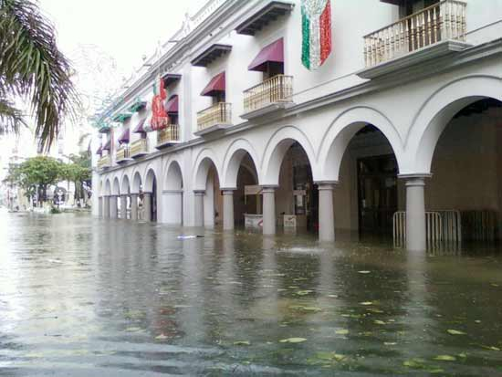
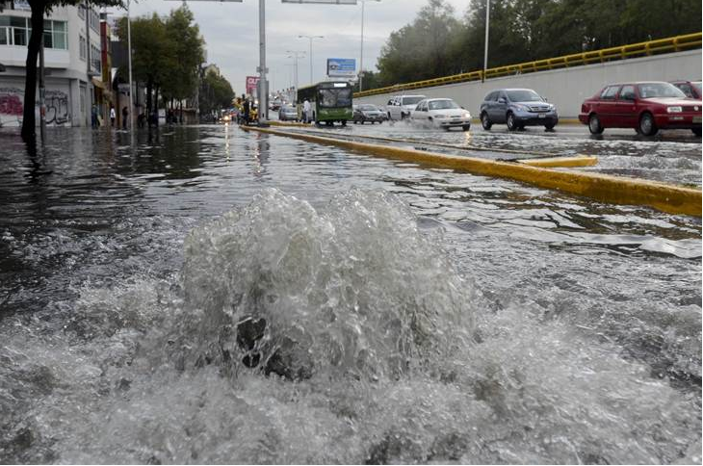
Introduction and Scope
Introduction
More than 54% of the world population lives in urban areas, and this percentage is projected to increase rapidly in future years. This growth significantly affects the hydrological cycle, which translates into social and economic costs due to urban flooding

Slide 5
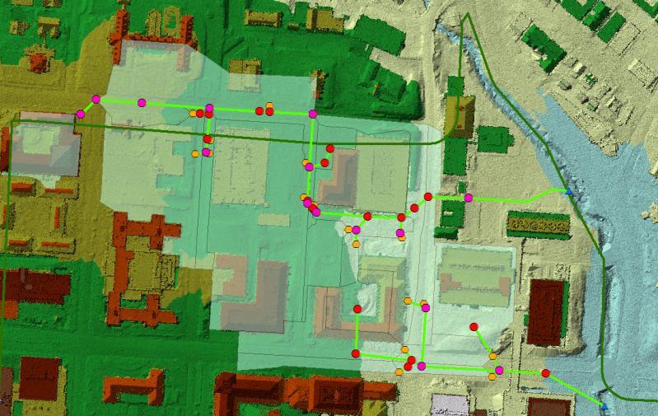
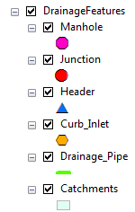
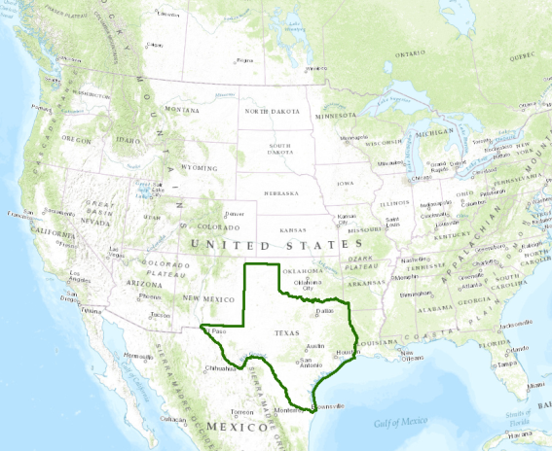
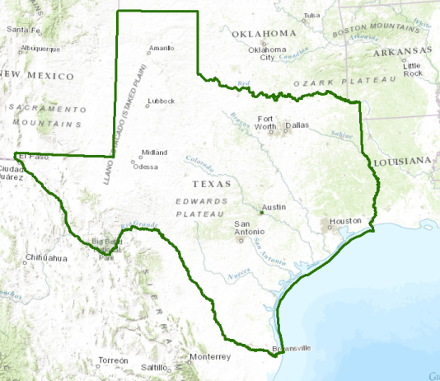
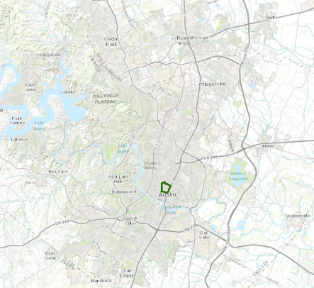
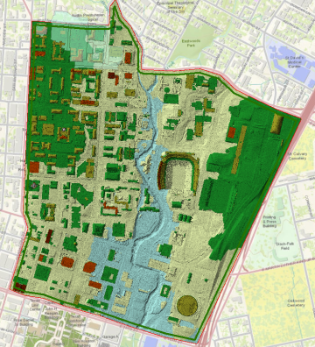
Introduction and Scope
Scope
The main scope is to develop a procedure to evaluate the current storm water infrastructure using Airborne LiDAR data. Airborne LiDAR data provides the elevation data necessary to characterize the elements involved in the storm water system.
The stormwater sewer system in northwest area of The University of Texas at Austin main campus is the region analyzed in this project.

Slide 6
Methodology

Slide 7
Methodology
General Methodology
Airborne LiDAR Data
Create LAS Dataset
Point File Toolbox
LAS to Multipoint
Create a TIN
Inputs
ArcMap
StormCAD
CAD files of Stormwater Sewer Systems
Results
Import CAD Files to ArcMap
Create the Feature Classes of the stormwater sewer system
Digitize the stormwater sewer system’s elements
Characterize the elements of the system
Invert Elevation
Ratio of Flow to the Total Capacity at pipeline
Austin’s
IDF Table
Import characterized elements to StormCAD
Add Gutters
Define Headloss coefficient
Run Model
StormCAD Catalog Conduit

Slide 8
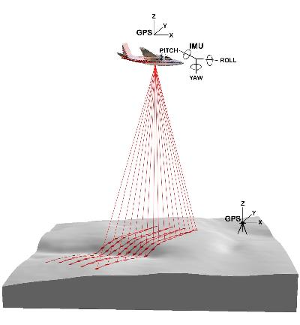
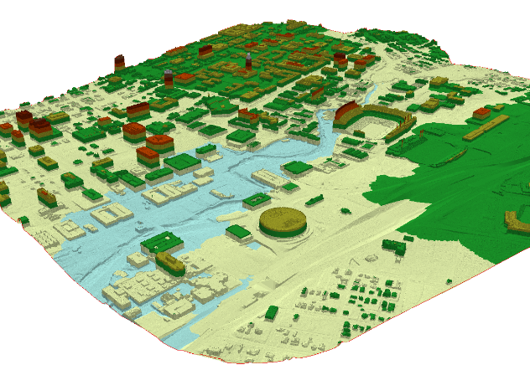
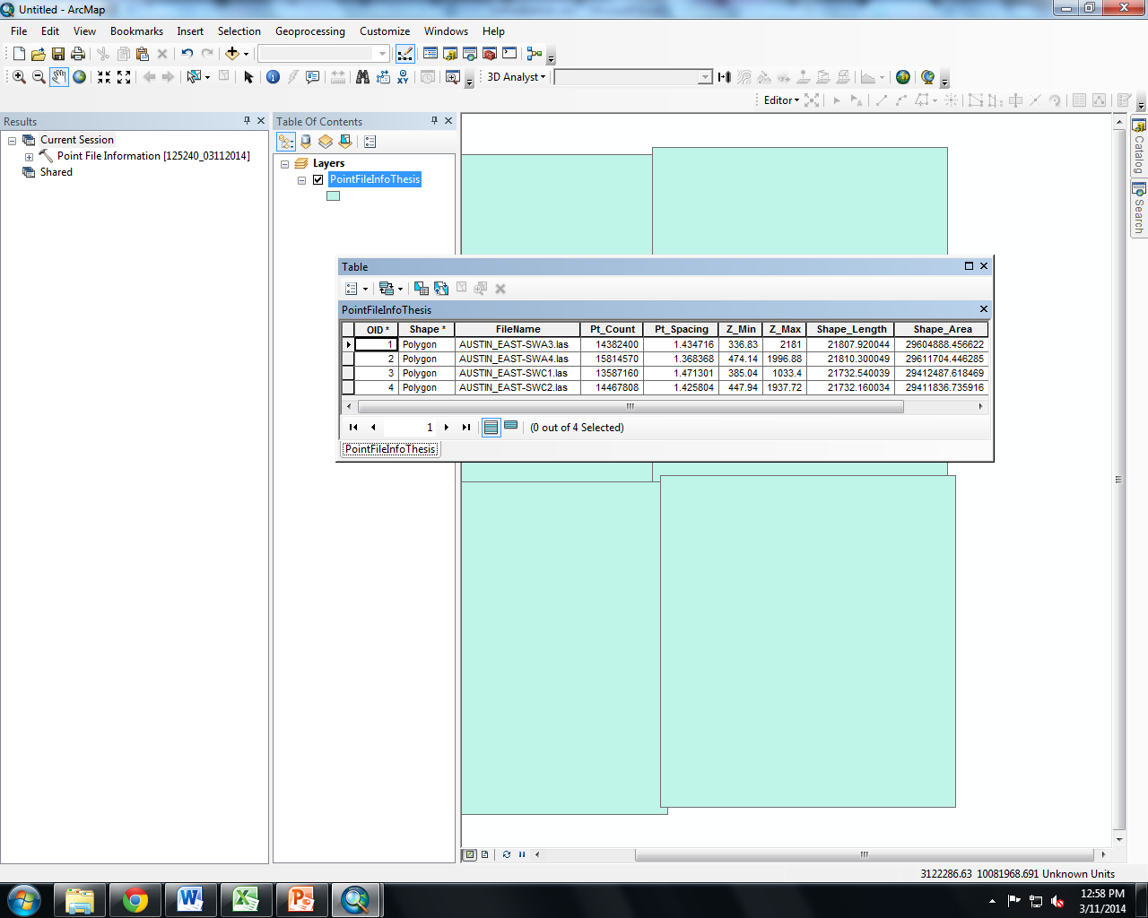
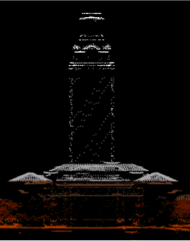
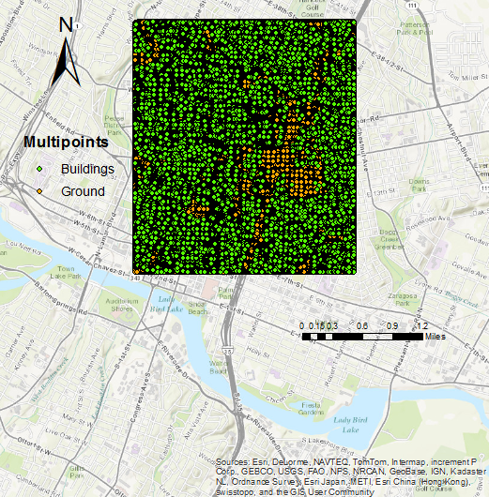
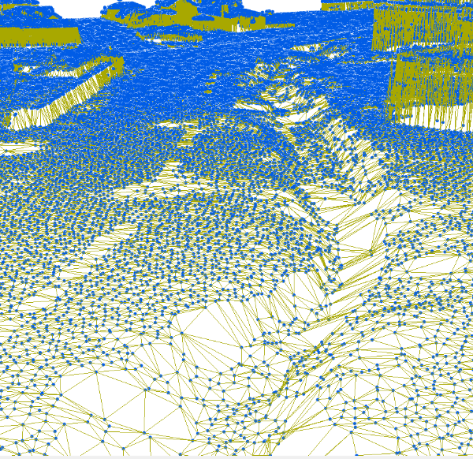
Methodology
TIN Methodology
Airborne LiDAR Data
Create LAS Dataset
Point File Toolbox
LAS to Multipoint
Create a TIN
Inputs
ArcMap

Slide 9

Methodology
TIN Methodology

Slide 10
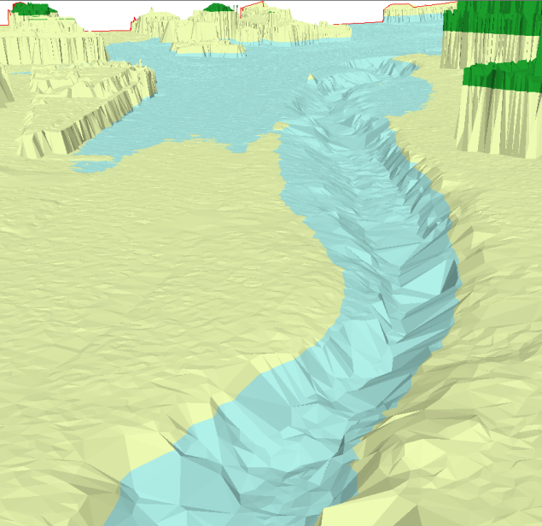
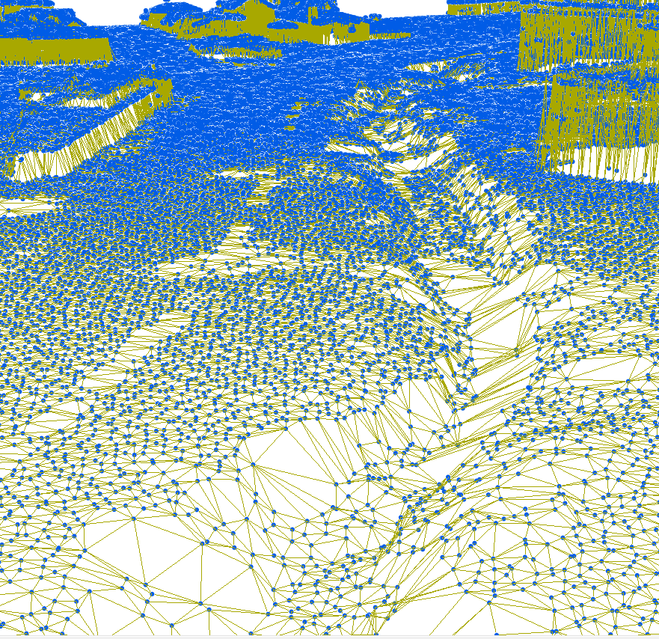
Methodology
TIN Methodology
View of face elevation with graduated color ramp of the TIN
View of nodes and edges that form the TIN

Slide 11
Methodology
Characterizing elements in the stormwater sewer system
Airborne LiDAR Data
Create LAS Dataset
Point File Toolbox
LAS to Multipoint
Create a TIN
Inputs
ArcMap
StormCAD
CAD files of Stormwater Sewer Systems
Results
Import CAD Files to ArcMap
Create the Feature Classes of the stormwater sewer system
Digitize the stormwater sewer system’s elements
Characterize the elements of the system
Invert Elevation
Ratio of Flow to the Total Capacity at pipeline
Austin’s
IDF Table
Import characterized elements to StormCAD
Add Gutters
Define Headloss coefficient
Run Model
StormCAD Catalog Conduit
11

Slide 12
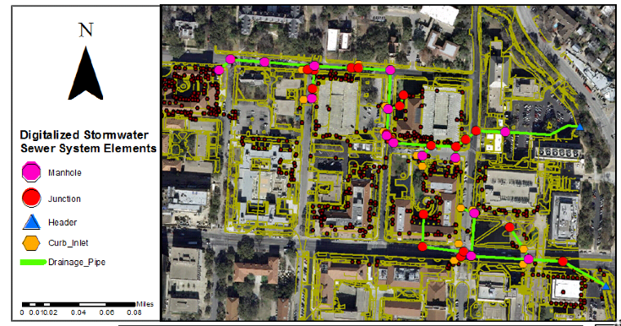
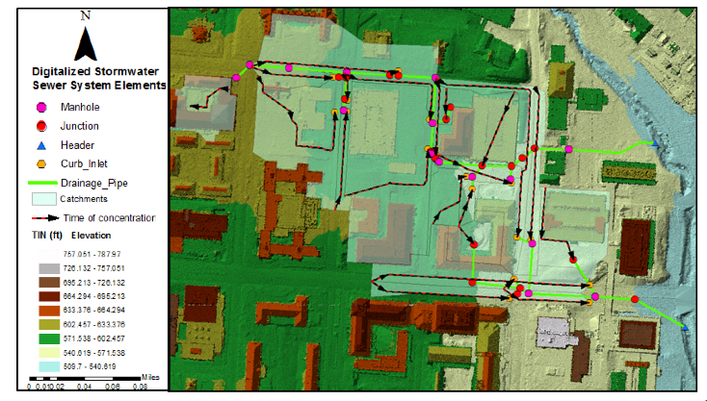
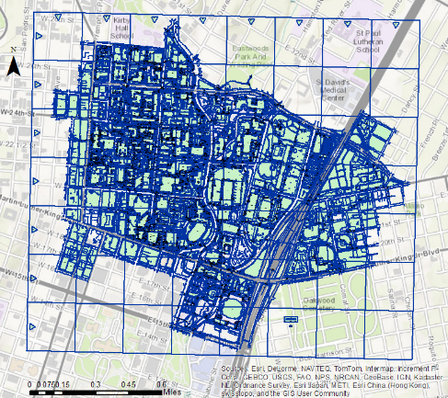
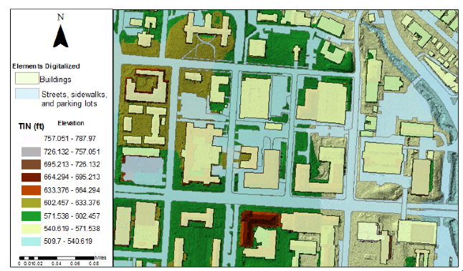
Methodology
Characterizing elements in the stormwater sewer system
Inputs
ArcMap
CAD files of Stormwater Sewer Systems
Import CAD Files to ArcMap
Create the Feature Classes of the stormwater sewer system
Digitize the stormwater sewer system’s elements
Characterize the elements of the system
Invert Elevation

Slide 13
Methodology
Characterizing elements in the stormwater sewer system
Elements’ characteristics of the Stormwater Sewer System
Point feature Classes | Data | Header | Manhole | Junction | Curb Inlet
 | Label | 1000000 | 1010001 | 1020001 | 1030001
 | Elevation (Ground) in ft. | 538.42 | 610.17 | 593.55 | 570.96
 | Elevation (Invert) in ft. | 530.64 | 599.32 | 580.12 | 555.87
Polyline feature Classes | Data | Pipelines
 | Label | 1040001
 | Diameter in inches | 24
 | Conduit Type (Label) | Catalog Conduit
 | Section Type (Label) | Circle
 | Section Size (Catalog Conduit) (Label) | 24 inch
 | Material | Concrete
Polygon feature Classes | Data | Catchments
 | Label | 1030001
 | Area (User Defined) in acres | 0.426193
 | Time of Concentration in min. | 5
 | Rational C | 0.602657

Slide 14
Methodology
Running Model in StormCAD
Airborne LiDAR Data
Create LAS Dataset
Point File Toolbox
LAS to Multipoint
Create a TIN
Inputs
ArcMap
StormCAD
CAD files of Stormwater Sewer Systems
Results
Import CAD Files to ArcMap
Create the Feature Classes of the stormwater sewer system
Digitize the stormwater sewer system’s elements
Characterize the elements of the system
Invert Elevation
Ratio of Flow to the Total Capacity at pipeline
Austin’s
IDF Table
Import characterized elements to StormCAD
Add Gutters
Define Headloss coefficient
Run Model
StormCAD Catalog Conduit

Slide 15
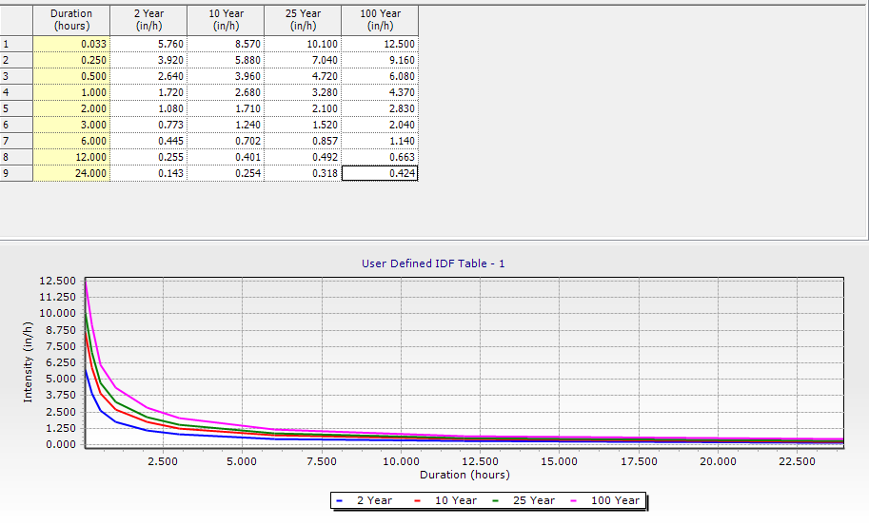
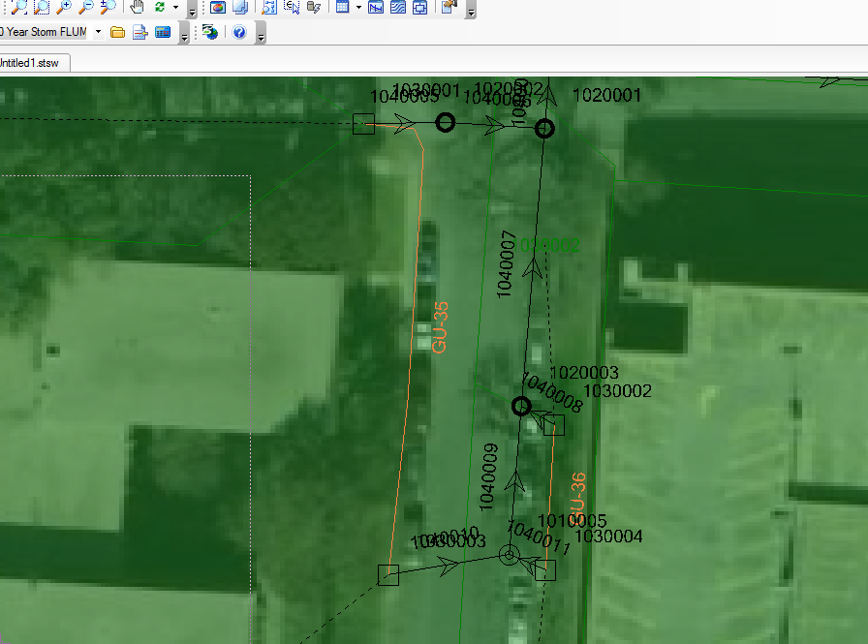
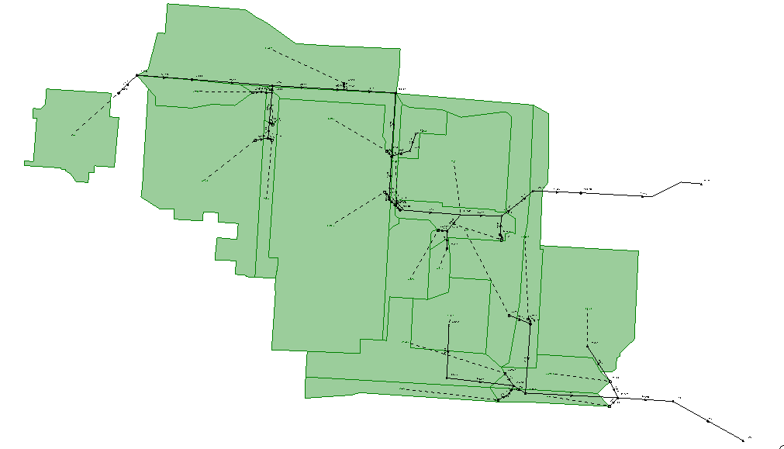
Methodology
Running Model in StormCAD
Inputs
StormCAD
Add gutters for those inlets that are On Grade. Since they don’t capture all the water that flows over them, a gutter has to be drawn to connect the Inlet On Grade to the next Inlet. This will help to indicate where the water that was not captured will end.
Inlets at the end of the line are defined by the standard method with a headloss coefficient of 1.25
Inlets in the middle of the line, manholes, and joints are defined by the HEC-22 Energy method with a flat HEC-22 benching method.
Austin’s
IDF Table
Import characterized elements to StormCAD
Add Gutters
Define Headloss coefficient
Run Model
StormCAD Catalog Conduit

Slide 16
Methodology
Generating Results
Airborne LiDAR Data
Create LAS Dataset
Point File Toolbox
LAS to Multipoint
Create a TIN
Inputs
ArcMap
StormCAD
CAD files of Stormwater Sewer Systems
Results
Import CAD Files to ArcMap
Create the Feature Classes of the stormwater sewer system
Digitize the stormwater sewer system’s elements
Characterize the elements of the system
Invert Elevation
Results and Conclusions
Austin’s
IDF Table
Import characterized elements to StormCAD
Add Gutters
Define Headloss coefficient
Run Model
StormCAD Catalog Conduit

Slide 17
Results and Conclusions

Slide 18
Results
Ratio of Flow to the Total Capacity for each pipeline
Pipeline Label | Ratio of Flow to the Total Capacity (%)
 | 2-yr | 10-yr | 25-yr | 100-yr
1040008 | 0.40% | 0.60% | 0.80% | 1.20%
2040015 | 1.00% | 1.60% | 2.00% | 3.10%
1040011 | 2.20% | 3.60% | 4.50% | 6.00%
1040033 | 1.90% | 3.30% | 4.20% | 6.00%
1040018 | 2.40% | 3.90% | 4.90% | 6.80%
1040020 | 2.40% | 4.00% | 5.10% | 7.10%
1040006 | 2.70% | 4.60% | 5.70% | 7.80%
1040005 | 3.00% | 5.00% | 6.30% | 8.60%
1040014 | 4.80% | 6.60% | 7.50% | 8.90%
2040008 | 4.30% | 7.00% | 8.80% | 11.40%
1040036 | 4.30% | 7.10% | 8.80% | 11.50%
1040022 | 7.70% | 10.00% | 11.20% | 13.00%
2040009 | 5.10% | 8.50% | 10.60% | 13.70%
1040010 | 8.10% | 10.80% | 12.20% | 14.40%
1040032 | 5.50% | 9.20% | 11.40% | 14.70%
1040003 | 5.30% | 9.00% | 11.30% | 15.70%
1040028 | 8.10% | 12.20% | 14.30% | 17.50%
1040019 | 6.60% | 11.20% | 14.10% | 19.70%
2040003 | 8.50% | 14.70% | 17.80% | 22.60%
1040035 | 9.00% | 14.90% | 18.40% | 24.20%
2040010 | 12.60% | 17.80% | 20.40% | 24.40%
1040013 | 11.10% | 16.80% | 20.20% | 25.80%
1040004 | 12.80% | 18.40% | 21.30% | 26.80%
1040023 | 13.30% | 18.60% | 22.00% | 27.40%
1040031 | 10.70% | 16.90% | 21.40% | 28.70%
1040027 | 14.50% | 20.30% | 24.00% | 29.90%
Pipeline Label | Ratio of Flow to the Total Capacity (%)
 | 2-yr | 10-yr | 25-yr | 100-yr
1040009 | 16.10% | 22.40% | 25.80% | 31.40%
1040017 | 14.70% | 21.10% | 25.20% | 31.80%
1040021 | 14.70% | 21.50% | 25.90% | 33.10%
1040037 | 15.60% | 22.70% | 27.40% | 35.10%
2040014 | 11.90% | 21.20% | 26.70% | 36.30%
2040006 | 12.90% | 21.60% | 27.10% | 37.40%
1040024 | 18.30% | 25.60% | 30.30% | 37.70%
1040012 | 16.50% | 24.80% | 29.80% | 38.60%
1040007 | 20.30% | 28.50% | 33.00% | 40.60%
2040017 | 15.80% | 25.90% | 31.10% | 41.20%
2040004 | 24.00% | 33.30% | 37.90% | 45.20%
1040001 | 15.60% | 26.20% | 32.80% | 45.50%
2040012 | 20.60% | 31.70% | 37.00% | 47.40%
1040040 | 22.30% | 32.40% | 39.10% | 50.10%
2040013 | 17.80% | 29.40% | 36.80% | 50.50%
1040030 | 24.90% | 35.10% | 41.50% | 51.70%
1040029 | 25.00% | 35.30% | 41.70% | 51.80%
1040016 | 25.20% | 36.90% | 43.70% | 54.80%
2040007 | 19.00% | 31.80% | 39.90% | 55.30%
1040002 | 20.30% | 34.00% | 42.70% | 58.90%
2040005 | 27.80% | 42.50% | 49.80% | 61.10%
1040039 | 27.50% | 40.00% | 48.20% | 62.00%
1040038 | 28.70% | 41.70% | 50.20% | 64.40%
1040034 | 29.60% | 42.40% | 51.00% | 65.00%
2040011 | 33.80% | 52.20% | 61.40% | 80.10%
2040016 | 32.70% | 52.90% | 63.50% | 83.70%

Slide 19
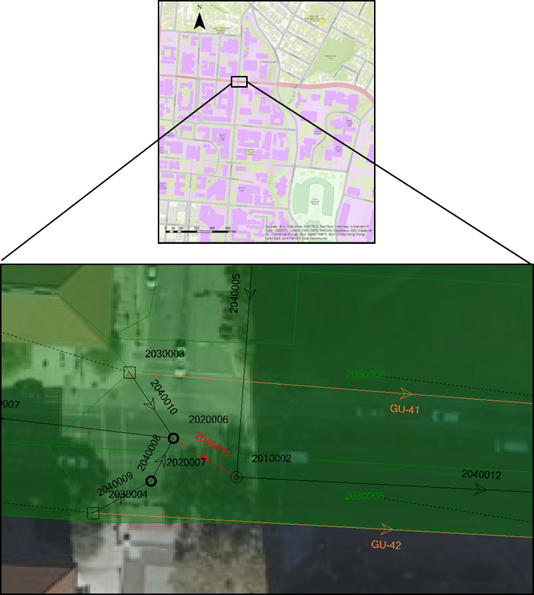
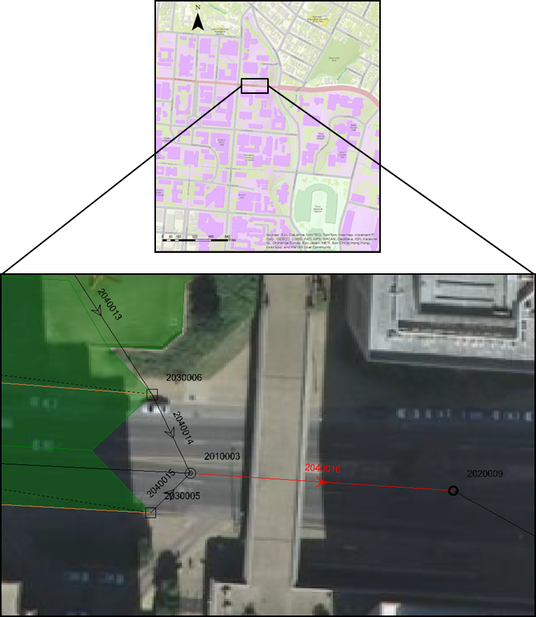
Results
Location of Max Values
Pipeline at intersection of Dean Keaton and Speedway
Pipeline at intersection of Dean Keaton and footbridge
Max value 2-yr storm event = 33.80%
Max value for:
10-yr storm event = 52.90%
25-yr storm event = 63.50%
100-yr storm event = 83.70%

Slide 20
Acknowledgments
CONACyT
Dr. David Maidment
Gonzalo, Denny, Amanda, and Georges
The EWRE faculty and students
Watershed Protection and Development Review Department of The City of Austin

Slide 21
Questions?

