Slide 1
Design Project Scope
CE 365K Hydraulic Engineering Design 6 March 2014

Slide 2
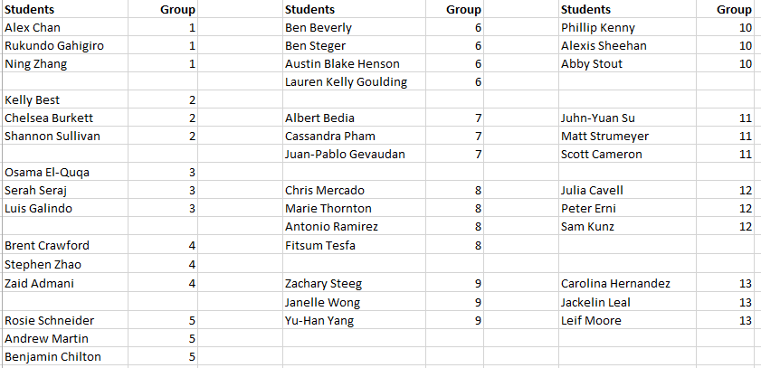
Project Groups

Slide 3
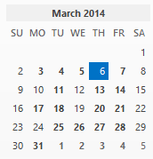
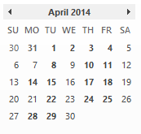
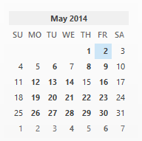
Key Dates
Proposal due: March 20
Second Quiz: April 17
Oral Presentations: April 24, April 29, May 1, (15 mins each including critique)
Written Project Report: May 2

Slide 4
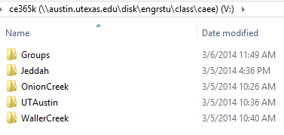
Project Data
\\austin.utexas.edu\disk\engrstu\class\caee\ce365k\

Slide 5
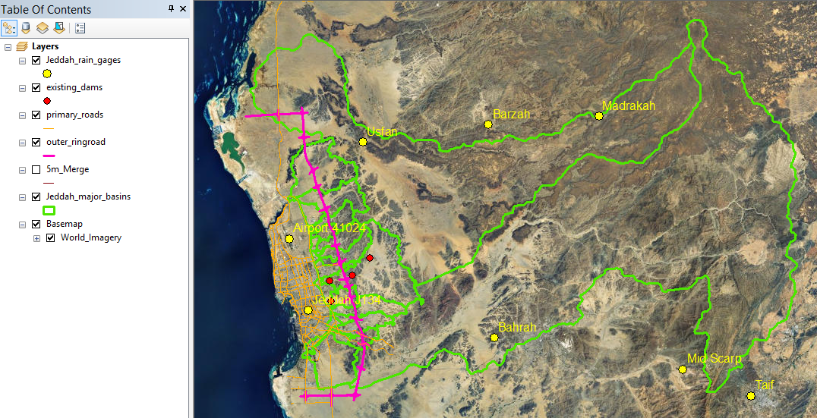
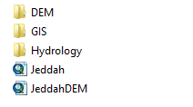
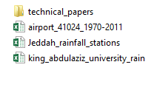
Data for Jeddah

Slide 6
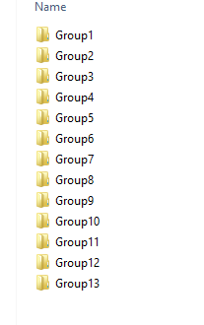
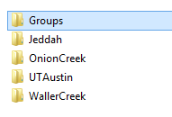
Group Data Workspaces
Group members access their own folder

Slide 7
Follow the HydroDesign Process
How should the study area be described?
How does the study area operate?
Is the current study area working well?
How might the study area be altered?
What differences would the changes cause?
How should the study area be changed?
Representation (database1)
Process
Evaluation
Change
Impact
Decision (database2)
Structure your reports (oral and written) using this framework

Slide 8
Project Focal Areas
Your project needs a professional mentor
I will provide these for the project focal areas in which I provide data (UTAustin, Waller Creek, Jeddah)
Several groups can work on same focal area with different goals in mind
If you want to work on some other focal area, you have to generate your own data and mentor

Slide 9
Anticipated Outputs
An initial and final GIS database that describe how the area looks now, and how it will look when your plan is implemented
A dimensioned design with CAD drawings for at least one key element of your project
A simulation model to show impact on hydraulic function of area of your plan (HEC-HMS, HEC-RAS, StormCAD, …)

Slide 10
Project Proposal (March 20)
What are the objectives and scope of your project?
What project data are needed?
What simulation model(s) do you plan to use?
What do you anticipate will be your key project element?
Who is going to do what within your group?
Proposal is 1-page typed, submitted as a pdf file
I will comment on it and return to the group

Slide 11
Project Assessment
The projects will be assessed using three criteria
Creativity – is it original, innovative?
Competence – is it properly engineered?
Presentation – is the report well presented?
The credit will be ¼ from the oral presentation and ¾ from the written presentation and the underlying data developed to support it

