Slide 1

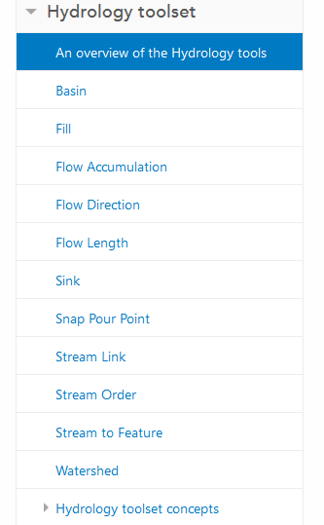
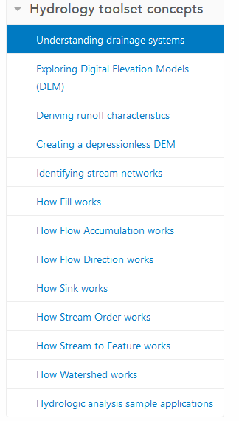
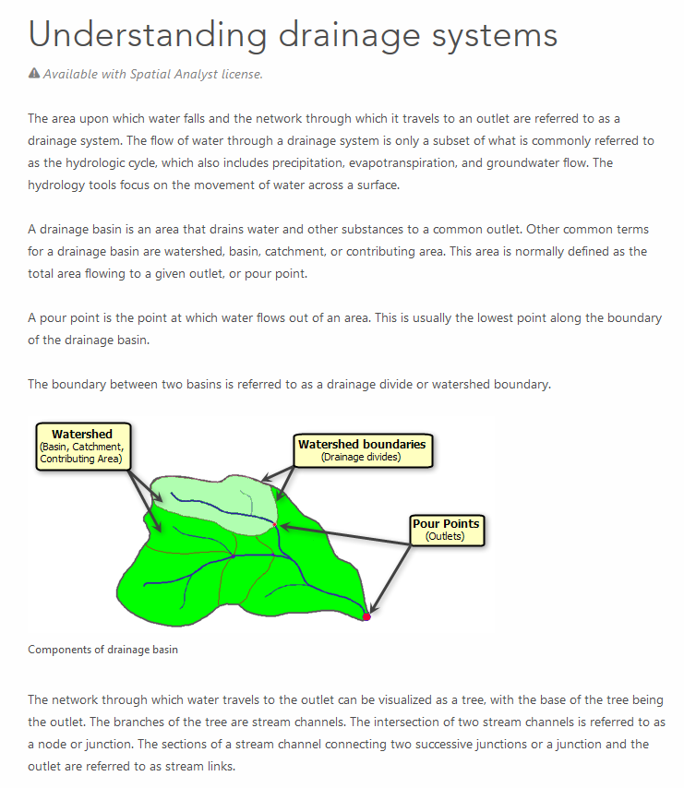
Digital Elevation Model Based Watershed and Stream Network Delineation
Reading
https://pro.arcgis.com/en/pro-app/tool-reference/spatial-analyst/an-overview-of-the-hydrology-tools.htm
How to use
Understanding

Slide 2
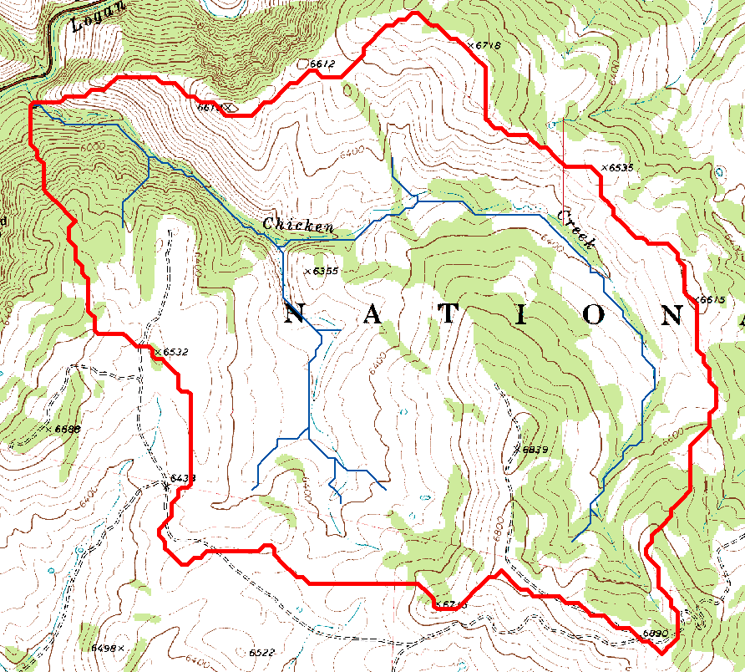
Topography defines watersheds which are fundamentally the most basic hydrologic landscape elements.

Slide 3
Learning Objectives
To be able to delineate watersheds as the basic hydrologic model elements from Digital Elevation Models using Geographic Information Systems tools and to use this information in Hydrologic Analyses
Explain the basic concepts involved in the terrain flow information model
Identify and fill sinks in a small digital elevation model
Calculate hydrologic slope in the direction of steepest descent and the eight direction pour point model flow direction
Calculate flow accumulation as the number of grid cells draining into a grid cell
Identify a stream network raster based on grid cells exceeding a flow accumulation threshold
Describe the sequence of steps involved in mapping stream networks, catchments and watersheds in preparation for learning how to actually do this in the next exercise

Slide 4
Outline
DEM Pit removal
Flow direction field derivation
Flow Accumulation
Channels and Watersheds
Raster to Vector Connection
Using vector stream information
DEM Conditioning
Hydrologic Terrain Analysis Software

Slide 5
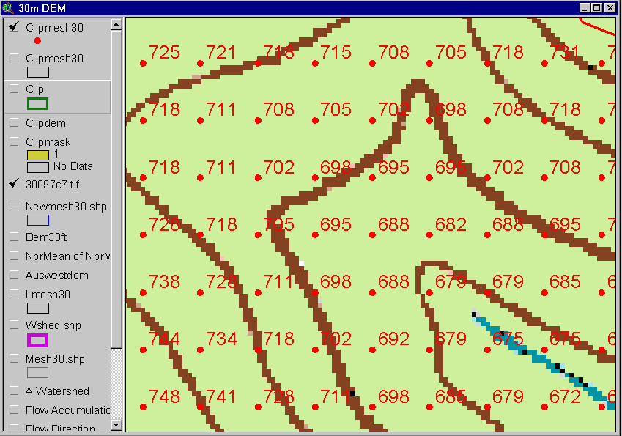
The starting point: a grid digital elevation model (DEM)
720
720
Contours
740
720
700
680
740
720
700
680

Slide 6




The terrain flow information model for deriving channels, watersheds, and flow related terrain information.
Raw DEM
Pit Removal (Filling)
Channels, Watersheds, Flow Related Terrain Information
Flow Field
Watersheds are the most basic hydrologic landscape elements
Notes:
This slide shows the general model for deriving flow field related derivative surfaces from digital elevation data. The input is a raw digital elevation model, generally elevation values on a grid. This is basic information used to derive further hydrology related spatial fields that enrich the information content of this basic data. The first step is to remove sinks, either by filling, or carving. Then a flow field is defined. This enables the calculation of flow related terrain information. My focus has been on flow related information working within this framework. I try to leave other GIS functionality, like radiation exposure, line of sight analyses and visualization to others. I have distributed my software in ways that it easily plugs in to mainstream systems, such as ArcGIS to enhance ease of use.

Slide 7
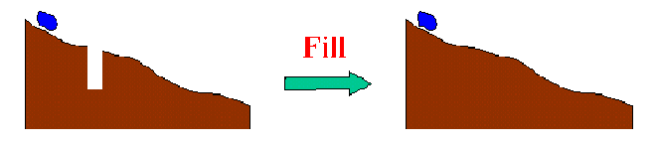
The Pit Removal Problem
DEM creation results in artificial pits in the landscape
A pit is a set of one or more cells which has no downstream cells around it
Unless these pits are removed they become sinks and isolate portions of the watershed
Pit removal is first thing done with a DEM

Slide 8
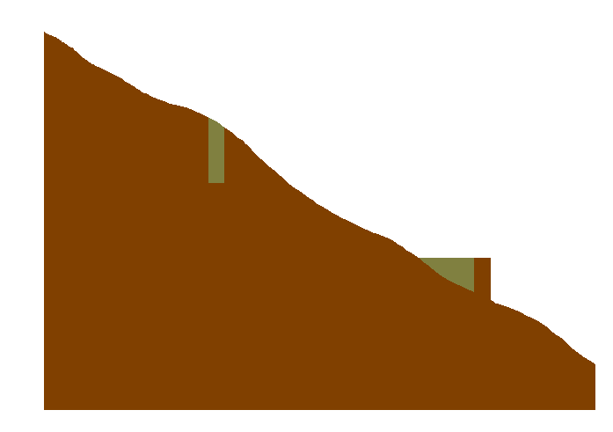

Pit Filling
Increase elevation to the pour point elevation until the pit drains to a neighbor

Slide 9
Pit Filling
Original DEM
Pits Filled
Pits
Pour Points
Grid cells or zones completely surrounded by higher terrain
The lowest grid cell adjacent to a pit

Slide 10
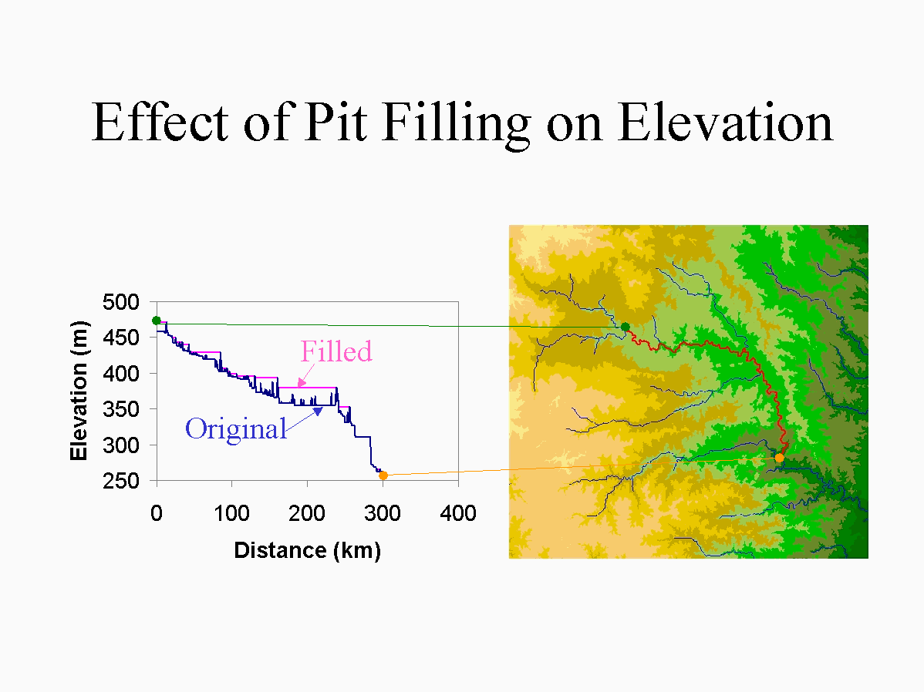

Slide 11
D8 Flow Direction Model
- Direction of steepest descent
30
80
74
63
32
64
128
69
67
56
16
1
60
52
48
8
4
2
Slope = Drop/Distance
Steepest down slope direction

Slide 12
Eight Direction (D8) Flow Model
32
64
128
16
1
8
4
2
2
2
4
4
8
1
2
4
8
4
4
1
2
4
8
2
4
4
4
4
1
2
1
4
16

Slide 13
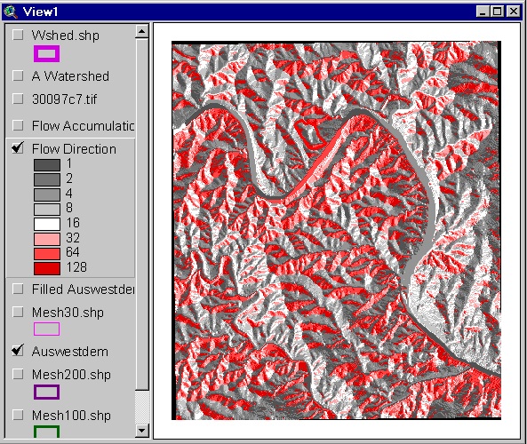
Flow Direction Grid
32
64
128
16
1
8
4
2

Slide 14
Grid Network

Slide 15
Flow Accumulation Grid.
Area draining in to a grid cell
0
0
0
0
0
0
0
0
0
0
0
2
2
2
0
0
2
2
2
0
0
0
10
0
1
0
0
1
0
10
1
0
0
14
0
1
0
0
0
14
0
4
1
19
1
0
4
1
1
19

Slide 16
Stream Definition
Stream Network for 10 cell Threshold Drainage Area
Flow Accumulation
> 10 Cell Threshold
0
0
0
0
0
0
0
0
0
0
0
2
2
2
0
0
2
2
2
0
0
0
10
0
1
0
0
1
0
10
1
0
0
14
0
1
0
0
0
14
0
4
1
19
1
0
4
1
1
19

Slide 17
TauDEM contributing area convention.
1
1
1
1
1
1
1
1
1
1
1
3
3
3
1
1
3
3
3
1
1
1
11
1
2
1
1
1
2
11
2
1
1
15
1
2
1
1
1
15
1
5
2
20
2
1
5
2
2
20
The area draining each grid cell includes the grid cell itself.

Slide 18
ArcGIS and TauDEM flow direction encodings
32
64
128
4
3
2
16
1
5
1
8
4
2
6
7
8
ArcGIS
TauDEM

Slide 19
Watershed Draining to Outlet
Watershed mapped as all grid cells that drain to an outlet
Streams mapped as grid cells with flow accumulation greater than a threshold

Slide 20
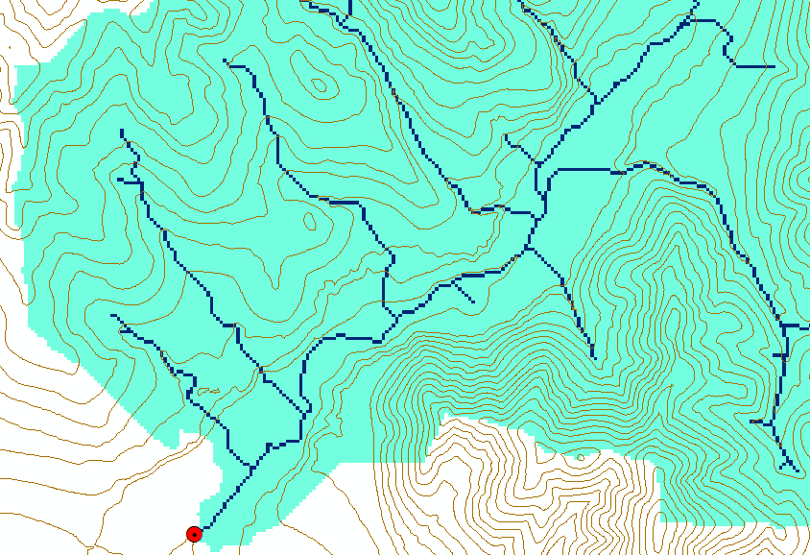
Watershed and Stream Grids
Watershed mapped as all grid cells that drain to an outlet
Streams mapped as grid cells with flow accumulation greater than a threshold

Slide 21
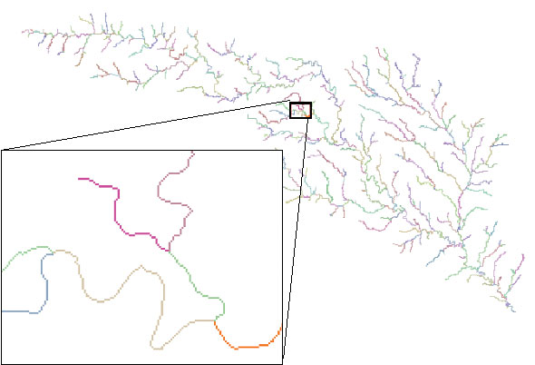
Stream Segments
201
172
202
203
206
204
209
Each link has a unique identifying number
ArcHydro Page 74
Maidment, D. R., ed. (2002), Arc Hydro GIS for Water Resources, ESRI Press, Redlands, CA, 203 p.

Slide 22
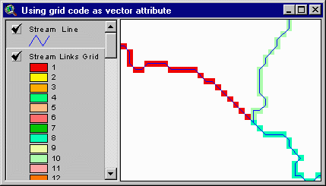
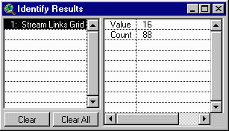
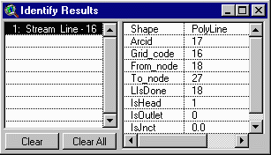
Vectorized Streams Linked Using Grid Code to Cell Equivalents
Vector
Streams
Grid
Streams
ArcHydro Page 75

Slide 23
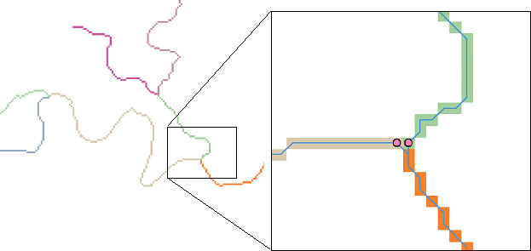
DrainageLines are drawn through the centers of cells on the stream links. DrainagePoints are located at the centers of the outlet cells of the catchments
ArcHydro Page 75

Slide 24
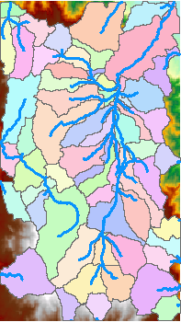
Catchments
For every stream segment, there is a corresponding catchment
Catchments are a tessellation of the landscape through a set of physical rules

Slide 25
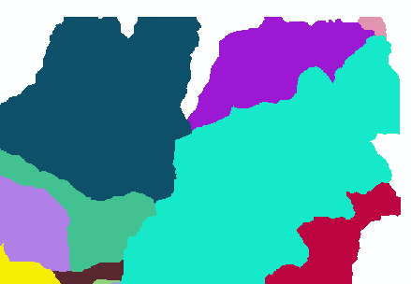
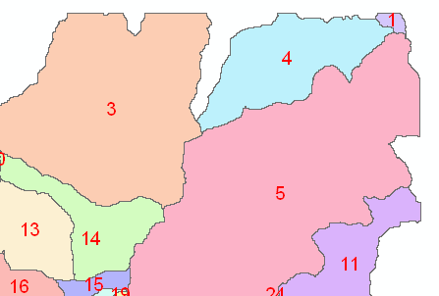
Raster Zones and Vector Polygons
One to one connection
DEM GridCode
Catchment GridID
4
3
5
Raster Zones
Vector Polygons

Slide 26
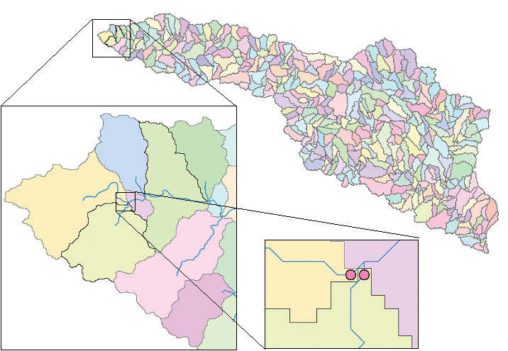
Catchments, DrainageLines and DrainagePoints of the San Marcos basin
ArcHydro Page 75

Slide 27
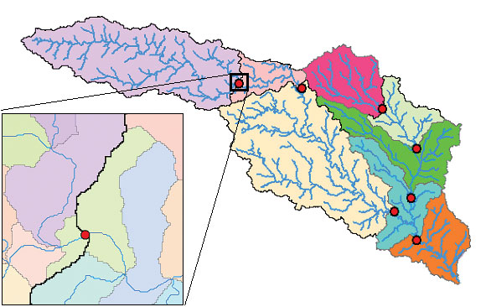
Catchment, Watershed, Subwatershed.
Subwatersheds
Catchments
Watershed
Watershed outlet points may lie within the interior of a catchment, e.g. at a USGS stream-gaging site.
ArcHydro Page 76

Slide 28
Using Vector Stream Information
“Burning In” the Streams
• Take a mapped stream network and a DEM
• Make a grid of the streams
• Raise the off-stream DEM cells by an arbitrary elevation
increment
• Produces "burned in" DEM streams = mapped streams
+
=

Slide 29
AGREE Elevation Grid Modification Methodology – DEM Reconditioning

Slide 30

Carving
Lower elevation of neighbor along a predefined drainage path until the pit drains to the outlet point

Slide 31
Carving
Original DEM
Carved DEM
Pits
Carve outlets
Notes:
Elevations are filled to that of the pools pour point

Slide 32
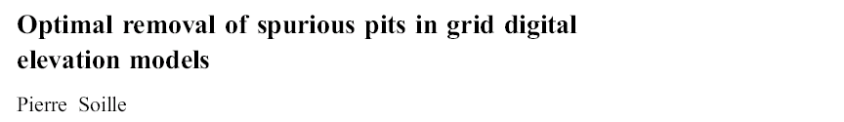
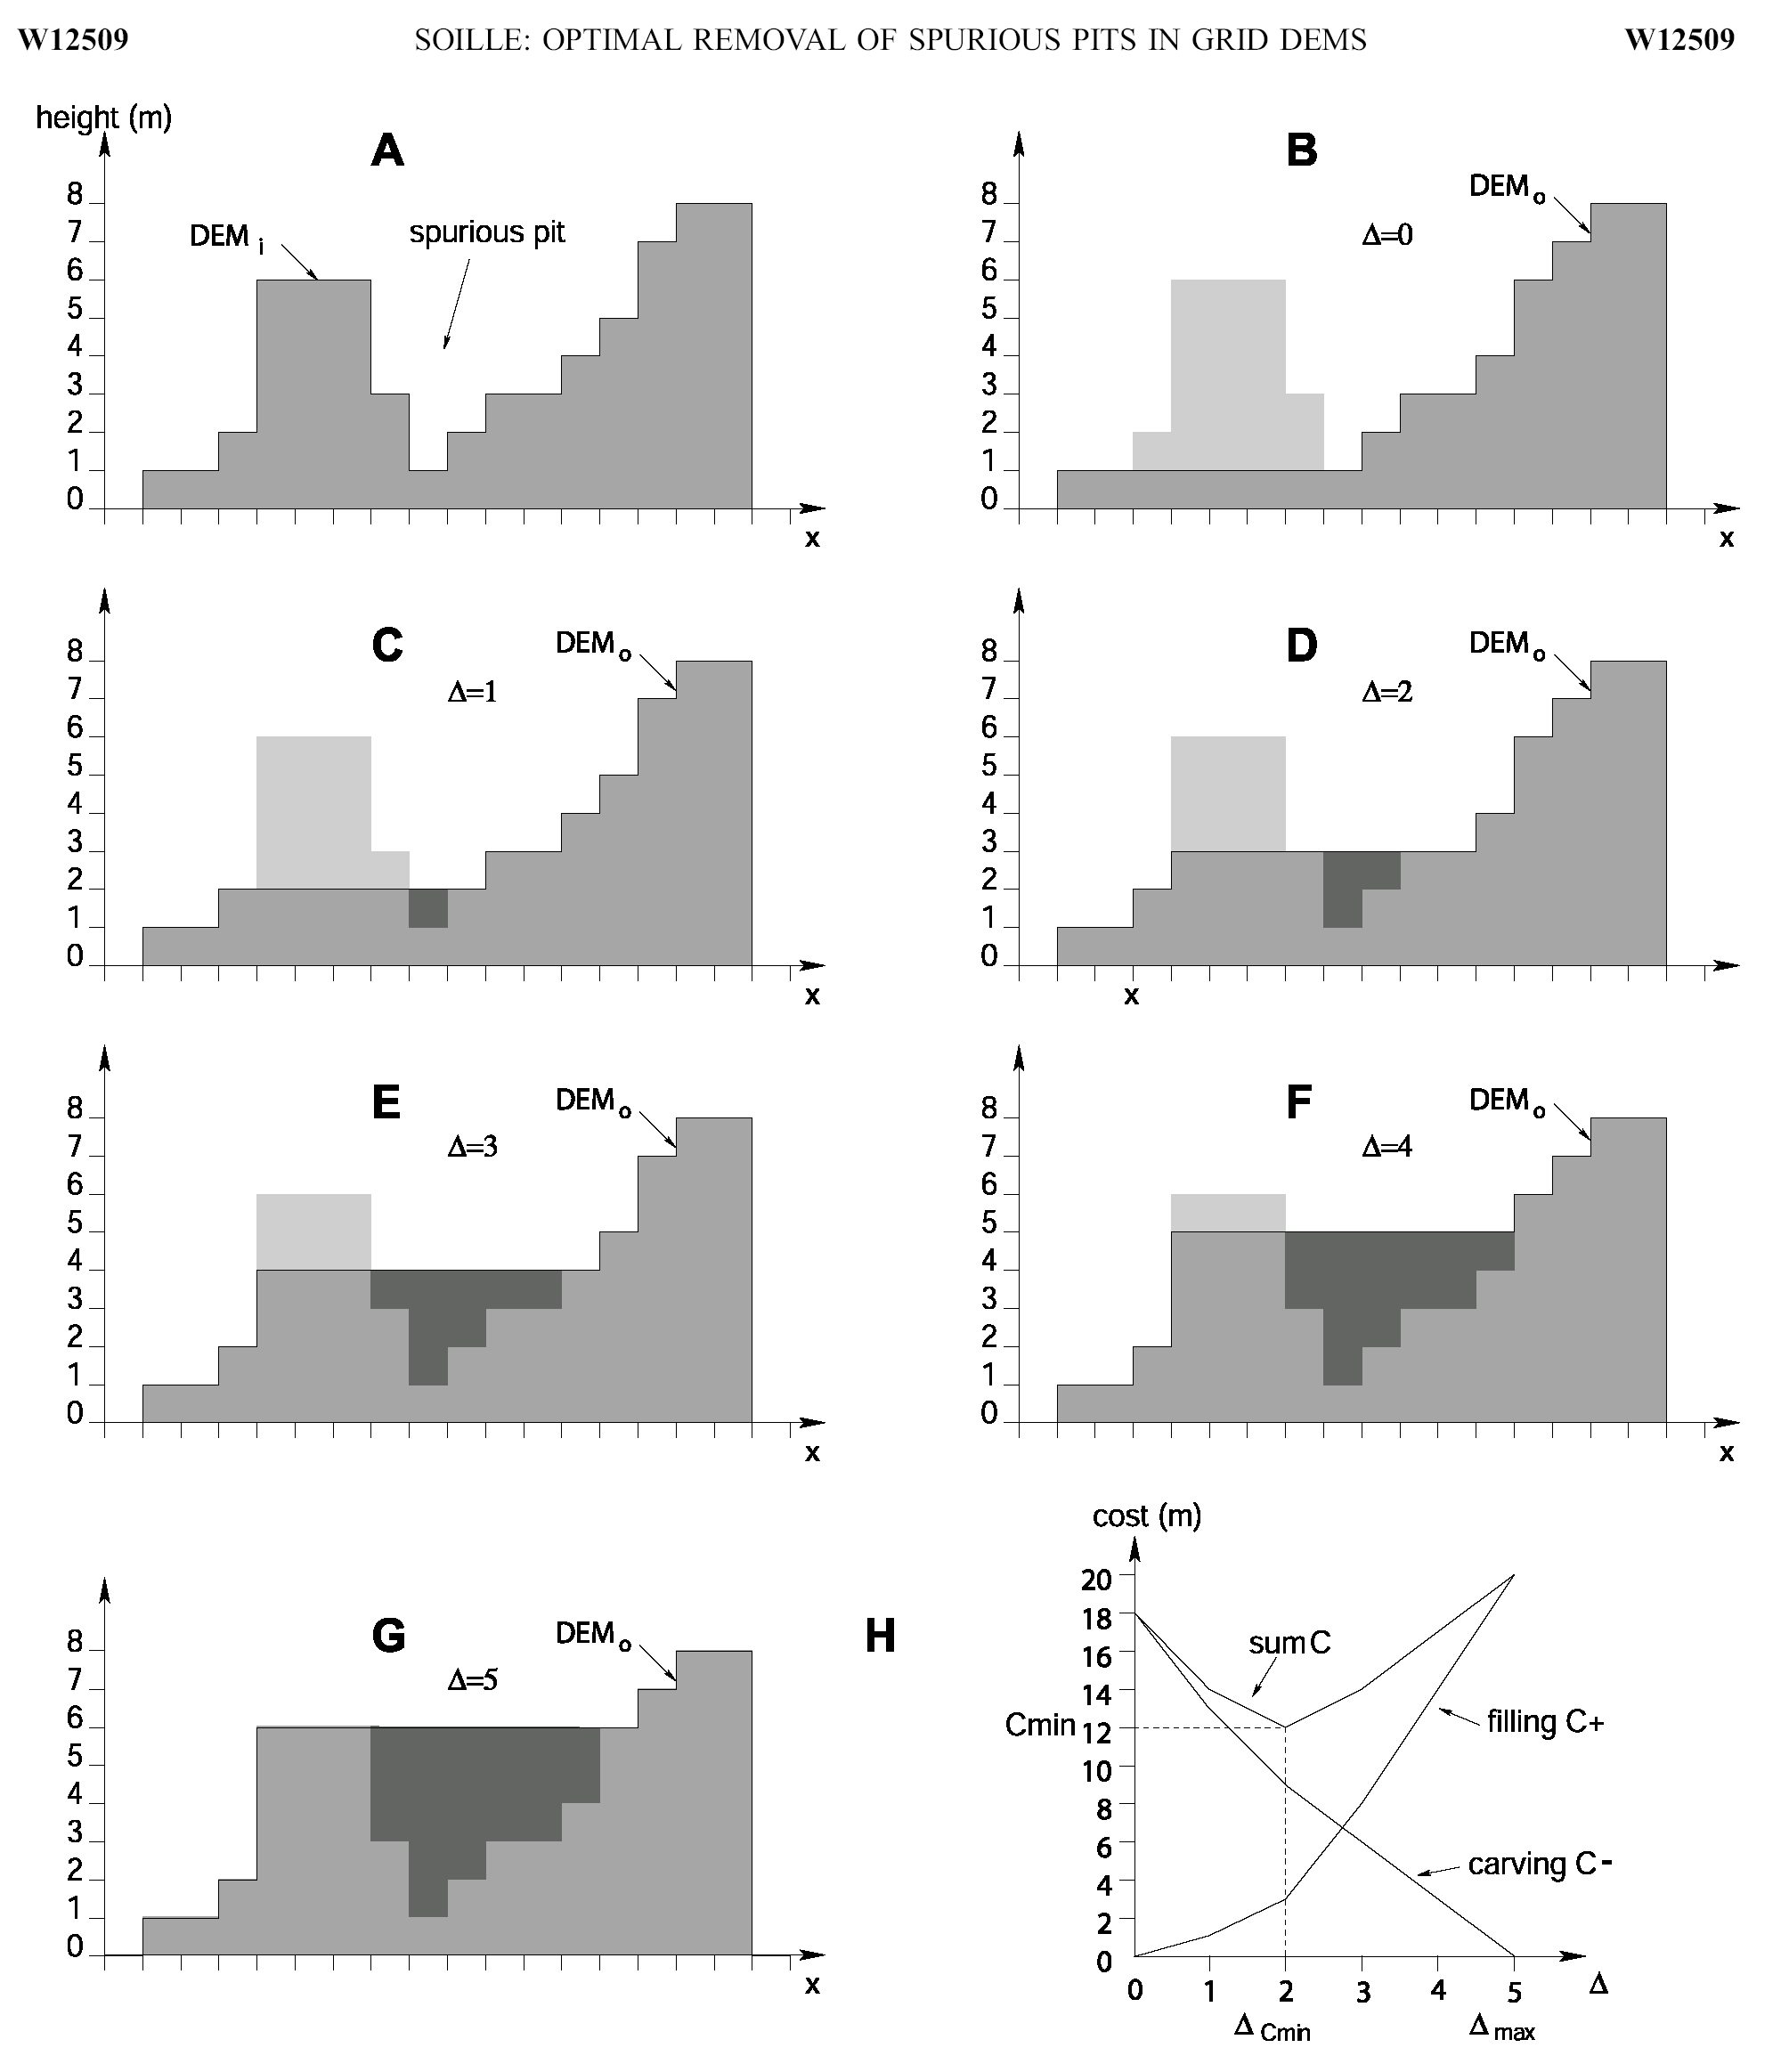
Filling
Minimizing Alterations
Carving

Slide 33
Minimizing DEM Alterations
Original DEM
Optimally adjusted
Carved
Pits
Filled
Notes:
Elevations are filled to that of the pools pour point

Slide 34
Summary of Key Processing Steps
[DEM Reconditioning]
Pit Removal (Fill Sinks)
Flow Direction
Flow Accumulation
Stream Definition
Stream Segmentation
Catchment Grid Delineation
Raster to Vector Conversion (Catchment Polygon, Drainage Line, Catchment Outlet Points)

Slide 35
Hydrologic Terrain Analysis Software
ArcGIS Portal ready to use tools
ArcGIS Hydrology Tools
ArcHydro
TauDEM
[RiverTools]
[GRASS]

Slide 36
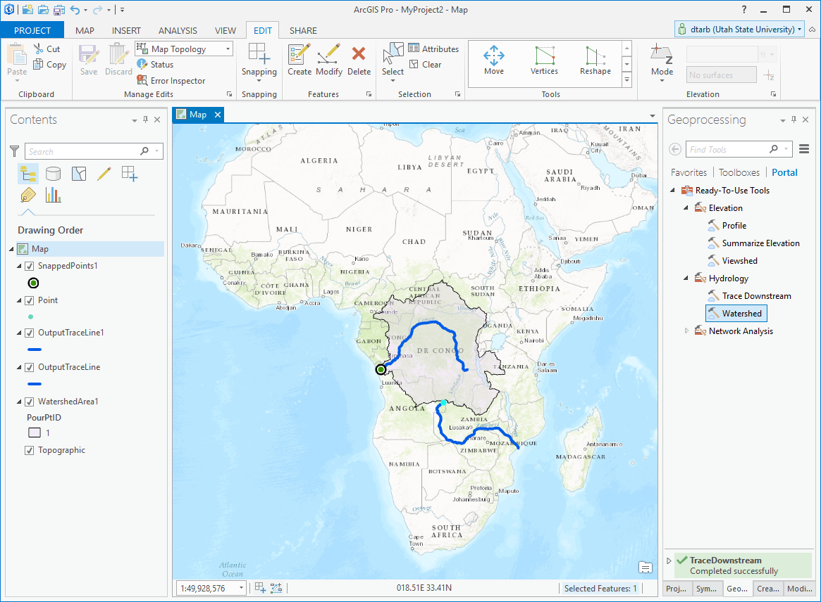
ArcGIS Pro Ready to Use Tools

Slide 37
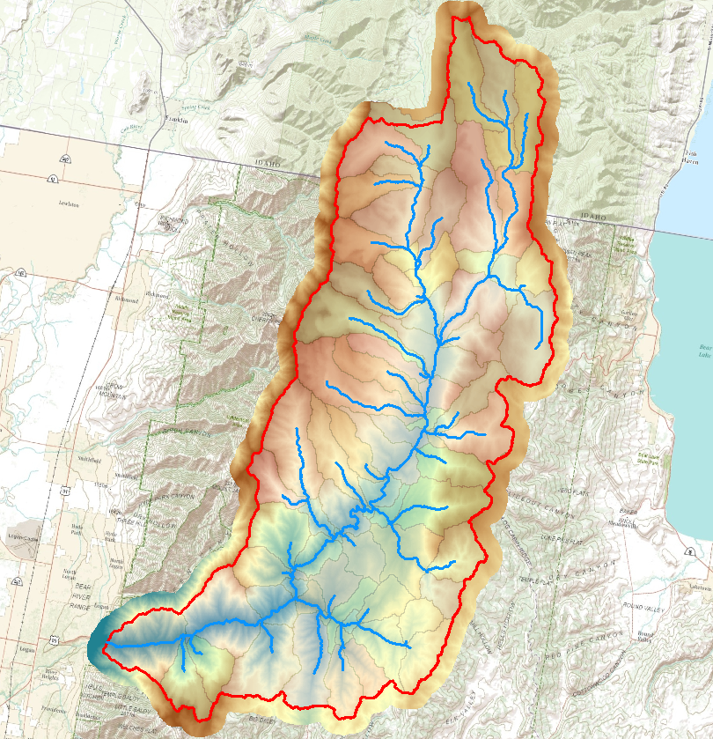
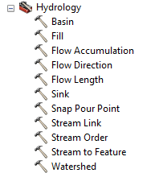
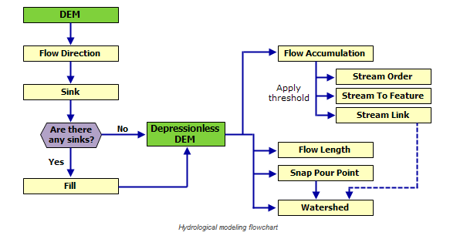
ArcGIS Hydrology Toolset

Slide 38
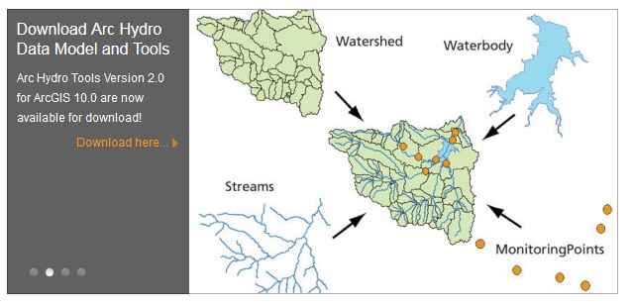
ArcHydro
http://resources.arcgis.com/en/communities/hydro/

Slide 39

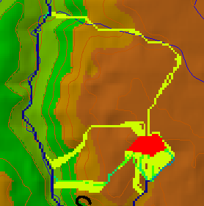
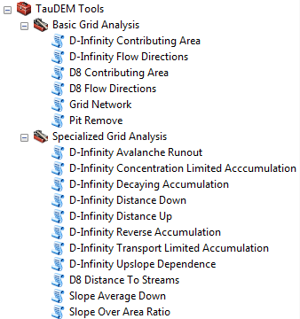

TauDEM
Stream and watershed delineation
Multiple flow direction flow field
Calculation of flow based derivative surfaces
MPI Parallel Implementation for speed up and large problems
Open source platform independent C++ command line executables for each function
Deployed as an ArcGIS Toolbox with python scripts that drive command line executables
CSDMS Cluster Implementation
Open Topography implementation
CyberGIS Implementation
http://hydrology.usu.edu/taudem/

Slide 40
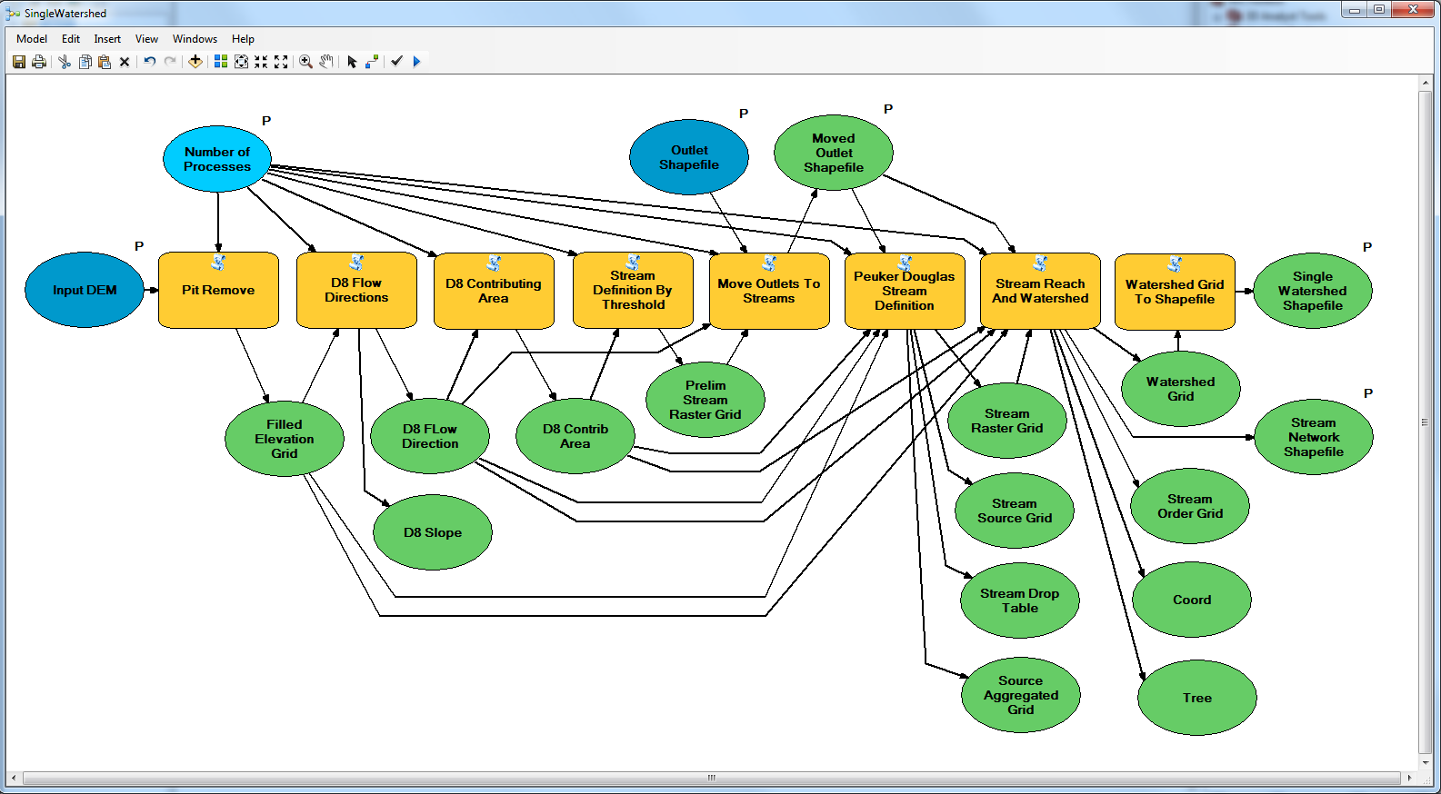
Workflow to automatically generate stream network upstream of outlet

Slide 41
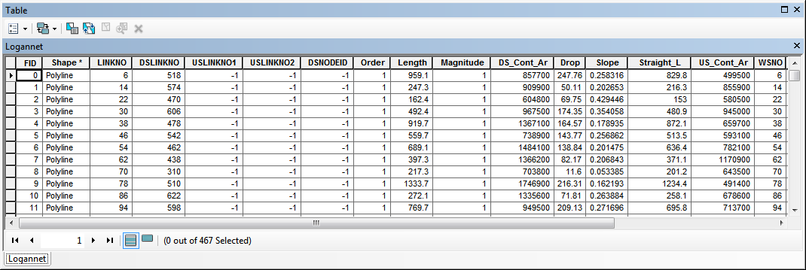
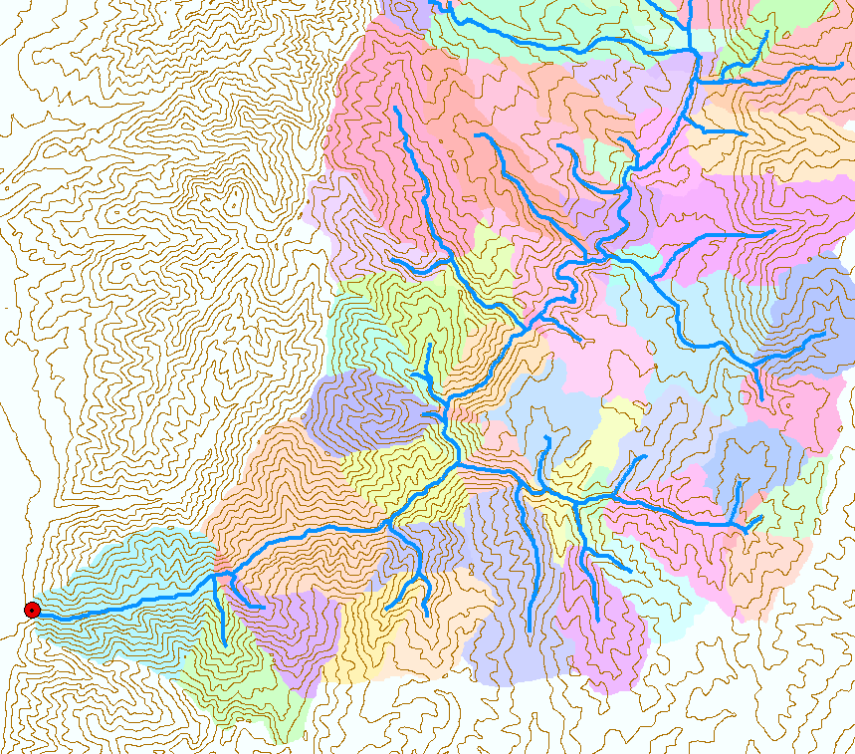
Catchments linked to Stream Network
The starting point for catchment based distributed hydrologic modeling

Slide 42
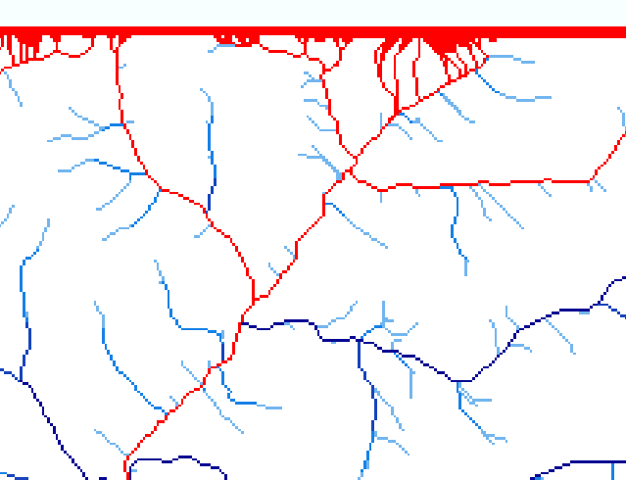
Edge contamination
Edge contamination arises when a contributing area value depends on grid cells outside of the domain. This occurs when drainage is inwards from the boundaries or areas with no data values. The algorithm recognizes this and reports "no data" resulting in streaks of "no data" values extending inwards from boundaries along flow paths that enter the domain at a boundary.

Slide 43
Summary Concepts
The eight direction pour point model approximates the surface flow using eight discrete grid directions
The elevation surface represented by a grid digital elevation model is used to derive surfaces representing other hydrologic variables of interest such as
  Slope
  Flow direction
  Drainage area
  Catchments, watersheds and channel networks
Software as a service approach is moving functionality into the cloud

