Slide 1
Land cover change in the Travis county
GIS in Water Resources Fall 2015
University of Texas at austin
Julie C Faure

Slide 2
Introduction
Travis county: a rapidly expanding county
National Land Cover Database 2006-2011 Percent Developed Imperviousness Change

Slide 3
Project steps
How can the land cover be modeled, using the population characteristics?
Original idea: studying the way that water infrastructures adapt to population and land cover change
Data collection
Data pre-processing
Analysis: choice of the input variables
Regression: finding a mathematical formula that models the land cover layer

Slide 4
Data collection
Land cover
National Land Cover Database (NLCD)
1992
2001
2006
and 2011 databases
NLCD 2011 Land cover
The model could be used to detremine the 2015 land cover

Slide 5

Data collection
Population data
Block groups in Texas from the American Census Bureau
Population data for each block in the Travis County from the American Community Survey
Total population per block groups in the Travis county

Slide 6
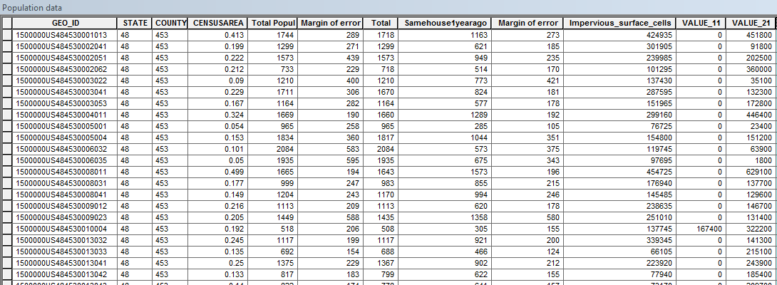
Data pre-processing
Joining interesting population data to Travis County Block groups
Using the Spatial Analysis tool Tabulate area in Arcmap to obtain the number of impervious surface cells in each block

Slide 7
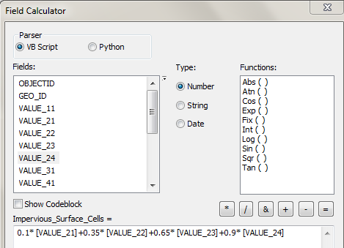
Data pre-processing
Joining interesting population data to Travis County Block groups
Using the Spatial Analysis tool Tabulate area in Arcmap to obtain the number of impervious surface cells in each block

Slide 8
Data pre-processing
Number of impervious surface cells per block groups in the Travis county
Joining interesting population data to Travis County Block groups
Using the Spatial Analysis tool Tabulate area in Arcmap to obtain the number of impervious surface cells in each block

Slide 9
Data Analysis
The factors that seem to have an effect on the number of impervious surface cells are:
  The total population of the block group
Income per housing
The number of housing units

Slide 10
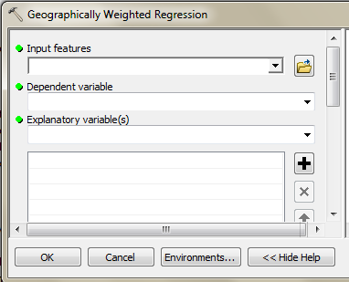
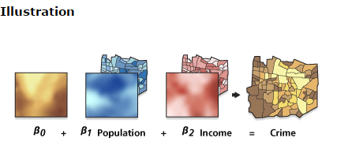
Regression
Using the Geographically Weighted Regression tool from Spatial Statistics: mathematical model for 2011
β0 + β1 population + β2 number of housing units + β3 income per housing = number of impervious cells
Illustration taken from Arcmap help

Slide 11
Further work
Performing the regression on the 2001 and 2006 data, and comparing it to the 2011 result
Using the mathematical model to « predict » the 2015 land cover layer
Try to find a link between land cover « urbanization » and water infrastructure problems/ construction works

