Slide 1

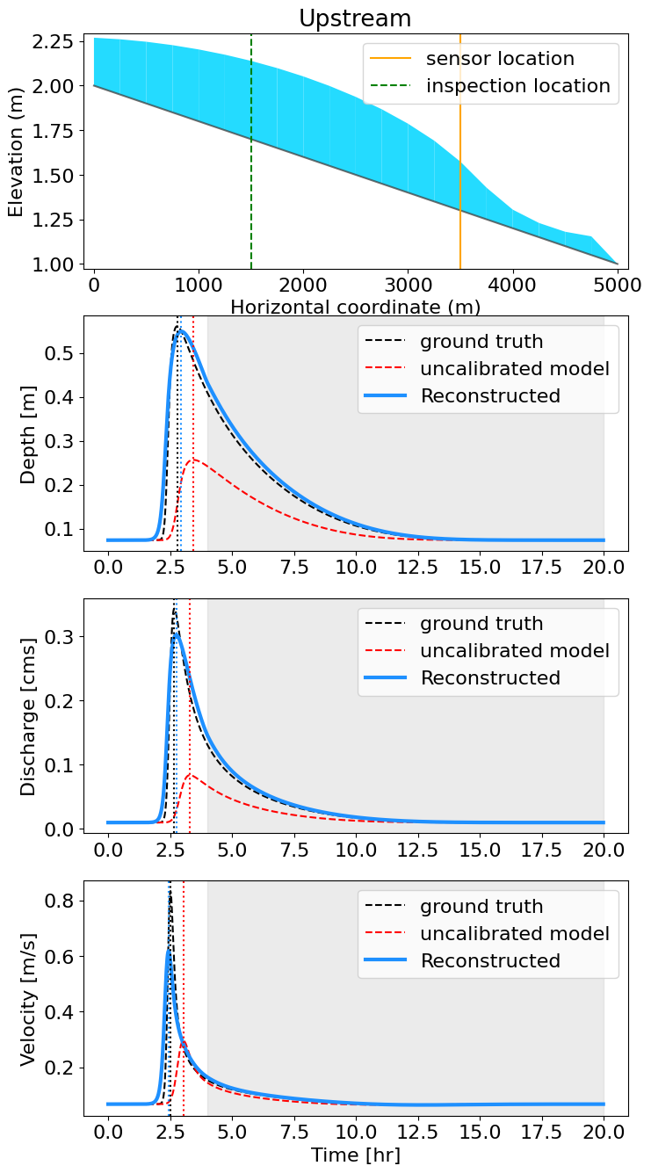
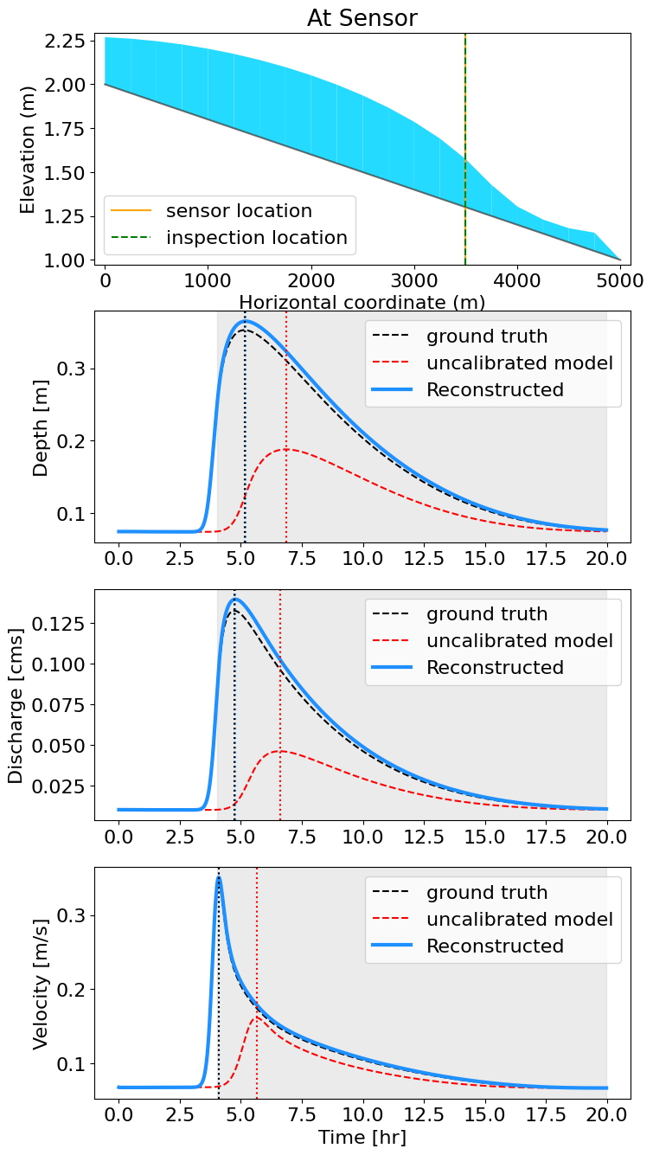
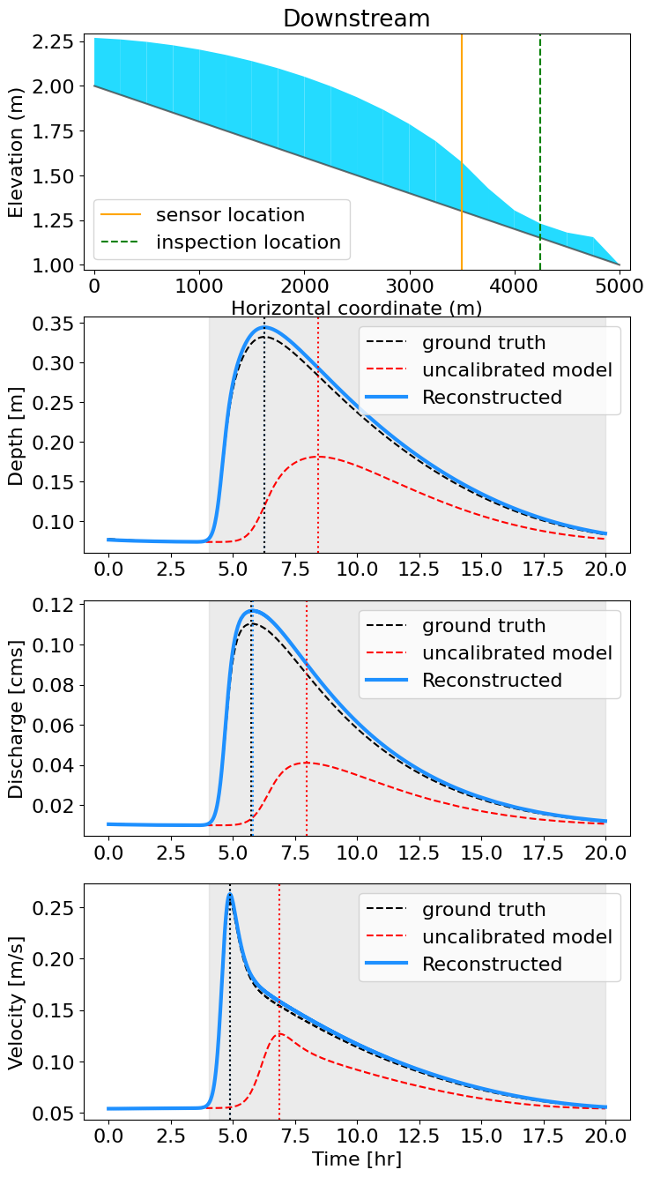
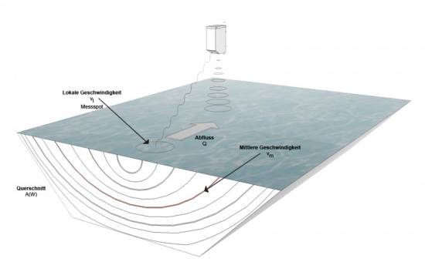
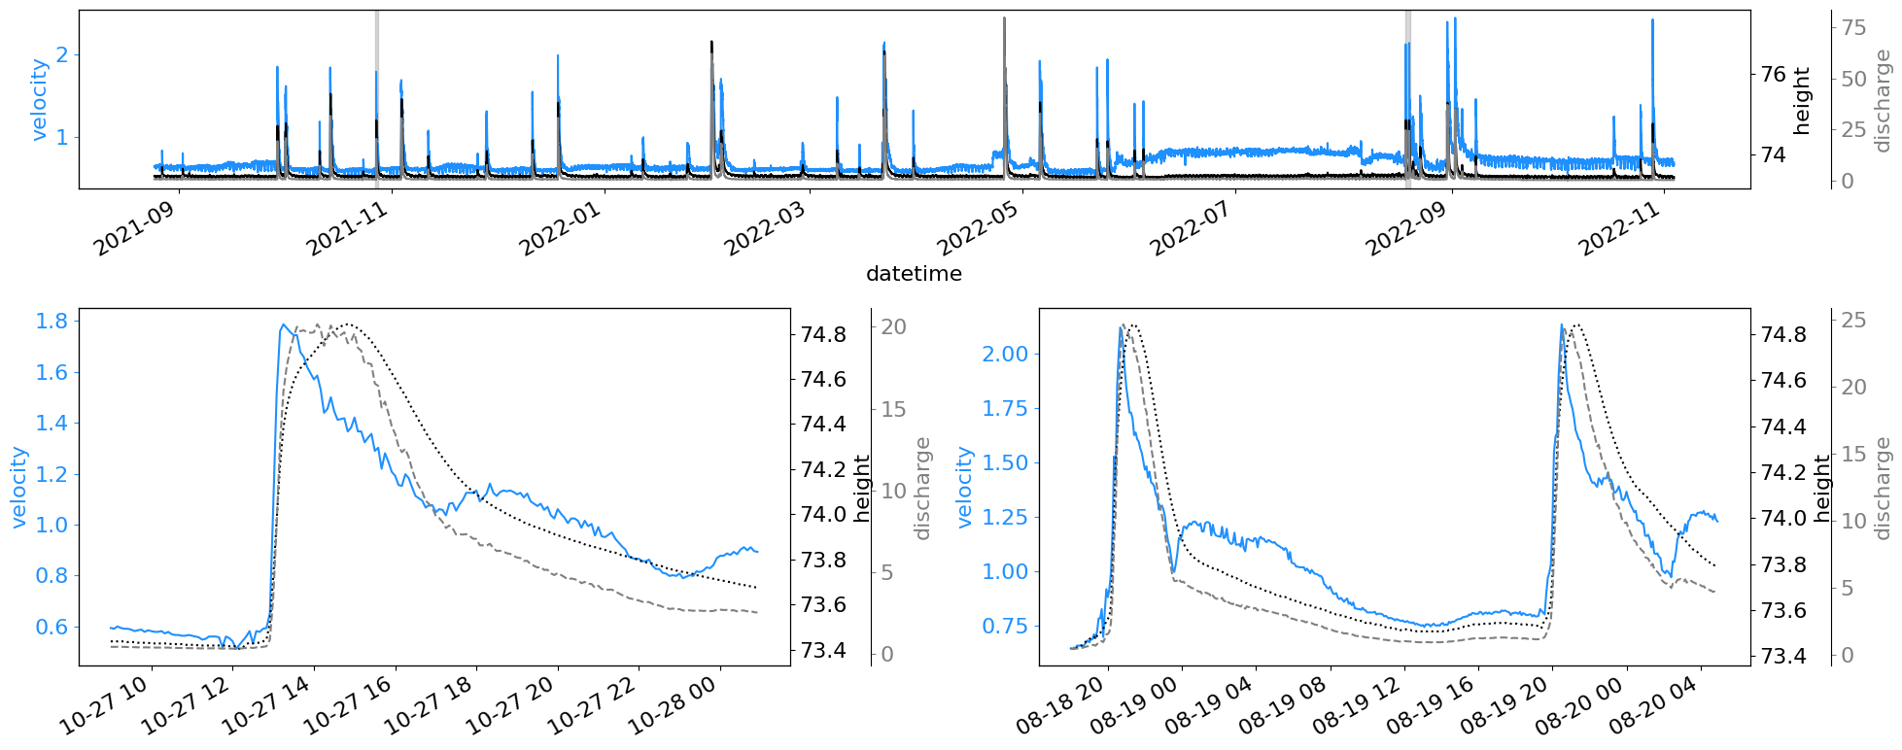
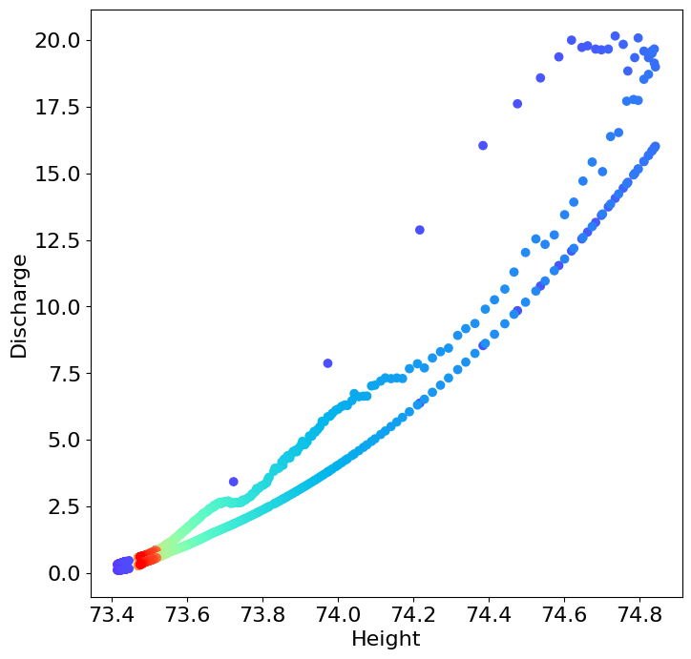
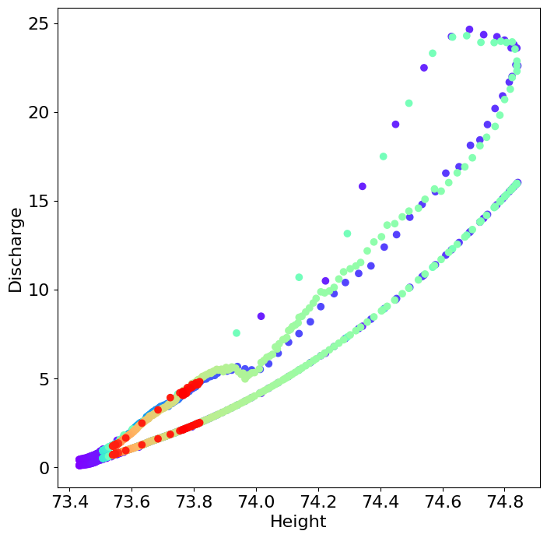
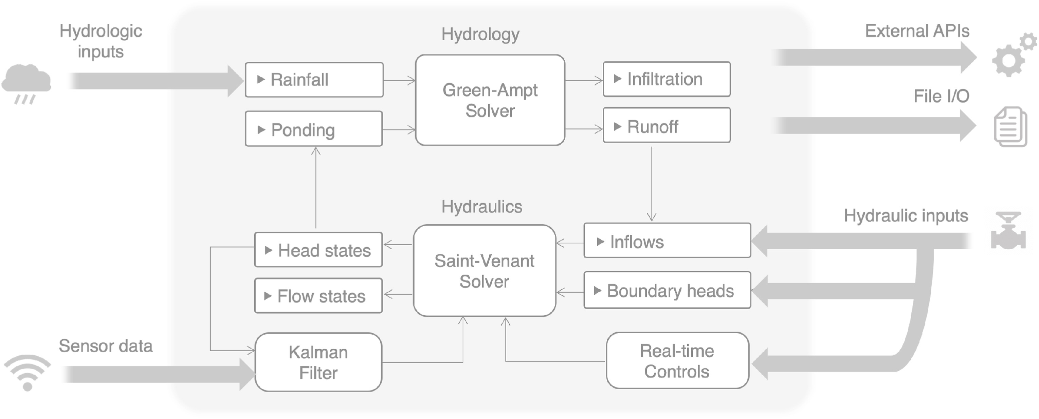
H33J-1922
AGU 2023
Harnessing hysteresis: pre-emptive velocity spikes in surface velocimetry data predict incoming flood waves
Jeil Oh and Matt Bartos
jeoh@utexas.edu
Introduction
Results
Radar-based surface velocimetry sensors are increasingly being used for discharge measurements in river networks. Unlike traditional gages, these sensors provide both water depth and water surface velocity measurements in real-time. These joint stage-velocity measurements often reveal previously unobserved hysteresis behavior in which the water velocity rises several hours before the flood stage peak.
This study shows that this pre-emptive velocity rise can be used to accurately predict the timing and magnitude of flood waves several hours before their onset using a physically-based data assimilation approach.
Reconstruction Performance
 | Depth |  | Discharge
 | Relative Peak Magnitude error (%) | Relative Peak timing error (%) | Relative Peak Magnitude error (%) | Relative Peak timing error (%)
At sensor | 3.48 | 0.97 | 5.30 | 0.7
Downstream | 3.61 | 0.26 | 5.87 | 0.86
The evaluation of forecast accuracy for synthetic flood events compares predicted to actual magnitudes and timings at sensor and downstream locations. The estimated peak magnitudes show a tight error margin, with depth at approximately 3% and discharge around 5%. The timing of peak predictions demonstrates exceptional accuracy, staying within 1% for both parameters. Additionally, the sequence of peak occurrences is consistent: velocity, discharge, then depth. More importantly, this holds true not just at sensor locations but also downstream, where early indications of velocity increases enable the prediction of flood waves, thereby granting sufficient preparation time for emergency actions.
Methods
Ongoing work
In the hydraulic simulation, one-dimensional Saint-Venant Equations are used to model unsteady flow in open channels. Real-time data from RQ-30 sensors, including water levels, discharge rates, and velocities, is integrated into the model. Kalman Filtering assimilates this data into the model (pipedream). The L-BFGS-B optimization technique, with gradient backtracking, reconstructs upstream inputs using data observed up to the pre-emptive peak in velocity, and predict flood waves.
The hysteresis effect can be observed at the USGS velocity gaging station #08111051, located at Carters Creek in Texas. The data shows that the peaks for the flow variables during unsteady flow are time-phased in the following sequence: velocity, discharge, and height. The RQ-30 gage demonstrates that the adoption of modern gauging methods, such as radar-based velocimetry, offers a way to detect the hysteresis effect. This is crucial because neglecting hysteresis can significantly skew flood forecasting, potentially leading to the underestimation of the rate at which floodwaters rise, the peak discharge values, and the resultant timing of the flood hydrographs.
Considering the lag between the peaks of depth and discharge, utilizing velocity data to predict upstream input reconstruction can offer valuable lead time for emergency preparations and flood response strategies.
Bartos, M., & Kerkez, B. (2021). Pipedream: An interactive digital twin model for natural and urban drainage systems. Environmental Modelling & Software, 144, 105120.

Slide 2
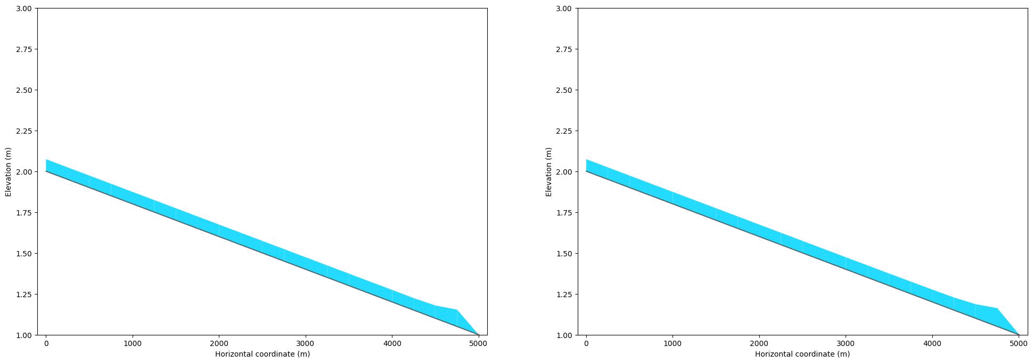
Ground truth
Reconstructed

