Slide 1
CE 374K Hydrology
Review for First Exam
February 21, 2012

Slide 2

Hydrology as a Science
“Hydrology is the science that treats the waters of the earth, their occurrence, circulation and distribution, their chemical and physical properties, and their reaction with their environment, including their relation to living things. The domain of hydrology embraces the full life history of water on the earth”
The “Blue Book”
From “Opportunities in Hydrologic Science”, National Academies Press, 1992
http://www.nap.edu/catalog.php?record_id=1543
Has this definition evolved in recent years? Are new issues important?

Slide 3
Hydrology as a Profession
A profession is a “calling requiring specialized knowledge, which has as its prime purpose the rendering of a public service”
What hydrologists do:
  Water use – water withdrawal and instream uses
  Water Control – flood and drought mitigation
  Pollution Control – point and nonpoint sources
Have these functions changed in recent years? Are priorities different now?

Slide 4
Global water balance (volumetric)
Units are in volume per year relative to precipitation on land (119,000 km³/yr) which is 100 units
Precipitation
100
Atmospheric moisture flow 39
Precipitation
385
Evaporation
424
Evaporation
61
Surface Outflow
38
Land (148.7 km²)
(29% of earth area)
Ocean (361.3 km²)
(71% of earth area)
Subsurface Outflow
1
What conclusions can we draw from these data?

Slide 5
Global water balance
Precipitation
800 mm (31 in)
Atmospheric moisture flow 316 mm (12 in)
Precipitation
1270 mm (50 in)
Evaporation
1400 mm (55 in)
Evaporation
480 mm (19 in)
Outflow
320 mm (12 in)
Land (148.7 km²)
(29% of earth area)
(Values relative to land area)
Ocean (361.3 km²)
(71% of earth area)
What conclusions can we draw from these data?
Applied Hydrology, Table 1.1.2, p.5

Slide 6
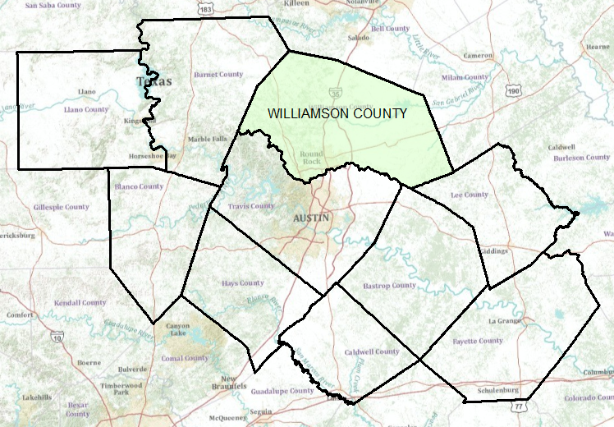
Capital Area Counties

Slide 7
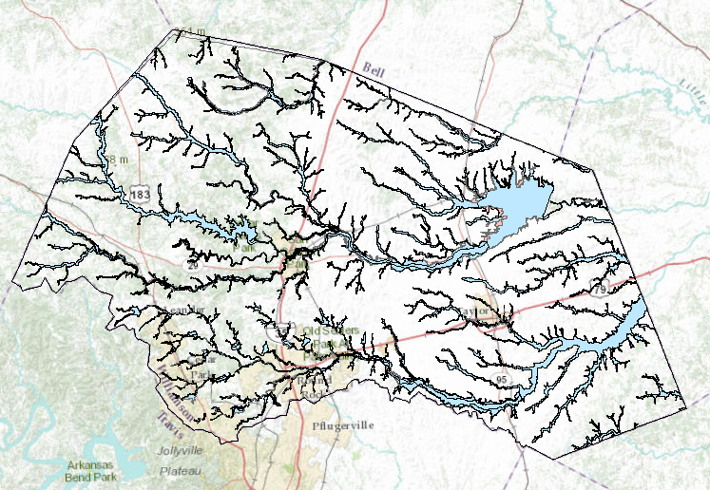
Floodplains in Williamson County
Area of County = 1135 mile²
Area of floodplain = 147 mile²
13% of county in floodplain

Slide 8
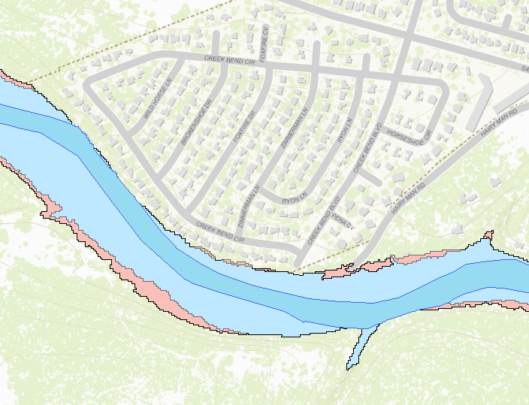

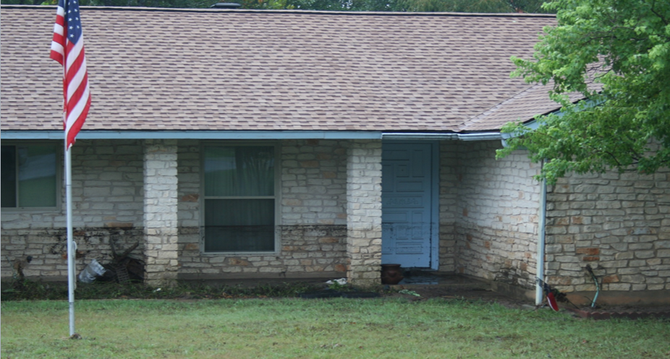

Floodplain Zones
1% chance
< 0.2% chance
Main zone of water flow
Flow with a Sloping Water Surface

Slide 9
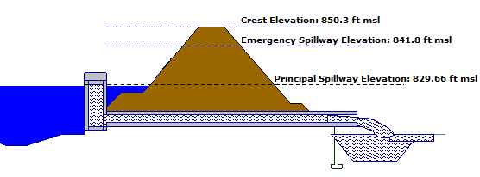
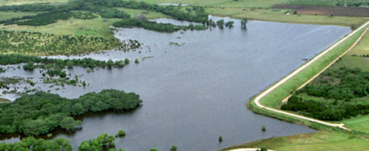
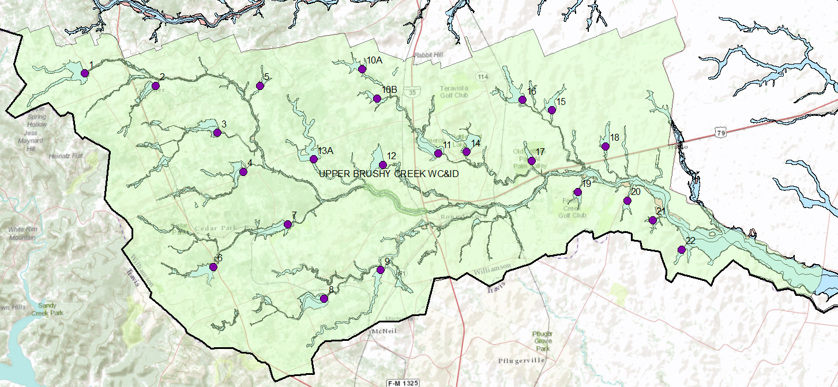
Flood Control Dams
Dam 13A
Flow with a Horizontal Water Surface

Slide 10
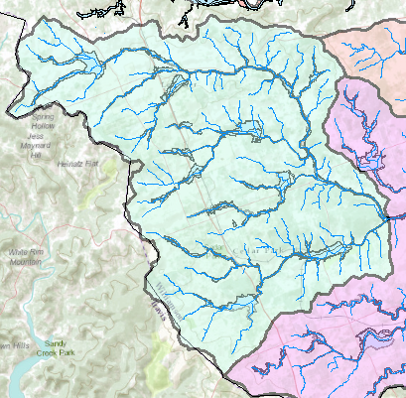
Watershed – Drainage area of a point on a stream
Rainfall
Streamflow
Connecting rainfall input with streamflow output

Slide 11
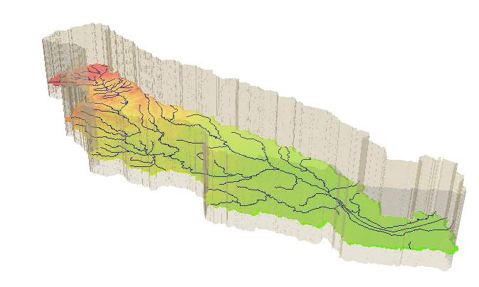
Hydrologic System
Take a watershed and extrude it vertically into the atmosphere
and subsurface, Applied Hydrology, p.7- 8
A hydrologic system is “a structure or volume in space surrounded by a boundary, that accepts water and other inputs, operates on them internally, and produces them as outputs”

Slide 12
Reynolds Transport Theorem
A method for applying physical laws to fluid systems flowing through a control volume
B = Extensive property (quantity depends on amount of mass)
β = Intensive property (B per unit mass)
Total rate of
change of B in fluid system (single phase)
Rate of change of B stored within the Control Volume
Outflow of B across the Control Surface

Slide 13
Mass, Momentum Energy
 | Mass | Momentum | Energy
B | m | mv
β = dB/dm | 1 | v
dB/dt | 0
Physical Law | Conservation of mass | Newton’s Second Law of Motion | First Law of Thermodynamics

Slide 14
Continuity Equation
B = m; b = dB/dm = dm/dm = 1; dB/dt = 0 (conservation of mass)
ρ = constant for water
hence
or

Slide 15
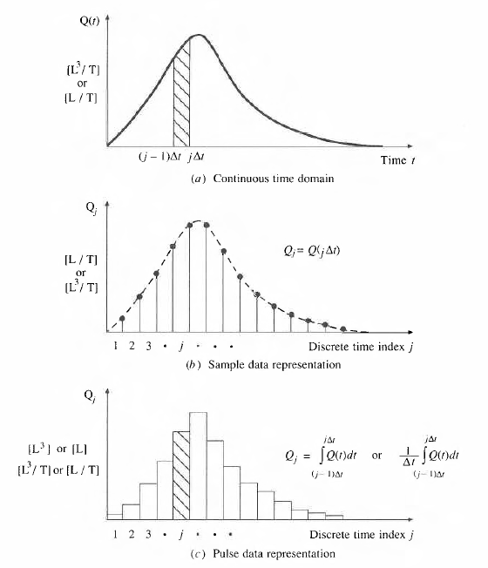
Continuous and Discrete time data
Figure 2.3.1, p. 28 Applied Hydrology
Continuous time representation
Δt
j-1
j
Sampled or Instantaneous data
(streamflow)
truthful for rate, volume is interpolated
Can we close a discrete-time water balance?
Pulse or Interval data
(precipitation)
truthful for depth, rate is interpolated

Slide 16
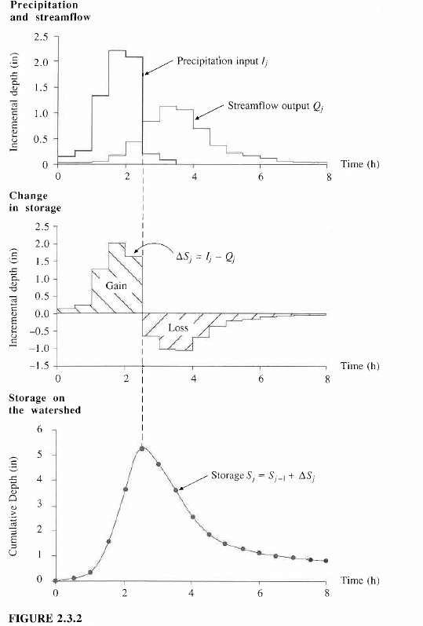
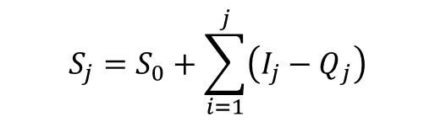
I_{j}
Continuity Equation, dS/dt = I – Q
applied in a discrete time interval [(j-1)Δt, jΔt]
Q_{j}
Δt
ΔS_{j} = I_{j} - Q_{j}
j-1
j
$$S_{j}=S_{0}+\sum_{i=1}^{j}{\left(I_{j}−Q_{j}\right)}$$
S_{j} = S_{j-1} + ΔS_{j}

Slide 17
Momentum
B = mv; b = dB/dm = dmv/dm = v; dB/dt = d(mv)/dt = ΣF (Newtons 2nd Law)
For steady flow
For uniform flow
so
In a steady, uniform flow

Slide 18
Energy equation of fluid mechanics
h_{f}
energy
grade line
y₁
water
surface
y₂
bed
z₁
L
z₂
Datum
How do we relate friction slope,
to the velocity of flow?

Slide 19
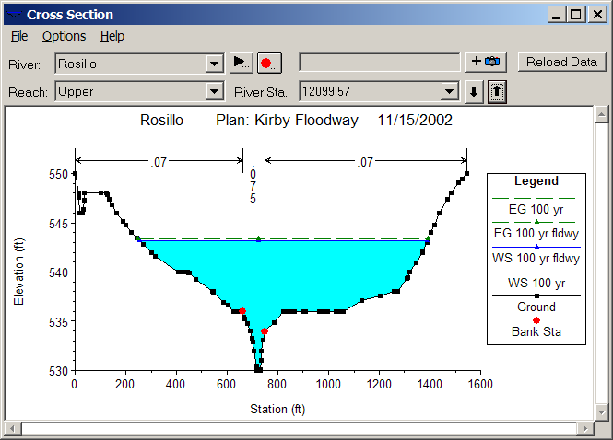
Open channel flow
Manning’s equation
Channel Roughness
Channel Geometry
Hydrologic Processes
(Open channel flow)
Hydrologic conditions
(V, S_{f})
Physical environment
(Channel n, R)

Slide 20
Subsurface flow
Darcy’s equation
q
A
q
Hydraulic conductivity
Hydrologic Processes
(Porous medium flow)
Hydrologic conditions
(q, S_{f})
Physical environment
(Medium K)

Slide 21
Internal Energy of Water
Water vapor
Water
Ice
Heat Capacity (J/kg-K) Latent Heat (MJ/kg)
Ice 2220 0.33
Water 4190 2.5
2.5/0.33 = 7.6
Water may evaporate at any temperature in range 0 – 100°C
Latent heat of vaporization consumes 7.6 times the latent heat of fusion (melting)

Slide 22
Radiation
Basic laws
  Stefan-Boltzman Law
    R = emitted radiation (W/m²)
    T = absolute temperature (K),
    and σ = 5.67x10⁻⁸W/m²-K⁴
    with ε = emissivity (0-1)
      Water, Ice, Snow (0.95-0.99)
      Sand (0.76)
Valid for a Black body or “pure radiator”
“Gray bodies emit a proportion of the radiation of a black body

Slide 23
Net Radiation, R_{n}
R_{i} Incoming Radiation
R_{o} =αR_{i} Reflected radiation
= albedo (0 – 1)
R_{e}
R_{n} Net Radiation
Average value of R_{n} over the earth and
over the year is 105 W/m²

Slide 24
Latent heat flux
Water flux
  Evaporation rate, E (mm/day)
Energy flux
  Latent heat flux (W/m²), H_{l}
ρ = 1000 kg/m³
l_{v} = 2.5 MJ/kg
28.94 W/m² = 1 mm/day
Temp | Lv | Density | Conversion
0 | 2501000 | 999.9 | 28.94
10 | 2477300 | 999.7 | 28.66
20 | 2453600 | 998.2 | 28.35
30 | 2429900 | 995.7 | 28.00
40 | 2406200 | 992.2 | 27.63
Area = 1 m²

Slide 25
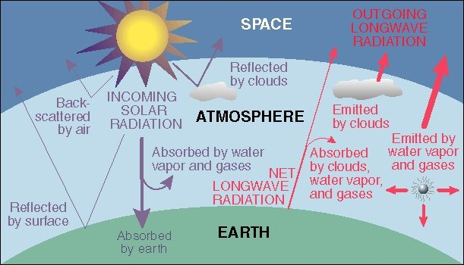
Energy Balance of Earth
20
70
100
6
6
26
4
38
15
19
21
Sensible heat flux 7
Latent heat flux 23
51
http://www.uwsp.edu/geo/faculty/ritter/geog101/textbook/energy/radiation_balance.html

Slide 26
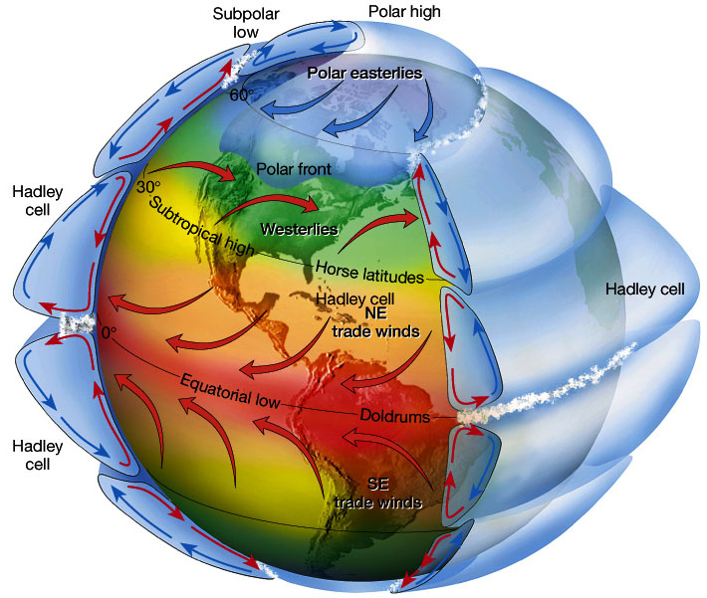
Atmospheric circulation
Circulation cells
Polar Cell
Hadley cell
Ferrel Cell
Polar cell
Ferrel Cell
Winds
Tropical Easterlies/Trades
Westerlies
Polar easterlies
Latitudes
Intertropical convergence zone (ITCZ)/Doldrums
Horse latitudes
Subpolar low
Polar high

Slide 27
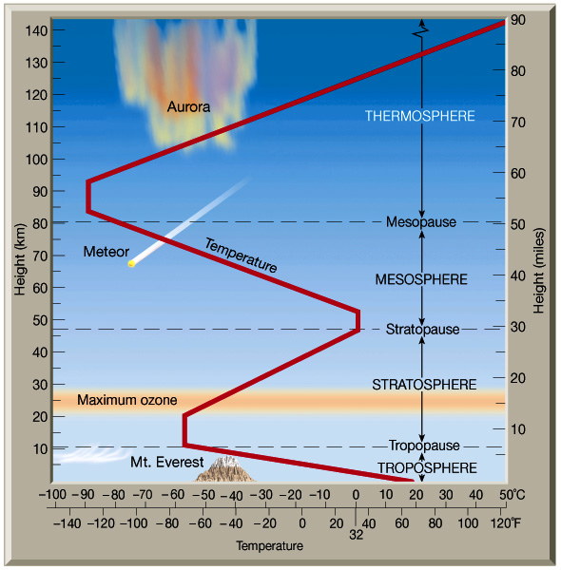
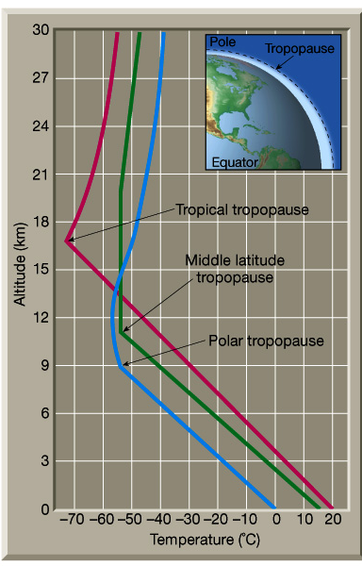
Structure of atmosphere

Slide 28
Specific Humidity, q_{v}
Specific humidity measures the mass of water vapor per unit mass of moist air
It is dimensionless

Slide 29
Vapor pressure, e
Vapor pressure, e, is the pressure that water vapor exerts on a surface
Air pressure, p, is the total pressure that air makes on a surface
Ideal gas law relates pressure to absolute temperature T, R_{v} is the gas constant for water vapor
0.622 is ratio of mol. wt. of water vapor to avg mol. wt. of dry air (=18/28.9)

Slide 30
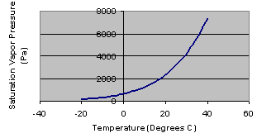
Saturation vapor pressure, e_{s}
Saturation vapor pressure occurs when air is holding all the water vapor
that it can at a given air temperature
T is in °C
Vapor pressure is measured in Pascals (Pa), where 1 Pa = 1 N/m²
1 kPa = 1000 Pa

Slide 31
Relative humidity, R_{h}
e_{s}
e
Relative humidity measures the percent
of the saturation water content of the air
that it currently holds (0 – 100%)

Slide 32
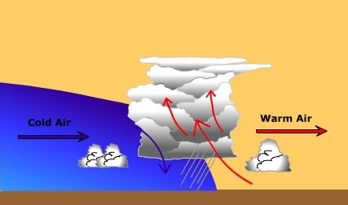
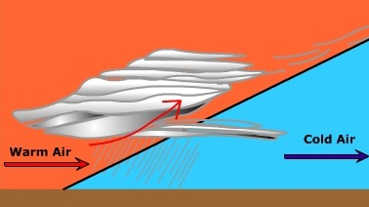
Frontal Lifting
Boundary between air masses with different properties is called a front
Cold front occurs when cold air advances towards warm air
Warm front occurs when warm air overrides cold air
Cold front (produces cumulus cloud)
Cold front (produces stratus cloud)

Slide 33
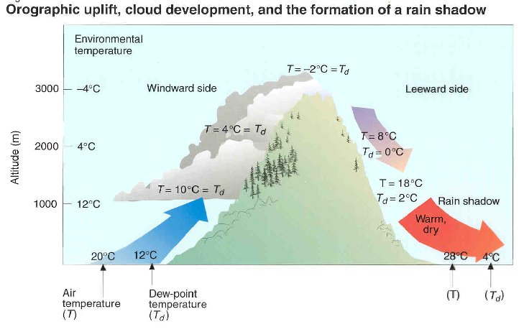
Orographic lifting
Orographic uplift occurs when air is forced to rise because of the physical presence of elevated land.

Slide 34
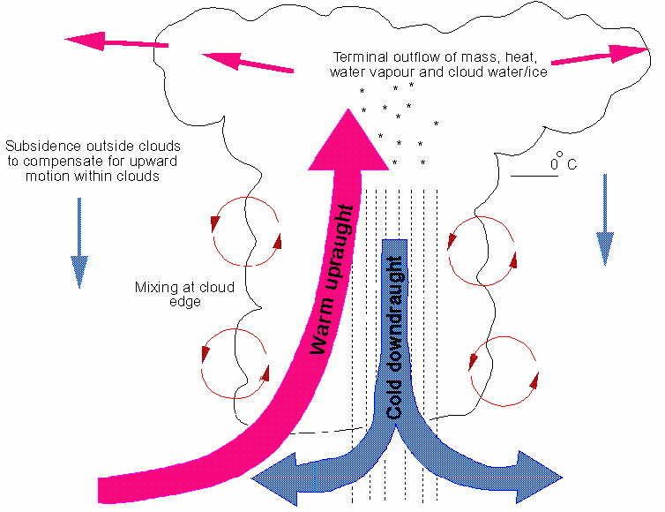
Convective lifting
Convective precipitation occurs when the air near the ground is heated by the earth’s warm surface. This warm air rises, cools and creates precipitation.
Hot earth surface

Slide 35
Incremental Rainfall
Rainfall Hyetograph

Slide 36
Cumulative Rainfall
Rainfall Mass Curve

Slide 37
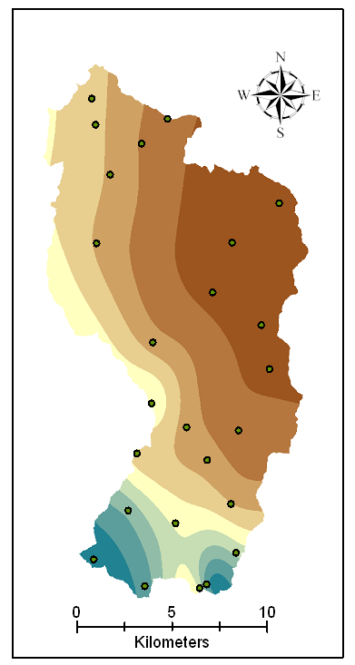
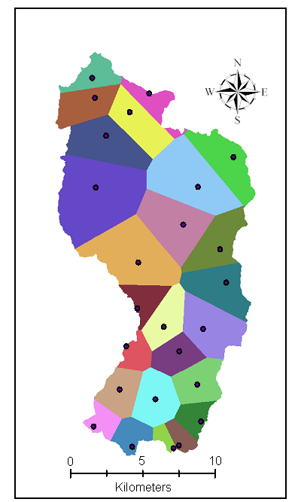
Rainfall maps in GIS
Nearest Neighbor “Thiessen” Polygon Interpolation
Spline Interpolation

Slide 38
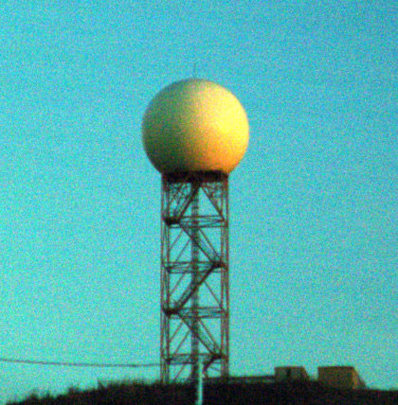

NEXRAD
NEXt generation RADar: is a doppler radar used for obtaining weather information
A signal is emitted from the radar which returns after striking a rainfall drop
Returned signals from the radar are analyzed to compute the rainfall intensity and integrated over time to get the precipitation
NEXRAD Tower
Working of NEXRAD

Slide 39
Evaporation
  Evaporation – process by which liquid water becomes water vapor
  Transpiration – process by which liquid water passes from liquid to vapor through plant metabolism
  Evapotranspiration – evaporation through plants and trees, and directly from the soil and land surface
  Potential Evaporation – evaporation from an open water surface or from a well-watered grass surface

Slide 40
ET -Eddy covariance method
Measurement of vertical transfer of water vapor driven by convective motion
Directly measure flux by sensing properties of eddies as they pass through a measurement level on an instantaneous basis
Statistical tool

Slide 41
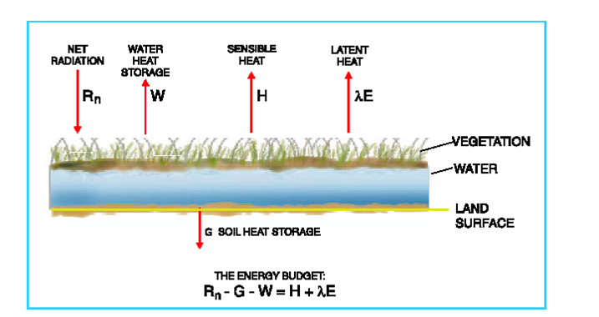
Energy Balance Method
Can directly measure these variables
How do you partition
H and λE??

Slide 42

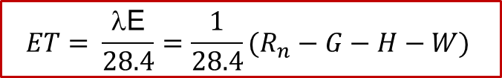

Energy Balance Method
$$\text{}$$
$$\frac{28.4 \text{W} }{m^{2} }×\frac{J/s}{W}×\frac{1 g}{2450 J}×\frac{3600 s}{ 1 hr}×\frac{24 hr}{1 day}×\frac{m^{3}}{1000 kg}×\frac{1 kg}{1000 g}×\frac{1000 mm}{1 m}=1 \frac{mm}{day}$$
$$ρ﷮w$$
$$ET= \frac{\text{λ}\text{E}}{28.4}=\frac{1}{28.4}(R_{n}−G−H−W)$$
The maximum radiative evaporation rate E_{r} = $\frac{R_{n}}{28.4}$
Temp | Lv | Density | Conversion
0 | 2501000 | 999.9 | 28.94
10 | 2477300 | 999.7 | 28.66
20 | 2453600 | 998.2 | 28.35
30 | 2429900 | 995.7 | 28.00
40 | 2406200 | 992.2 | 27.63
Conversion valid at 20°C

Slide 43
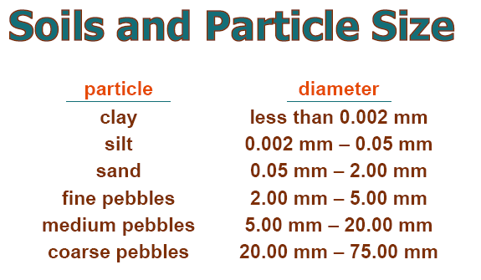
http://www.uga.edu/srel/kidsdoscience/soils-planets/soil-particle-size.pdf

Slide 44
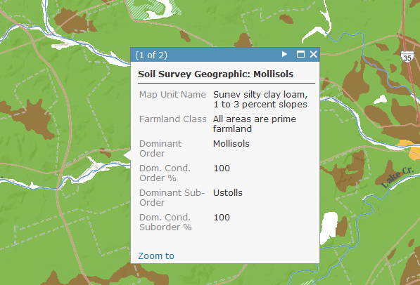
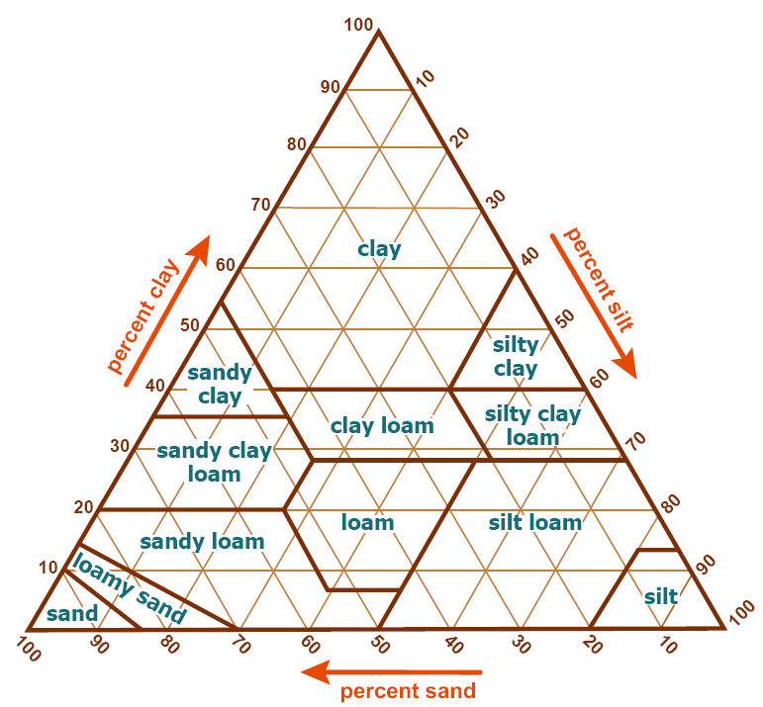
Soil Texture is defined by % of silt, sand, clay
Silty Clay Loam
~ 55% silt, 10% sand, 35% clay

Slide 45
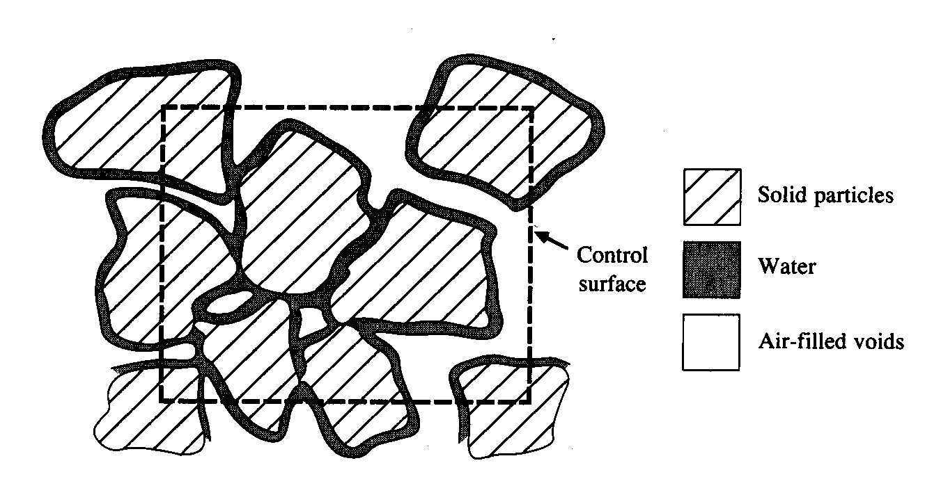
Soil Water Content
Soil Water Content

Slide 46
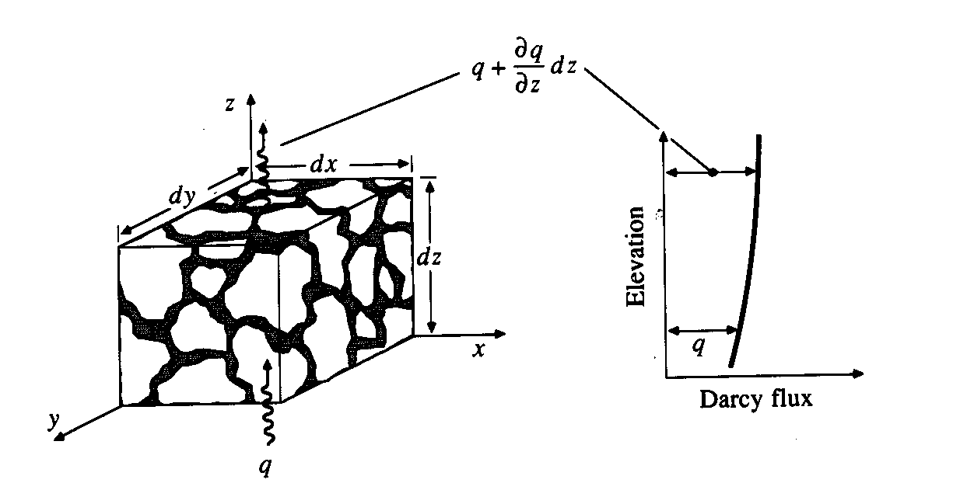
Soil Water Flux, q
q = Q/A

Slide 47
Soil Water Tension, ψ
Measures the suction head of the soil water
Like p/γ in fluid mechanics but its always a suction (negative head)
Three key variables in soil water movement
  Flux, q
  Water content, θ
  Tension, ψ
Total energy head = h
z=0
z₁
q₁₂
z₂

Slide 48
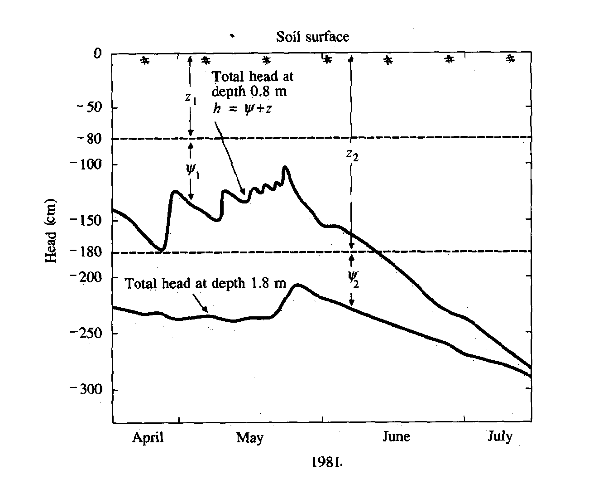

Slide 49
Richard’s Equation
Recall
  Darcy’s Law
  Total head
So Darcy becomes
Richard’s eqn is:
Soil water diffusivity

Slide 50
Infiltration
Infiltration rate, f(t)
  Rate at which water enters the soil at the surface (in/hr or cm/hr)
Cumulative infiltration, F(t)
  Accumulated depth of water infiltrating during given time period
f, F
F
f
t

Slide 51
Green – Ampt Infiltration
Ponded Water
Ground Surface
Wetted Zone
Wetting Front
Dry Soil

Slide 52
Green – Ampt Infiltration (Cont.)
Ground Surface
Wetted Zone
Wetting Front
Apply finite difference to the derivative, between
  Ground surface
  Wetting front
Dry Soil

Slide 53
Conductivity and Suction Head
(Data from Table 4.3.1)
Conductivity, K
(cm/hr)
Sand
Loamy Sand
Sandy Loam
Silt Loam
Suction Head, ψ (cm)
Loam
Sandy Clay Loam
Clay Loam
Silty Clay Loam
Sandy Clay
Silty Clay
Clay

Slide 54
Green-Ampt Parameters
(Data from Table 4.3.1)
Texture | Porosity n | Residual Porosity ϴ_{r} | Effective Porosity ϴ_{e} | Suction Head ψ (cm) | Conductivity K (cm/hr)
Sand | 0.437 | 0.020 | 0.417 | 4.95 | 11.78
Loamy Sand | 0.437 | 0.036 | 0.401 | 6.13 | 2.99
Sandy Loam | 0.453 | 0.041 | 0.412 | 11.01 | 1.09
Loam | 0.463 | 0.029 | 0.434 | 8.89 | 0.34
Silt Loam | 0.501 | 0.015 | 0.486 | 16.68 | 0.65
Sandy Clay Loam | 0.398 | 0.068 | 0.330 | 21.85 | 0.15
Clay Loam | 0.464 | 0.155 | 0.309 | 20.88 | 0.10
Silty Clay Loam | 0.471 | 0.039 | 0.432 | 27.30 | 0.10
Sandy Clay | 0.430 | 0.109 | 0.321 | 23.90 | 0.06
Silty Clay | 0.470 | 0.047 | 0.423 | 29.22 | 0.05
Clay | 0.475 | 0.090 | 0.385 | 31.63 | 0.03

Slide 55
Green-Ampt Porosity
(Data from Table 4.3.1)
0.09
0.45
ϴ_{r}
ϴ_{e}
Total porosity ~ 0.45
Clay soils retain water in ~ 20% of voids when dry
Other soils retain water in ~ 6% of voids when dry
0.03

Slide 56
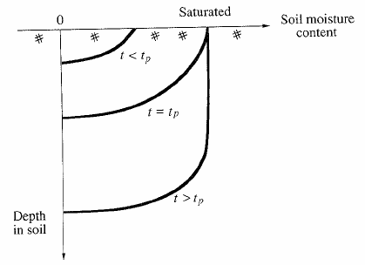
Ponding time
Elapsed time between the time rainfall begins and the time water begins to pond on the soil surface (t_{p})

Slide 57
Ponding Time
Up to the time of ponding, all rainfall has infiltrated (i = rainfall rate)
Potential
Infiltration
Infiltration rate, f
Rainfall
Actual Infiltration
Accumulated
Rainfall
Time
Cumulative
Infiltration, F
Infiltration
Time

Slide 58
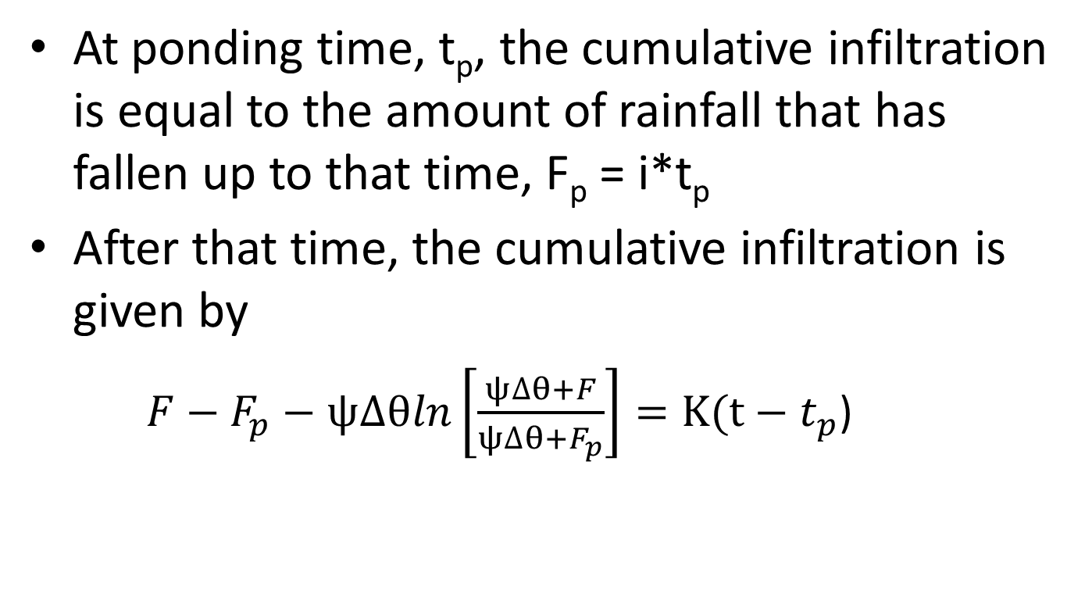
Infiltration after ponding has occured
At ponding time, t_{p}, the cumulative infiltration is equal to the amount of rainfall that has fallen up to that time, F_{p} = i*t_{p}
After that time, the cumulative infiltration is given by
  ${F−F}_{p}−ψ∆θln\left[\frac{ψ∆θ+F}{ψ∆θ+F_{p}}\right]=K(t−t_{p}$)

Slide 59
Hortonian Flow
Sheet flow described by Horton in 1930s
When i<f, all i is absorbed
When i > f, (i-f) results in rainfall excess
Applicable in
  impervious surfaces (urban areas)
  Steep slopes with thin soil
  hydrophobic or compacted soil with low infiltration
Rainfall, i
i > q
Infiltration, f
Later studies showed that Hortonian flow rarely occurs on vegetated surfaces in humid regions.

Slide 60
Subsurface flow
Lateral movement of water occurring through the soil above the water table
primary mechanism for stream flow generation when f>i
  Matrix/translatory flow
    Lateral flow of old water displaced by precipitation inputs
    Near surface lateral conductivity is greater than overall vertical conductivity
    Porosity and permeability higher near the ground
  Macropore flow
    Movement of water through large conduits in the soil

Slide 61
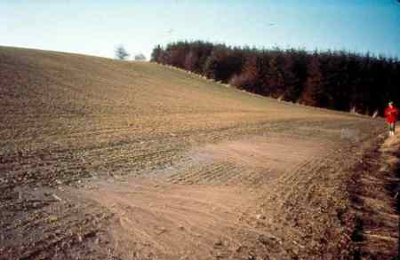
Saturation overland flow
Soil is saturated from below by subsurface flow
Any precipitation occurring over a saturated surface becomes overland flow
Occurs mainly at the bottom of hill slopes and near stream banks

Slide 62
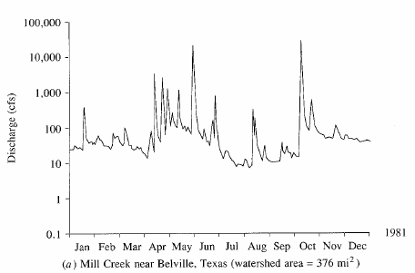
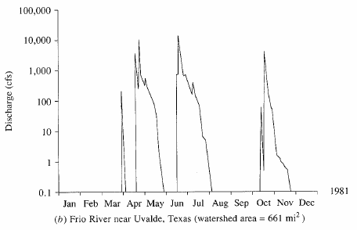
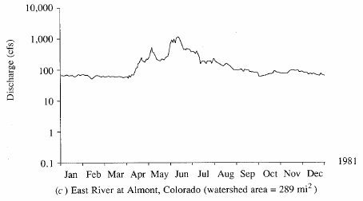
Streamflow hydrograph
Direct runoff
Graph of stream discharge as a function of time at a given location on the stream
Baseflow
Perennial river
Ephemeral river
Snow-fed River

Slide 63
SCS method
Soil conservation service (SCS) method is an experimentally derived method to determine rainfall excess using information about soils, vegetative cover, hydrologic condition and antecedent moisture conditions
The method is based on the simple relationship that P_{e} = P - F_{a} – I_{a}
P_{e} is runoff depth, P is precipitation depth, F_{a} is continuing abstraction, and I_{a} is the sum of initial losses (depression storage, interception, ET)
Precipitation
Time

Slide 64
Abstractions – SCS Method
In general
After runoff begins
Potential runoff
SCS Assumption
Combining SCS assumption with P=P_{e}+I_{a}+F_{a}
Precipitation
Time

Slide 65
SCS Method (Cont.)
Experiments showed
So
Surface
  Impervious: CN = 100
  Natural: CN < 100

Slide 66
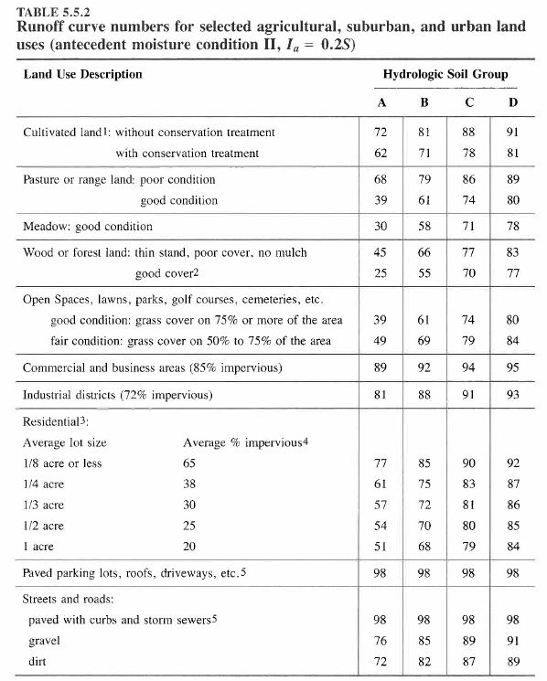
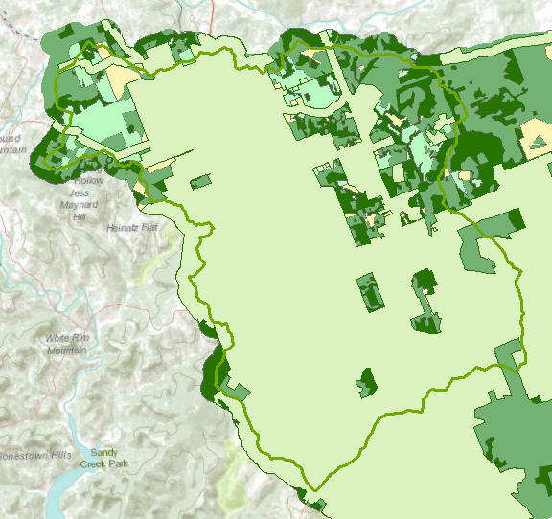
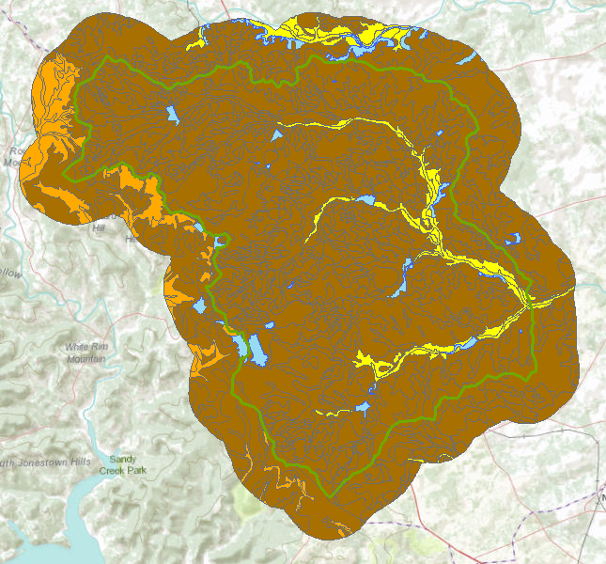
CN Table

Slide 67
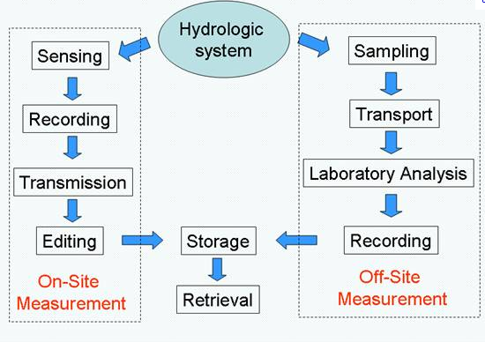
Hydrologic Measurement
Precipitation, Climate, Stream Gaging
Water Quality Sampling

Slide 68
Stream Flow Rate
Water Surface
Height
above
bed
Depth
Averaged
Velocity
Velocity
Velocity profile in stream
Discharge at a cross-section

Slide 69
Rating Curve
It is not feasible to measure flow daily.
Rating curves are used to estimate flow from stage data
Rating curve defines stage/streamflow relationship
http://nwis.waterdata.usgs.gov/nwis/measurements/?site_no=08158000

Slide 70
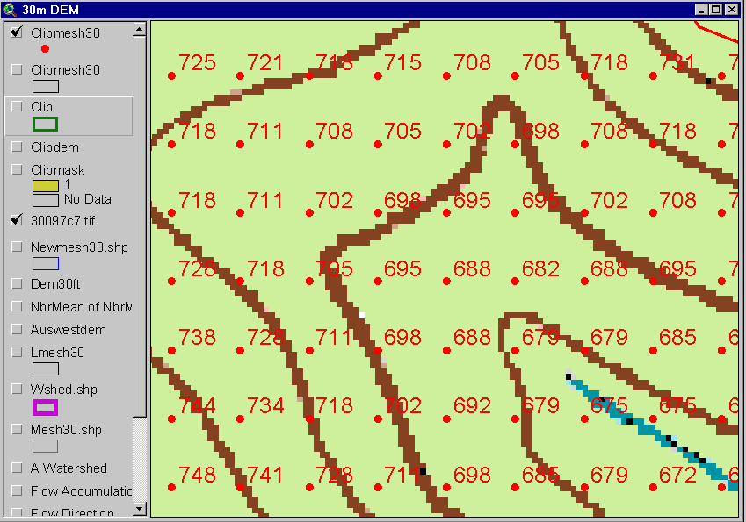
Digital Elevation Model (DEM)
720
720
Contours
740
720
700
680
740
720
700
680

Slide 71
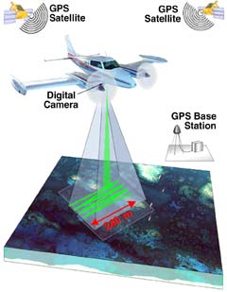
LIDAR surveying
LIDAR (Light Detection and Ranging; or Laser Imaging Detection and Ranging) is a technology that determines distance to an object or surface using laser pulses. Like the similar radar technology, which uses radio waves instead of light, the range to an object is determined by measuring the time delay between transmission of a pulse and detection of the reflected signal.

Slide 72
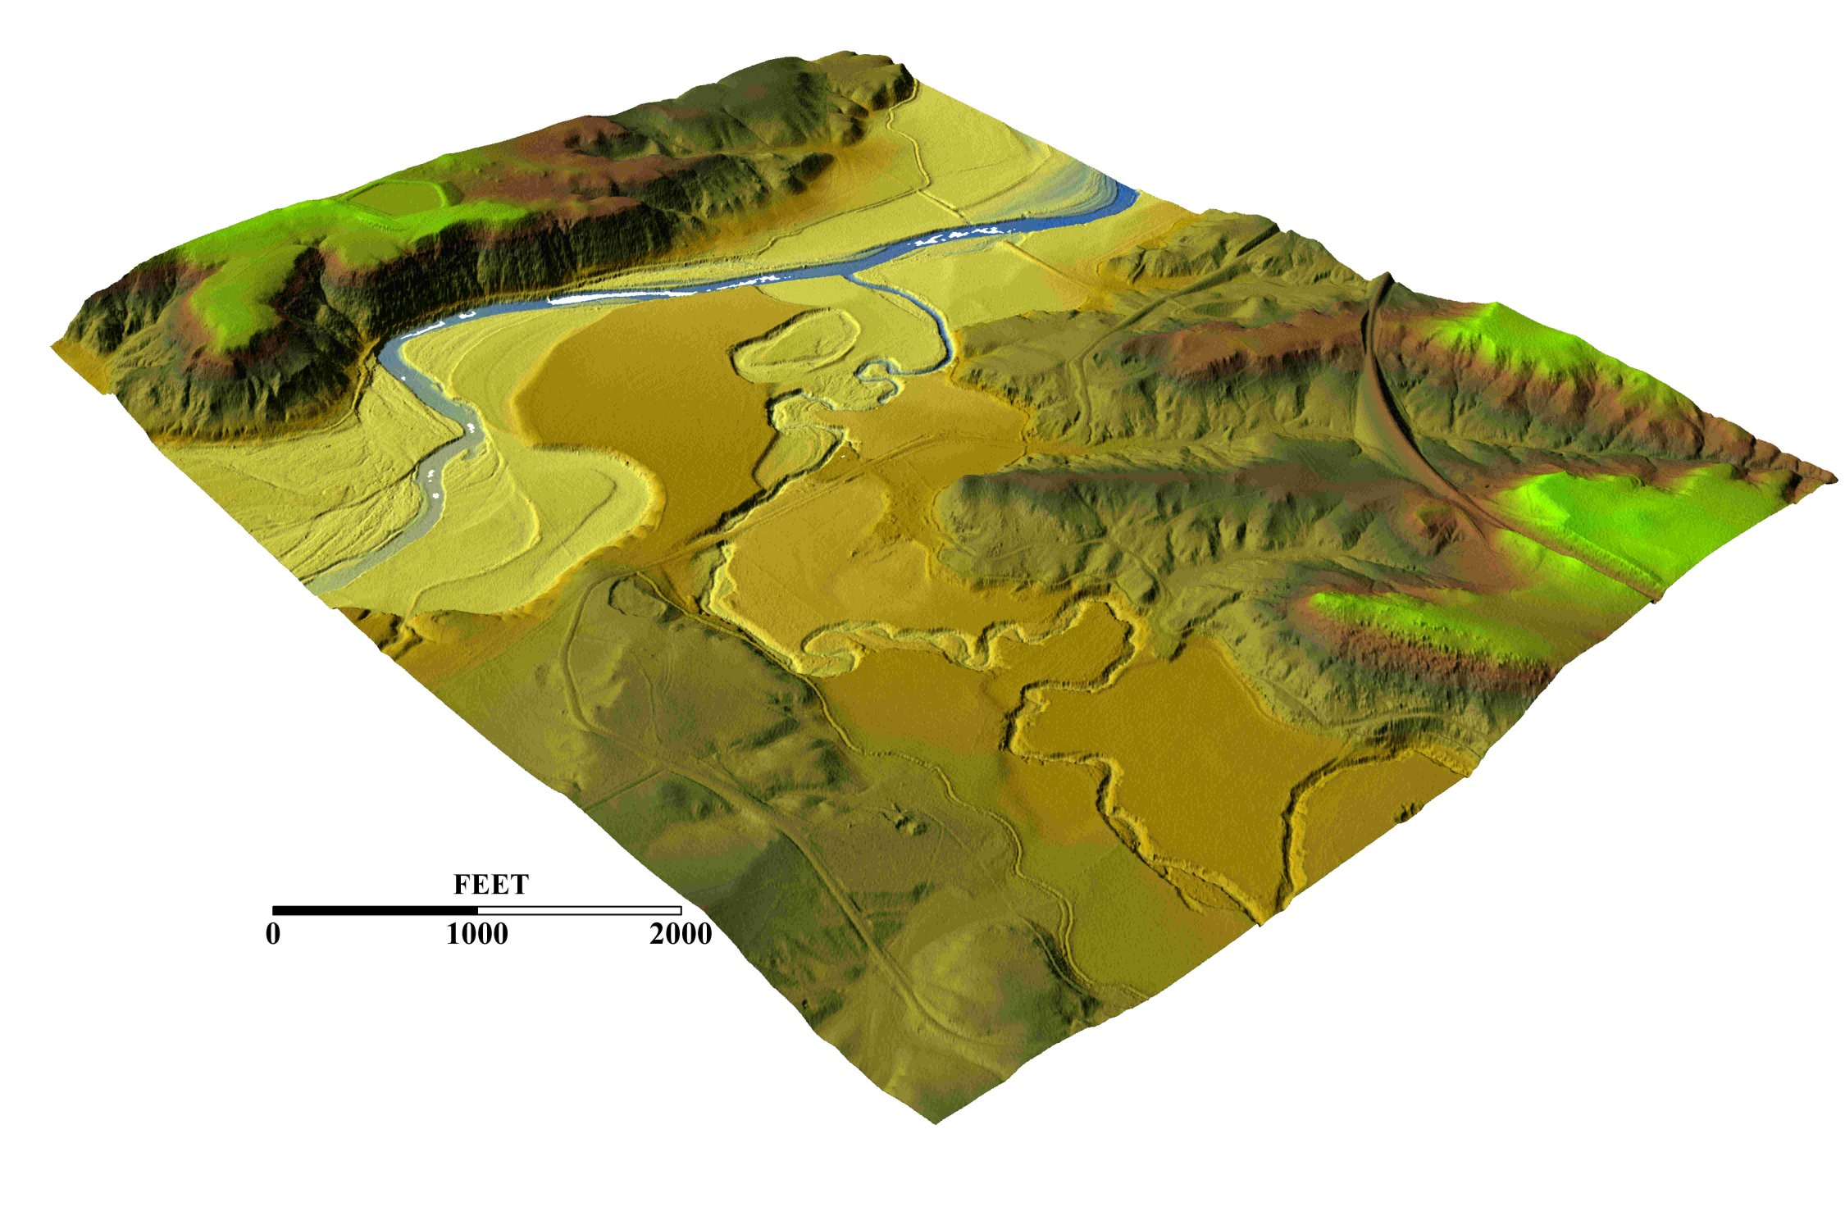
3-D detail of the Tongue river at the WY/Mont border from LIDAR.
Roberto Gutierrez
University of Texas at Austin

