Slide 1
Parking Lot 53 Drainage
by John Anderson, Martin Bermudez, and Megan Jordan
Notes:
Martin

Slide 2
Overview
Representation
Process
Evaluation
Goals
Change
Pervious pavement
Detention Ponds
Impact
Design
Notes:
Martin

Slide 3
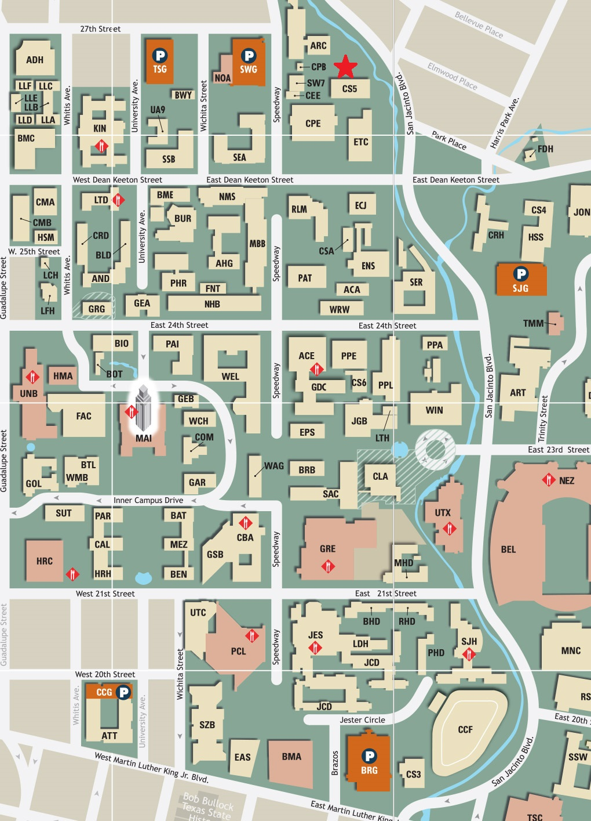
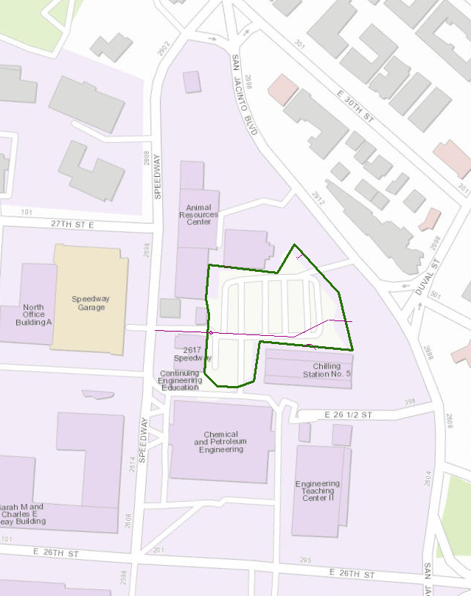
Representation
Study are located between Speedway and San Jacinto Boulevard
Notes:
Megan

Slide 4
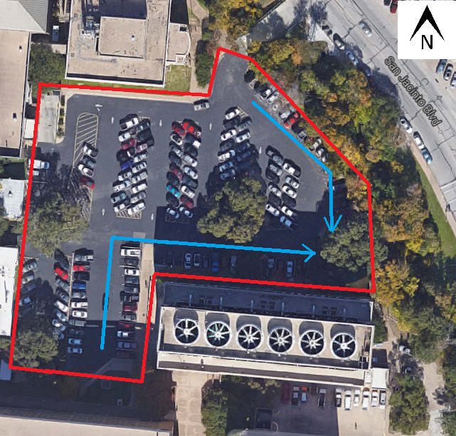
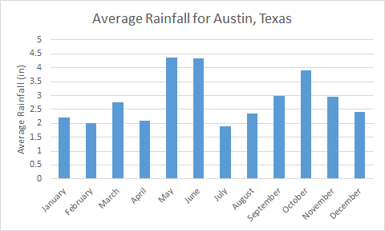
Process
Drainage area: 66,500 ft2
Average yearly rainfall: 34.25 inches
Peak month: May
Notes:
Megan

Slide 5
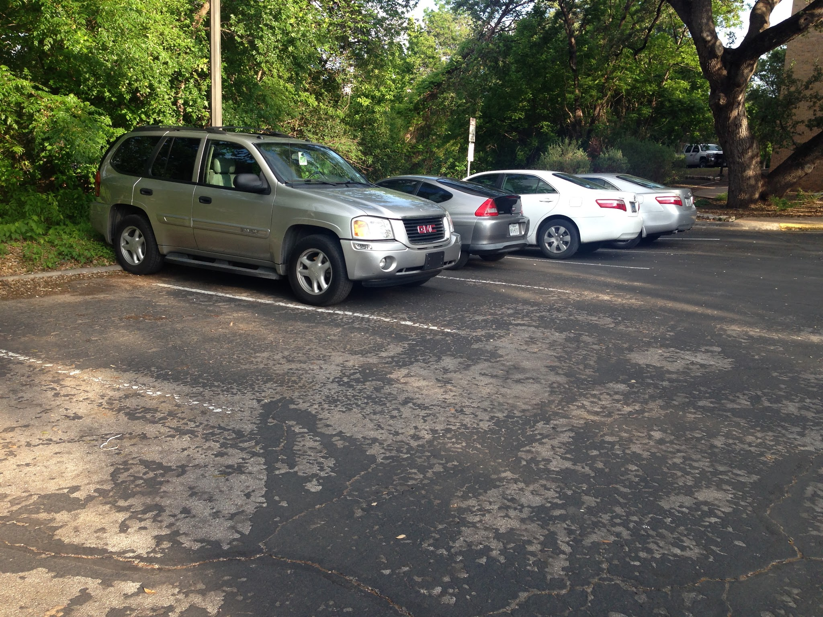
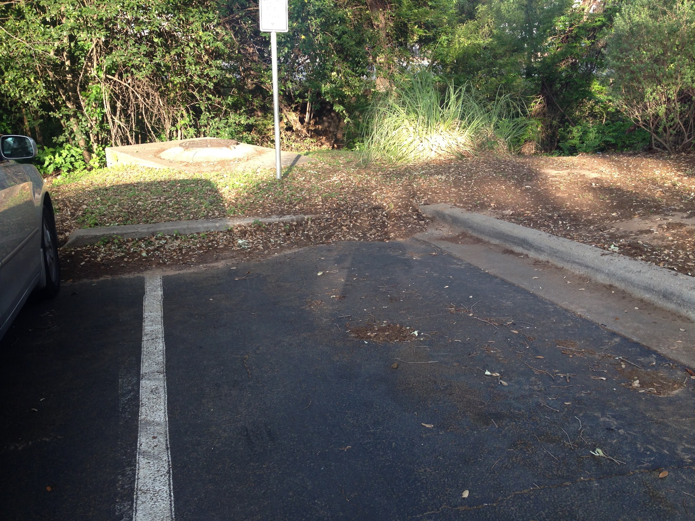
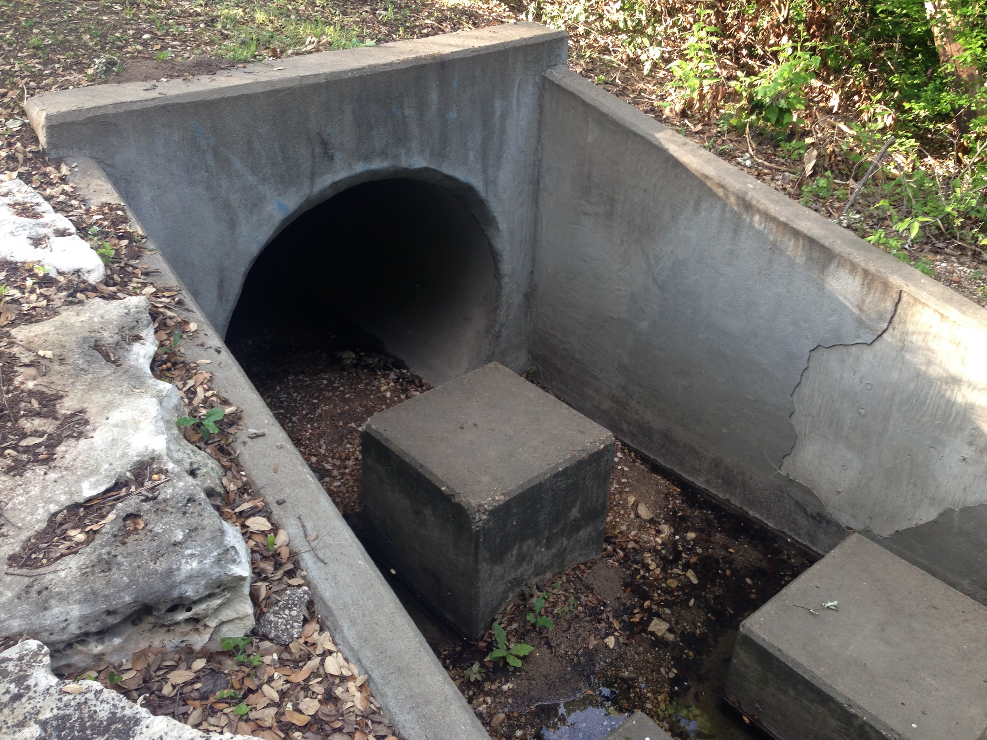
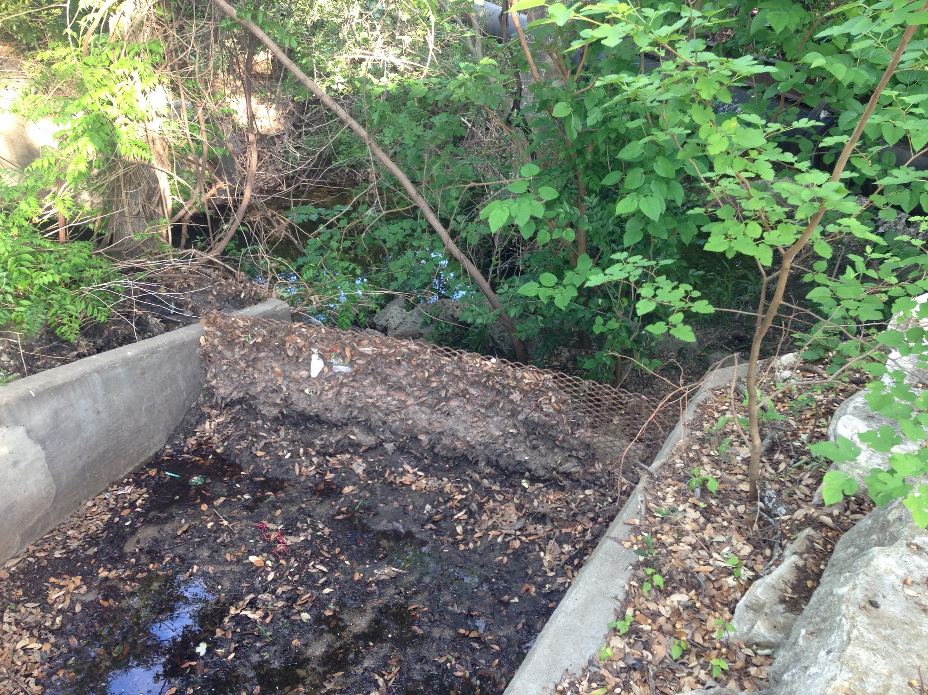
Evaluation
Findings:
One large outlet
Three curb cuts for the parking lot
Erosion along the bank of Waller Creek
Large amount of sediment build up near curb cuts
Conclusion:
Staff Parking Lot 53 could benefit from low-impact design solutions
Notes:
John

Slide 6
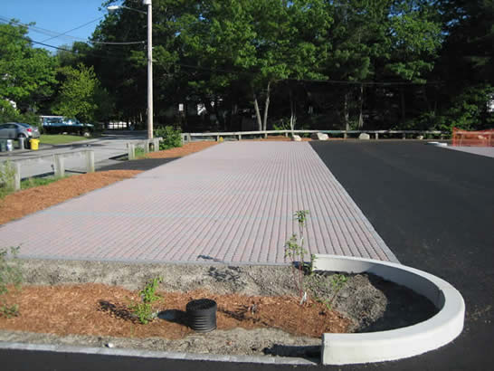
Change
How might the study area be altered?
Pervious pavement
Bioretention/detention pond
Notes:
John: We look to apply Low Impact Design, either through pervious pavement or a Bioretention pond or a combination of the two, to reduce the the peak discharge rate currently experienced by the parking lot.

Slide 7
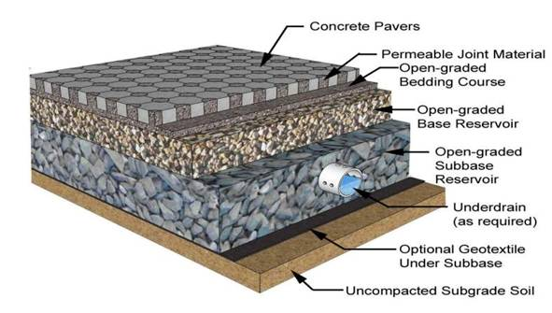
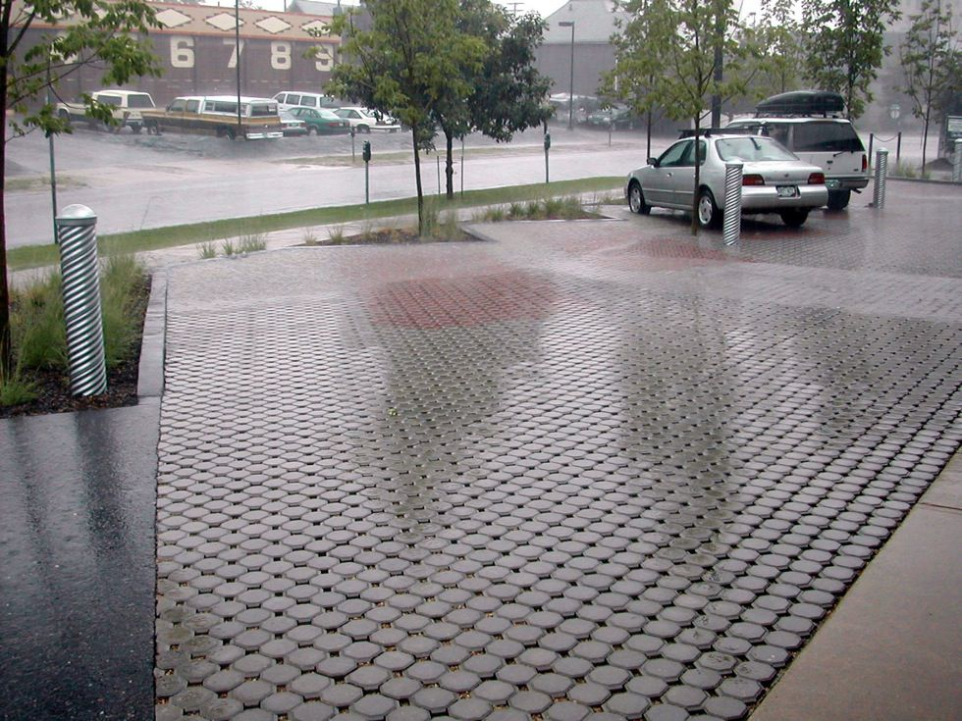
Pervious Pavement
Reduces surface runoff through infiltration
Pollutant removal
Aesthetically pleasing
Notes:
Martin: infiltration can reduce surface runoff, by avoiding large volumes of urban runoff we can avoid erosion/channel degradation.
keeps the pollutants in place in the soil. prevents them from washing downstream and accumulating in the surrounding environment.
cost could be a disadvantage__mention ideas about only including parking spaces affected.

Slide 8
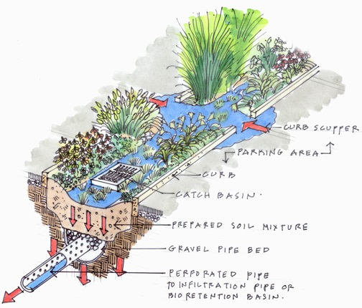
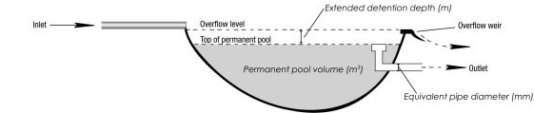
Detention Ponds
Detention pond acts as sedimentation basin
Underlain soil provides pollutant filtering
Decreases peak discharge rate
Plant life increases aesthetics
Notes:
Megan

Slide 9
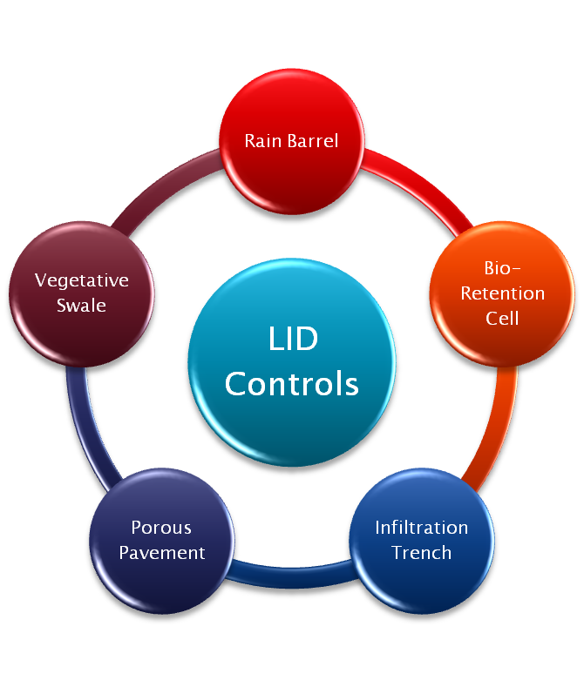
Impact
Improve water quality of the runoff
Decrease erosion on the bank
Improve aesthetics in the parking lot
Optimize the number of parking spots
Notes:
John

Slide 10
Decision
Steps left to take:
Finish ArcGIS model in order to find slope and watershed area
Use rational method in order to determine current peak discharge
Use ICPI Permeable Design Pro to assess if pervious pavement will provide a solution that will reduce the current peak runoff discharge.
Analyze the effectiveness of a Bioretention/detention pond
Create a cost analysis for each solution
Choose one or both solutions to be implemented based on both cost and runoff reduction
Notes:
John

Slide 11
Questions?

