Slide 1
38th ½ Street Improvements
(between Grayson and Airport)
Group 10:
Jordan Alvarez
Emily Tat
Charles Yamashiro

Slide 2
Outline
Representation
  Description of project site
    Drainage area
Process
  Operation of study area
    Existing drainage
    Slope calculations / contour map
    Simulation under 10 year storm condition
Evaluation
  Performance of study area
    Current conditions
    Problems
    Goals
Changes
  Design problem and objectives
    North alternatives and proposed change
    South proposed change
Impact
Decision
  Design selection
    Design implementation
    Approximate cost estimate
Q&A

Slide 3
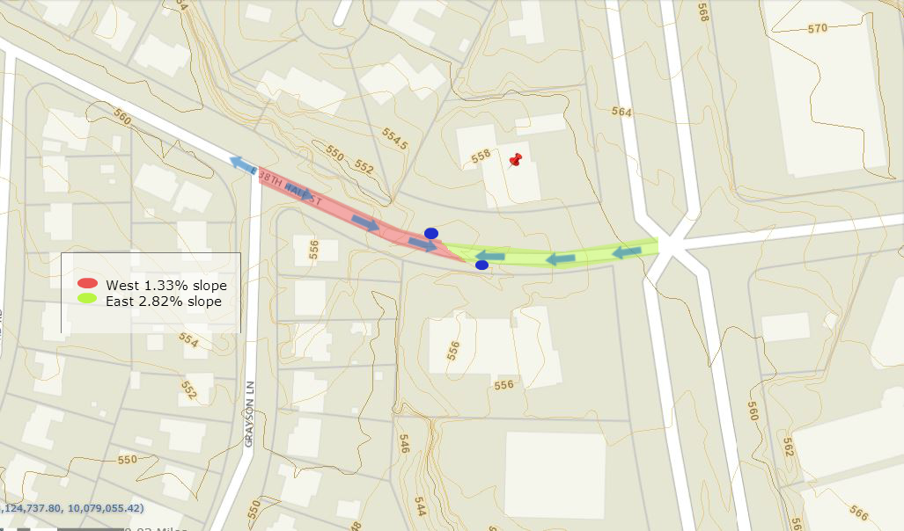
Representation
Project Site
how should the study area be described?
EXISTING CONDITIONS
Located in east Austin
Asphalt pavement
2-lane roadway; 10-12 ft widths
Scope of project focuses on 38th ½ from Grayson to Airport
468 ft stretch of road
Slope of the street found using Austin GIS contour map

Slide 4
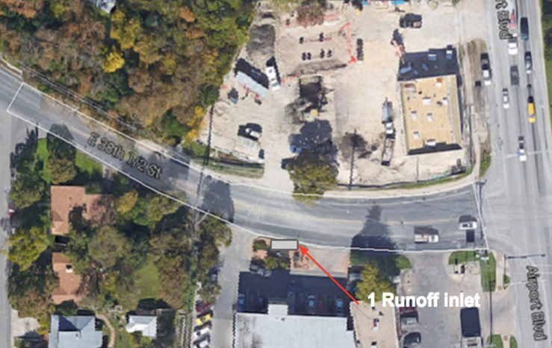
Drainage Area
A2
A4
A1
A3
A5
A6
Total drainage area: 28,569 sq. ft. (0.655 acres)
Software used: AutoCAD

Slide 5
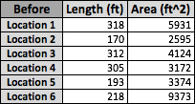

Process
how does the study area operate?
The current study area has a rainfall depth of around 7.17 in on the north side of the street, and a rainfall depth of around 7.59 in on the south side of the street.

Slide 6
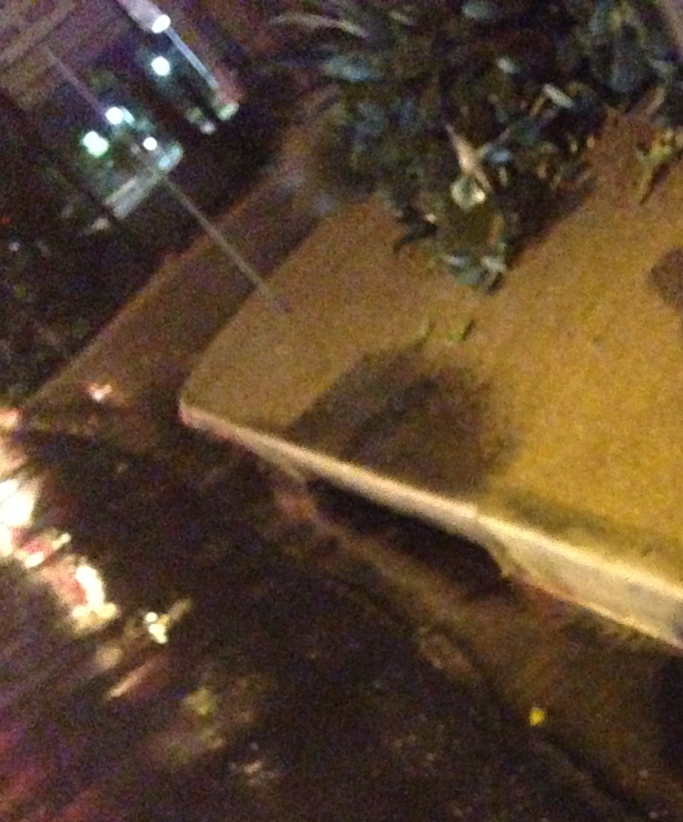
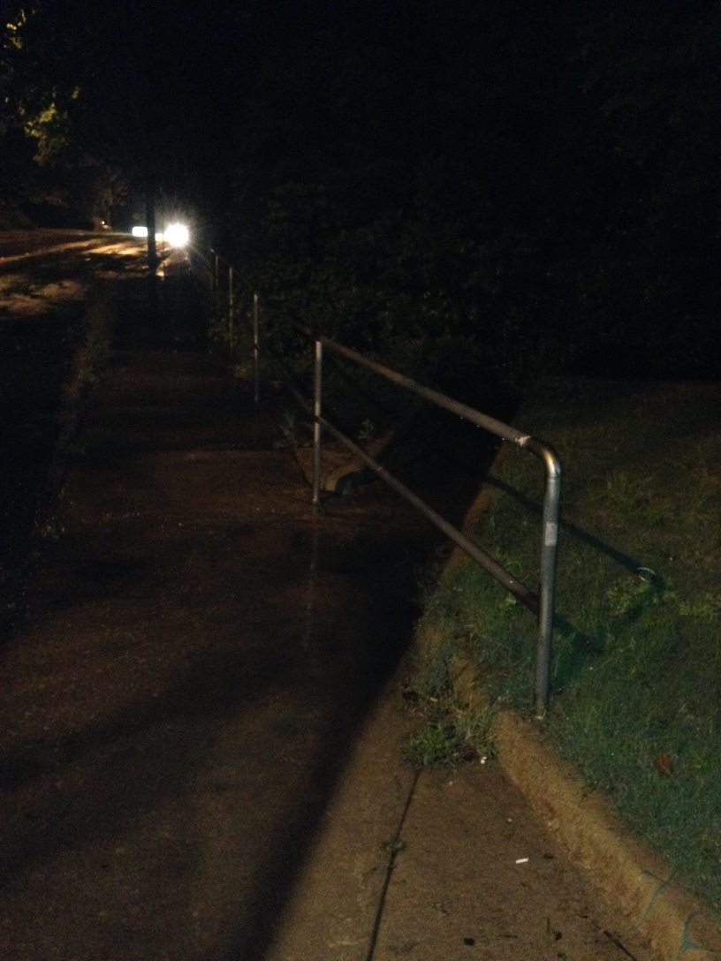
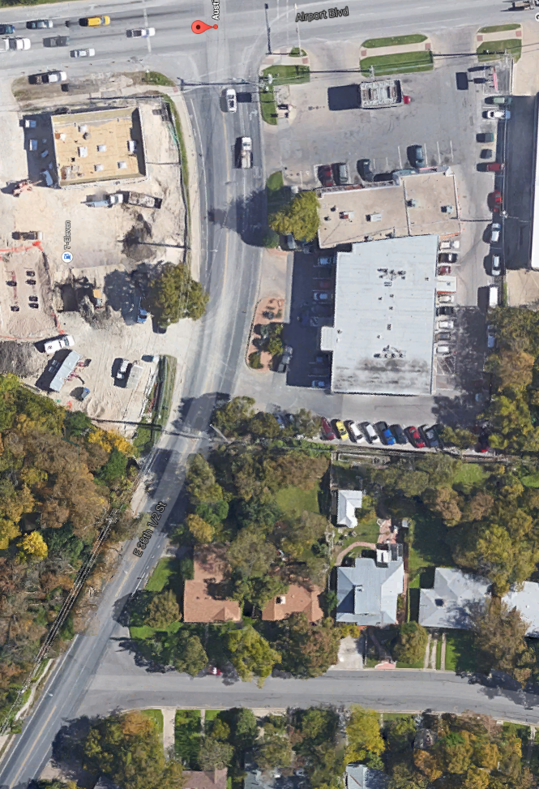
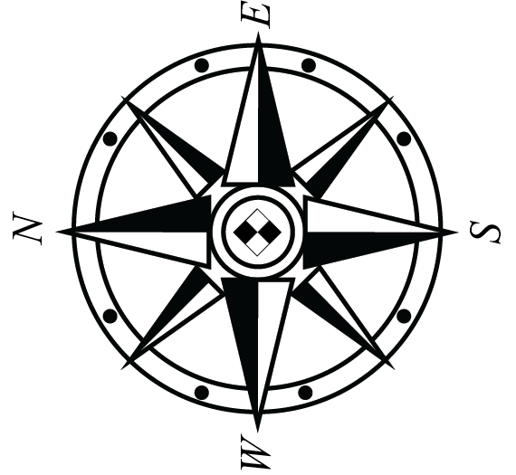
Existing
Drainage
Airport Blvd.
Grayson Ln.

Slide 7
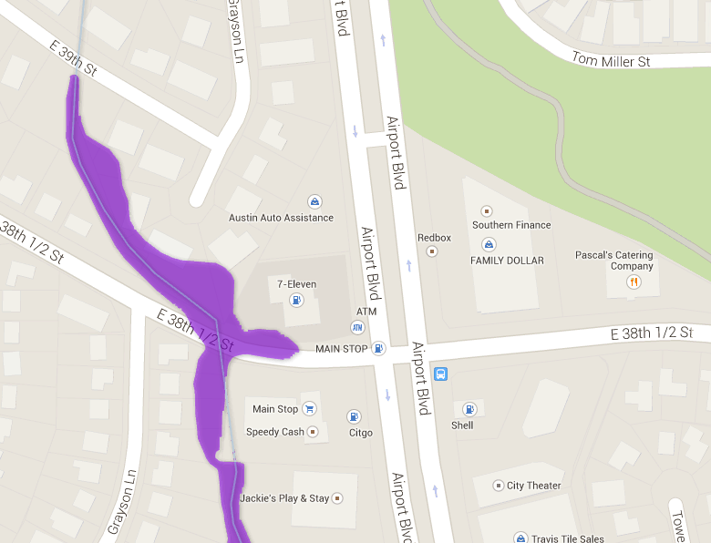
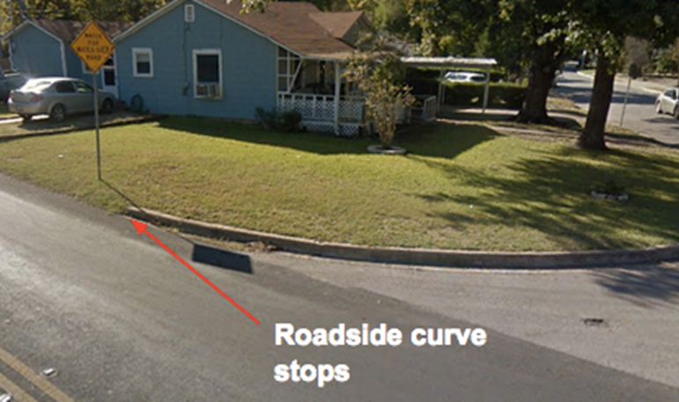
Evaluation
is the current study area working well?
City of Austin lists this as a flood zone
Also observed to flood during a typical 1-2 year storm (April 18th)
Roadside Curb Stops
City of Austin Flood Plain Maps, http://www.atxfloods.com/FP_mods/Map.html

Slide 8
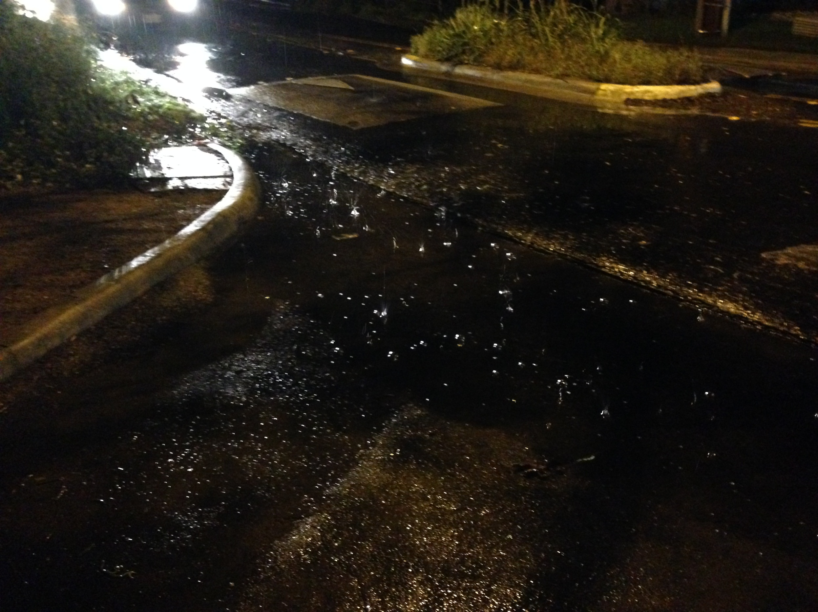
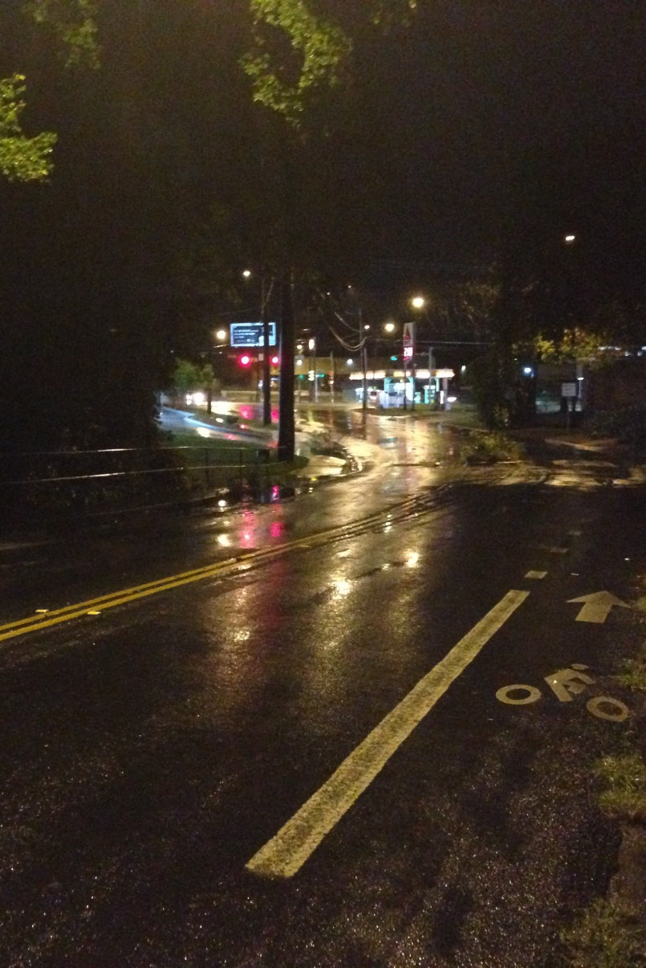
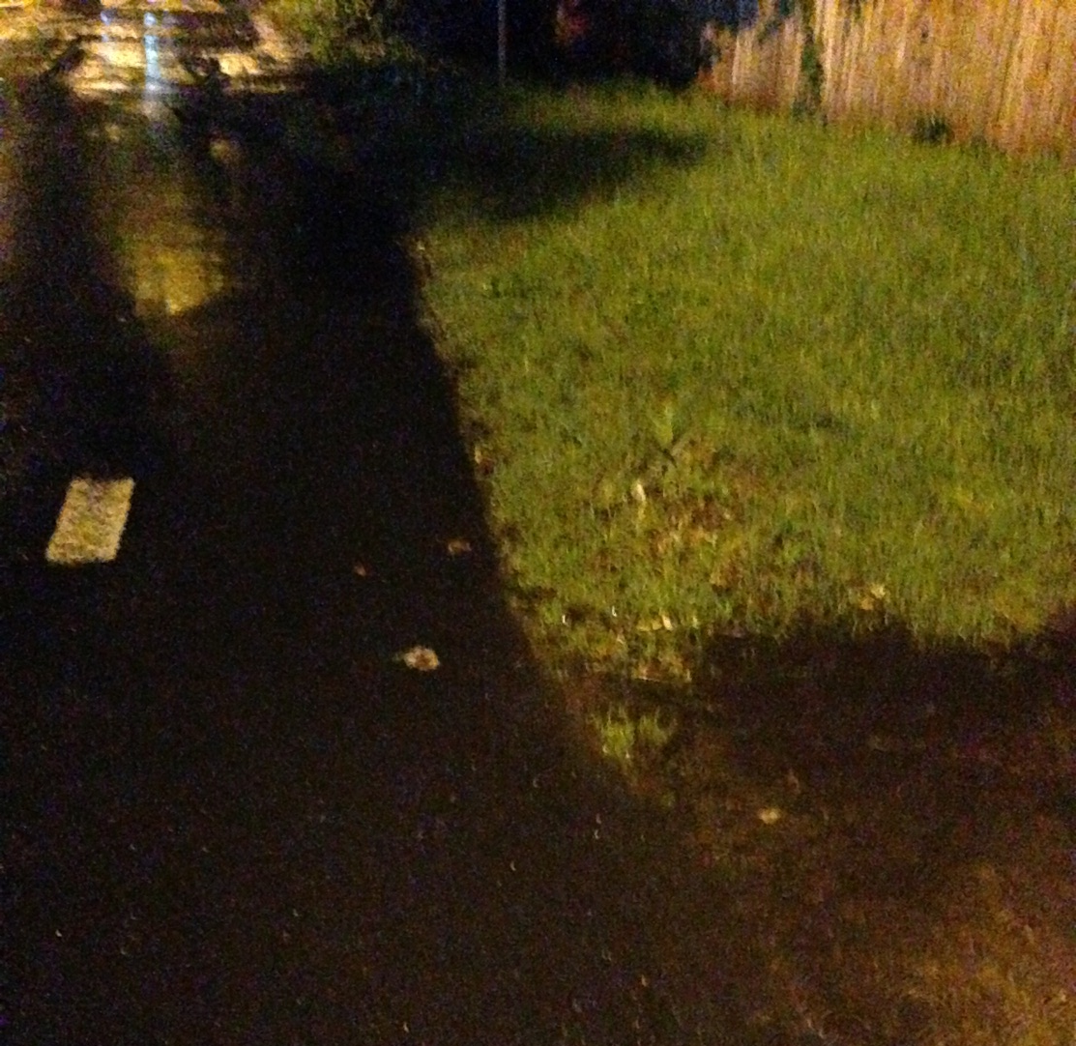
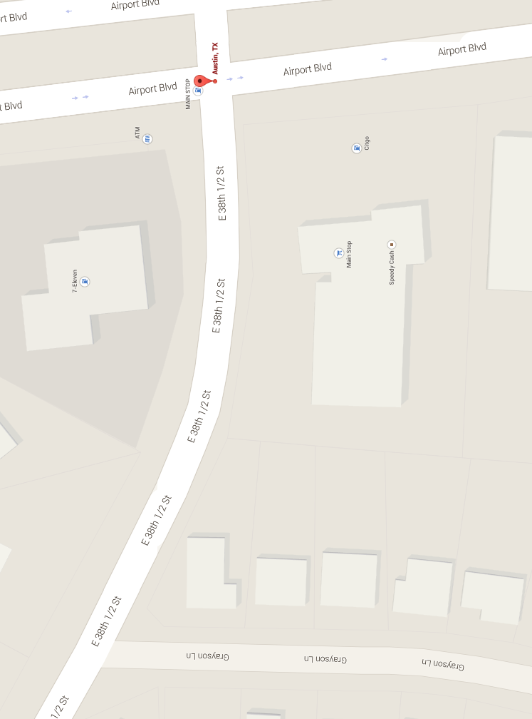

Problems

Slide 9
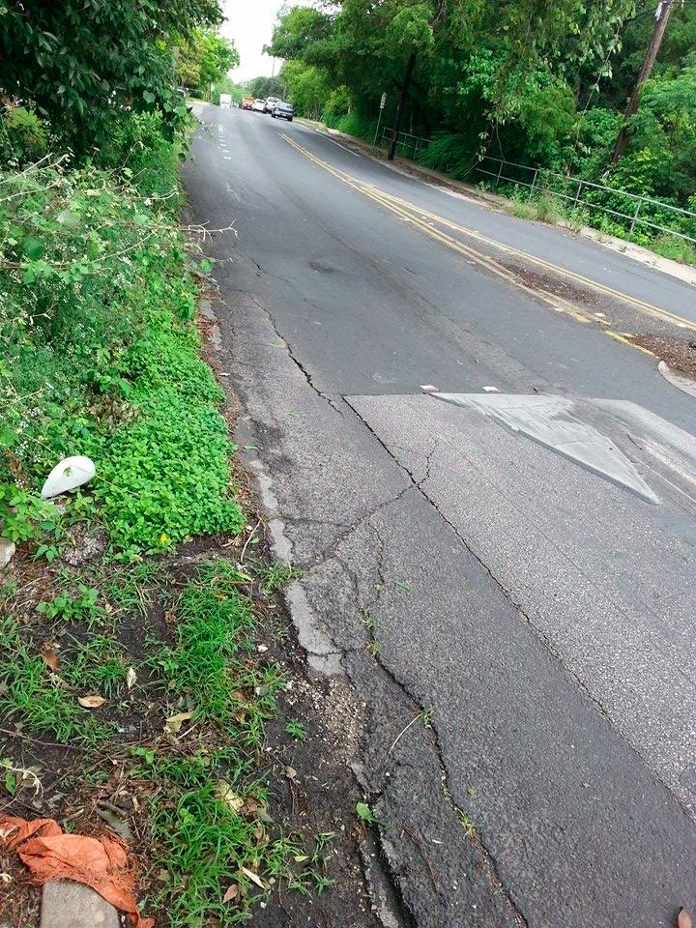
Summary of Current Problems
Water ponding downstream of both inlets
Lack of curb around residence
Flooding in residential neighbourhood

Slide 10
Change
how might the study area be altered?
Problem:
38th ½ St between Airport Blvd and Grayson Lane is a flood zone
Our objective is to improve the drainage to mitigate flooding by adding:
  - curbs to direct flow on south side of street
  - one inlet on each side of street where ponding is currently occurring

Slide 11
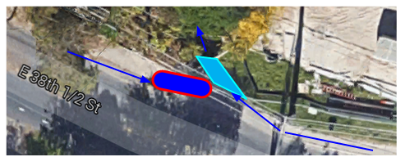
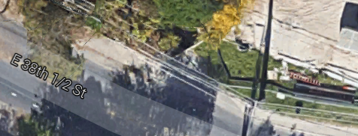
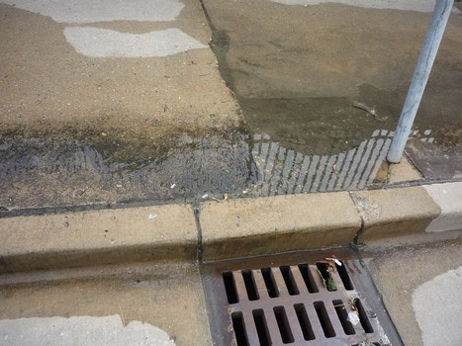
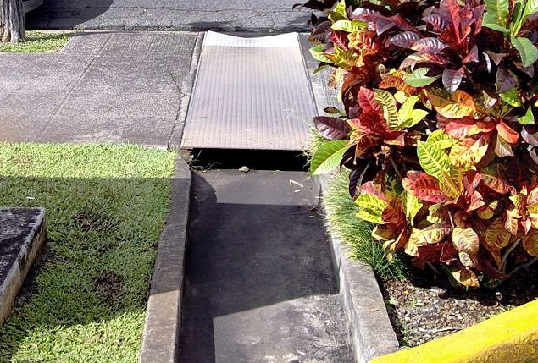
North Alternatives
GOAL:
connect west storm water runoff to the existing drainage flume on north side of street
Option 1
Option 2

Slide 12
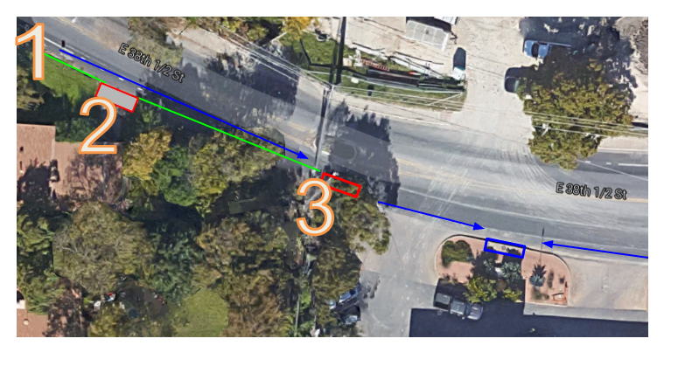
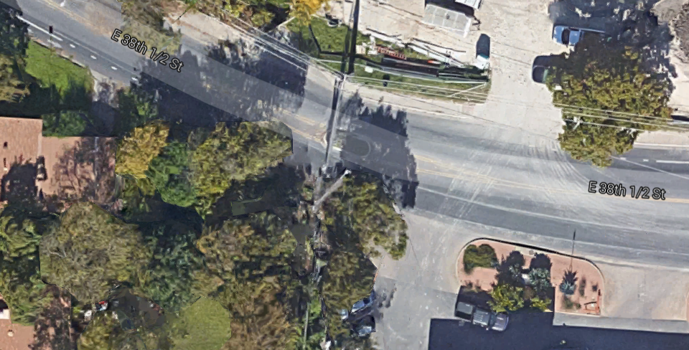
South Proposed Changes
1
2
3

Slide 13
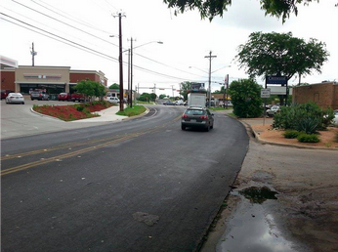
Impact
what differences would the changes cause?

Slide 14
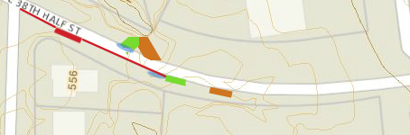
Decision
how should the study area be changed?

Slide 15
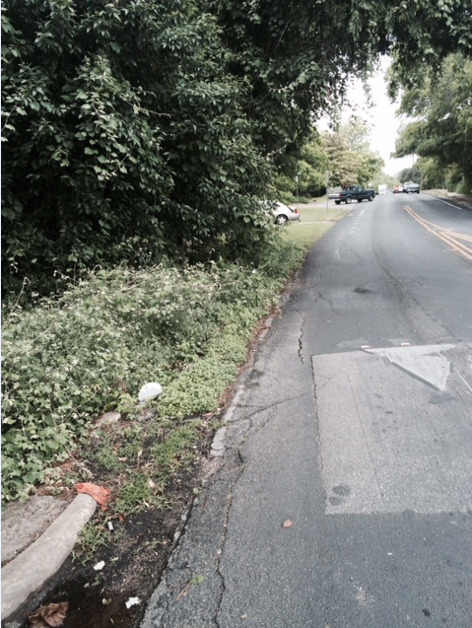
Curb
Installation of a curb along 38th ½ St would help decrease flooding in this region by allowing more stormwater to be directed towards the drain inlet
217 ft of curb at 6”
Extend roadside curb

Slide 16
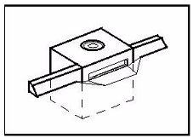
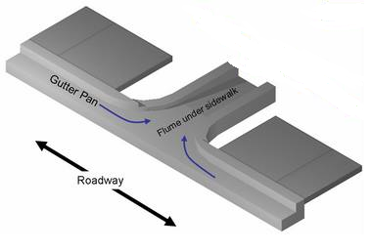
Inlets
South Side
Stormwater Inlet
Length = 5 ft
North Side
Under Sidewalk Flume
Length = 2 ft

Slide 17
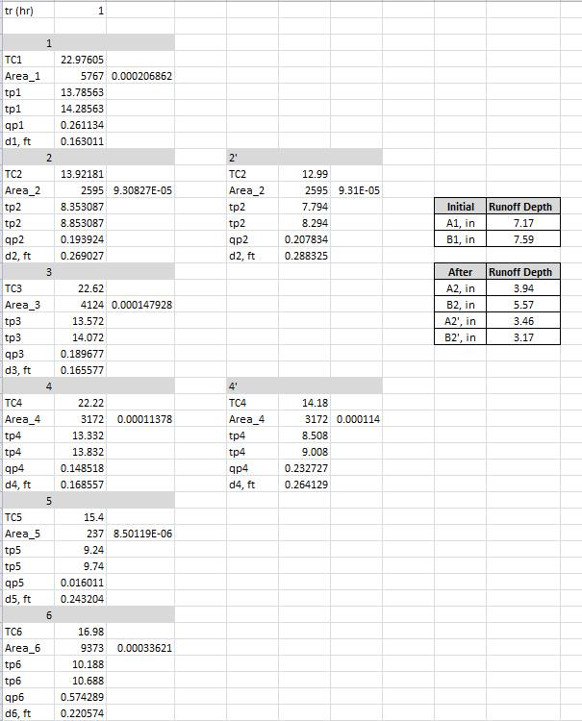
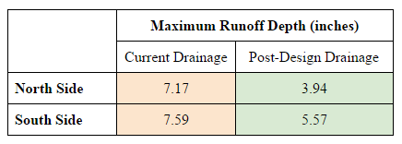
Additional Inlets Analysis
Excel Calculations using SCS Method

Slide 18
Approximate Cost Estimate
Item | Unit Cost | Quantity | Total Cost
Curb (Installation, Materials) | $15.49 / ln. ft. | 217 | $3361.33
Inlet (Installation, Design, and Road Repair) | $12500 / inlet | 1 | $12500.00
Flume (Installation, Design, Road Repair) | $3500 / flume | 1 | $3500.00
Plate Cover | $613.20 / plate | 1 | $613.20
 |  | Subtotal | $19,974.53
20% Contingency | $3994.91 | TOTAL | $23,969.44
Notes:
http://www.homewyse.com/services/cost_to_install_concrete_curb.html - curb cost, zip code 78705, mid average: $15.49 / ln ft
Currently we are estimating a cost of approximately $12,500
$5,000 in design fees
$5,000 for inlet installation
$2,500 for road repair
*Based on TxDOT’s bid tab’s data.
http://www.metalsdepot.com/catalog_cart_view.php?msg=
Diamond plate cover - 2 x 4 = $613

Slide 19
Questions?
Notes:
http://www.ce.utexas.edu/prof/maidment/CE365KSpr15/Docs/Assessment.pdf

