Slide 1



Driverless Cars: Implications for Travel Behavior - #AutoBhatSX
Dr. Chandra Bhat (with Prof. Pendyala of ASU)
Center for Transportation Research
University of Texas

Slide 2
Outline
Motivation
Automated vehicle technology
Activity-travel behavior considerations
Infrastructure planning & modeling implications
Conclusions

Slide 3
The Context
Automated Vehicles: Vehicles that are able to guide themselves from an origin point to a destination point desired by the individual
Individual yields near-full or partial control to artificial intelligence technology
  Individual decides an activity-travel plan (or tour-specific information)
  The plan is keyed into the car’s intelligence system
  The car (or an external entity connected to the car) decides on a routing and circuit to complete the plan

Slide 4
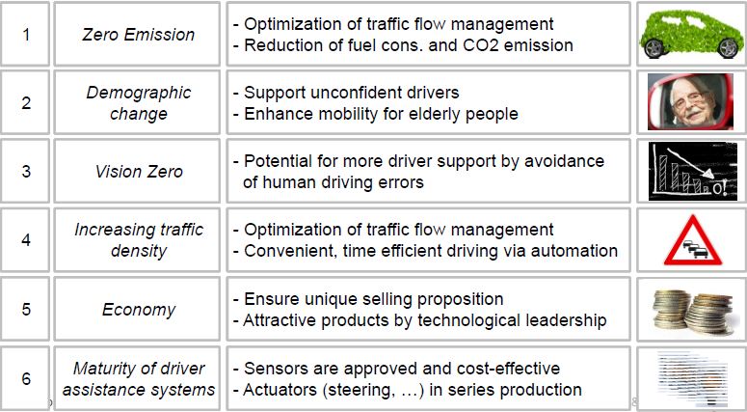
Motivation

Slide 5
McKinsey: Autonomous Cars One of 12 Major Technology Disruptors
Source: Disruptive Technologies:
Advances that will transform life,
Business, and the global economy
McKinsey Global Institute
May 2013

Slide 6
Automated Vehicles and Transportation
Technology
Infrastructure
Traveler
Behavior

Slide 7
Automated Vehicle Technology

Slide 8
Two Types of Technology
Self-Driving Vehicle (e.g., Google) | Connected Vehicle
AI located within the vehicle | AI wirelessly connected to an external communications network
“Outward-facing” in that sensors blast outward from the vehicle to collect information without receiving data inward from other sources | “Inward-facing” with the vehicle receiving external environment information through wireless connectivity, and operational commands from an external entity
AI used to make autonomous decisions on what is best for the individual driver | Used in cooperation with other pieces of information to make decisions on what is “best” from a system optimal standpoint
AI not shared with other entities beyond the vehicle | AI shared across multiple vehicles
A more “Capitalistic” set-up | A more “Socialistic” set-up

Slide 9
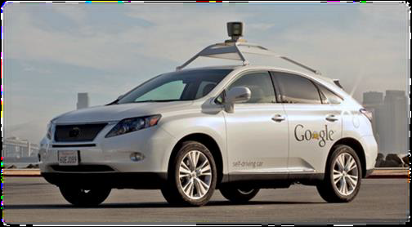
Autonomous (Self-driving) Vehicle
Google cars driven 500,000 miles – Release Date Expected 2018

Slide 10

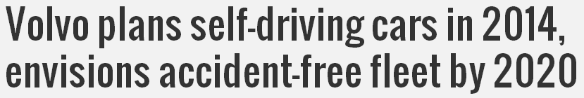
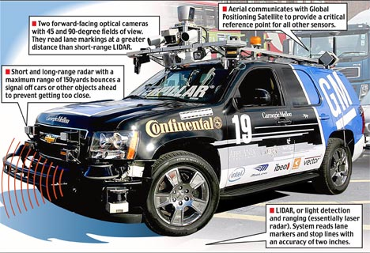
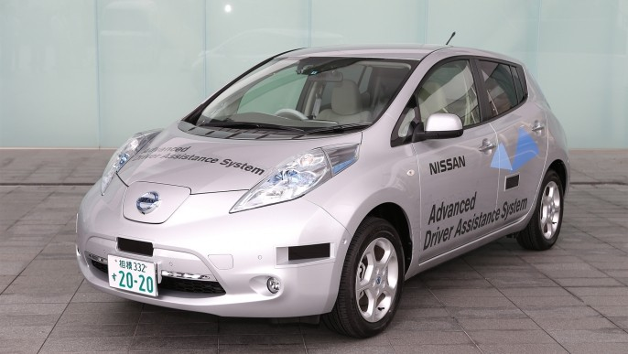

Autonomous (Self-driving) Vehicle

Slide 11
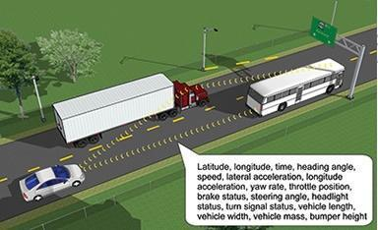
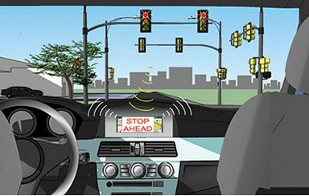
Connected Vehicle Research
Addresses suite of technology and applications using wireless communications to provide connectivity
  Among vehicle types
  Variety of roadway infrastructure

Slide 12
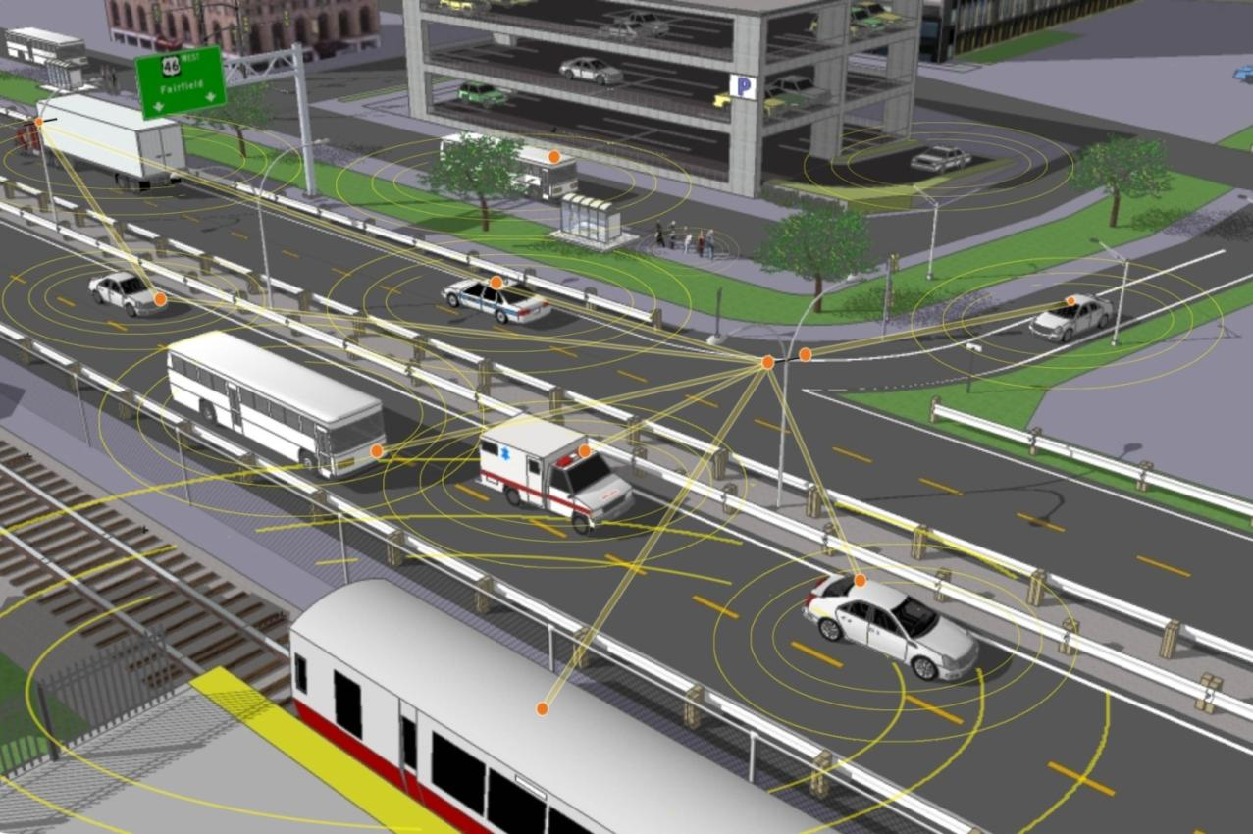
Connected Vehicle Research

Slide 13

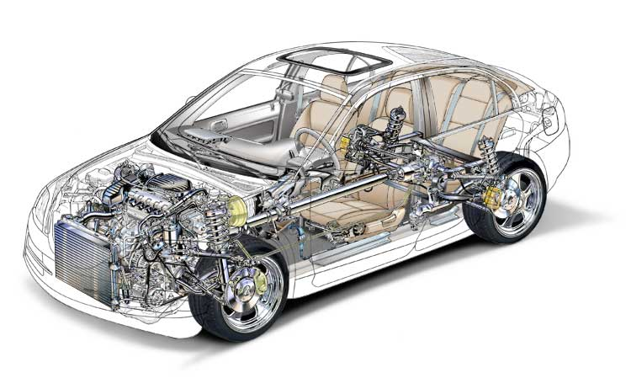
A “Connected” Vehicle
Data Sent from the Vehicle
Real-time location, speed, acceleration, emissions, fuel consumption, and vehicle diagnostics data
Data Provided to the Vehicle
Real-time traffic information, safety messages, traffic signal messages, eco-speed limits, eco-routes, parking information, etc.
Improved Powertrain
More fuel efficient powertain including; hybrids, electric vehicles, and other alternative power sources

Slide 14
Levels of Vehicle Automation
Level 0: No automation
Level 1: Function-specific Automation
  Automation of specific control functions, e.g., cruise control
Level 2: Combined Function Automation
  Automation of multiple and integrated control functions, e.g., adaptive cruise control with lane centering
Level 3: Limited Self-Driving Automation
  Drivers can cede safety-critical functions
Level 4: Full Self-Driving Automation
  Vehicles perform all driving functions

Slide 15

Government Recognition
Several US states have passed legislative initiatives
National Highway Traffic and Safety Administration Policy
Autopilot Systems Council in Japan
Citymobil2 initiative in Europe

Slide 16
Infrastructure Needs/Planning Driven By…
Complex activity-travel patterns
Growth in long distance travel demand
Limited availability of land to dedicate to infrastructure
Budget/fiscal constraints
Energy and environmental concerns
Information/ communication technologies (ICT) and mobile platform advances
Autonomous vehicles leverage technology to increase flow without the need to expand capacity

Slide 17
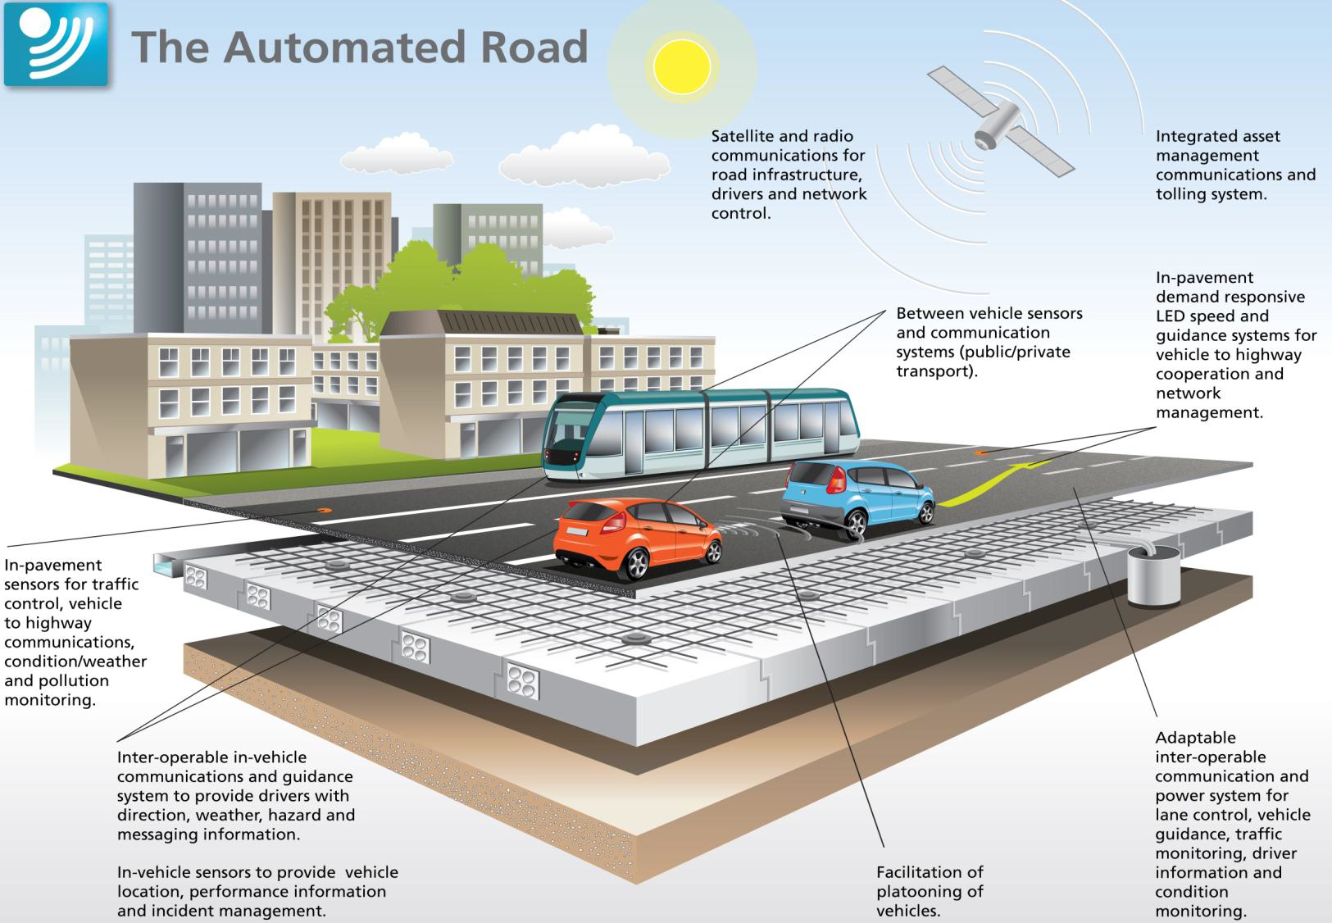
Smarter Infrastructure

Slide 18
Technology and Infrastructure Combination Leads To…
Safety enhancement
  Virtual elimination of driver error – factor in 80% of crashes
  Enhanced vehicle control, positioning, spacing, speed, harmonization
  No drowsy, impaired, stressed, or aggressive drivers
  Reduced incidents and network disruptions
  Offsetting behavior on part of driver

Slide 19
Capacity enhancement
  Platooning reduces headways and improves flow at transitions
  Vehicle positioning (lateral control) allows reduced lane widths and utilization of shoulders; accurate mapping critical
  Optimized route choice
Energy and environmental benefits
  Increased fuel efficiency and reduced pollutant emissions
  Clean fuel vehicles
  Car-sharing

Slide 20
But Let’s Not Forget Traveler Behavior Issues!

Slide 21
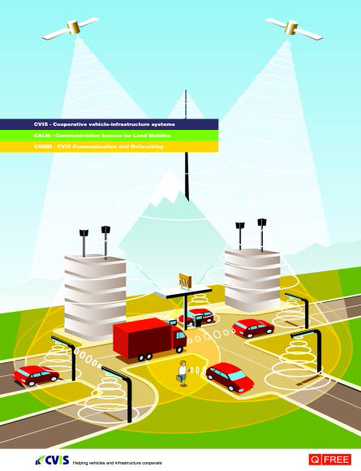
Impacts on Land-Use Patterns
Live and work farther away
  Use travel time productively
  Access more desirable and higher paying job
  Attend better school/college
Visit destinations farther away
  Access more desirable destinations for various activities
  Reduced impact of distances and time on activity participation
Influence on developers
  Sprawled cities?
  Impacts on community/regional planning and urban design

Slide 22
Impacts on Household Vehicle Fleet
Potential to redefine vehicle ownership
  No longer own personal vehicles; move toward car sharing enterprise where rental vehicles come to traveler
More efficient vehicle ownership and sharing scheme may reduce the need for additional infrastructure
  Reduced demand for parking
Desire to work and be productive in vehicle
  More use of personal vehicle for long distance travel
  Purchase large multi-purpose vehicle with amenities to work and play in vehicle

Slide 23
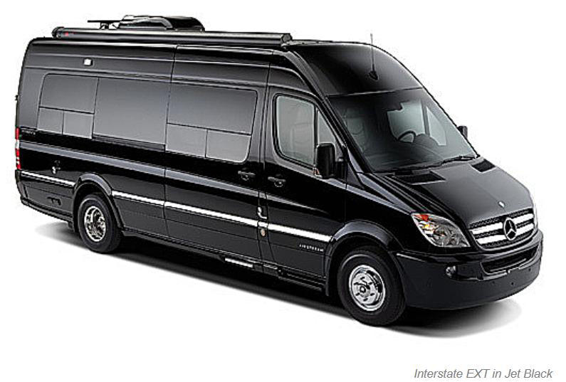
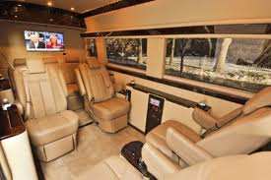
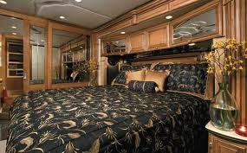
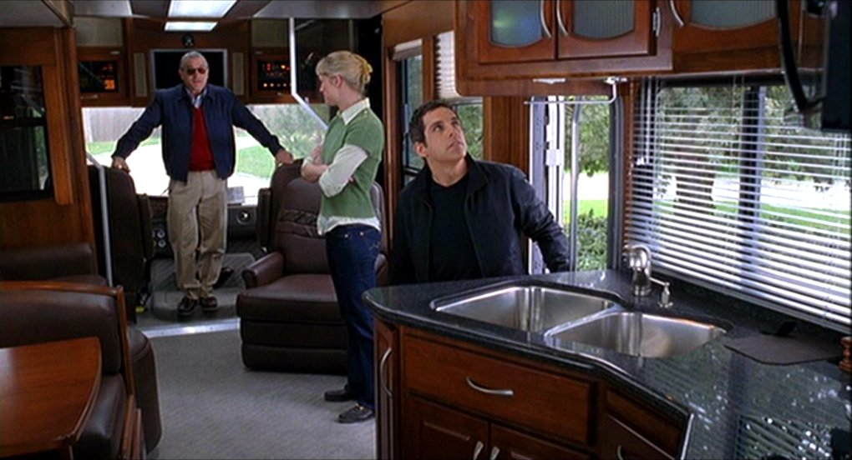

Slide 24
Impacts on Mode Choice
Automated vehicles combine the advantages of public transportation with that of traditional private vehicles
Catching up on news
Texting friends
Reading novels
Flexibility
Comfort
Convenience
What will happen to public transportation?
Also Automated vehicles may result in lesser walking and bicycling shares
Time less of a consideration
So, will Cost be the main policy tool to influence behavior?

Slide 25
Impacts on Mode Choice
Driving personal vehicle more convenient and safe
Traditional transit captive market segments now able to use auto (e.g., elderly, disabled)
Reduced reliance/usage of public transit?
However, autonomous vehicles may present an opportunity for public transit and car sharing
  Lower cost of operation (driverless) and can cut out low volume routes
  More personalized and reliable service - smaller vehicles providing demand-responsive transit service
  No parking needed – kiss-and-ride; no vehicles “sitting” around
  20-80% of urban land area can be reclaimed
  Chaining may not discourage transit use

Slide 26
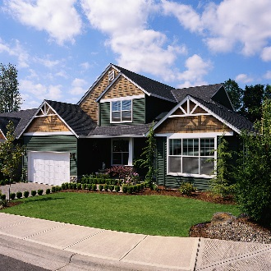


Activity Chaining Issues
Drive Alone
Very Good Transit Service
Home
Work
Drive Alone
Drive Alone
Shopping

Slide 27

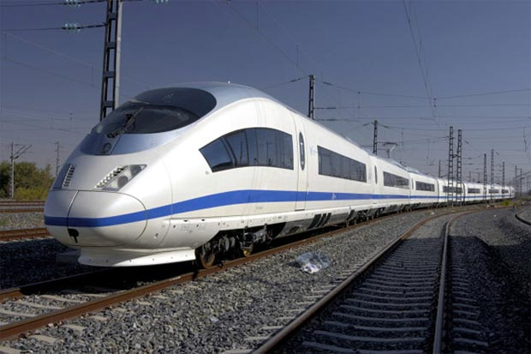
Impacts on Long Distance Travel
Less incentive to use public transportation?
Should we even be investing in high capital high-speed rail systems?
  Individuals can travel and sleep in driverless cars
  Individuals may travel mostly in the night
  Speed difference?

Slide 28
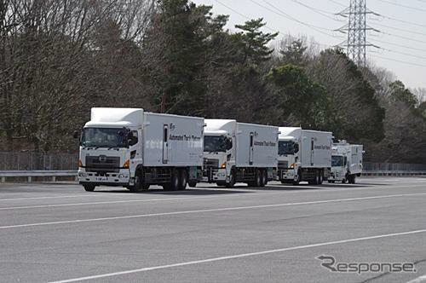
Impacts on Commercial Vehicle Operations
Enhanced efficiency of commercial vehicle operations
Driverless vehicles operating during off-peak and night hours reducing congestion
Reduced need for infrastructure

Slide 29
Mixed Vehicle Operations
Uncertainty in penetration rates of driverless cars
Considerable amount of time of both driverless and traditional car operation
When will we see full adoption of autonomous? Depends on regulatory policies
Need infrastructure planning to support both, with intelligent/dedicated infrastructure for driverless

Slide 31
SimAGENT (Simulator of Activities, Greenhouse gas emissions, Energy,
Networks, and Travel)
Forecast Year Outputs and GHG Emissions Prediction
Synthetic population generator (SPG)
Dynamic Traffic Assignment (DTA)
Aggregate socio-demographics
(base year)
Link volumes and speeds
Socio-economics, land-use and transportation system characteristics simulator (CEMSELTS)
Activity-travel environment characteristics (base year)
Detailed individual-level socio-demographics (base year)
Individual activity-travel patterns
Policy actions
Socio-demographics and activity-travel environment
Activity-travel simulator (CEMDAP)
Model parameters
Base Year Inputs
CEMUS

Slide 32
The Bottom Line
Uncertainty, Uncertainty, Uncertainty
More uncertainty implies more need for planning
But planning must recognize the uncertainty (need a change in current thinking and philosophy)
Conduct studies to understand possible behavioral responses and develop scenarios
Will policy tool primarily be cost-based?

Slide 33
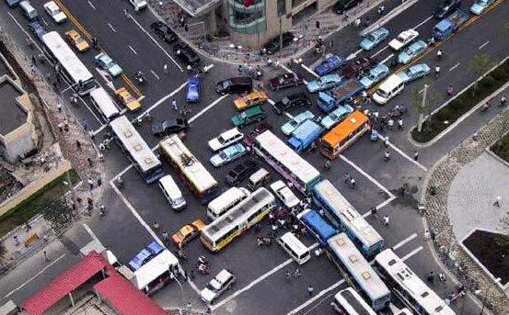
You want to know the future?
You can’t handle the future….
….unless you have models to evaluate alternative scenarios and develop robust planning trajectories

