Slide 1
HW2 Discussion
Mbed CO2 | MBath CO2 | Laundry CO2 | Living CO2 | SBed CO2 | Bath CO2 | Control CO2

Slide 2
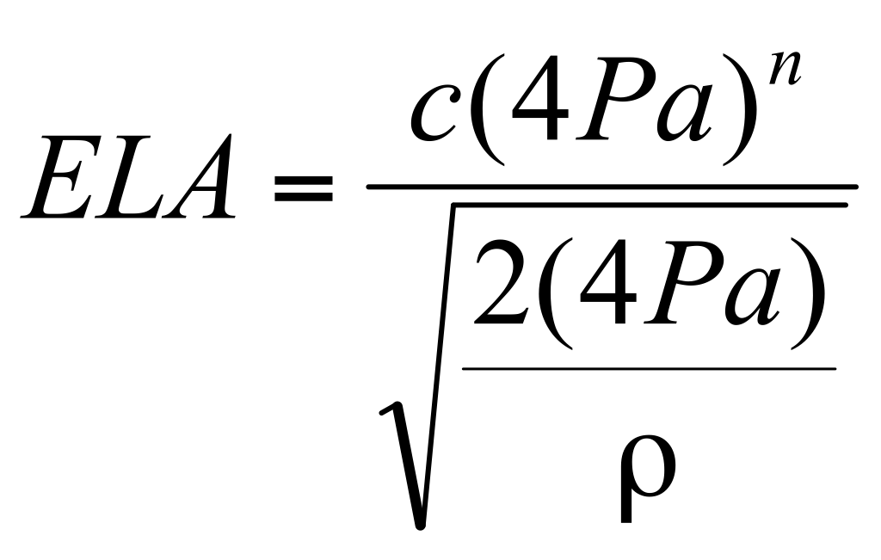
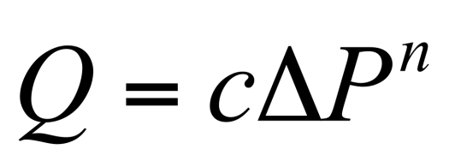
Effective leakage areas (ELA)
Defined as the area of a special nozzle-shaped hole (similar to the inlet of your Blower Door fan) that would leak the same amount of air as the building does at a pressure of 4 Pascals.
Find C and n

