Slide 1
A Services-Oriented Architecture for Water Observations Data
David R. Maidment
GIS in Water Resources Class
University of Texas at Austin
10 November 2010

Slide 2

We welcome to class today…
…Dr András Szöllösi-Nagy
Rector, UNESCO-IHE Institute for Water Education Delft, the Netherlands

Slide 3
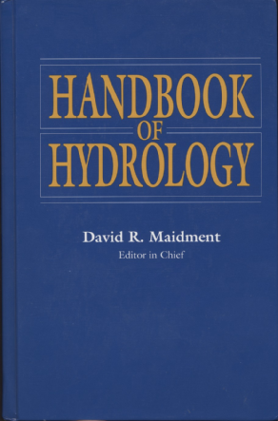
How is new knowledge discovered?
After completing the Handbook of Hydrology in 1993, I asked myself the question: how is new knowledge discovered in hydrology?
I concluded:
By deduction from existing knowledge
By experiment in a laboratory
By observation of the natural environment

Slide 4


Deduction – Isaac Newton
Deduction is the classical path of mathematical physics
  Given a set of axioms
  Then by a logical process
  Derive a new principle or equation
In hydrology, the St Venant equations for open channel flow and Richard’s equation for unsaturated flow in soils were derived in this way.
Three laws of motion and law of gravitation
http://en.wikipedia.org/wiki/Isaac_Newton
(1687)

Slide 5
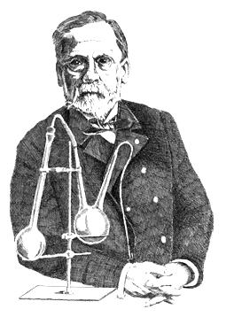
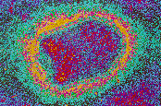
Experiment – Louis Pasteur
Experiment is the classical path of laboratory science – a simplified view of the natural world is replicated under controlled conditions
In hydrology, Darcy’s law for flow in a porous medium was found this way.
Pasteur showed that microorganisms cause disease & discovered vaccination
Foundations of scientific medicine
http://en.wikipedia.org/wiki/Louis_Pasteur

Slide 6

Observation – Charles Darwin
Observation – direct viewing and characterization of patterns and phenomena in the natural environment
In hydrology, Horton discovered stream scaling laws by interpretation of stream maps
Published Nov 24, 1859
Most accessible book of great
scientific imagination ever written

Slide 7

Conclusion for Hydrology
Deduction and experiment are important, but hydrology is primarily an observational science
discharge, climate, water quality, groundwater, measurement data collected to support this.

Slide 8
Great Eras of Synthesis
2020
Hydrology (synthesis of water observations leads to knowledge synthesis)
Scientific progress occurs continuously, but there are great eras of synthesis – many developments happening at once that fuse into knowledge and fundamentally change the science
2000
1980
Geology (observations of seafloor magnetism lead to plate tectonics)
1960
1940
1920
1900
Physics (relativity, structure of the atom, quantum mechanics)

Slide 9











CUAHSI Hydrologic Information System (HIS) team
University of Texas at Austin – David Maidment, Tim Whiteaker, James Seppi, Fernando Salas, Harish Sangireddy, Jingqi Dong
San Diego Supercomputer Center – Ilya Zaslavsky, David Valentine, Tom Whitenack, Matt Rodriguez
Utah State University – David Tarboton, Jeff Horsburgh, Kim Schreuders, Justin Berger
University of South Carolina – Jon Goodall, Anthony Castronova
Idaho State University – Dan Ames, Ted Dunsford, Jiri Kadlec
CUAHSI Program Office – Rick Hooper, Yoori Choi

Slide 10
HIS Goals
Data Access – providing better access to a large volume of high quality hydrologic data;
Hydrologic Observatories – storing and synthesizing hydrologic data for a region;
Hydrologic Science – providing a stronger hydrologic information infrastructure;
Hydrologic Education – bringing more hydrologic data into the classroom.

Slide 11
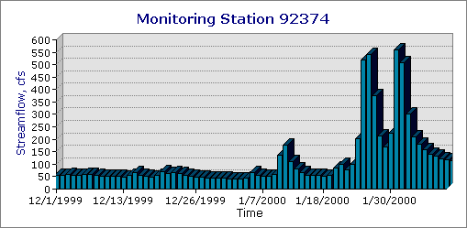
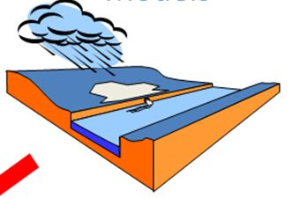
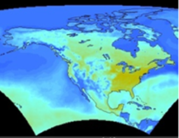

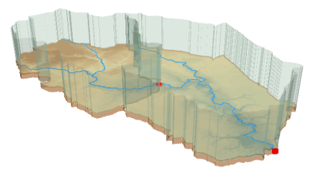
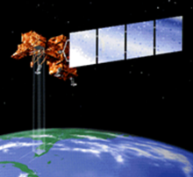
Component 1:
Desktop Hydrologic Information System
Observations
Weather and Climate
Modeling
GIS
Remote Sensing

Slide 12
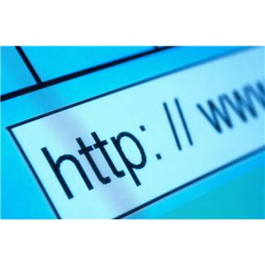
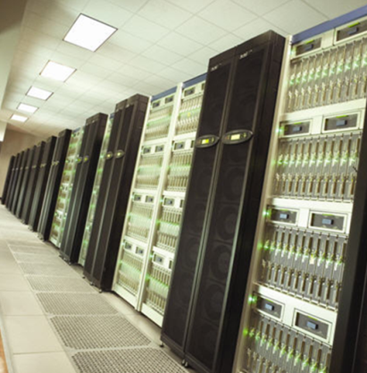
Component 2:
Services-Oriented Architecture for Water Data
Catalogs
Metadata
Search
Data
Users
Servers

Slide 13
Crossing the Digital Divide
Discrete spatial objects with time series
Continuous space-time arrays
Weather and Climate
Observations
Remote Sensing
GIS
These are two very different data worlds

Slide 14
Focus on Water Observations Data
Observations
Weather and Climate
Modeling
GIS
Remote Sensing
We have focused on water observations data

Slide 15
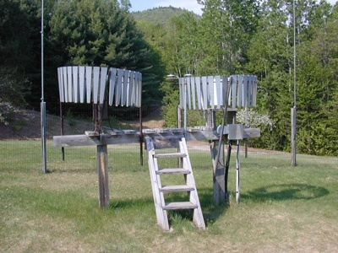

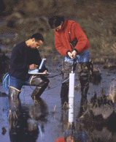
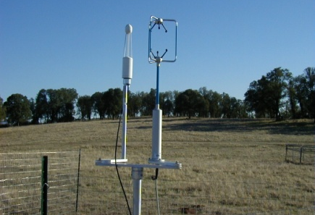
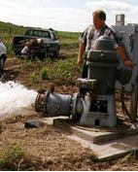
Water Observations Data Measured at Gages and Sampling Sites
Water quantity
Rainfall
Soil water
Time series of observations at point locations
Water quality
Meteorology
Groundwater

Slide 16
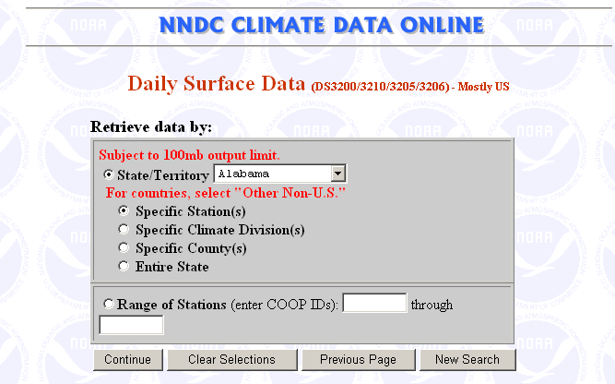
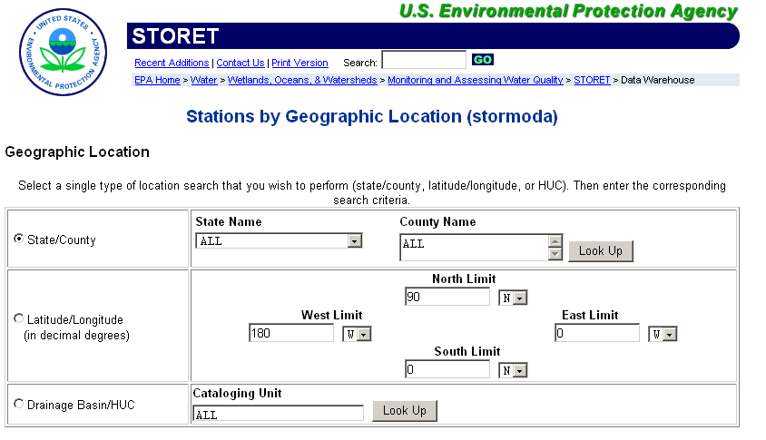
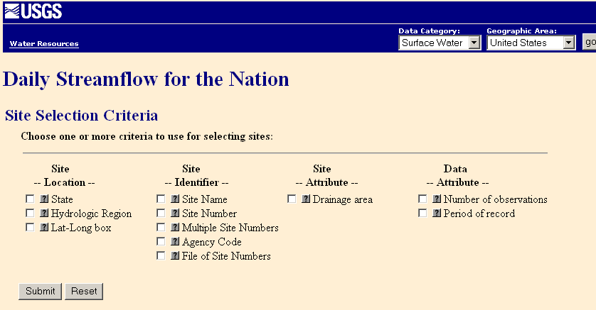
Water Data Web Sites
We need a process of archive web enablement …..
….. discovering, accessing, and synthesizing data from the internet

Slide 17
How does the internet work?
This is how it got started …..
Web servers
Text, Pictures
in HTML
Mosaic browser
…..this is how it works now
Google, Yahoo, Bing
Catalogs
Three key components linked by services and a common language
Metadata harvesting
Search Services
Web servers
Text, Pictures
Firefox, Internet Explorer
in HTML
Servers
Users

Slide 18
What has CUAHSI Done?
Taken the internet services model …..
Catalogs
Servers
Users
…..and implemented it for water observations data
HIS Central
Metadata harvesting
Search Services
HydroServer, Agency Servers
Time series data
in WaterML
HydroDesktop, HydroExcel, ...

Slide 19
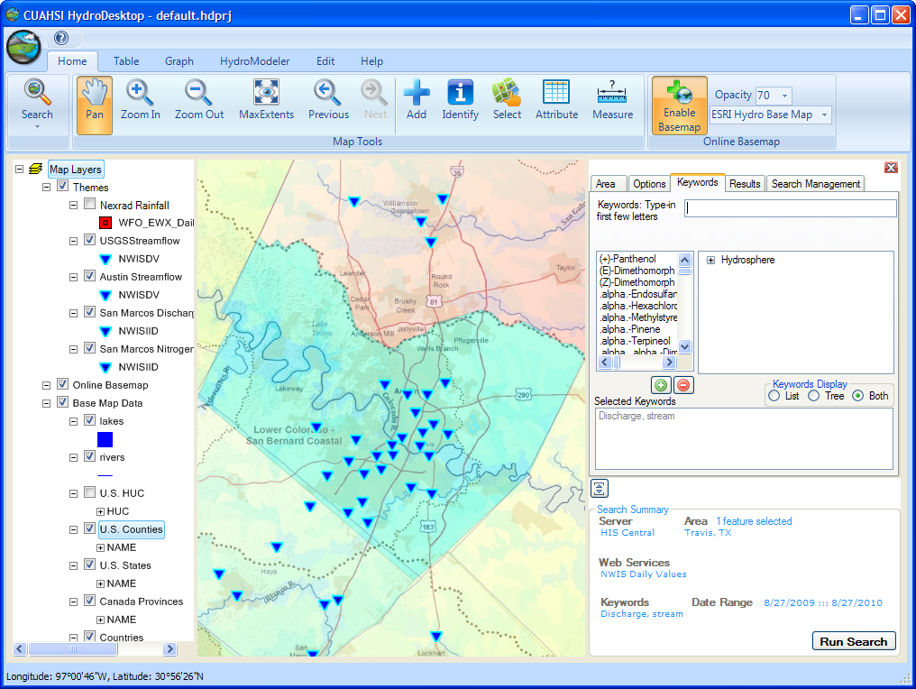
CUAHSI HydroDesktop http://www.hydrodesktop.org

Slide 20
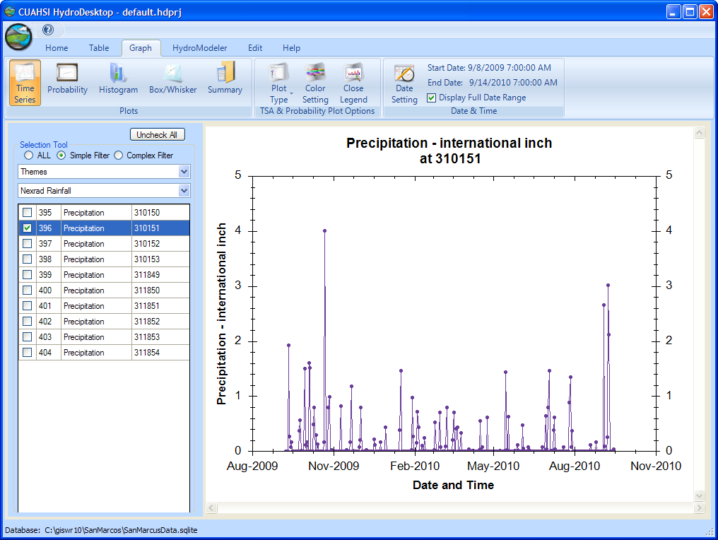
A Hydrologic Information System
Searching and Graphing Time Series

Slide 21
CUAHSI Network-Observations Model
NWIS Daily Values
Data Service
NWIS Sites
Network
GetSites
San Marcos River at Luling, Tx
GetSiteInfo
Sites
Discharge, stage
(Daily or instantaneous)
GetVariableInfo
Variables
GetValues
Observation
18,700 cfs, 3 July 2002
{Value, Time, Qualifier}
A data source operates an observation network
A network is a set of observation sites
A site is a point location where one or more variables are measured
A variable is a property describing the flow or quality of water
A value is an observation of a variable at a particular time
A qualifier is a symbol that provides additional information about the value

Slide 22
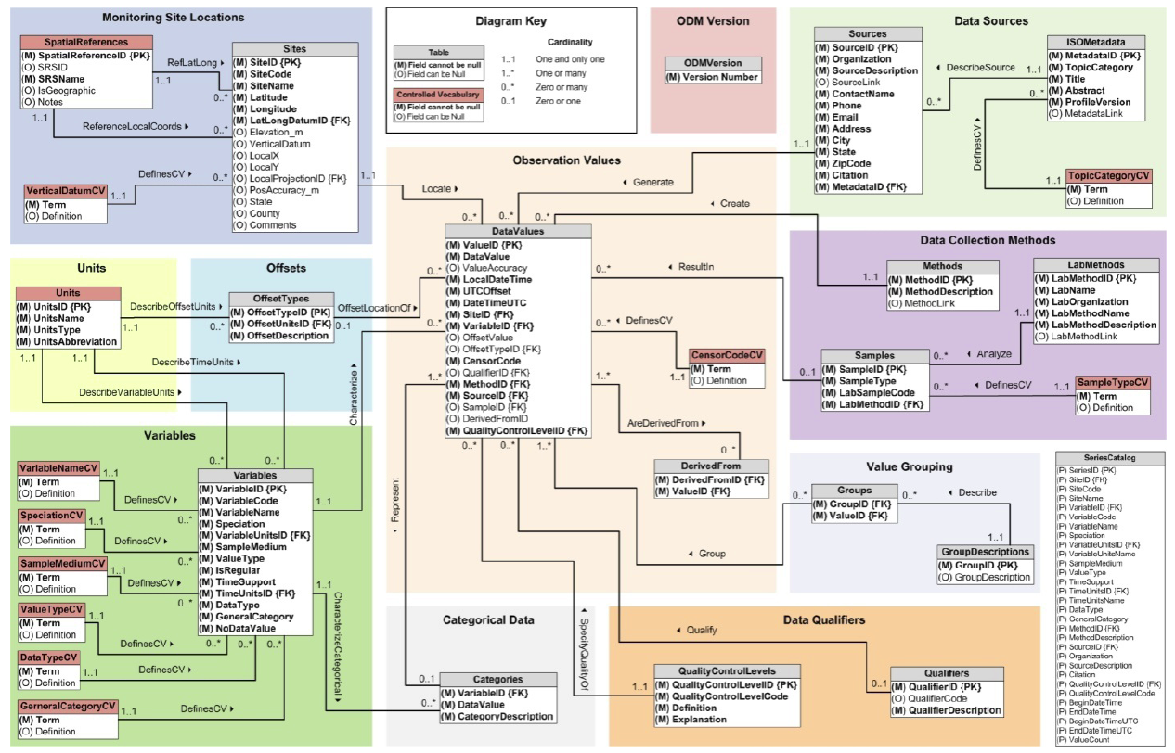
Observations Data Model
Horsburgh, J. S., D. G. Tarboton, D. R. Maidment and I. Zaslavsky, (2008), "A Relational Model for Environmental and Water Resources Data," Water Resour. Res., 44: W05406, doi:10.1029/2007WR006392.

Slide 23
Data Values – indexed by “What-where-when”
Time, T
“When”
t
A data value
v_{i} (s,t)
s
“Where”
Space, S
V_{i}
“What”
Variables, V

Slide 24
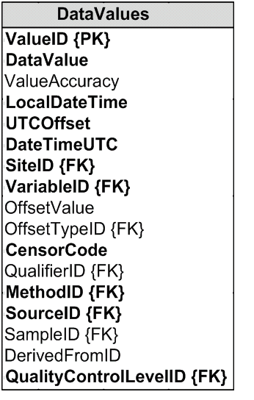
Data Values Table
Time, T
t
v_{i} (s,t)
s
Space, S
V_{i}
Variables, V

Slide 25
Data Series – Metadata description
Time
There are C measurements of Variable V_{i} at Site S_{j} from time t₁ to time t₂
End Date Time, t₂
Count, C
Begin Date Time, t₁
Site, S_{j}
Space
Variable, V_{i}
Variables

Slide 26

Publishing an ODM Water Data Service
Utah State University
University of Florida
University of Iowa
Assemble Data From Different Sources
ODM Data Loader
Ingest data using ODM Data Loader
WaterML
Observations Data Model (ODM)
Load Newly Formatted Data into ODM Tables in MS SQL/Server
USU ODM
UFL ODM
UIowa ODM
Wrap ODM with WaterML Web Services for Online Publication
http://icewater.usu.edu/littlebearriver/cuahsi_1_0.asmx?WSDL

Slide 27
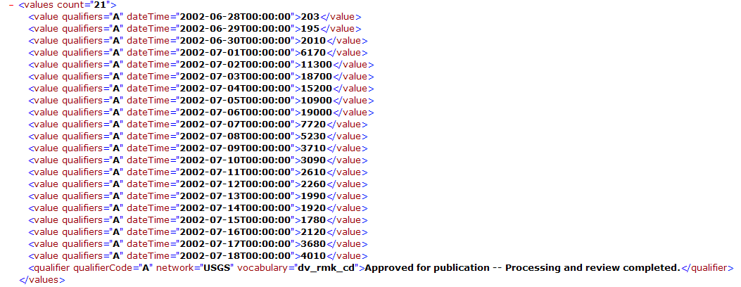
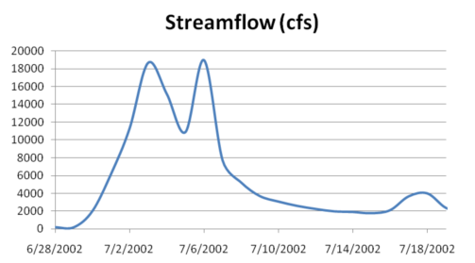
WaterML as a Web Language
Discharge of the San Marcos River at Luling, TX June 28 - July 18, 2002
USGS Streamflow data in WaterML language
This is the WaterML GetValues response from NWIS Daily Values

Slide 28
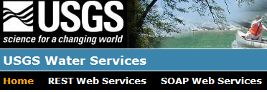
Publishing a Hybrid Water Data Service
USGS Metadata are Transferred to CUAHSI HIS Central
WaterML
USGS
METADATA
USGS
Water Data Service
USGS
DataValues
Web Services can both Query the HIS Central for Metadata and use a USGS WaterML Web Service for Data Values
Get Values from:
Metadata From:
Data Dump from USGS to CUAHSI HIS Central
USGS WaterML Web Service
Calling the WSDL Returns Metadata and Data Values as if from the same Database
http://river.sdsc.edu/wateroneflow/NWIS/DailyValues.asmx?WSDL

Slide 29
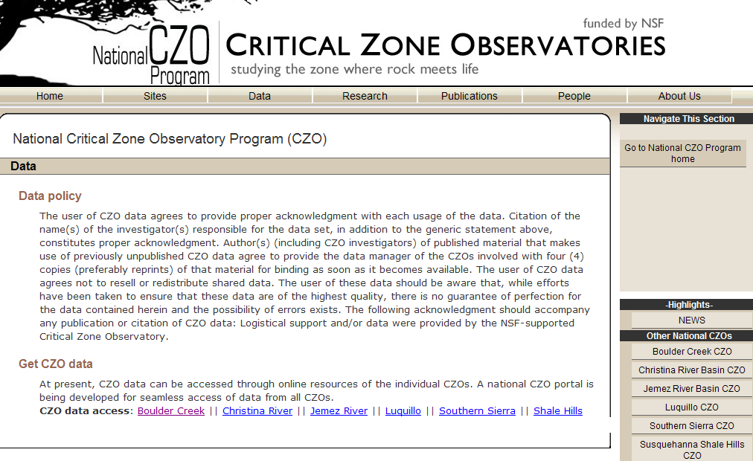
http://criticalzone.org/data.html
Data managed independently at each site and ASCII files sent to a national CZO portal at SDSC
Published in WaterML

Slide 30
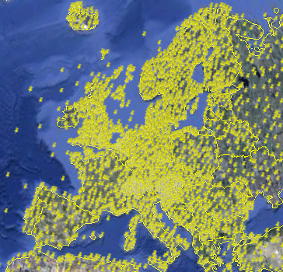
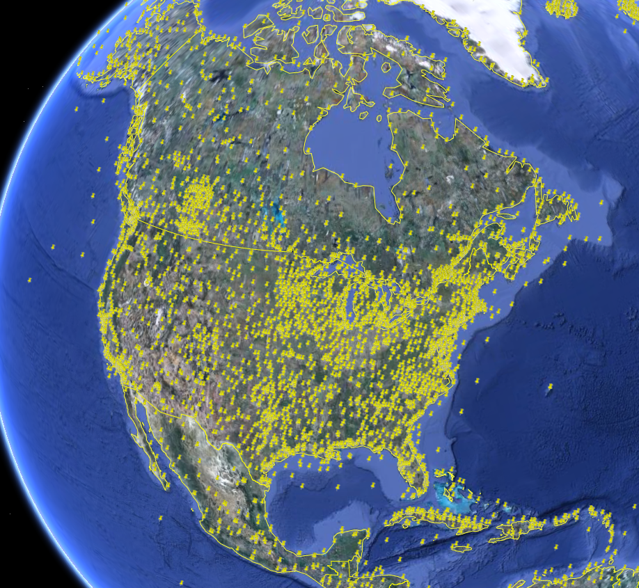
NCDC Integrated Station Hourly Data
Hourly weather data up to 36 hours ago
13,628 sites across globe
34 variables
Published by National Climate Data Center and populated with weather observations from national weather services
http://water.sdsc.edu/wateroneflow/NCDC/ISH_1_0.asmx?WSDL

Slide 31

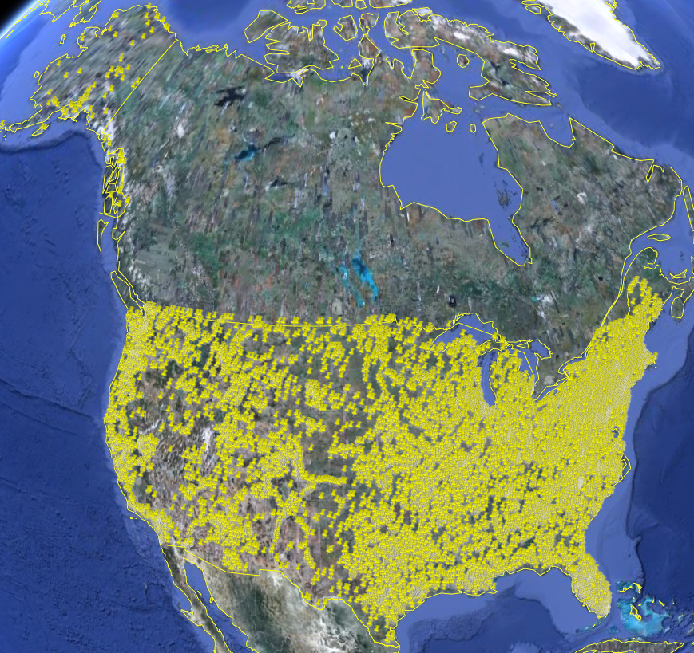
USGS Instantaneous Data
Real time, instantaneous data over the last 60 days
11188 sites, nationally for the US
80 variables
Published by USGS National Water Information System

Slide 32

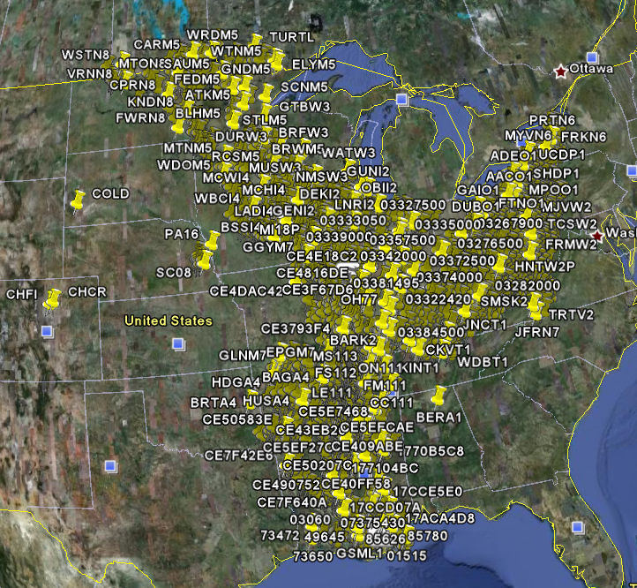
Corps of Engineers Water Observations
Time series at Corps gages
2210 sites, mainly in Mississippi Basin
80 variables
4954 series
Published by Corps of Engineers, Rock Island District to support their WaterML plugin to HEC-DSS
http://www2.mvr.usace.army.mil/watercontrol/SOAP/WaterML_SOAP.cfc?wsdl

Slide 33

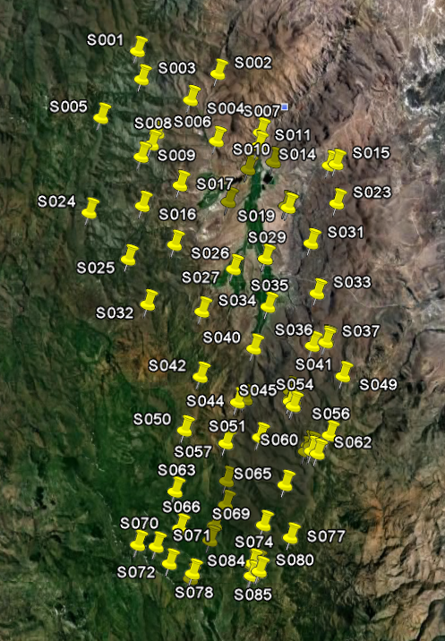
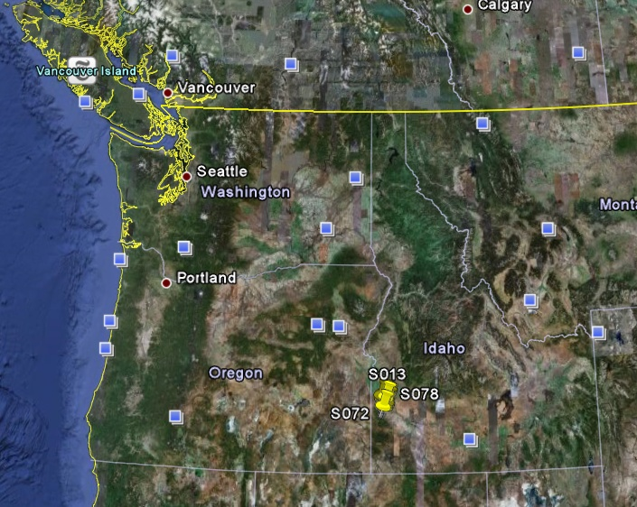
Reynolds Creek Experimental Watershed
1 data service
84 sites
65 variables
372 series
17.8 million data
Published by USDA-ARS as part of an Idaho Waters project
http://idahowaters.uidaho.edu/RCEW_ODWS/cuahsi_1_0.asmx?WSDL

Slide 34
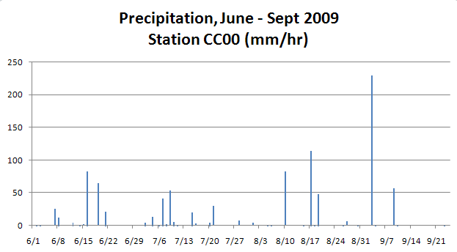
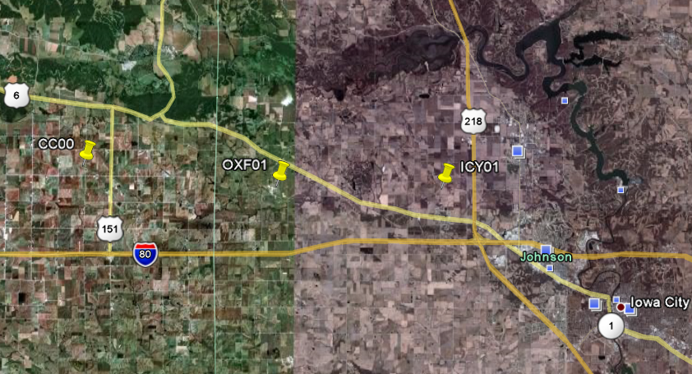
Iowa Tipping Bucket Raingages
Data Manager:
Nick Arnold, IIHR

Slide 35
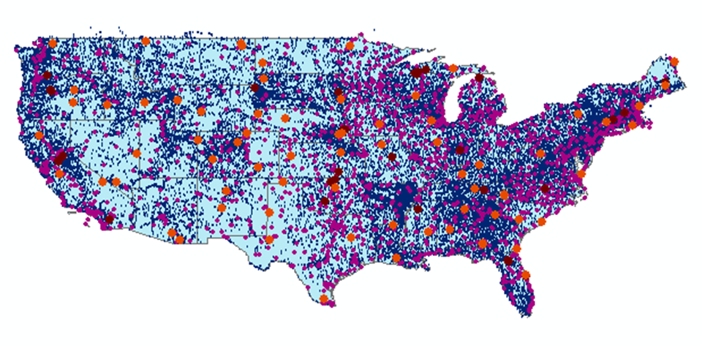
The CUAHSI Water Data Catalog
57 services
15,000 variables
1.8 million sites
9 million series
4.3 billion data Values
. . . All the data is accessible in WaterML

Slide 36
What have we learned?
Three core patterns
  Centralized data services using ASCII file ingestion;
  ODM-based data services at a university
  Water agency data services from USGS, EPA, NWS, ….
    The metadata describing these water agency services is huge and is difficult to ingest and manage centrally

Slide 37
Three Categories of Data Services
Catalog Services – which list water web services that can supply particular types of water data over particular geographic regions;
Metadata Services – which identify collections or series of data associated with particular spatial locations that can be depicted on maps;
Data Services – which convey the values of the water observations data through time, and can be depicted in graphs.
Metadata
Search
Data
Catalog
Services
Metadata
Data

Slide 38
Proposed Strategy
Catalog
Metadata
Search
Services
Metadata
Data
Data
Approach | Catalog | Metadata | Data
ASCII files (CZO) | Centralized | Centralized | Centralized
ODM (CUAHSI) | Centralized or Distributed | Centralized or Distributed | Distributed
Water Agencies | Distributed | Distributed | Distributed

Slide 39
Search Mechanism in HydroDesktop
Start
Select Region
(where)
Select Time Period
(when)
Select Service(s)
(who)
Select Keyword(s)
(what)
Filter Results
Save Theme
End
“Who, What, When, Where” model…….

Slide 40
OCG Catalog Services for the Web (CSW)
Catalog
CSW provides a single URL address that indexes a set of OGC web services and permits search across them
Services
Metadata
Data
https://hydroportal.crwr.utexas.edu/geoportal/csw/discovery

Slide 41
Federation of Web Services Catalogs
UT
Catalog
USGS
Catalog
CZO
Catalog
UT
Services
USGS
Services
CZO
Services
Metadata
Metadata
Metadata
Data
Data
Data
University of Texas
US Geological Survey
Critical Zone Observatories

Slide 42










Data Searching
Search multiple heterogeneous data sources simultaneously regardless of semantic or structural differences between them
Searching each data source separately
NWIS
request
return
request
request
return
return
NAWQA
request
return
NAM-12
request
return
request
return
request
return
request
return
NARR
Michael Piasecki
Drexel University

Slide 43

Semantic Mediation
Searching all data sources collectively
GetValues
GetValues
NWIS
GetValues
GetValues
generic
request
GetValues
GetValues
NAWQA
Michael Piasecki
Drexel University
GetValues
NARR
GetValues
HODM

Slide 44
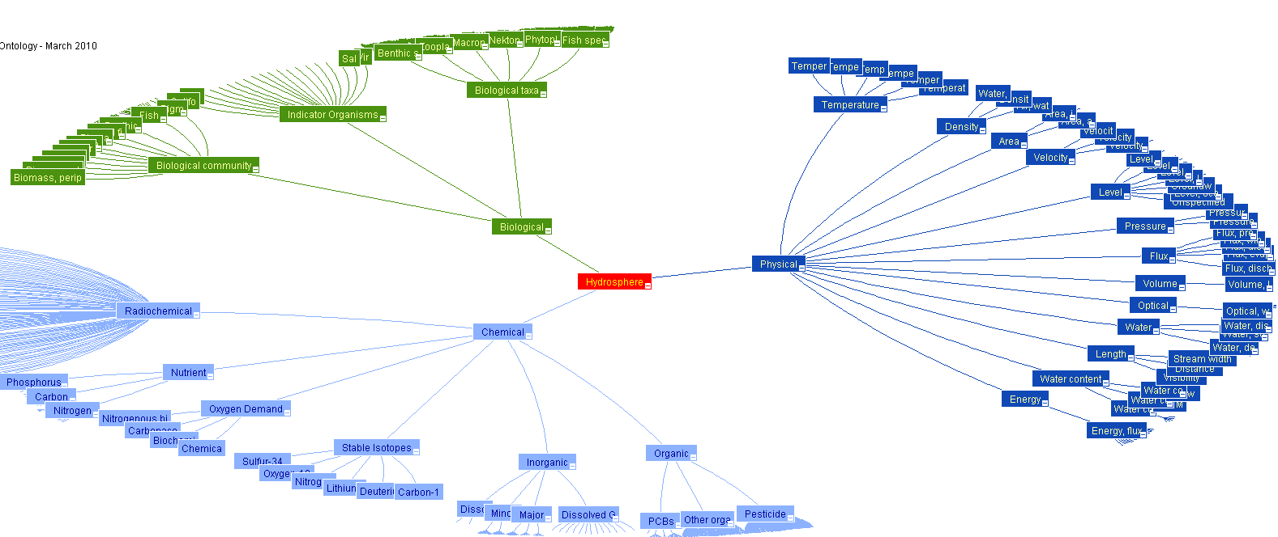
Hydrologic Ontology
http://water.sdsc.edu/hiscentral/startree.aspx

Slide 45
CUAHSI HIS: We are doing this now
We’ve built a very large scale prototype….
…….we’ve discovered that simple but general patterns exist
HIS Central
GetSites
GetSiteInfo
(WaterML)
GetSeriesCatalogForBox (XML)
  GetWaterOneFlowServiceInfo (XML)
  GetOntologyTree (XML)
HydroServer
(ODM)
HydroDesktop
GetValues
(WaterML)
All these services are custom-programmed …..
….. we can transition to using OGC web service standards

Slide 46
Open Geospatial Consortium Web Services
Sensor Observation Service
Web Processing Service
Web Coverage Service
Web Map Service
Web Feature Service
Remote Sensing
Using an OGC-standards based approach we can cross the digital divide

Slide 47
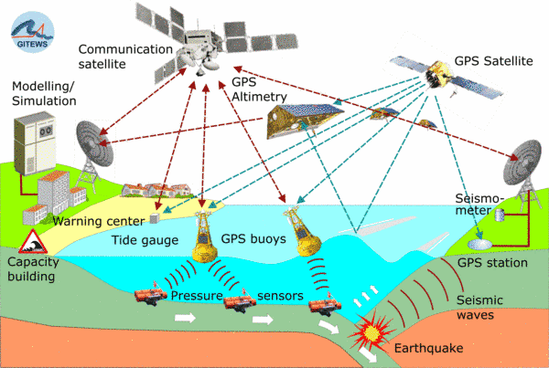
OGC Sensor Web Enablement
Image from Arne Broering, 52North

Slide 48
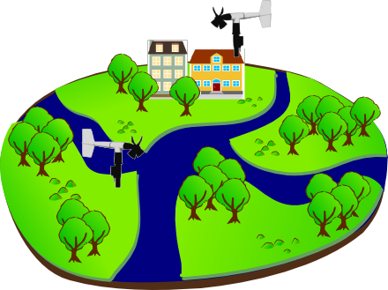
Sensor Observations Service: Get Observation
Observed Property := “Wind_Speed“
Sampling Time
Result
Feature of Interest
23 m/s 16.9.2010 13:45
uom
Procedure (ID := “DAVIS_123“)
Observation
Slide adapted from Arne Broering, 52North
Notes:
Basis for a standardized access to sensor data is the observation model defined in the Observations & Measurements standard. Let me briefly describe the main concepts / terms used in this model…

Slide 49
Archive Web Enablement
….uses the same Get Observations functions as Sensor Web Enablement

Slide 50
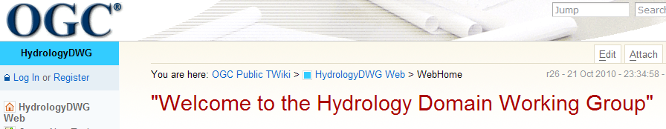
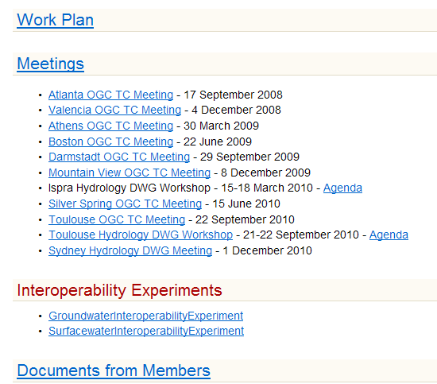
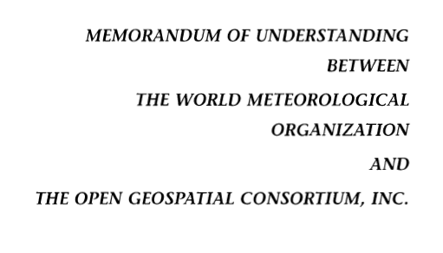
Jointly with World Meteorological Organization
Evolving WaterML into an International Standard
Meets every 3 months
Teleconferences most weeks
November 2009
WaterML Version 2 standard to be proposed
Vote for adoption 3-6 months later

Slide 51
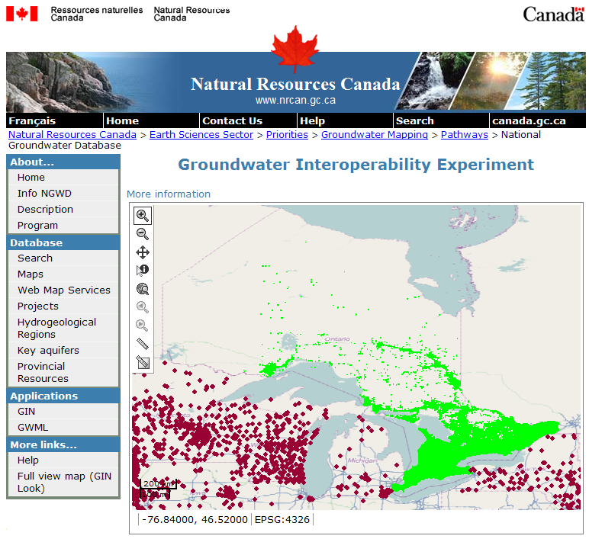
Groundwater Interoperability Experiment (US and Canada)
http://ngwd-bdnes.cits.nrcan.gc.ca/service/api_ngwds/en/wmc/gie.html

Slide 52
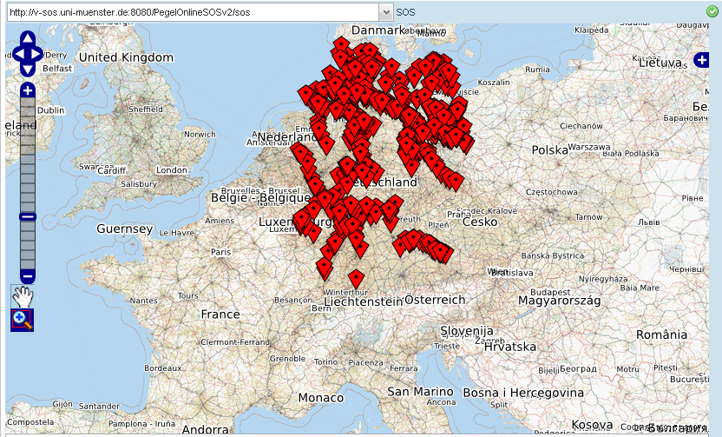
Surface Water Interoperabilty Experiment (France and Germany)
SOS DLZ-IT
SOS SANDRE
Slide from Arne Broering, 52North

Slide 53
CUAHSI HIS in OGC Web Services
HydroCatalog
Register services and pass Metadata with
WFS:GetCapabilities
Search the catalog for services with CSW:GetRecords
Get the metadata with WFS:GetFeature
Get the data with
GetValues (WaterML 1.1)
or SOS:GetObservations (WaterML 2.0)
HydroServer
HydroDesktop

Slide 54
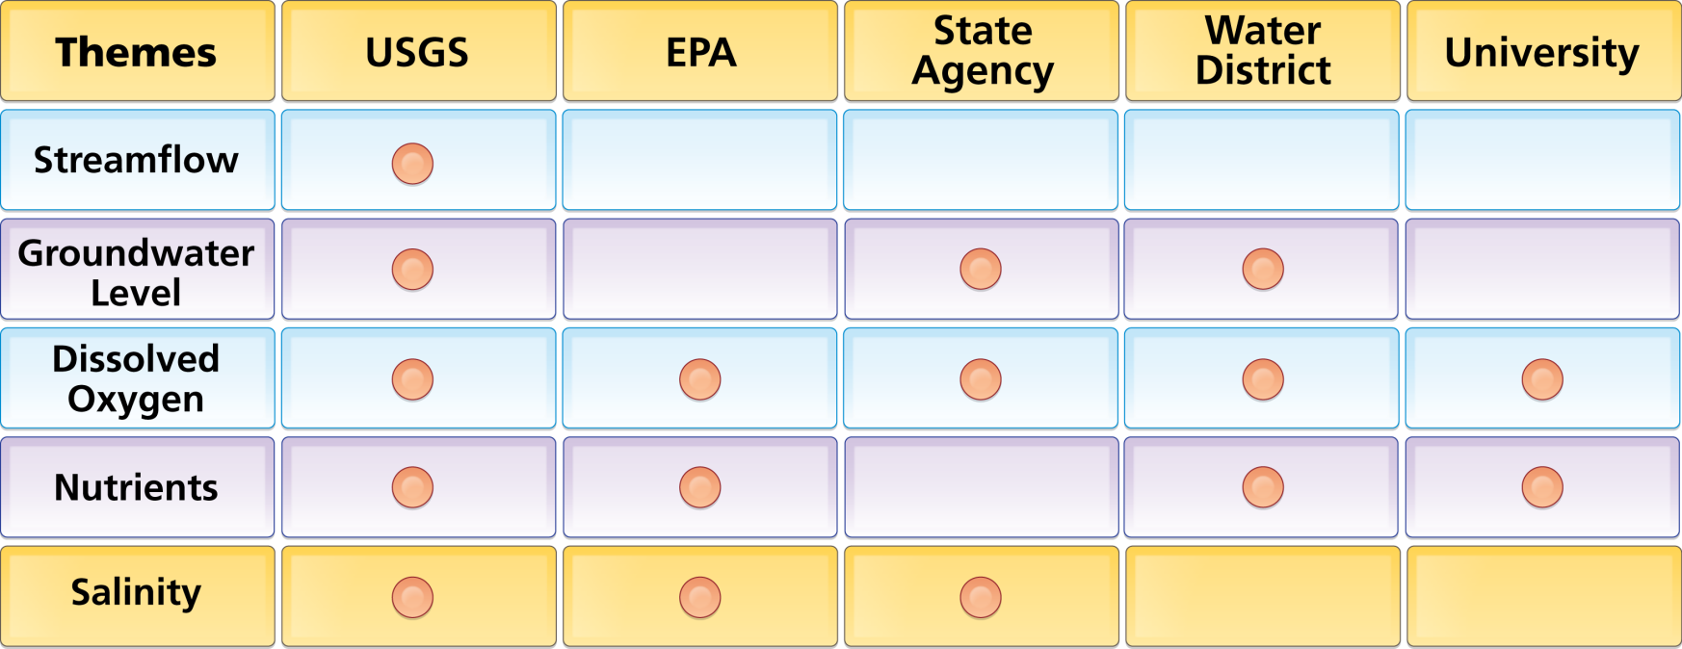
Organize Water Data Into “Themes”
Integrating Water Data Services From Multiple Agencies
WaterML
WaterML
WaterML
WaterML
WaterML
. . . Across Groups of Organizations

Slide 55
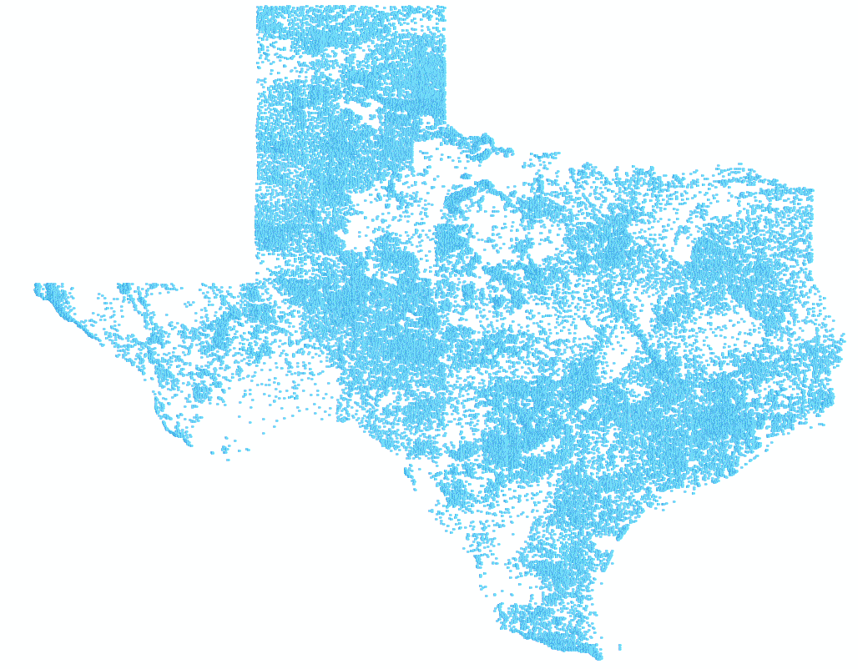
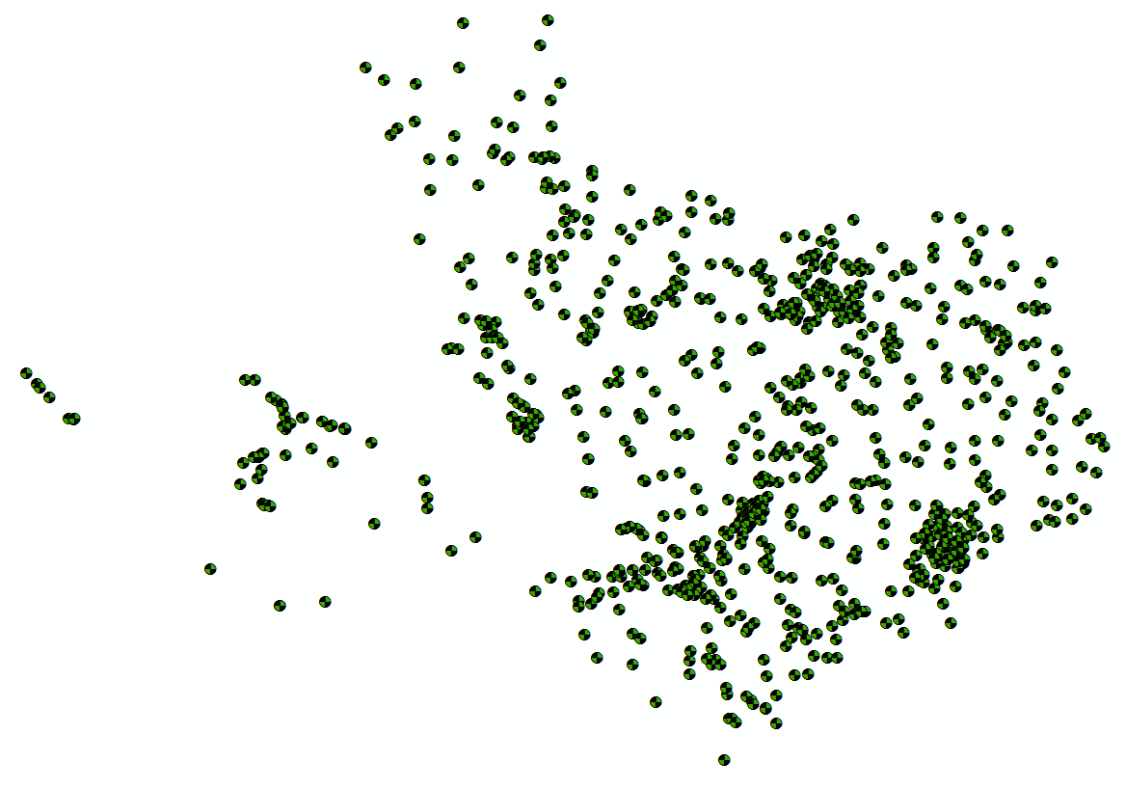
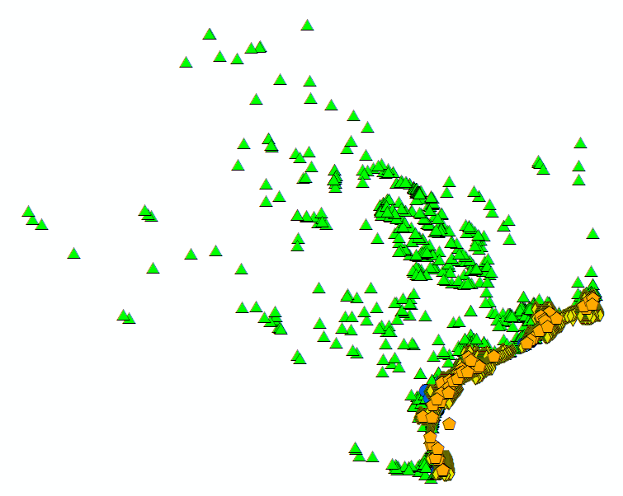
Bringing Water Into GIS
Thematic Maps of Water Observations as GIS Layers
Groundwater
Streamflow
Bacteria

Slide 56
Data Access Workflow
Query for matching Services from HydroCatalog
OGC Catalog Services for the Web
Get Services
A national water portal?
Narrow
Query for matching Series from each HydroServer
OGC Web Feature Service
Get Metadata
Metadata in space
Narrow
Get Values from each HydroServer
WaterML and future
OGC WaterML2 standard
Get Data
Observations in time
Narrow
Produce the final Theme
Better water science!!

Slide 57
Water Information Triangle: ArcGIS Map Services
ArcGIS.com
Search ArcGIS.com for type of information using keywords
Register ArcGIS Map Services
Get the metadata with ArcGIS map services or layer packages
Get the data with
GetValues (WaterML 1.1)
or SOS:GetObservations (WaterML 2.0) REST services
ArcGIS Server
Web browser
ArcGIS Desktop

Slide 58
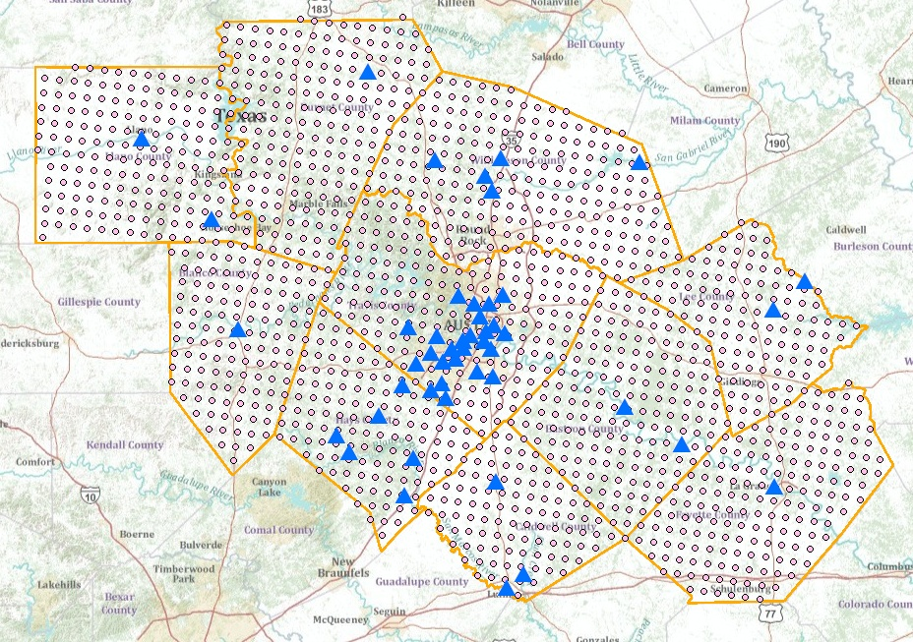
Observations Metadata Web Feature Service
USGS Streamflow and Nexrad Rainfall in CAPCOG region

Slide 59
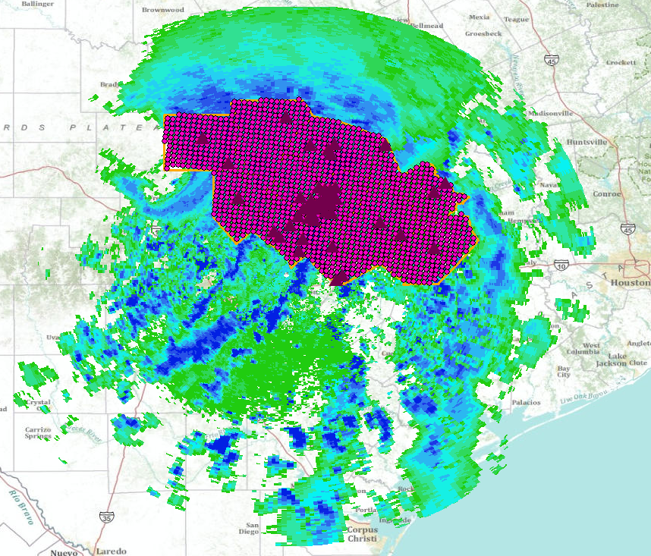
Tropical Storm Hermine, 8 Sept 2010
An ArcGIS map service in space
Tropical Storm Hermine CRWR Map service
Tropical Storm Hermine CRWR Layer Package

Slide 60
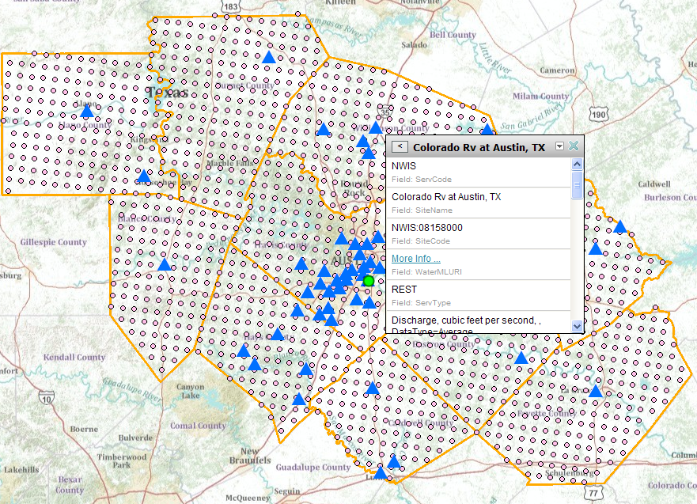
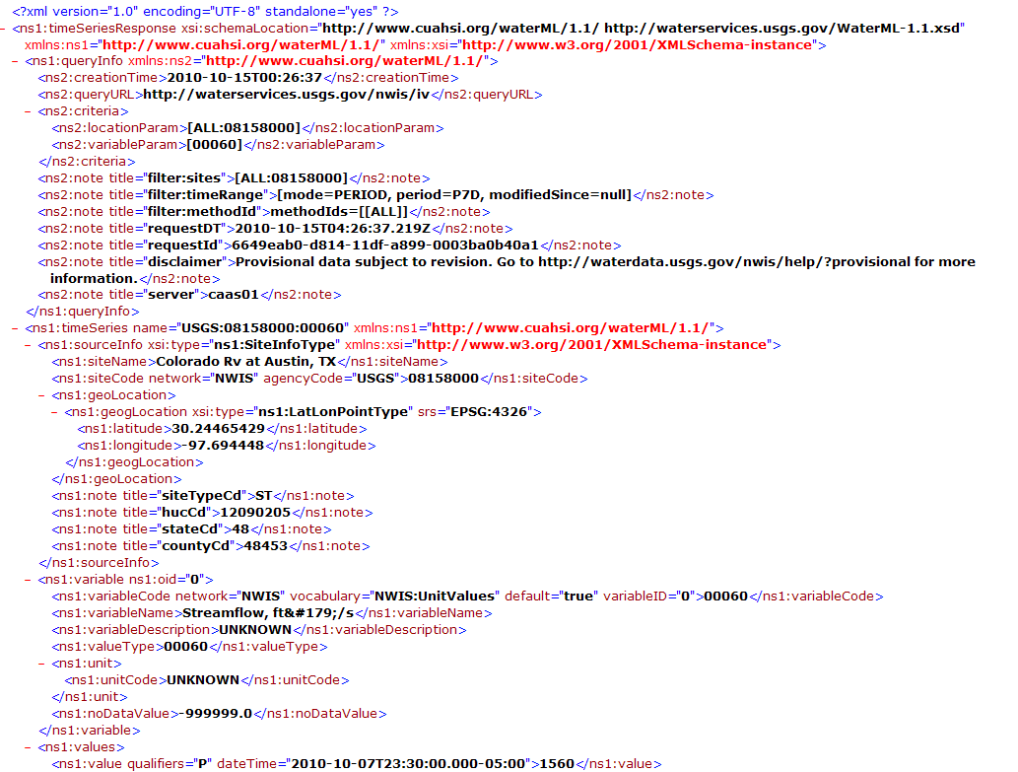

USGS REST service
http://waterservices.usgs.gov/nwis/iv?sites=08158000&period=P7D&parameterCd=00060
A WaterML observations service in time

Slide 61
Observations Data Layers for Precipitation, Streamflow and Water Level
Not just a pretty map but rich observations data layers for which you can create new displays and drill down into for geospatial analysis

Slide 62
Conclusions
CUAHSI has constructed a very large scale prototype
  A services-oriented architecture with distributed data and centralized metadata
  This performs syntactic mediation (unity of format in WaterML) and semantic mediation (unity of meaning using concept ontology)
The patterns revealed by the prototype show that the same functions can be performed using OGC and ESRI map services supported by a time series services for the observations values
Same pattern that CUAHSI has developed can be applied in different application contexts (HydroDesktop, ESRI, …..)
Can continue with centralized metadata for water research servers, but need to have distributed metadata for water agency servers
OGC Services are the key to making a services-oriented architecture for water data

