Slide 1





Dec. 2, 2010
Water Impairment Assessment
in South Korea
Term project presentation: GIS in Water Resource
Gihye Shin (irisnow@mail.utexas.edu)
EWRE, CAEE, University of Texas at Austin

Slide 2


Contents
1. Background and Purpose of the project
2. Methodology
3. Water impairment assessment
4. Conclusion
1. Background and Purpose of the project
2. Methodology
3. Water impairment assessment
4. Conclusion

Slide 3

1. Background & Purpose
Overview
Environment protection
Development
Balance?
Sustainable Development
- compromise or sustainability, optimal development
Best Environmental Management Program
- EIA (Environmental Impact Assessment) (sometimes substituted by SEA, EA etc.)
- IWM (Integrated Watershed Management)
TMDL (Total Maximum Daily Load), EFA (Environmental Flow Assessment)

Slide 4
1. Background & Purpose
TMDL in US and South Korea
TMDL (Total Maximum Daily Load)
- a value of the maximum amount of a pollutant that a body of water can receive
while still meeting water quality standards (Clean Water Act, 303(d))
Water Impairment Assessment
Water Impairment Assessment
- identifying water bodies not satisfied with water
quality standard and causes of impairment
Calculating TMDL
Simple prediction model
The role of local government and
national environmental authority
Build-up TMDL measures
Assessment Unit
Water quality index & standards
Implementing TMDL program
Duration of TMDL program
implementation
Monitoring and evaluation
Source: Draft Guidance for Water Quality-based Decisions : The TMDL Process (2nd Edition)", EPA (1999)
Navigating the TMDL Process : Evaluation and Improvements, IWA & Water Env. Federation (2003)
Technical guideline for TMDL Process : Evaluation and Improvements, Korean Ministry of Env. (2008)

Slide 5
1. Background & Purpose
Surface water quality standard and index
US
South Korea
Clean Water Act
Framework Act on Environmental Policy
National recommended and state-established standard
National recommended standard
Regulatory
frame
Type of water body:
Freshwater / Saltwater
Use: ex) General / Aquatic life /
Recreation / Fish consumption /
Public supply / Oyster harvest etc.
Type of water body:
River / Lake / Underground
Use: ex) Human health,
General (Public / Industrial supply / Oyster harvest / Irrigation supply etc.)
Clean Water Act
Water Quality and Water ecosystem Conservation Act
Index & standard: Site-specific
Metals, Pathogens
Nutrients, Sedimentations / Siltation
Organic enrichment / Low DO etc.
Index
BOD (Biologic Oxygen Demand)
T-P (Total Phosphorous)
TMDL
Standard: Site-specific
Source: EPA (http://water.epa.gov) / Strategy for water quality standard and criteria, EPA (2003)
Technical guideline for TMDL Process : Evaluation and Improvements, Korean Ministry of Env. (2008)

Slide 6
1. Background & Purpose
US
Recreation Use
General Use
A index : 3 mg/L
A index : 5 mg/L
B index : …
C index : …
D index : …
E index : …
Source: 2010 Guidance for Assessing and Reporting Surface Water Quality in Texas (2009)

Slide 7
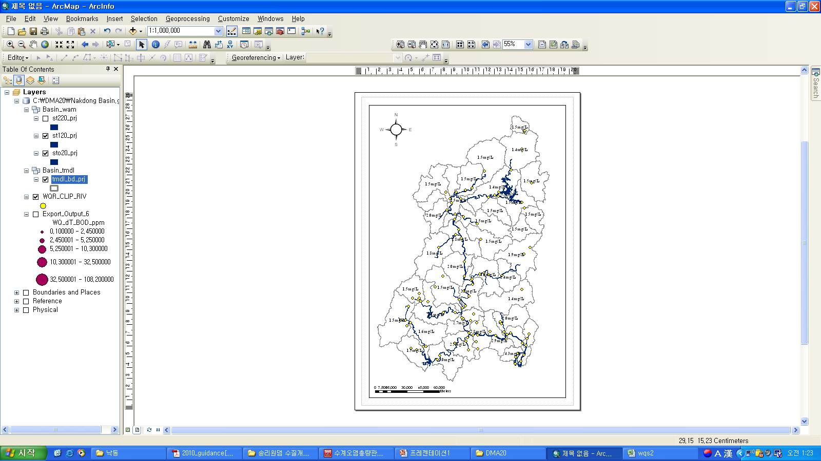
1. Background & Purpose
South Korea
BOD

Slide 8

Objective
GIS application for Best Environmental Management?
Prediction
Spatial Visualizing of status
Assessment
Automated input-data mining for modeling
e.g. Sedimentation (RUSLE)
Non-point load / runoff (HSPF, SWAT etc.)
e.g. Identify impaired water
e.g. water quality
Simple prediction for initial decision making
e.g. 1D steady-state conservative-pollutant
behavior estimation
Water quality status (Temporal-spatial visualizing),
identifying impaired water in South Korea, using ArcGIS

Slide 9
Contents
1. Background and Purpose of the project
2. Methodology
3. Water impairment assessment
4. Conclusion

Slide 10
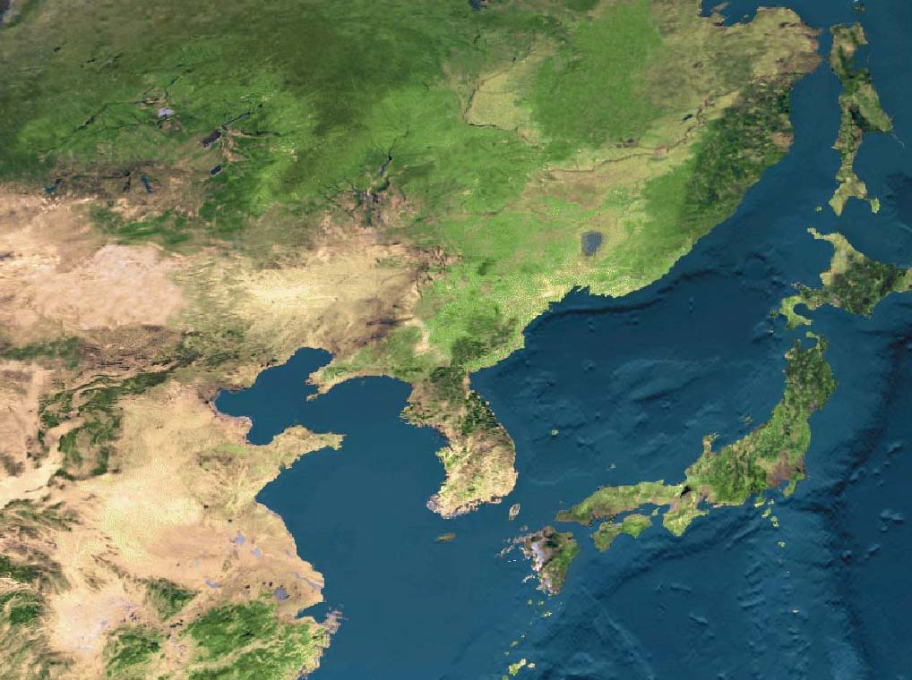
2. Methodology
Project area: Nakdong-River Basin
The longest river in South Korea (the second one in Korean peninsula)
The region exposed frequently to water quality issues
i.e. turbidity, non-point pollutions, toxic materials-spill (phenol etc.), etc.
National-first-Dam for Environmental water supply is constructing
turbidity, non-point pollutions, toxic materials-spill (phenol etc.)
Basin length: 511 km
Total flowline length: 68,888 km
Drainage area: 23,702 km²
Basin avg. width: 46.3 km
Basin avg. elevation: 291.18 m
Basin Avg. slope: 32.26%
Unity shape factor: 3.33

Slide 11
2. Methodology
Procedure
Used ArcGIS tools
Watershed delineation from DEM
- Data management tool/
Projection define and Projection
- Spatial analysis tool/ Hydrology
- Clip, Mask, Dissolve,
Extract-Create new feature class
- Data query table
(for time-enable feature class)
- Statistics, Merge etc.
Assessment Unit assignment
Water quality data & standard
matching to AU
Water quality status &
Impaired water identification

Slide 12
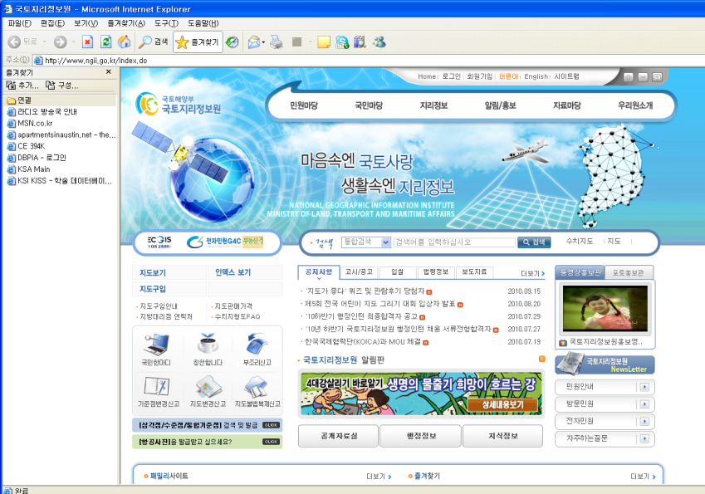
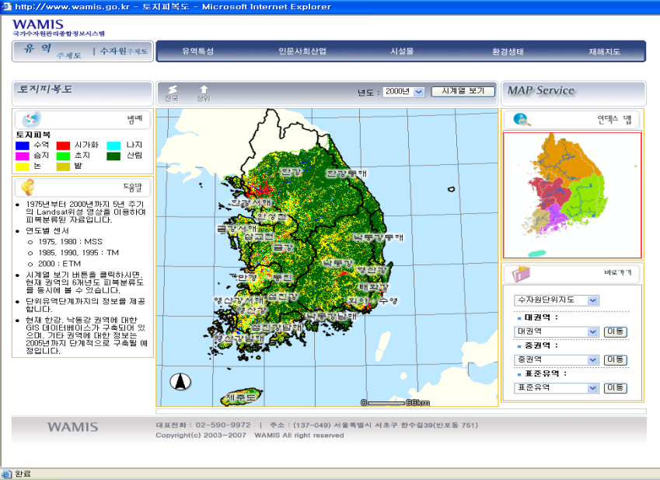
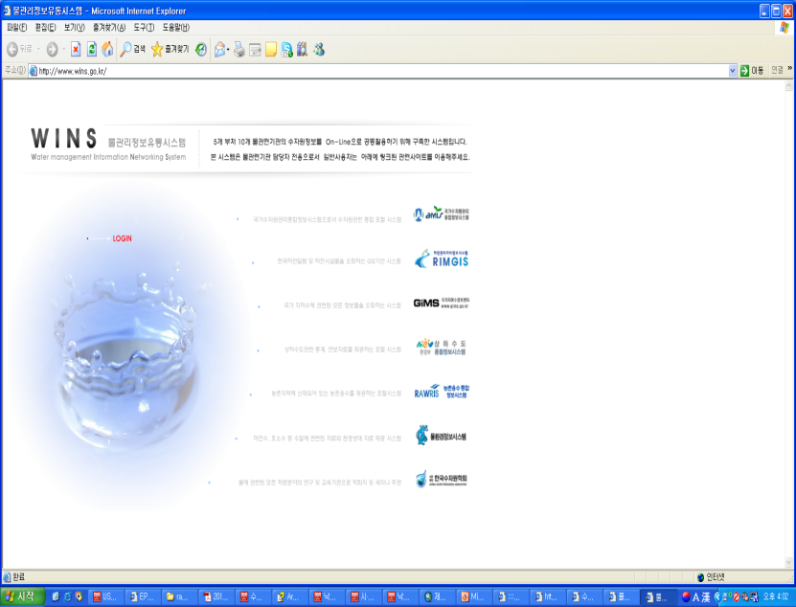
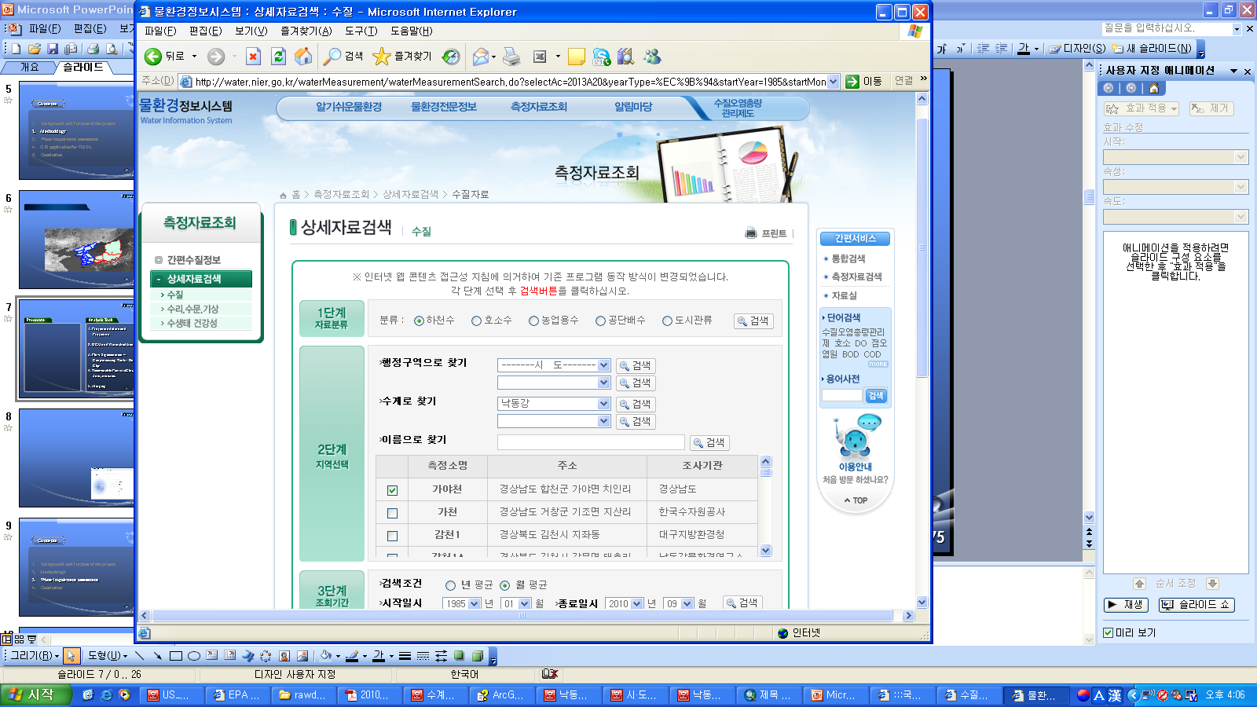
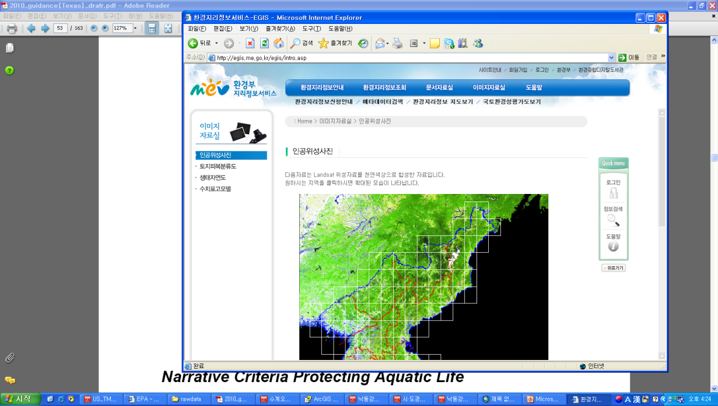
2. Methodology
Data source
DEM
National hydrography Dataset
http://www.wamis.go.kr
http://www.wamis.go.kr
Env. Monitoring data
Satellite Image, Land cover map
http://www.wins.go.kr
http://water.nier.go.kr
http://egis.me.go.kr

Slide 13
Data overview
monthly water quality monitoring data: since 1989 ~ present
- monitoring site (river): 103
- other water body (lake, groundwater, pipe outlet, etc): 665
- open to public (web-service)
- ph, DO, BOD, TN, TP, SS, E. coli., Metals, phenol (Total 35 parameters)
Used for water impairment assessment
daily water quality & streamflow data: since 2004 ~
- 8 consecutive day monitoring, 30 times per yr
- monitoring site: 13
- partly open to public (approval process required)
Using published data for comparing to the results
daily streamflow data: runoff model result (web-service)

Slide 14
Contents
1. Background and Purpose of the project
2. Methodology
3. Water impairment assessment
4. Conclusion

Slide 15

2. Methodology
Geography Transformation
Projection (Trans-Mercator)
Korea_1985_TM.prj
Georeferrence (Korean Datum)
Molodensky-Badekas
Korean_1985_To_ITRF_2000.prj
Geography Transformation
Georeference (ITRF)
ITRF_2000_TM.prj
Projection (Trans-Mercator)
Reference: Technical Note (Geography transformation in ArcGIS), ESRI Korea, 2009

Slide 16
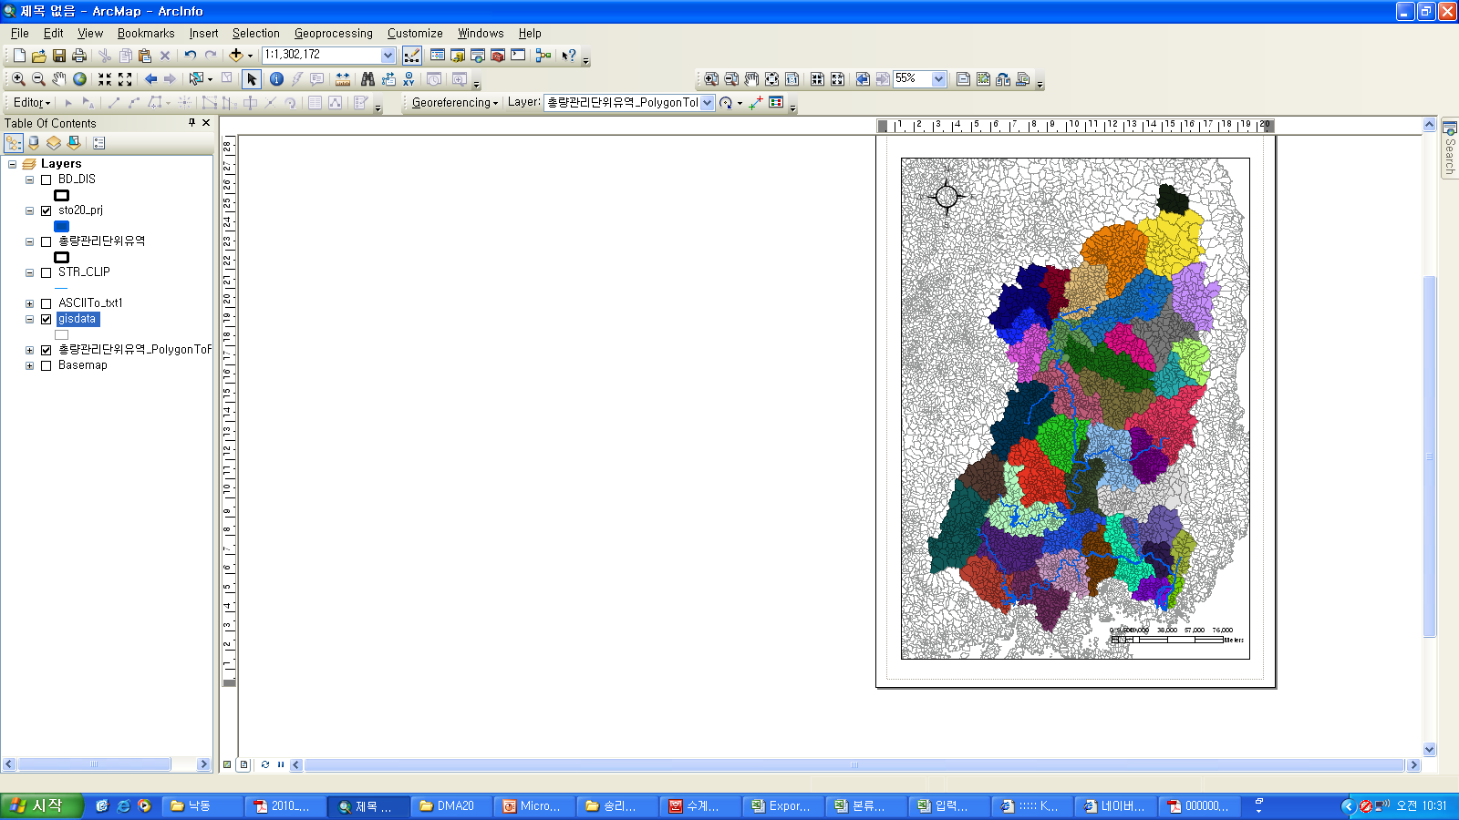
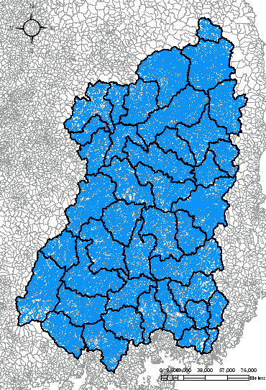
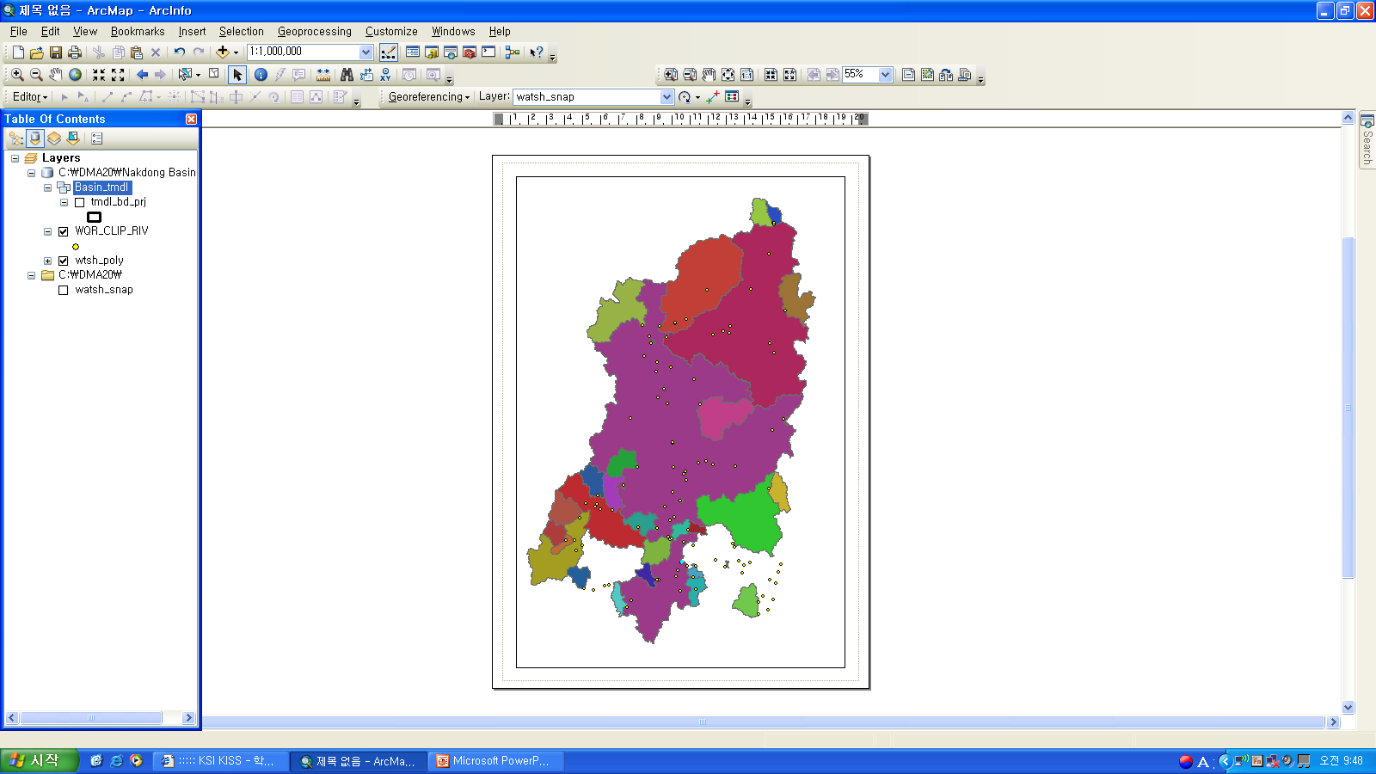
Assessment Unit – snap pour/watershed
3. Water Impairment Assessment

Slide 17
Instead of Numerical mean,
Annual average water quality during 3 yrs = (C_{1st} + C_{2nd}+ C_{3rd} ) / 3
CA = (log(monitoring result) + … ) / Number of data
V =((log(monitoring result) – CA) ² + … ) / (Number of data -1)
C = ^{10 – (CA+0.5V)}
Source: Technical guideline for TMDL Process : Evaluation and Improvements, Korean Ministry of Env. (2008)
BOD
T-P
Source: Advanced strategies on water quality management in Nak-dong River , Jung (2009)

Slide 18
Water quality - Time-enable feature
3. Water Impairment Assessment
Source: Long-term water quality trend analysis in Nak-dong River Basin, Lee et al., (2006)

Slide 19
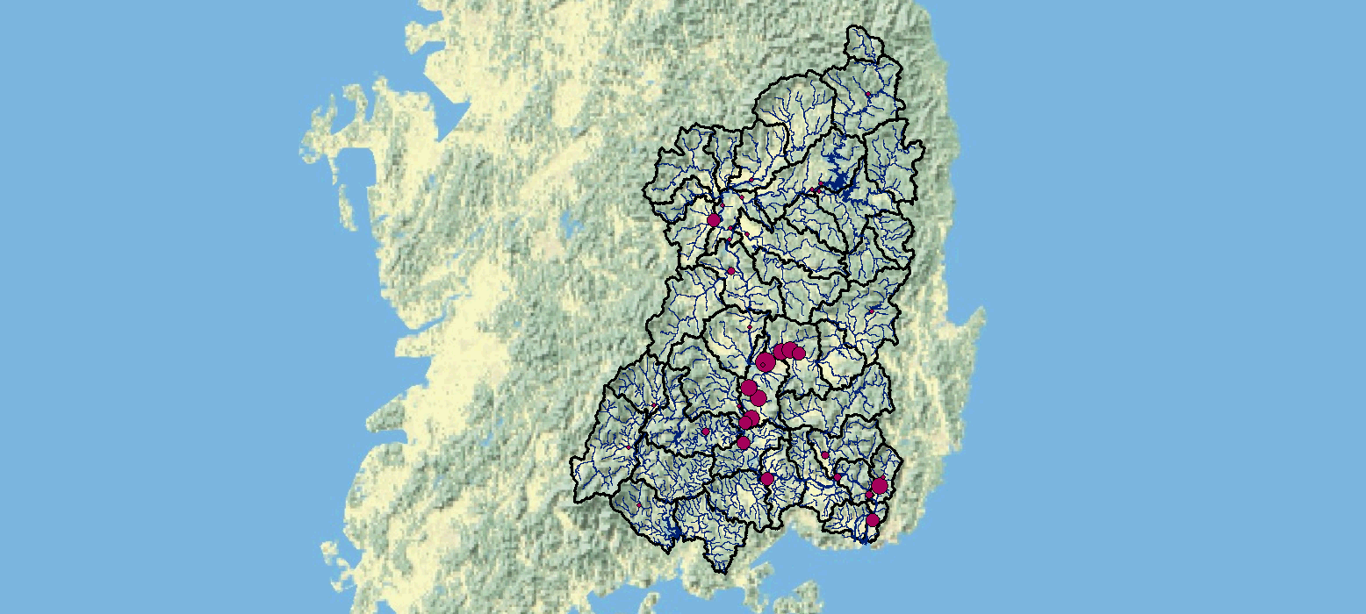

Slide 20
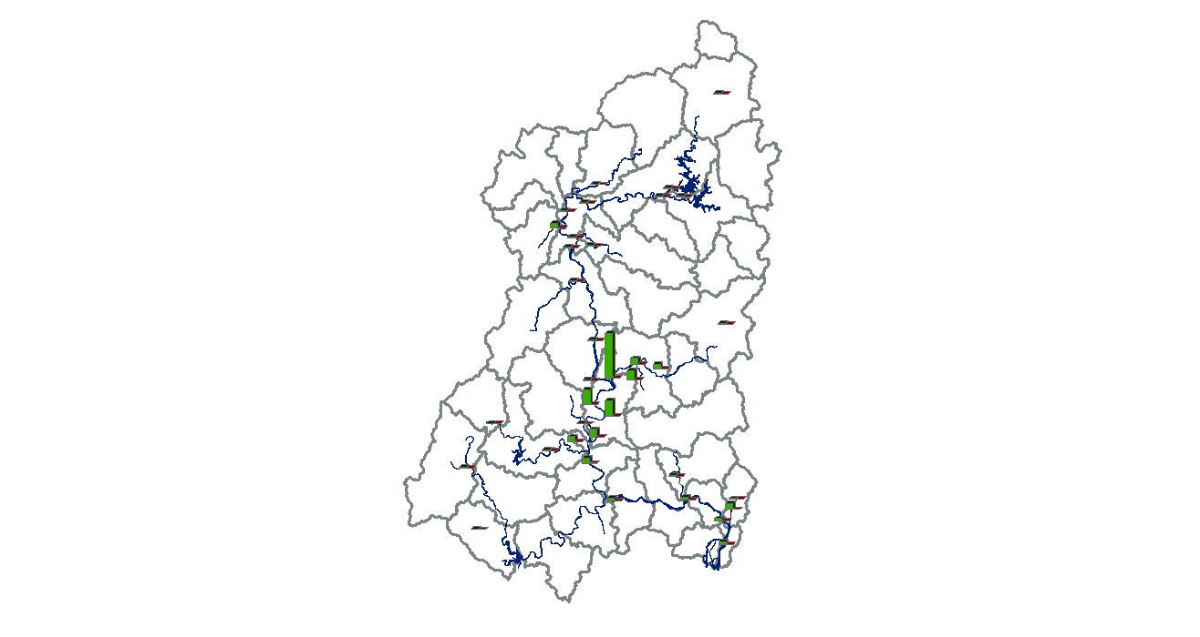
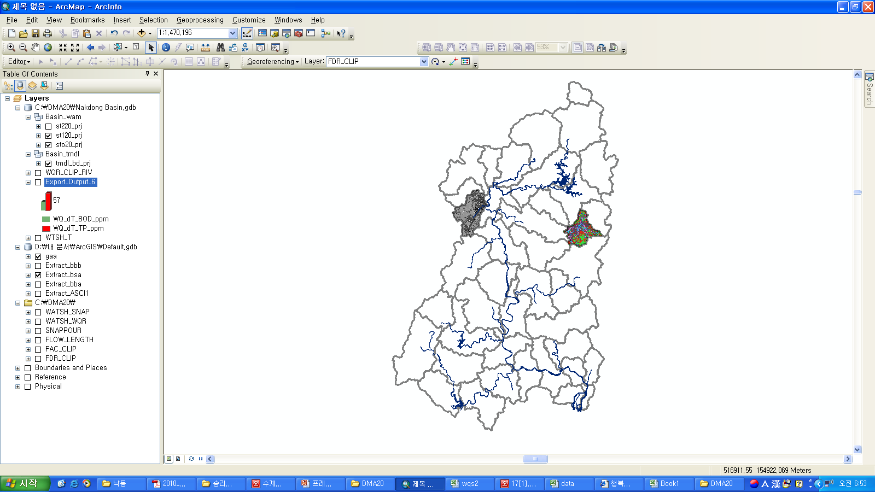

Slide 21
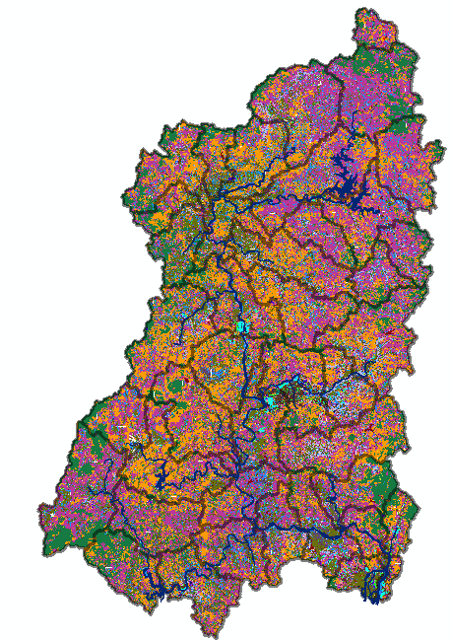
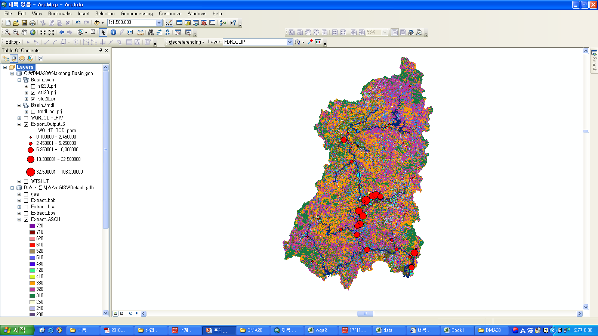
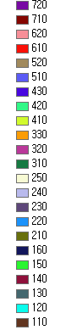
3. Water Impairment Assessment
Sea
Inland water
Uncovered land
Mining
Seashore wetland
Inland wetland
Grass
Golf field
Natural grass
Forest (mixed)
Forest (needle)
Forest (broad)
Other farm land
Orchard
Green House farm
Farm
Rice paddy
Utilities
Transportation sys.
Municipal
Urban area
Industrial area
Residential area

Slide 22
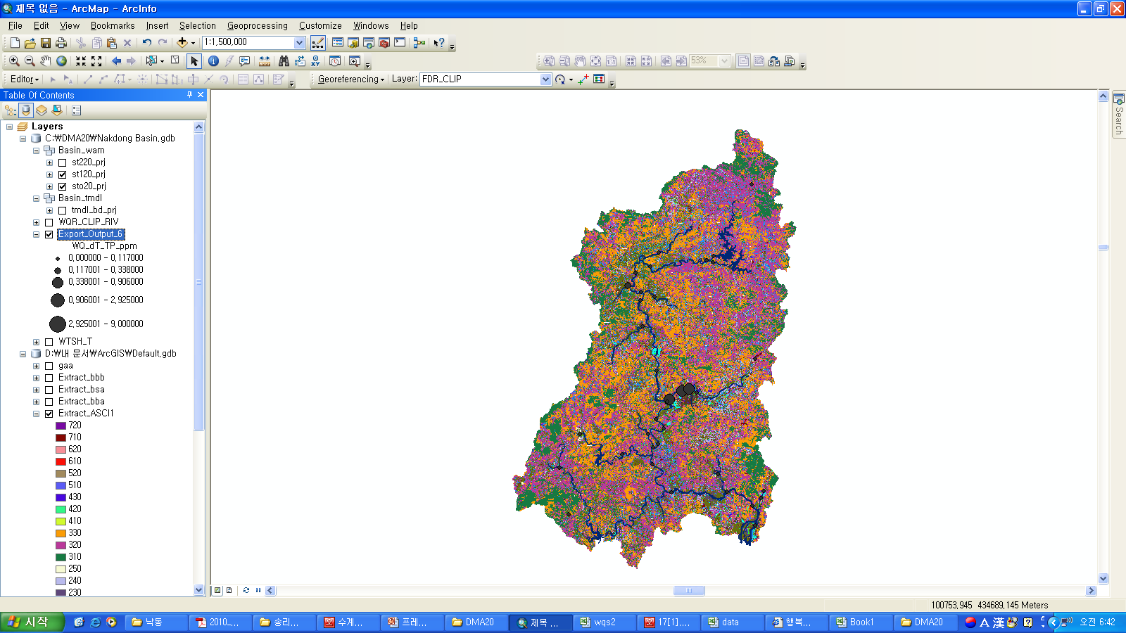
3. Water Impairment Assessment
Type | BOD (kg/km², day) | T-N | T-P
Rice Paddy | 1.59 | 9.44 | 0.24
Farm | 2.30 | 6.56 | 0.61
Mountain | 0.93 | 2.20 | 0.14
Uncovered land | 85.90 | 13.69 | 2.10
Others | 0.960 | 0.759 | 0.027

Slide 23




3. Water Impairment Assessment
Causes of impaired water and mitigations
Not treated waster water (past)
Non-point pollutant – rainfall, runoff flow and water quality dataset
Low level flow & long residual time – Env. Flow
Land use change (’89~’10)
Developed area
Farm land
Mountain

Slide 24
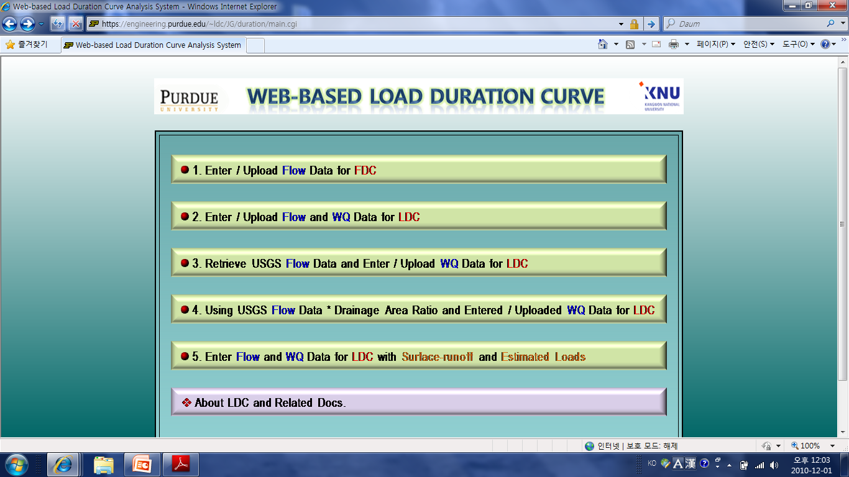
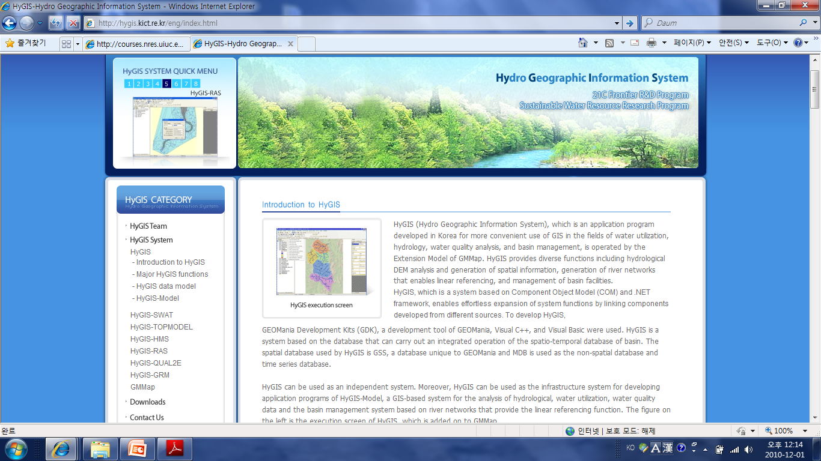
3. Water Impairment Assessment
Future tasks : GIS Application for TMDL
Prediction in organic way is not recommended
dynamic model / 3D / Non-conservative pollutant model / processing loads
Assistant tool for modeling
automated input data extraction
ex) Non-point source load (HSPF, SWAT), sediment yield (runoff) (GIS based RUSLE)
- Pollutant delivery rate calculation tool
https://engineering.purdue.edu/~ldc
Simple steady state prediction for initial decision making
- Duration Load Curve calculation tool (flow-water quality data required)
http://hygis.kict.re.kr/eng

Slide 25
3. Water Impairment Assessment
Future tasks : GIS Application for EIA
Initial planning :
reject an environmentally undesirable project
Cumulative effect assessment
DB and assessment tool for development project planning
e.g. Criteria for choosing dam construction project area
not permitted to the region of national parks, green belt, wildlife habitat, or high-rank afforestation etc.
not permitted to highly impaired water body, etc.

Slide 26
Contents
1. Background and Purpose of the project
2. Methodology
3. Water impairment assessment
4. Conclusion

Slide 27

5. Conclusion
Long-term water quality changes in Nakdong-River Basin
- 1989s ~ 2010
- Main reason
Water impairment assessment in Nakdong-River Basin
- Middle and downstream region is highly water-impaired
- Mitigation measures
GIS is a supportive tool for TMDL
- Automated tool for statistics analysis / input data extraction
e.g. LOWESS (LocallyWeighted Scatter plot Smoother) etc.
Pollutant delivery rate, Non-point pollution runoff weight factor calculation

Slide 28



Thank you
Any Questions?
For the detailed information,
you can reach me at my e-mail (irisnow@mail.utexas.edu),
or find the details from the website, (https://webspace.utexas.edu/gs22543/GIS_project/)
Notes:
이상으로
우리공사 주요사업부분 경영실적 보고를 마치겠습니다.
경청하여 주신 평가위원님께 다시 한번 감사를 드립니다.

