Slide 1
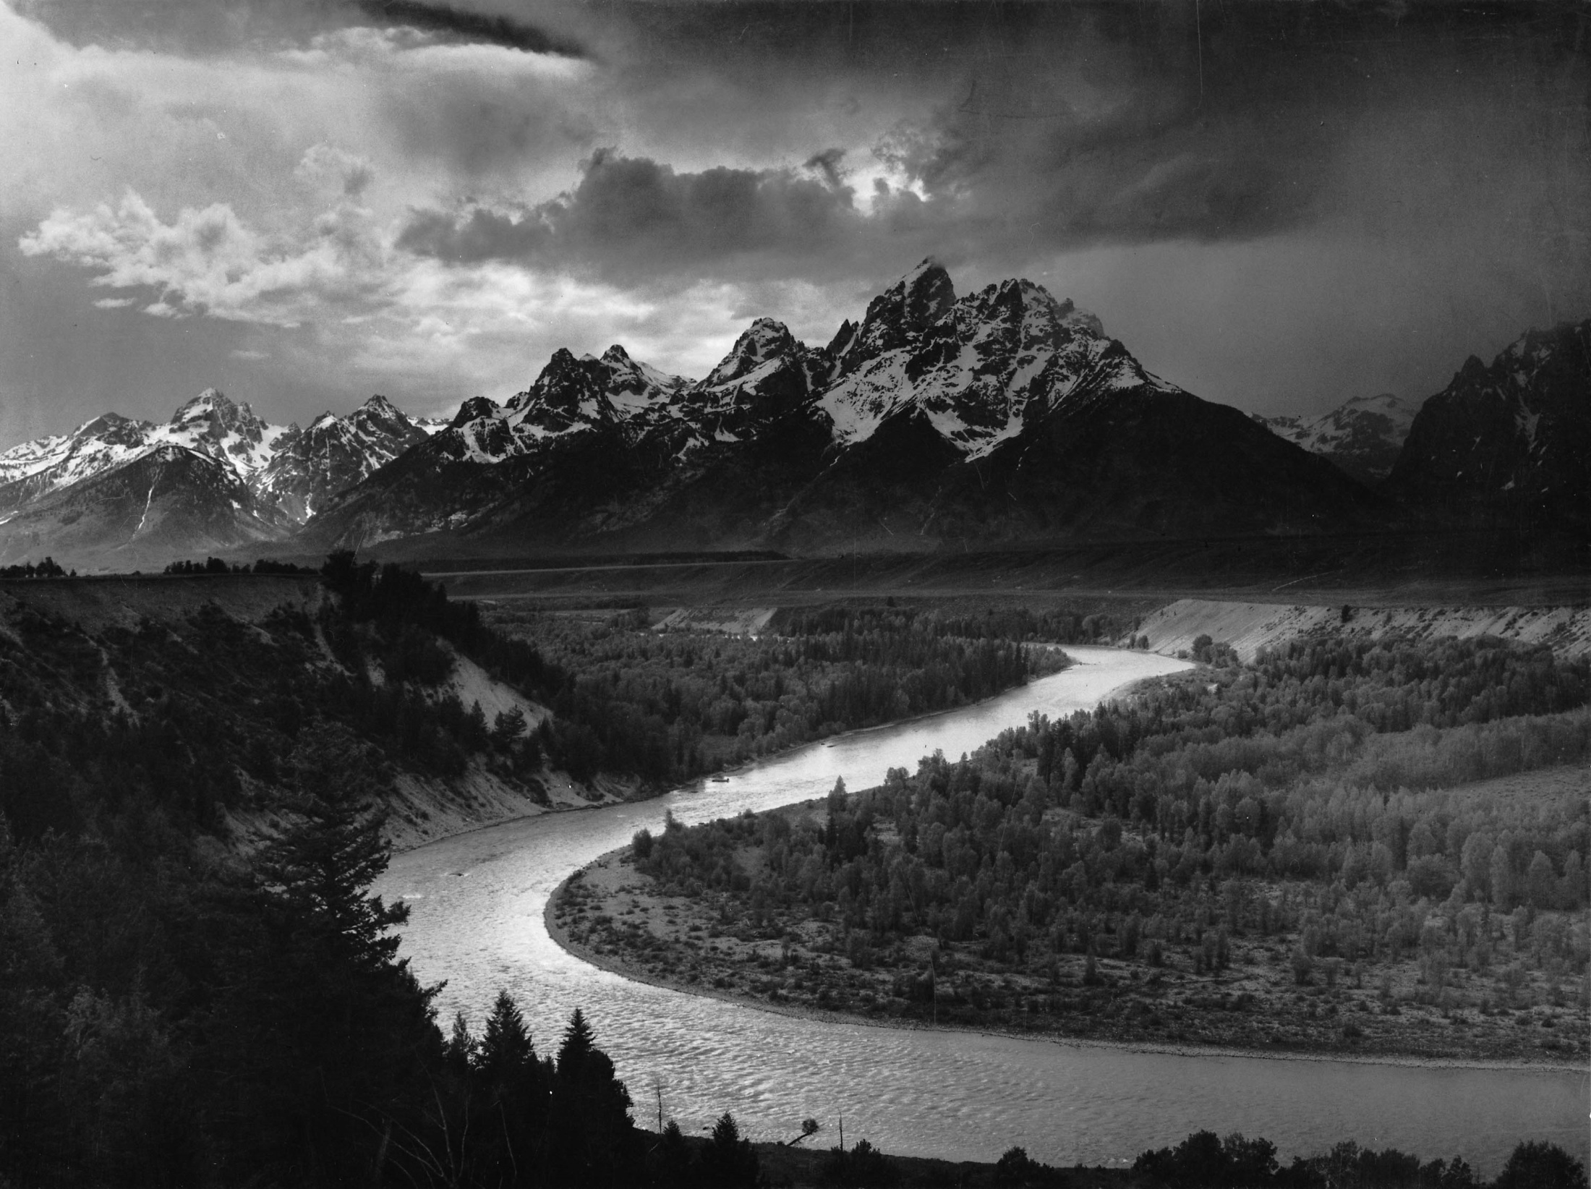
Pacific Northwest Salmon Migration and the Relationship with Hydroelectric Dams
Matt Jordan
CE 394 GIS and Water Resources

Slide 2
introduction
objective
methods
results
conclusions

Slide 3
introduction – pacific northwest salmon
Types of salmonoid species :
Chinook
Coho
Sockeye
Salmon Run
2500 km every 3 months
http://www.bcsalmon.ca/Resources/wildsalmon/pages/BC%20salmon%20migration%20chart.htm
http://www.fs.fed.us/r10/tongass/districts/mendenhall/fishcam/images/sockeye_female.jpg

Slide 4
objective – understanding dams salmon
dramatic declines in fish populations
contributing factors:
dam construction
increased logging, climate change, agriculture, over fishing
Bonneville Dam
Federal Dam Complex- Lower Snake River
http://mail.google.com/mail/?ui=2&view=js&name=js&ver=LMLtlgTYR0Q&am=X_MwtcT3ECEJFpSxaw

Slide 5
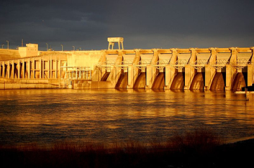
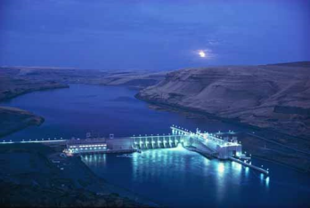
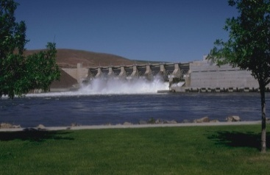
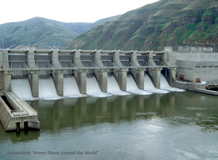
objective – understanding dams salmon
Four federal dams on the lower Snake River effect salmon migration
Salmon species are endangered and/or threatened under the Endangered Species Act (ESA)
ice harbor
Lower monumental
little goose
lower granite

Slide 6
methodology – data collection
NHD Plus
base map and flowline attributes
National Inventory of Dams (NID)
dam locations and attributes
NOAA National Marine Fisheries Service
critical habitat for endangered species

Slide 7
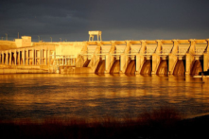
methodology – map building
Lower Monumental
Little Goose
Lower Granite
Ice Harbor

Slide 8
results – two worlds of energy
SALMON
Salmon travel 1100 km, in 36 days, consuming their own body mass.
Exerts an average of 2 Watts for the duration of the journey .
HYDROELECTRIC DAMS
Turbines in the dams utilize the potential and kinetic energy of the river system to produce power.
On average: 600 MW
``
Energy calculation includes: elevation change (potential) + drag of fish in the river (kinetic) + velocity of fish (kinetic)
Energy calculation includes: elevation change (potential) + flow of river

Slide 9
results – critical habitat (NOAA)
Critical habitat as designated by the Federal Government under the Endangered Species Act (ESA)
Contrasting:
engineered system (Federal Dam Complex)
natural system (Tucannon River)

Slide 10
results – flow profile(natural)
The Tucannon River is classified as critical habitat but does not house any hydroelectric dams
Drops in the flow profile are the result of inflows from tributaries and rivers

Slide 11
results – hypsometric (natural)
The hypsometric profile displays a gradual change in the channel elevation
Approximate Slope = 1%

Slide 12
results – flow profile (eng.)
The Snake River is classified as critical habitat and maintains 7 megawatt hydroelectric dams
Flow profile indicates there are large rivers feeding the system
Tucannon
Clearwater River
Grand Ronde
Salmon River

Slide 13
results – hypsometric (eng.)
Two megawatt hydroelectric complexes.
L. Granite
Little Goose
L. Monumental
Ice Harbor
Hell’s Canyon Complex
Federal Dam complex (lower Snake River)

Slide 14
results – chinook habitat loss
BPA designation of chinook habitat in the lower snake river
change since 1900
Chinook habitat pre-1900 on the lower snake river
Approximately 714 km
present chinook habitat on the lower Snake River
60% loss of habitat

Slide 15
conclusion –
the dams significantly alter the hydrology of the river system
the presence of dams on the Snake River likely contributes to the destruction of endangered salmon habitat

Slide 16
questions – ?
http://madinkbeard.com/blog/wp-content/images/salmon2.jpg

