Slide 1
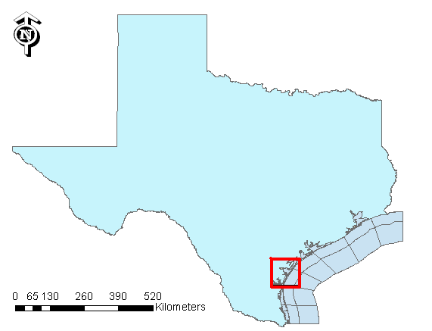
Hypoxia Conditions in Corpus Christi Bay
By: Eliora Bujari
11/25/2008

Slide 2
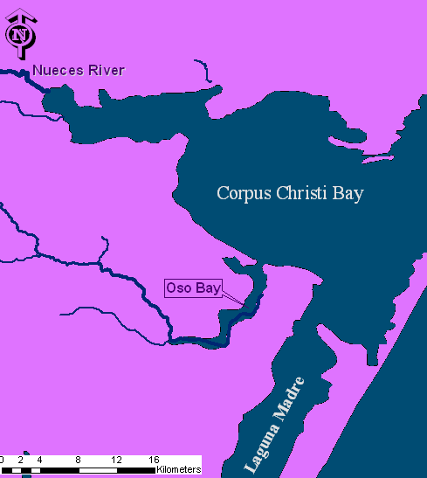
Corpus Christi Bay
Located in Southern Texas Bend
Separated from the Gulf of Mexico by Mustang and North Padre Islands.
Freshwater inflows from Nueces River and Oso Bay.

Slide 3
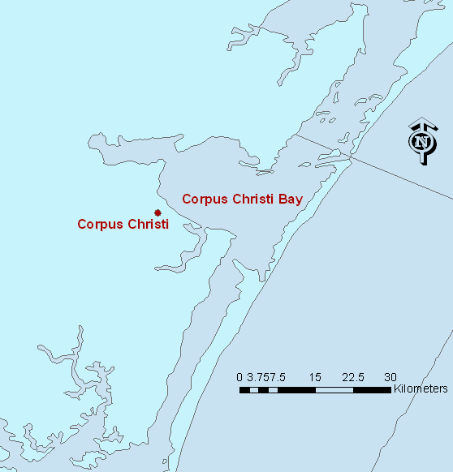
Project Problem
The Corpus Christi Bay is greatly effected by hypoxia, especially during the summer months
Hypoxia is a condition occurring when oxygen levels in the water are below 2 mg/L
Why is this a problem?
Why does it occur during the summer months?

Slide 4
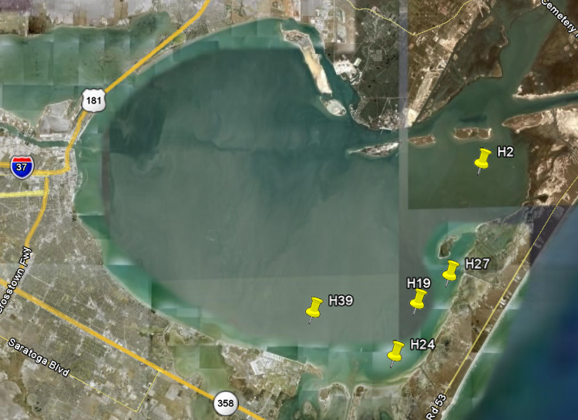
Hypoxia Stations
Corpus Christi Bay Test Bed uses advanced sensing and environmental information systems (EIS).
Observation Data Modeling (ODM) hypoxia sites.
Five stations that measure Continuous Dissolved Oxygen Concentrations , Salinity, and Temperature

Slide 5
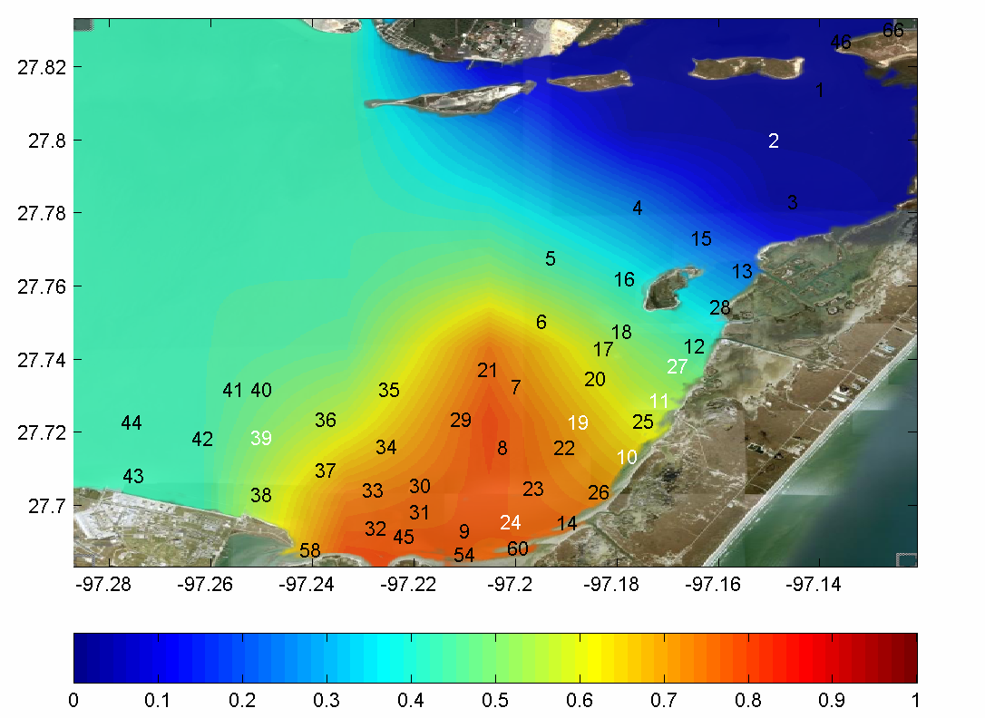
Probability of Occurrence of Hypoxia in Corpus Christi Bay
There is a 60 to 85% chance that low levels of dissolved oxygen will be measured

Slide 6
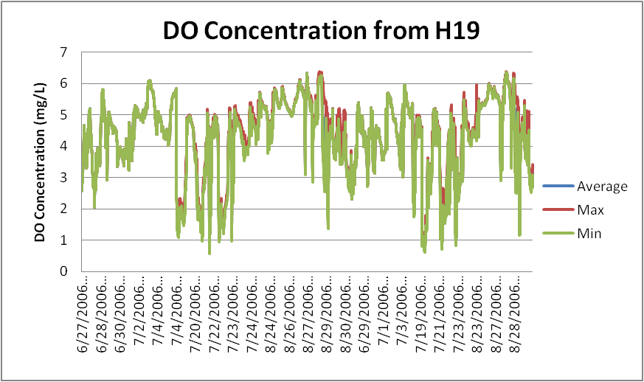
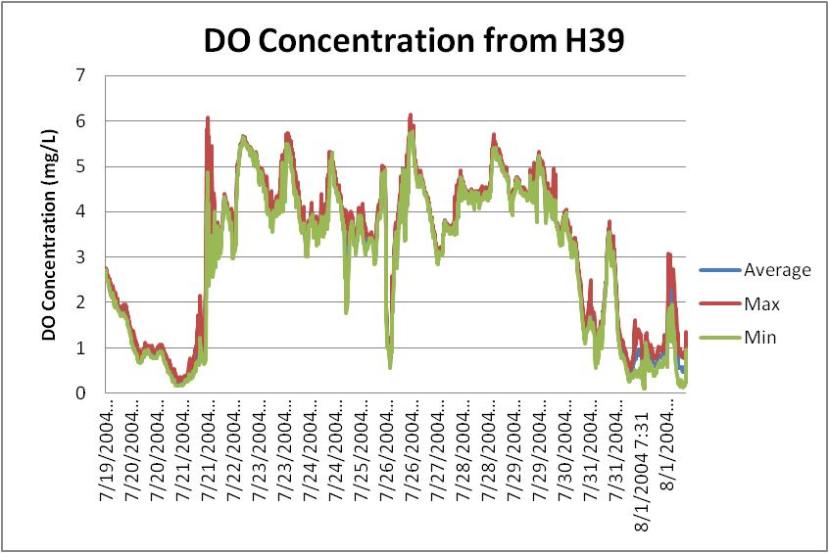
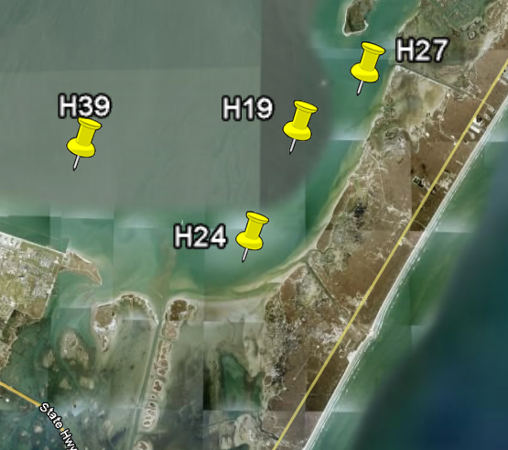
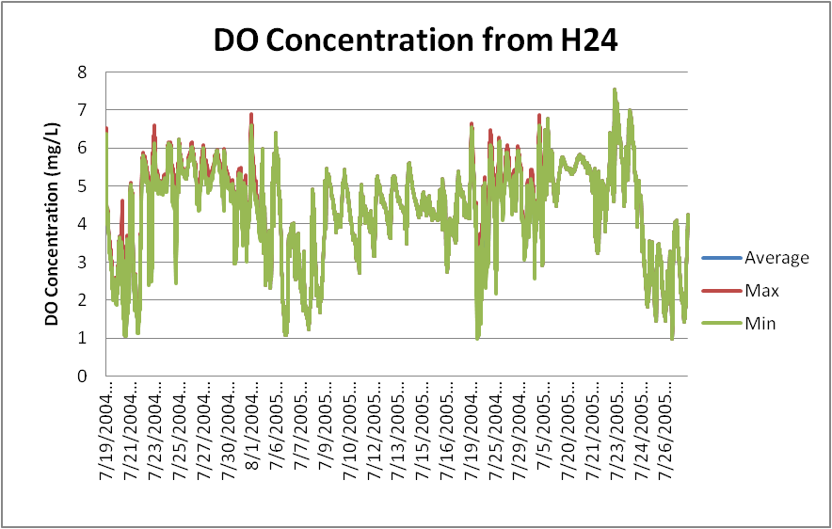
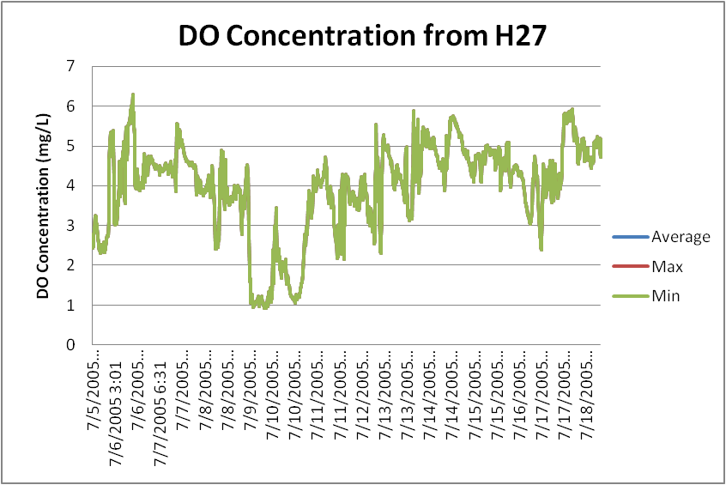
Continuous Dissolved Oxygen

Slide 7
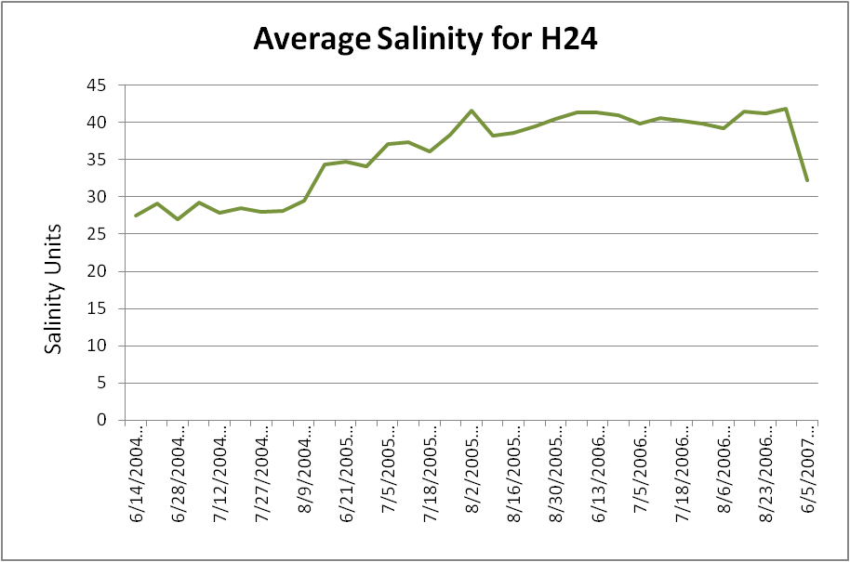
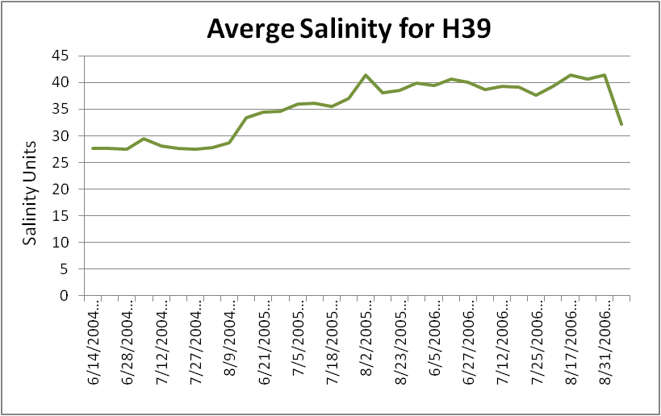
Salinity Paterns

Slide 8
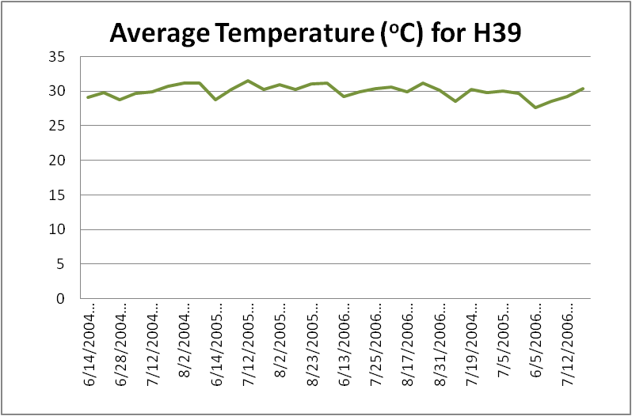
Temperature of Surface Water
Temperatures of the water in the Corpus Christi Bay range from 28 to 30 degree Celsius during the summer.

Slide 9
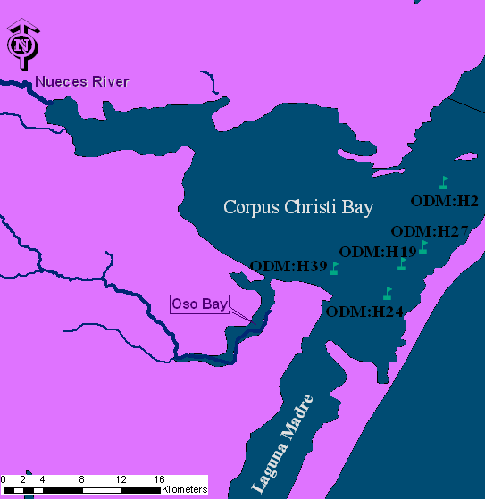
Possible Causes of Hypoxia
Waste Water Treatment Plants and Power Plants discharging into the Oso Bay.
Hypersalinity condition from Laguna Madre and Oso Bay

Slide 10
Conclusions
Hypoxia is an alarming condition that occurs mostly in the summer.
The salinity stratification of the water column in the summer months, is a key factor in occurrence of Hypoxia.
Hypersaline water is created due to the high temperatures and evaporations in the Bay.
Photosynthesis and Respiration also affect the dissolved oxygen levels in the Bay.

Slide 11
Future Work
Further analyze the hypoxia data by looking at other variables
Animation of Dissolved Oxygen Concentrations in the Bay during the summer

Slide 12
Questions ?

