Slide 1
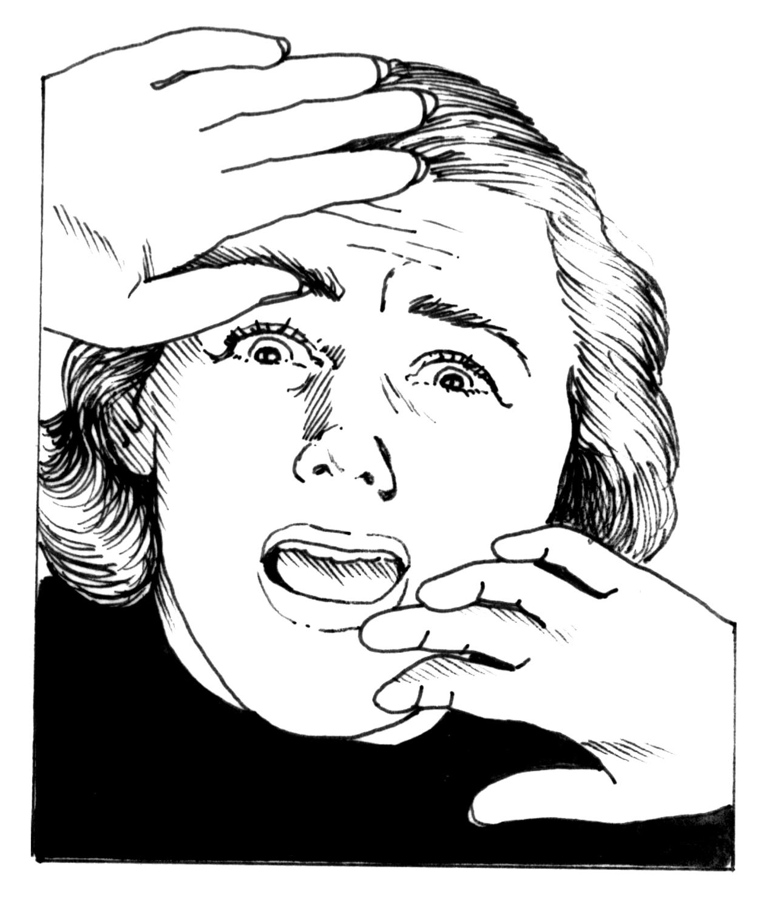
IS WASTE WATER GETTING INTO YOUR LOCAL STREAMS
THE ZERO FIELD WORK APPROACH
CARSON WERNER
20 Nov 2008

Slide 2
OUTLINE
1. INTRODUCTION – Austin Area and Urbanization
2. HYPOTHESIS – Municipal water inputs are influencing streamflow
3. RESULTS – Is it really?
4. CONCLUSIONS – Maybe.
5. FUTURE WORK
6. QUESTIONS – Do you have any?

Slide 3
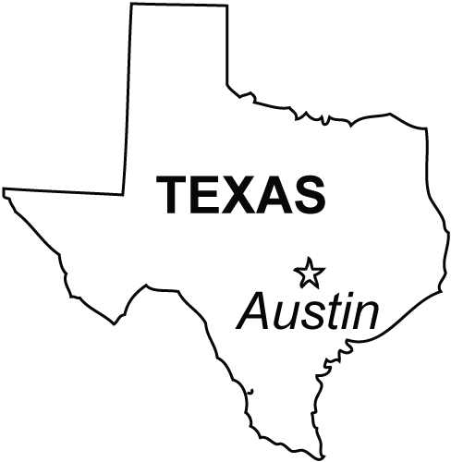
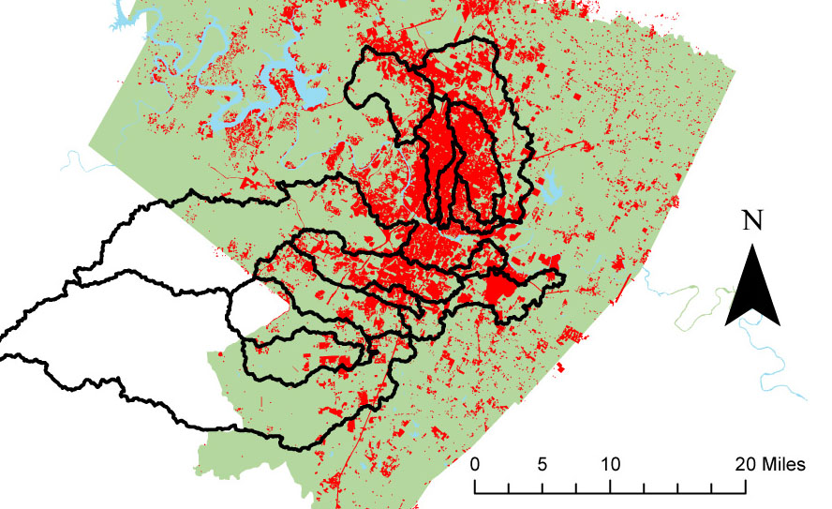
THE YEAR IS 1990 IN AUSTIN, TX…
Land Use Data – City of Austin

Slide 4
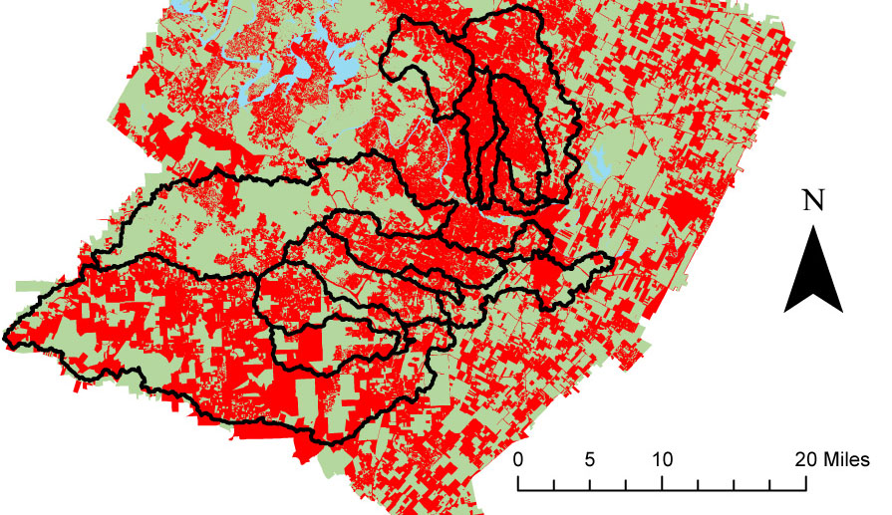
NOW IT IS 2003…
Land Use Data – City of Austin

Slide 5
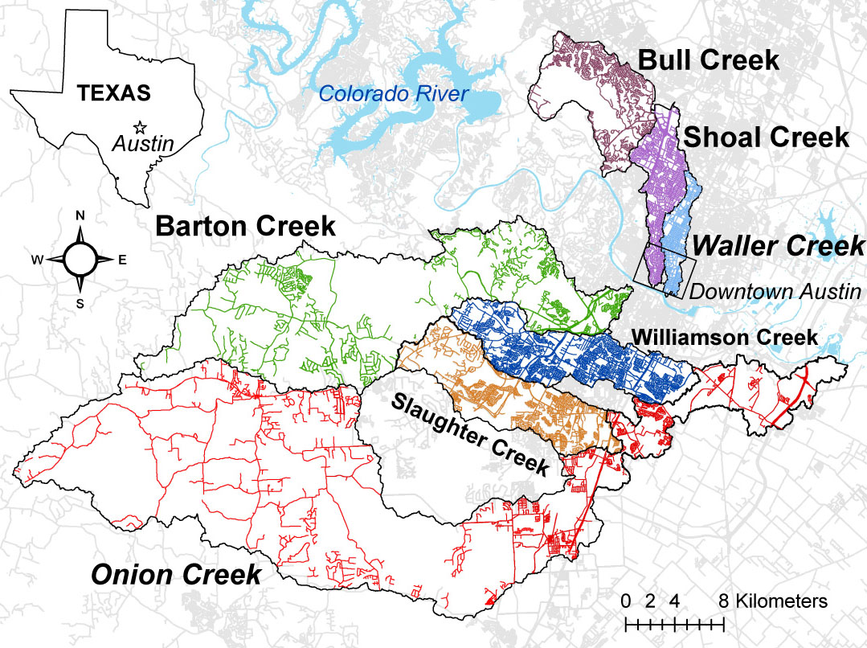
STREET DENSITY
Watershed | Total Length of Streets (Miles) | Watershed Area (Sq. Miles) | Density
Onion | 612.8 | 211.1 | 2.9
Barton | 432.0 | 108.6 | 4.0
Bull | 188.9 | 24.4 | 7.7
Slaughter | 259.7 | 30.7 | 8.5
Carson | 55.4 | 5.8 | 9.6
Walnut | 473.0 | 43.2 | 10.9
Williamson | 401.3 | 30.3 | 13.3
Boggy | 116.9 | 6.1 | 19.1
Shoal | 254.2 | 13.0 | 19.5
Waller | 121.3 | 5.6 | 21.5
Created from City of Austin
GIS Data

Slide 6
HYPOTHESIS
Increasing urbanization in a watershed increases the input of anthropogenic (municipal and waste) water into streams.
Therefore, streams in more urbanized watersheds should flow more perennially than those in relatively un-urbanized watersheds.

Slide 7
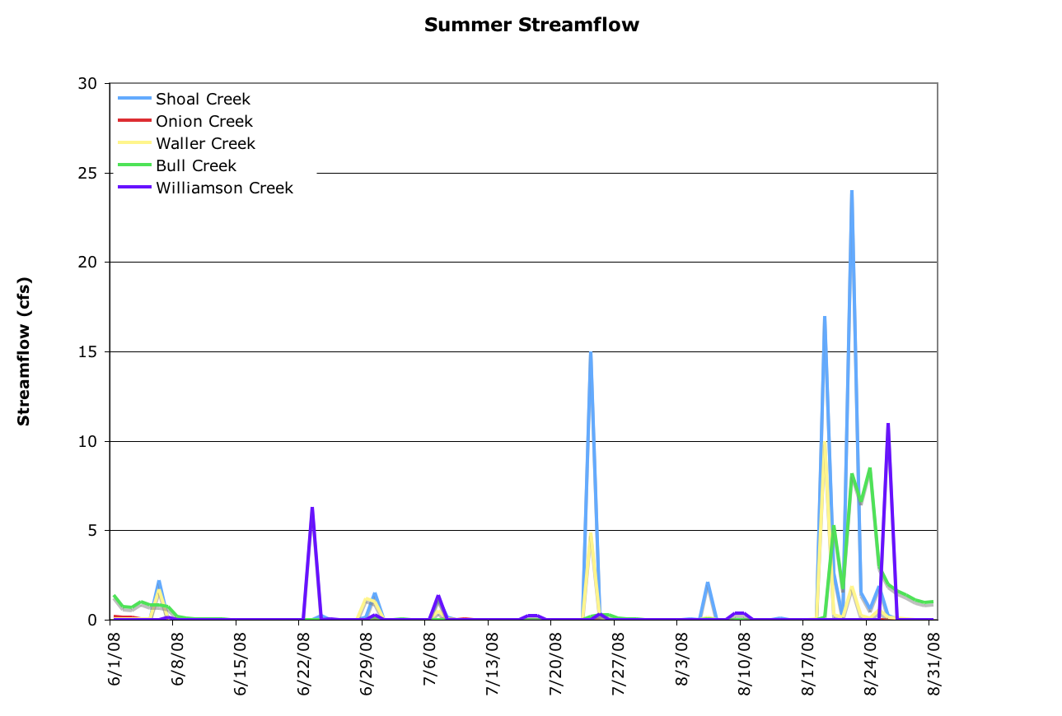
TESTING THE HYPOTHESIS

Slide 8
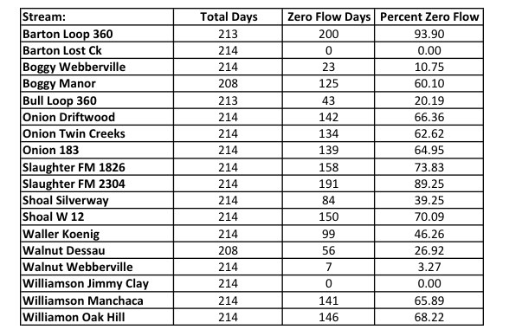
TESTING THE HYPOTHESIS
Dates: 04 Apr 2008 - 31 Oct 2008

Slide 9
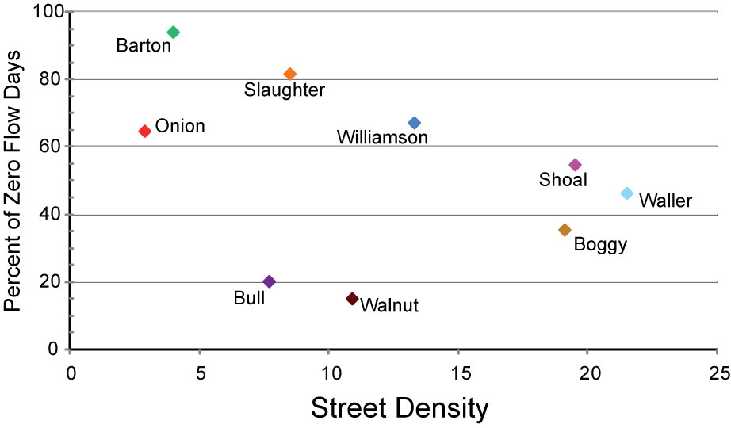
RESULTS

Slide 10
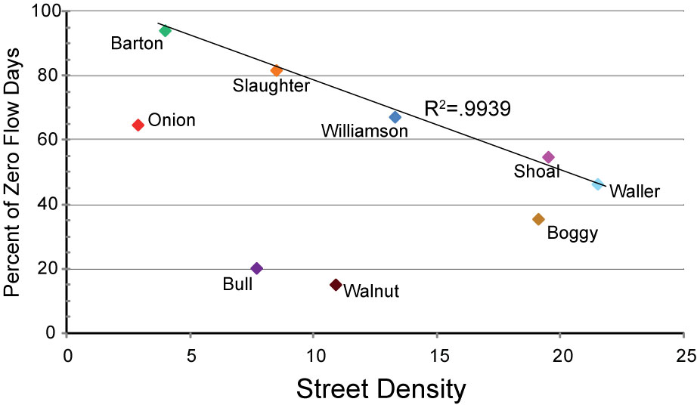
RESULTS

Slide 11
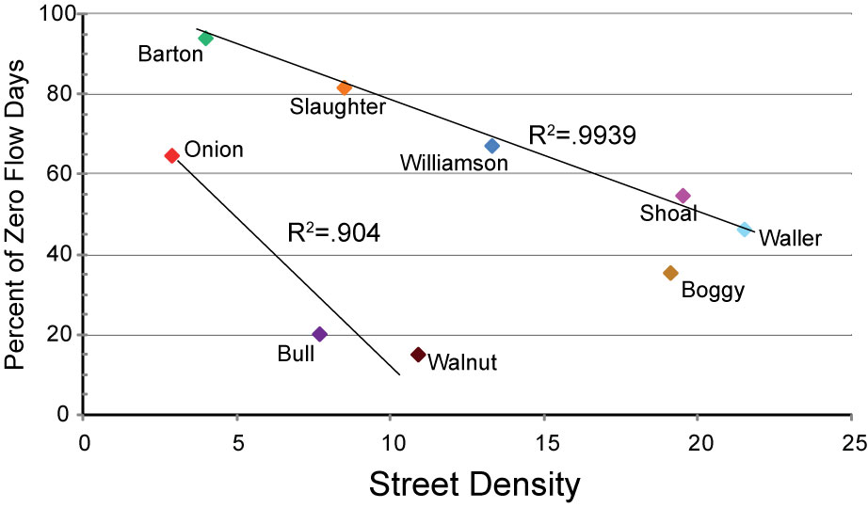
RESULTS

Slide 12
CONCLUSIONS
Potential correlations very strong, but still complicated. Are there outliers (Walnut, Bull) or two separate systems at work?
Complications come from accuracy of stream gages and number of sample sites.
This correlation is based only on street density, other measures of urbanization may yield different results.

Slide 13
FUTURE WORK
Do same analysis for different periods back in time
Test correlations between zero flow days and different indices of urbanization (land use categories, pipe length)
Explore what may be happening with Bull and Walnut Creeks

Slide 14
DO YOU HAVE ANY QUESTIONS FOR ME TO ANSWER?!

