Slide 1
Sea Level Rise in Galveston, Miami and New York
Maelle LIMOUZIN
November 18, 2008

Slide 2
Background on sea level rise
Consequence of global warming through two principal processes:
Thermal expansion of water
Melting of glacial ice
Great differences due to currents and coasts and sea-beds configurations
Possible consequences :
Important floods in many cities and islands in the world,
Change in groundwater quality,
Losses of natural coastal habitats and coastal erosion…

Slide 3
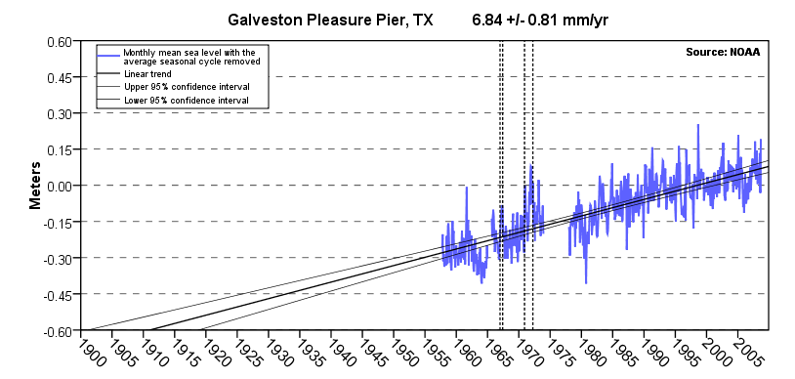
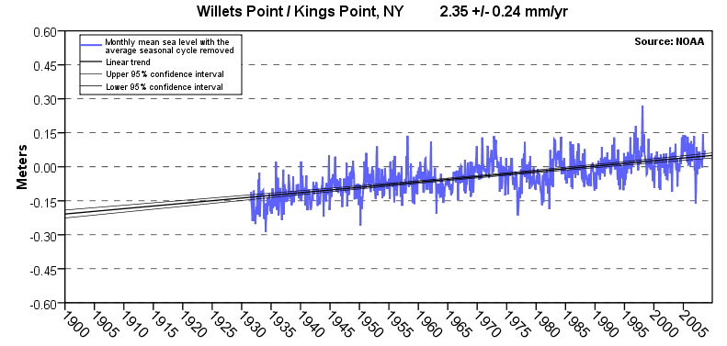
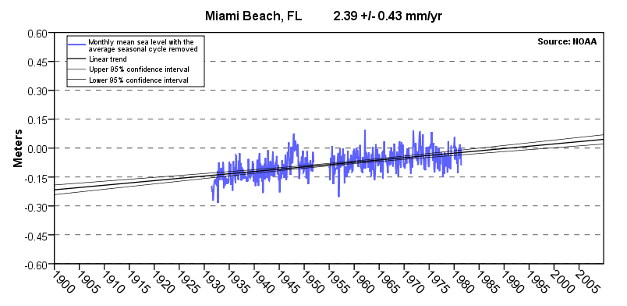
Sea level trends
From NOAA tides and currents

Slide 4
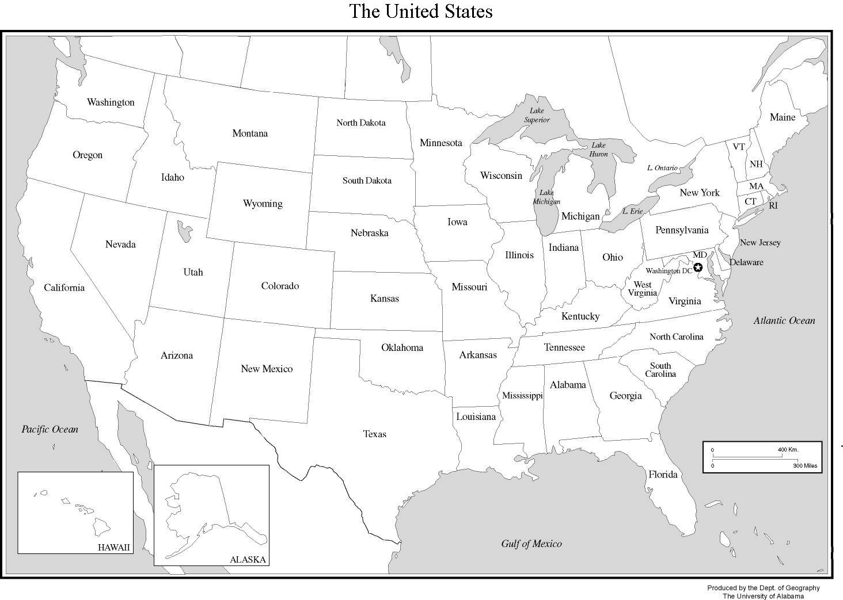
Locations

Slide 5
Data
National Elevation Dataset from USGS seamless server
Shorelines from National Geodetic Survey NOAA Shoreline Data Explorer
Roads and Rails from ESRI Census 2000 TIGER/Line® Shapefiles
Land cover use from USGS

Slide 6
Miami map
8 different layers =
8 different scales
-> adapted display
Miami

Slide 7
Miami in 50 years sea level + 119.5 mm = 0.392 ft

Slide 8
Miami in 100 years sea level + 239 mm = 0.784 ft

Slide 9
Miami in 200 years sea level + 478 mm = 1.568 ft

Slide 10
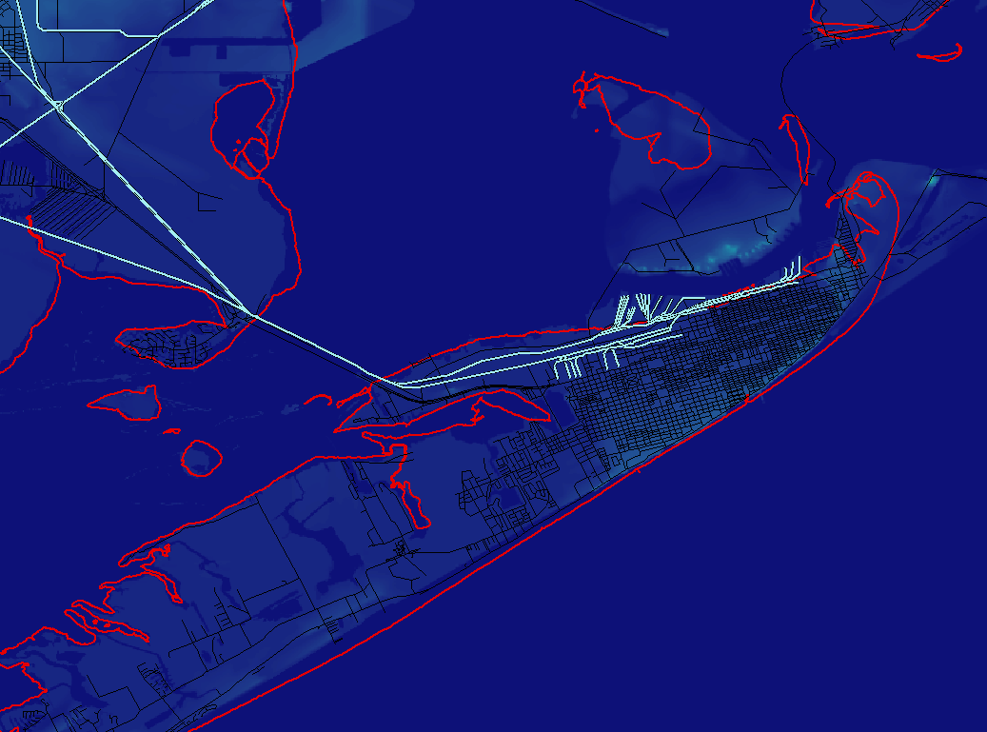
Galveston map
Galveston

Slide 11
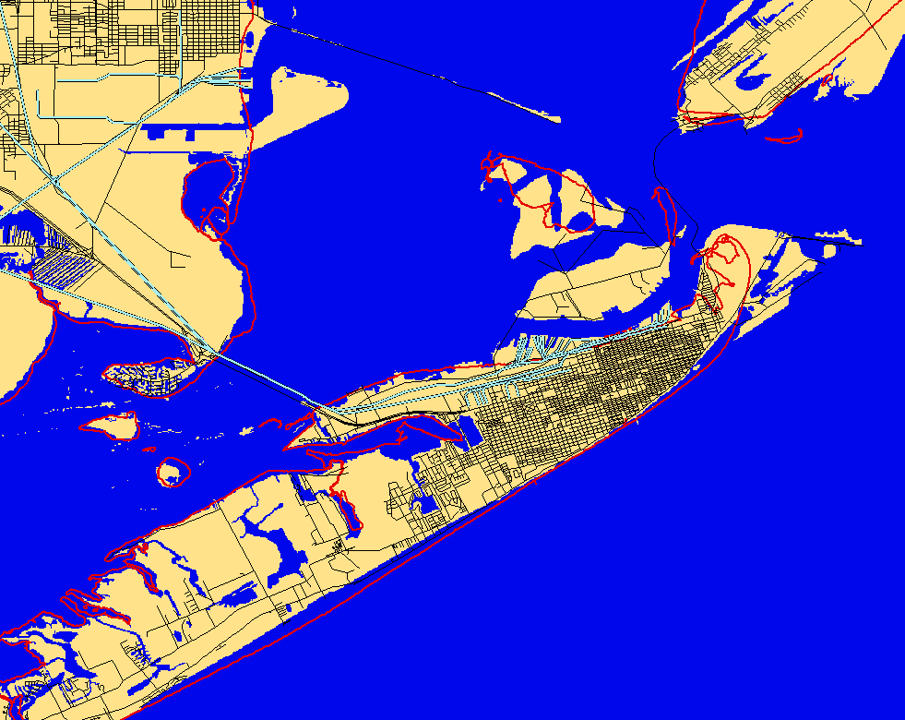
Galveston in 50 years sea level + 342 mm=1.122 ft

Slide 12
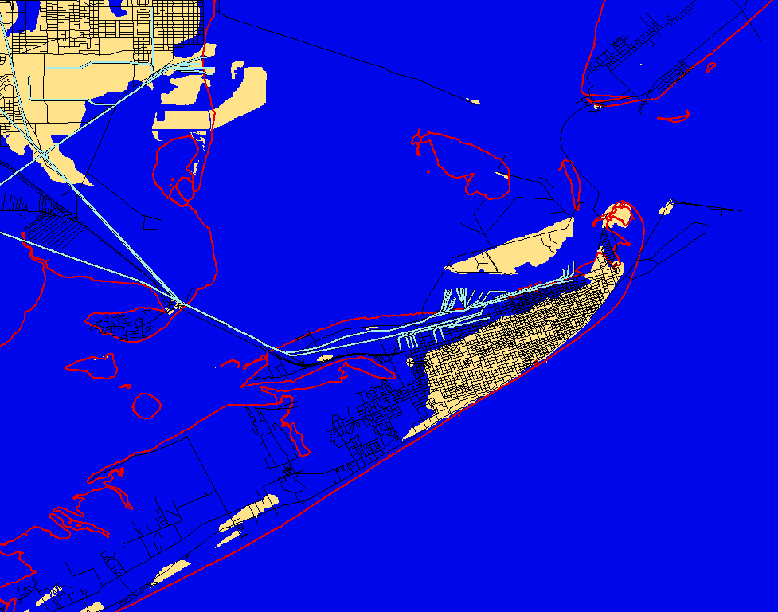
Galveston in 100 years sea level + 684 mm=2.244 ft

Slide 13
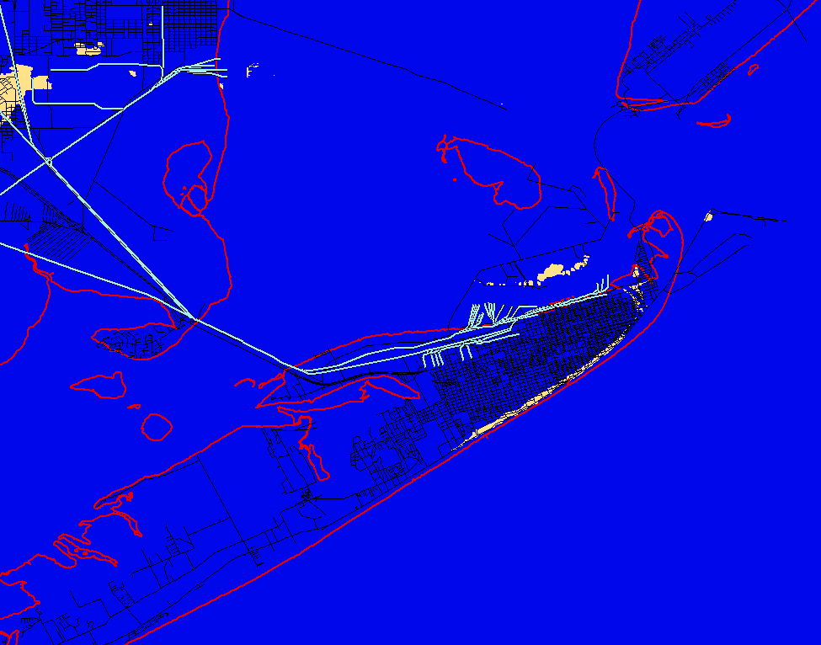
Galveston in 200 years sea level + 1.37 m = 4.495 ft

Slide 14
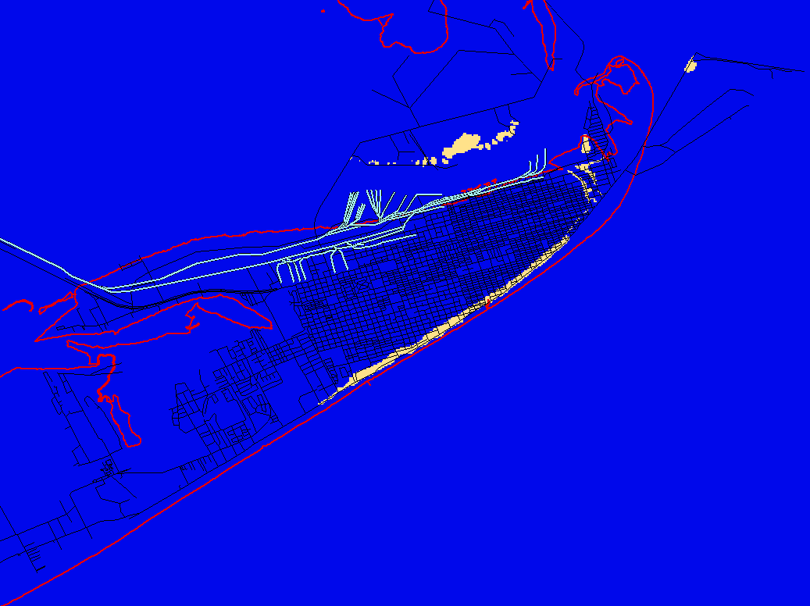
Galveston in 200 years sea level + 1.37 m = 4.495 ft

Slide 15
Land cover use
cultivated crops
developed area
Emergent herbaceous wetlands

Slide 16
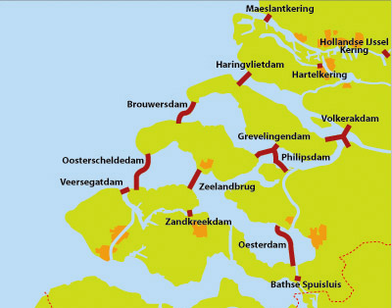
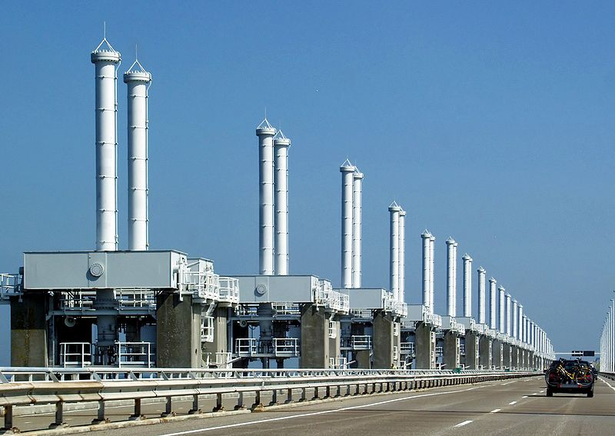
Suggestions for Galveston
Levees and dikes around critical areas
Seal off the entire Galveston Bay during storm attack as in Netherlands

Slide 17
Conclusions
Sea level rise can be a real threat
Populations may have to be displaced
Long-term solutions have to be found during the next decades
HOWEVER,
Estimation really approximate
Future behavior unknown

Slide 18
Future work
New York map
More precise analysis of the consequences
Suggest solutions for Miami and New York

Slide 19
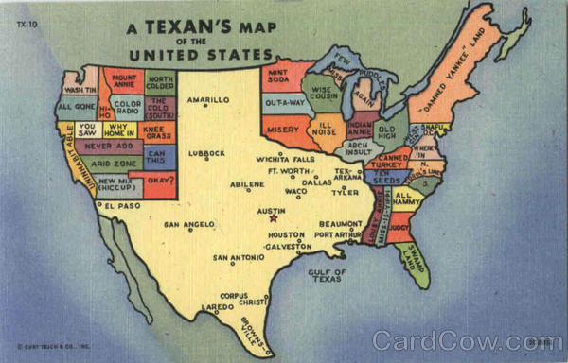
Questions ?
Sea Level Rise in Galveston, Miami
and New York
vvv
vvv
vvv

