Slide 1
Review Slides for Exam 1
CE 365K Spring 2015
Some class material was presented primarily on the board, and you should refer to your class notes for that material
The balance and emphasis in the Review Sheet is what you should consider definitive for the various topics covered in class so far.

Slide 2
HydroDesign Process
How should the study area be described?
How does the study area operate?
Is the current study area working well?
How might the study area be altered?
What differences would the changes cause?
How should the study area be changed?
Representation
Process
Evaluation
Change
Impact
Decision
Structure your reports (oral and written) using this framework

Slide 3
Evolution of Hydraulic Design
Stormwater runoff disposal
  Get the water off the site as quickly and efficiently possible
Stormwater detention
  Slow down the stormwater so that peak flow after development is not more than before
Water Quality Control
  Retain and filter water on site so that bacteria are reduced and water quality improves
Low Impact Development
  Dispersed onsite infiltration, filtration and retention schemes

Slide 4
Bentley Computer Programs
Flow Master
  Design of pipes, gutters, inlets, ditches, open channels, weirs and orifices
Culvert Master
  Design and analyze culvert hydraulics
StormCAD
  Design and analyze storm sewer systems
PondPack
  Pre- and Post-developed watershed conditions
  Sizing ponds
  Outlet structure rating curves
Steady Flow
Unsteady Flow

Slide 5
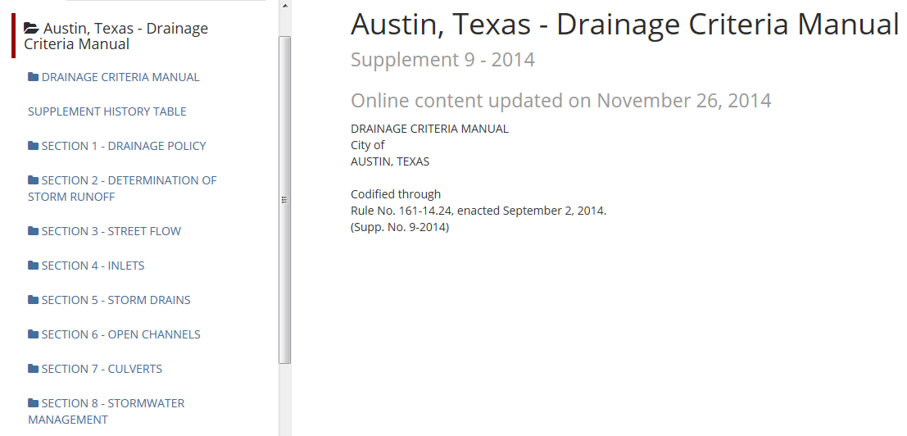
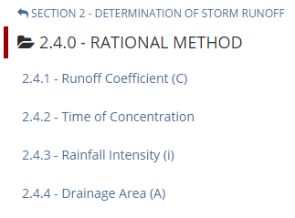
City of Austin Drainage Criteria Manual
https://www.municode.com/library/#!/tx/austin/codes/drainage_criteria_manual

Slide 6
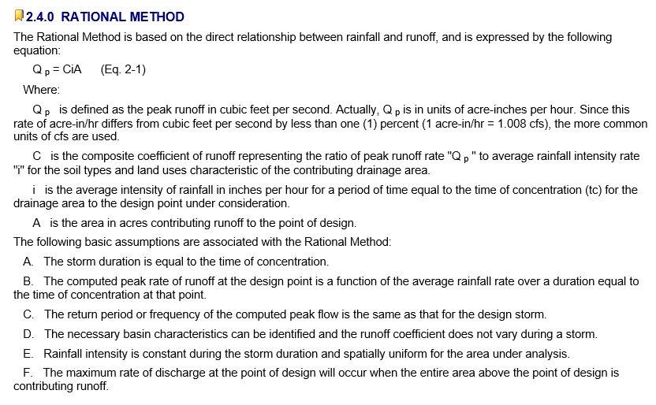
Rational Method
Source: Austin Drainage Criteria Manual, Chapter 2

Slide 7
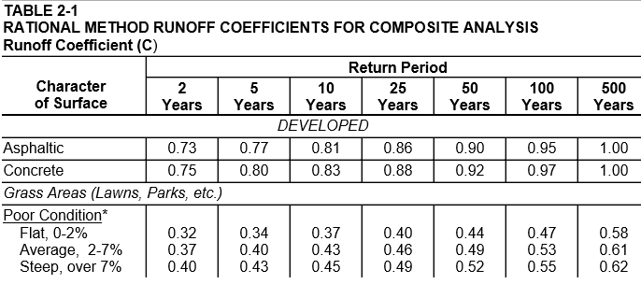
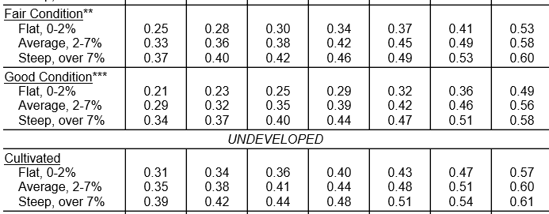
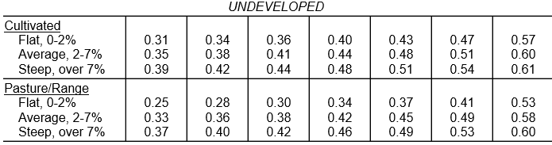

Source: Austin Drainage Criteria Manual, Chapter 2

Slide 8
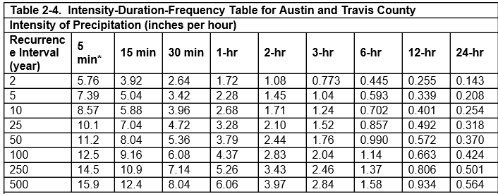
Intensity-Duration-Frequency Curves

Slide 9
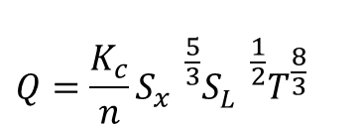
Gutter Flow
$$Q=\frac{K_{c}}{n}{{{S_{x}^{}}^{\frac{5}{3}}{S_{L}^{}}^{\frac{1}{2}}T^{\frac{8}{3}}}_{}^{}}^{}$$
T
d
S_{x}
1
Q = flow in gutter (cfs)
K_{c} = coefficient (0.56 for US units, 0.376 for SI units
S_{L} = longitudinal slope
T = spread (ft)
S_{x} = transverse slope
Ref: Haested p. 99

Slide 10
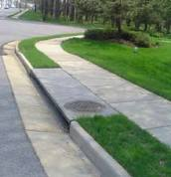
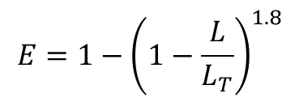
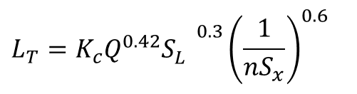
Flow into a Curb Inlet
L_{T}
$$L_{T}={{{K_{c}Q^{0.42}S}_{L}^{}}^{0.3}{\left(\frac{1}{nS_{x}}\right)}^{0.6}}_{}$$
L_{T} = required length to intercept all flow (ft)
Q = flow in gutter (cfs)
K_{c} = coefficient (0.60 for US units, 0.817 for SI units)
S_{L} = longitudinal slope
S_{x} = transverse slope
$$E=1−{\left(1−\frac{L}{L_{T}}\right)}^{1.8}$$
E = efficiency (proportion of flow captured
L = actual length (ft) (for L < L_{T})
Ref: Haested p. 103

Slide 11
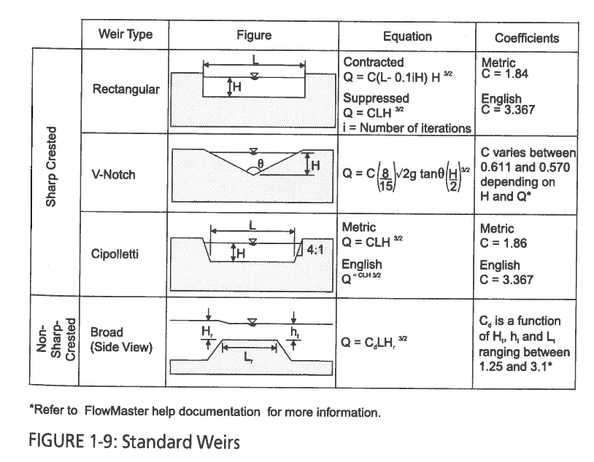
Weir Coefficients
Source: “Computer Applications in Hydraulic Engineering”, 8th Ed. Haested Methods, 2013

Slide 12
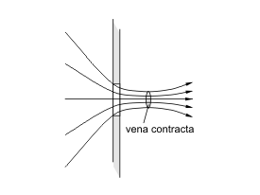

Vena Contracta
Contraction = $\frac{A_{2}}{A_{1}}$ ~ 0.64
A₁
A₂
http://en.wikipedia.org/wiki/Vena_contracta

Slide 13
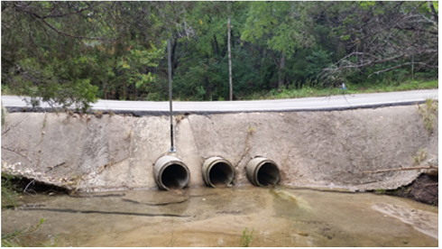
Road Culvert

Slide 14
Flow through a Circular Pipe
$$A= \frac{1}{8}(α−\sin{α)D^{2}}$$
D
α
y
$$P= \frac{1}{2}αD$$
$$R= \frac{1}{4}(1−\frac{Sinα}{α})D{ }$$

Slide 15
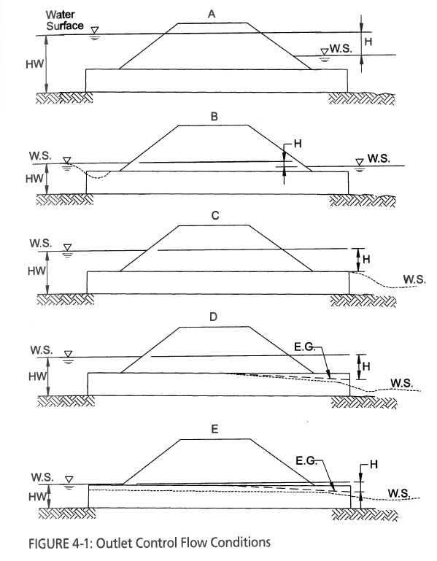
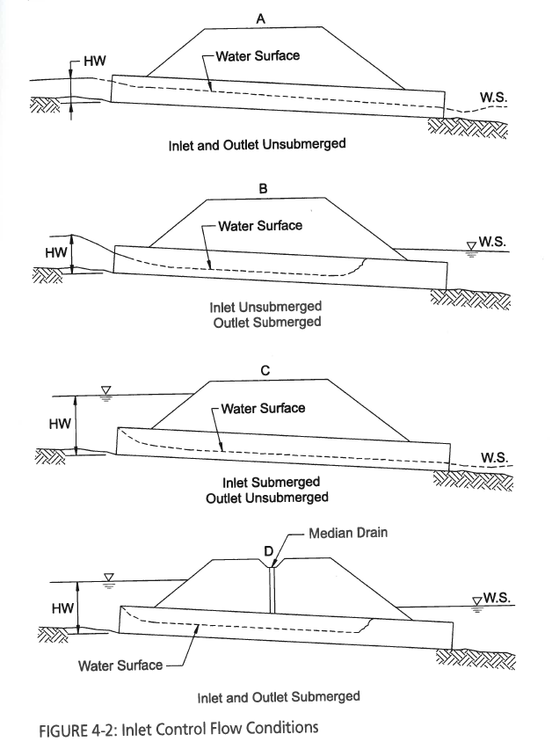
Culvert Flow Control
Haested Methods Water Solutions “Computer Applications in Hydraulic Engineering, 8th Edition

Slide 16
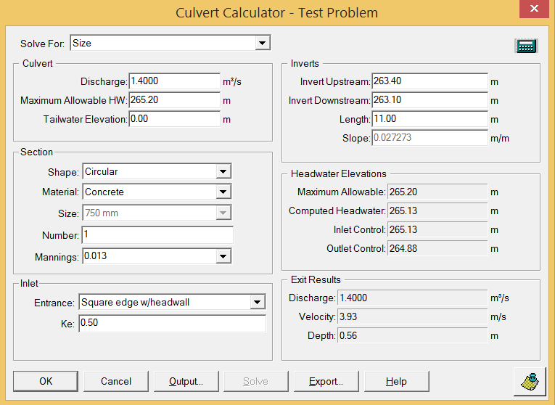
Example Problem: Solve for Size

Slide 17
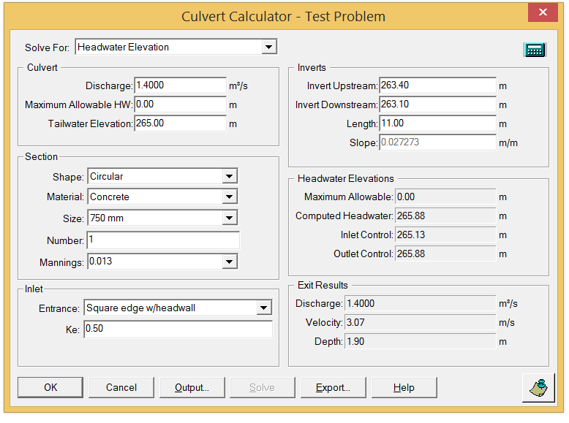
Example Problem: Solve for Headwater

Slide 18
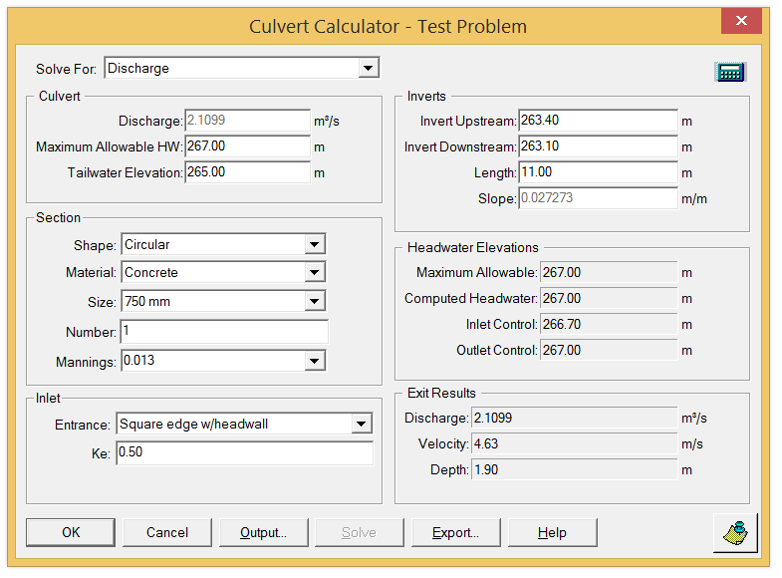
Example Problem: Solve for Discharge

Slide 19
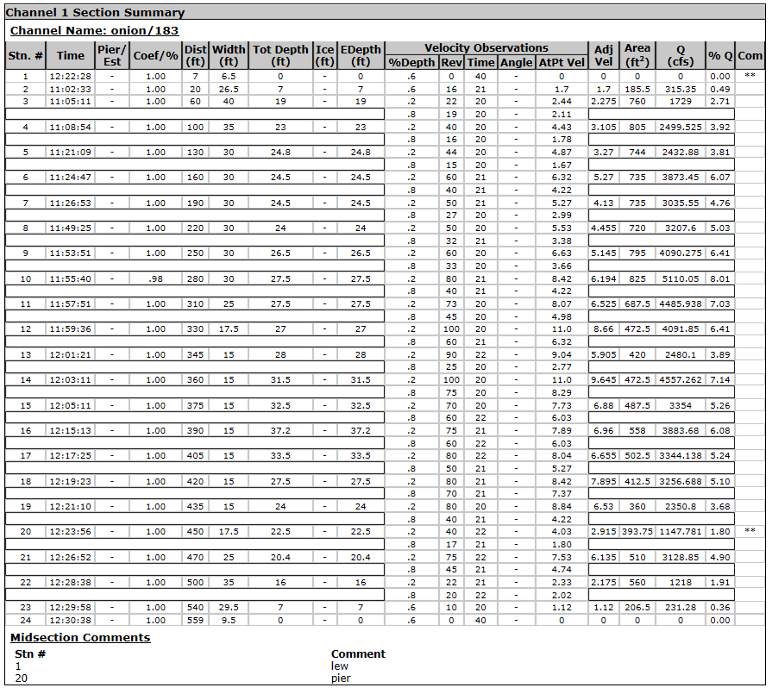
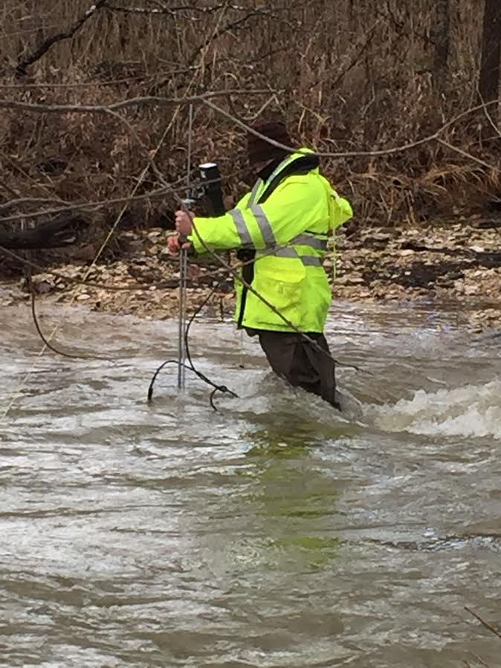
Stream Gaging, Onion Creek at Highway 183
For method see: http://water.usgs.gov/edu/measureflow.html

Slide 20
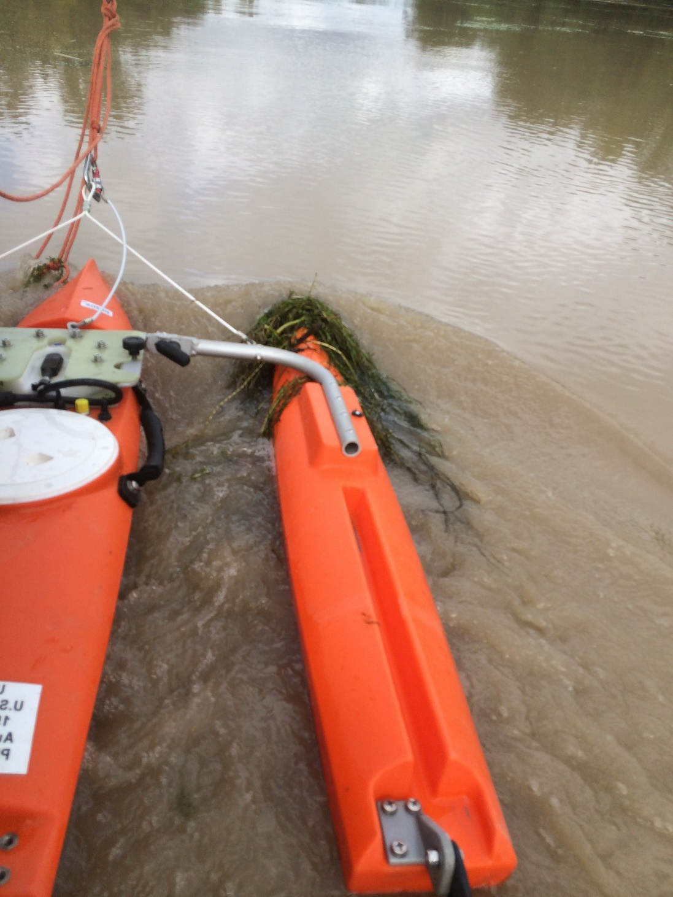
ADCP
Acoustic Doppler Current Profiler

Slide 21
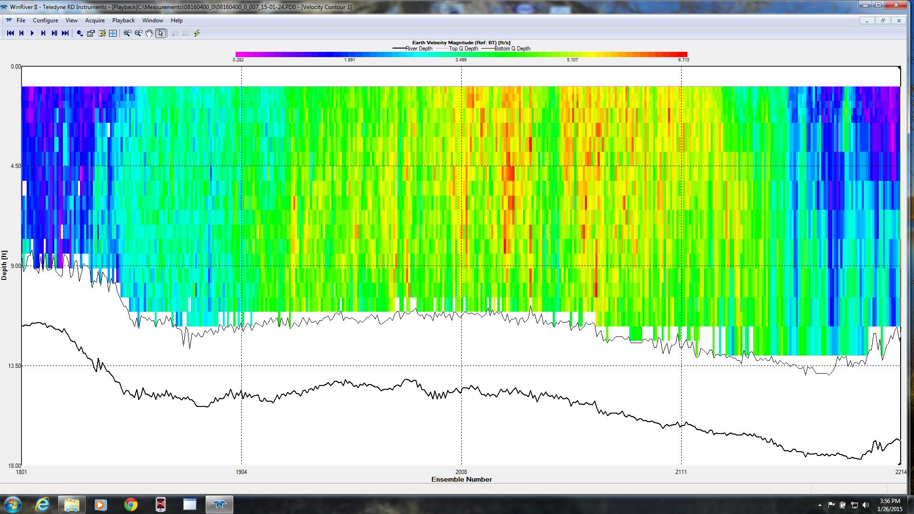
ADCP Velocity Profile – Colorado River at La Grange

Slide 22




What is GIS
A geographic information system (GIS) is a system designed to capture, store, manipulate, analyze, manage, and present all types of geographical data. -- Wikipedia
data
computers
maps
tools

Slide 23
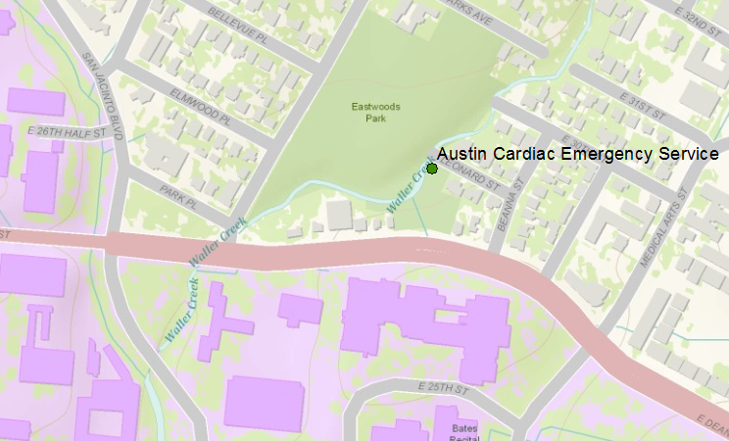
Vector data represent discrete features
points
lines
data
polygons
map

Slide 24
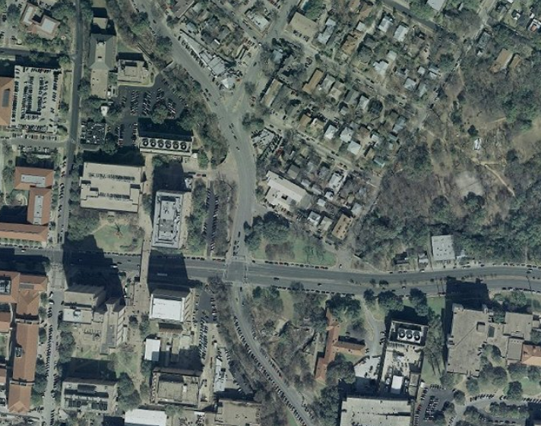
Raster data form a grid of cells or pixels
data
map

Slide 25
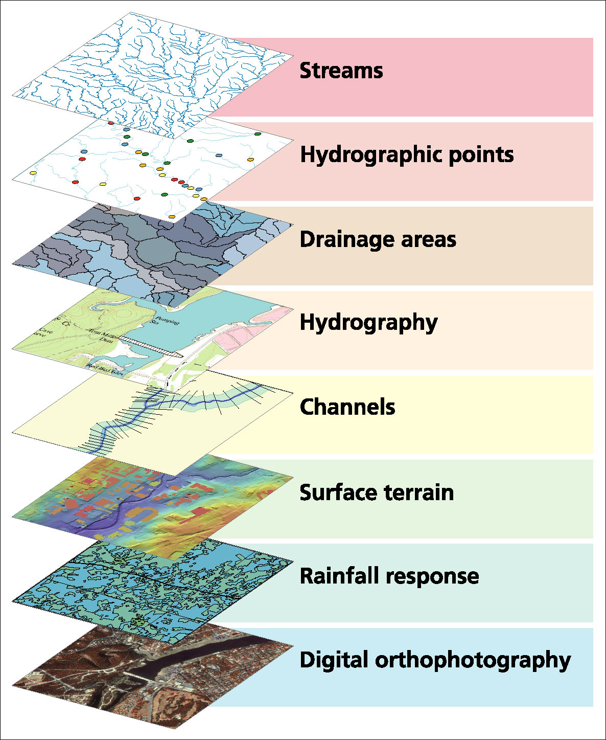
Data Model based on a collection of data themes

Slide 26

Shape of the Earth
It is actually a spheroid, slightly larger in radius at the equator than at the poles
We think of the
earth as a sphere

Slide 27
Representations of the Earth
Mean Sea Level is a surface of constant
gravitational potential called the Geoid
Sea surface
Ellipsoid
Earth surface
Geoid

Slide 28
Definition of Latitude, φ
m
S
p
O
n
φ
q
r
(1) Take a point S on the surface of the ellipsoid and define there the tangent plane, mn
(2) Define the line pq through S and normal to the
tangent plane
(3) Angle pqr which this line makes with the equatorial
plane is the latitude φ, of point S

Slide 29
Cutting Plane of a Meridian
P
Prime Meridian
Equator
Meridian
plane

Slide 30
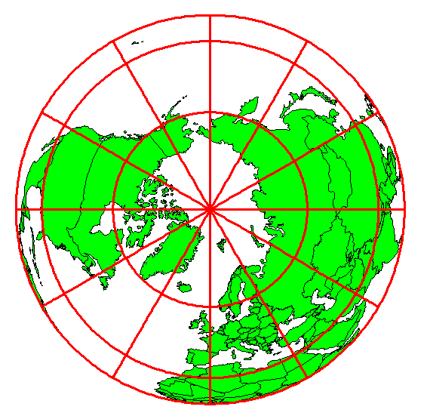
Definition of Longitude, λ
λ = the angle between a cutting plane on the prime meridian
and the cutting plane on the meridian through the point, P
180°E, W
-150°
150°
-120°
120°
90°W
(-90 °)
90°E
(+90 °)
-60°
P
λ
-60°
-30°
30°
0°E, W

Slide 31
Geoid and Ellipsoid
Earth surface
Ellipsoid
Ocean
Geoid
Gravity Anomaly
Gravity anomaly is the elevation difference between
a standard shape of the earth (ellipsoid) and a surface
of constant gravitational potential (geoid)

Slide 32
Definition of Elevation
Elevation Z
P
z = z_{p}
•
z = 0
Land Surface
Mean Sea level = Geoid
Elevation is measured from the Geoid

Slide 33
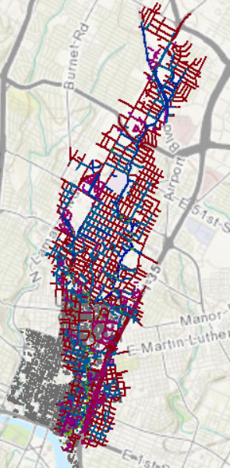
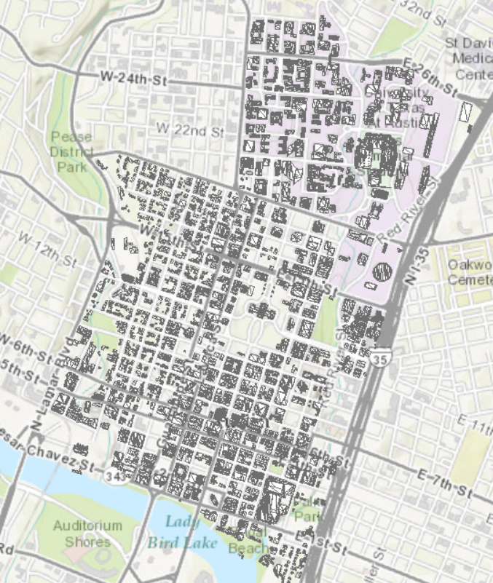
Digital Campus and Waller Creek Drainage Infrastructure
Data for Digital Campus
3D Buildings for Campus and Central Austin
Stormwater drainage infrastructure in the Waller Creek watershed

Slide 34
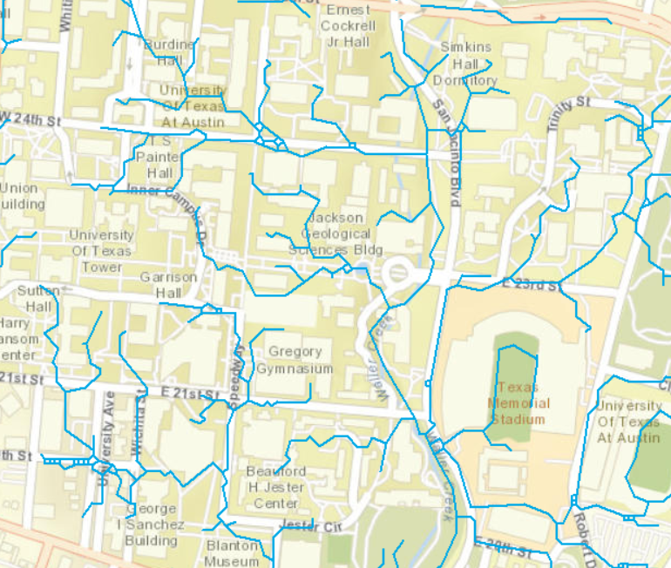
Drainage Patterns at UT-Austin

Slide 35
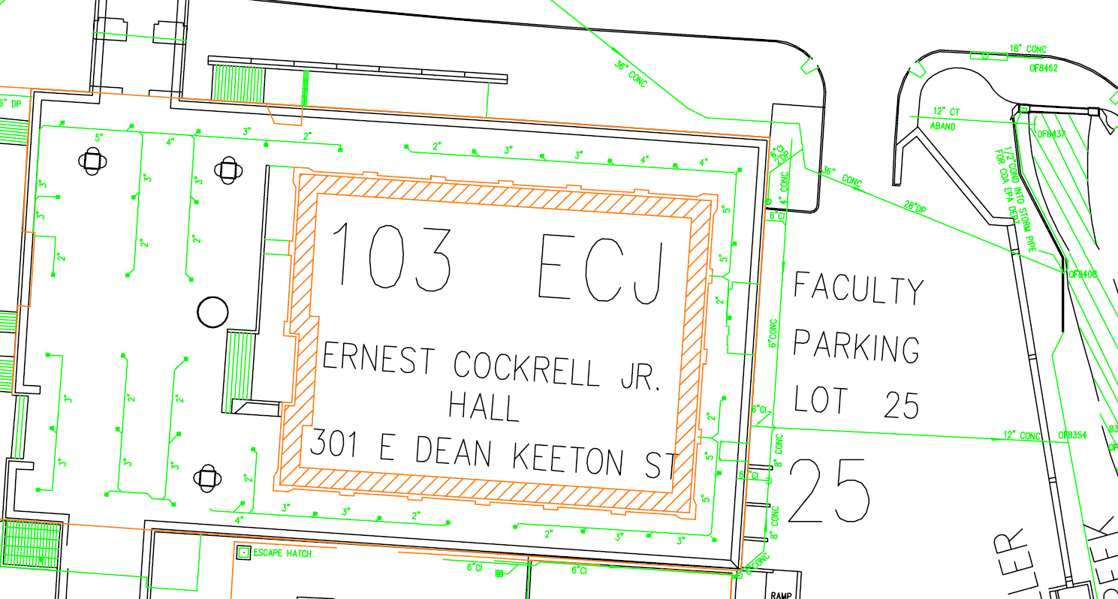
ECJ and Waller Creek

Slide 36
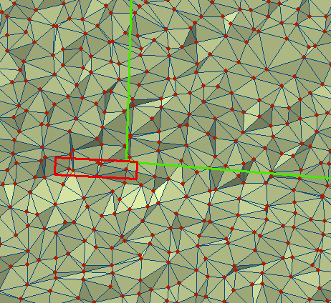
TIN of a portion of Dean Keaton St

Slide 37
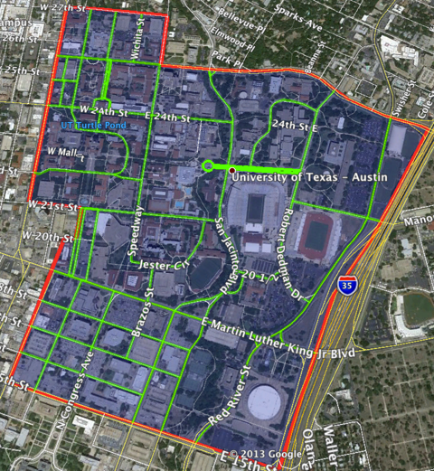
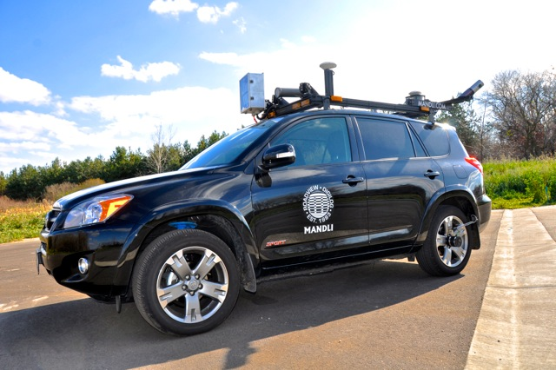
Vehicle-based LIDAR collection at UT-Austin
Mandli Communications

Slide 38
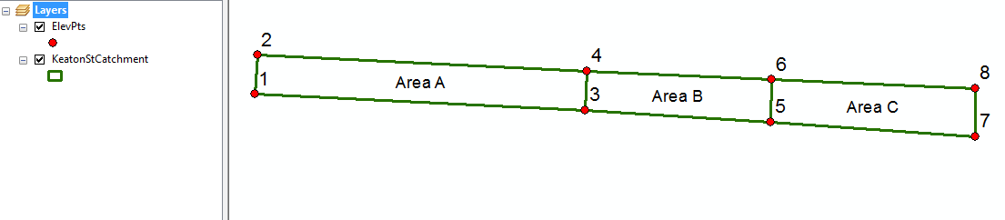
Dean Keaton St
CrossSection 56
Location

Slide 39
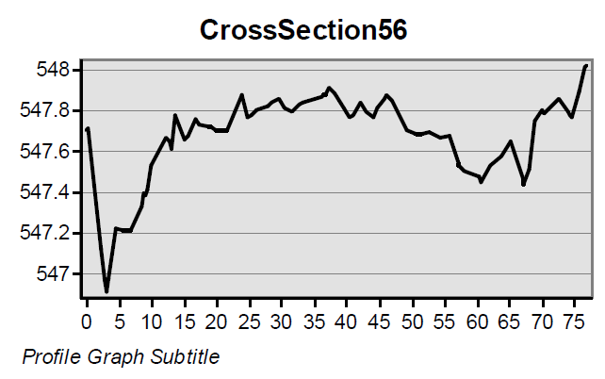
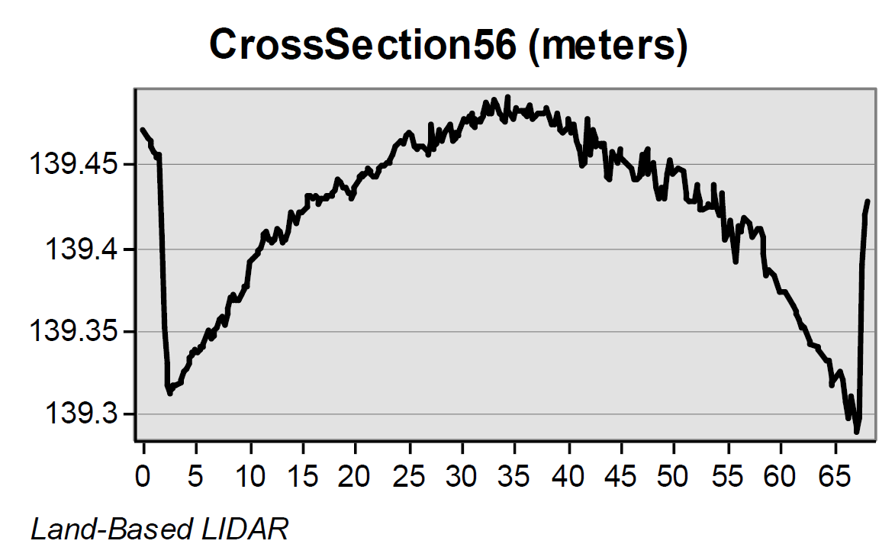
Road CrossSections from LIDAR
Location 5-6 is shown
in previous slides
Airborne LIDAR (ft)
(City of Austin data)
Its clear that the vehicle-based
LIDAR gives a better definition
of the road Cross-Section
Vehicle LIDAR (vertical in meters, horizontal in ft)

Slide 40
Stormwater Best Management Practices
Michael Barrett, Ph.D., P.E.
University of Texas at Austin

Slide 42
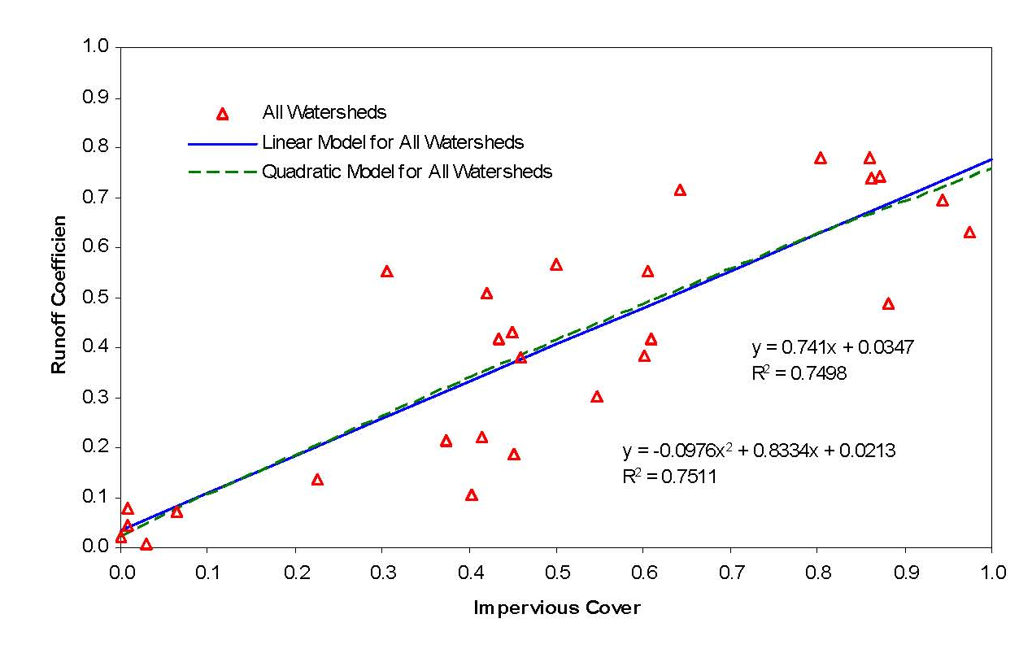
Impervious Cover and Runoff

Slide 43
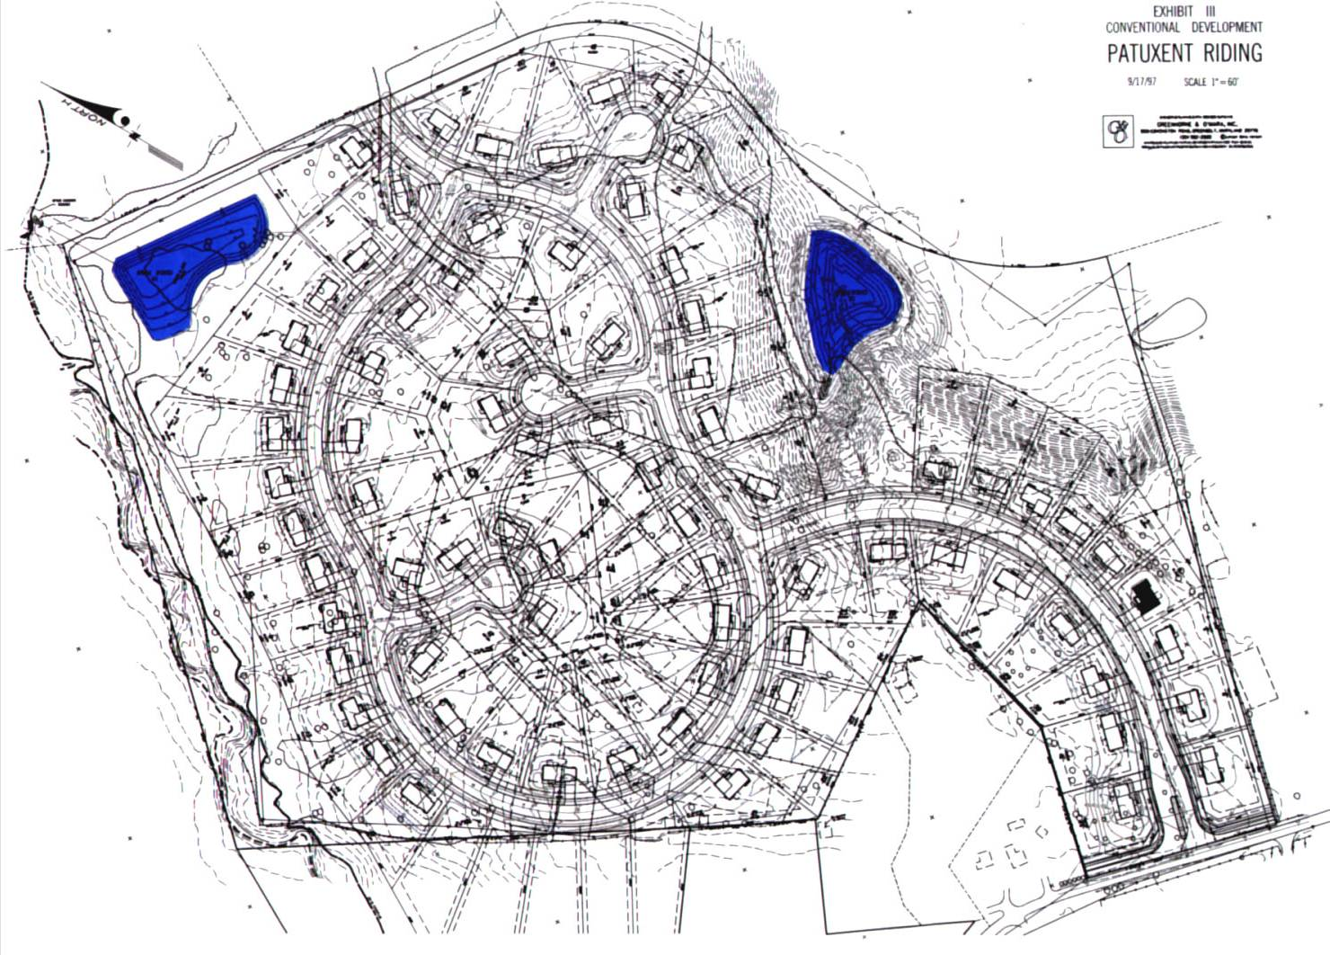
Conventional Development

Slide 44
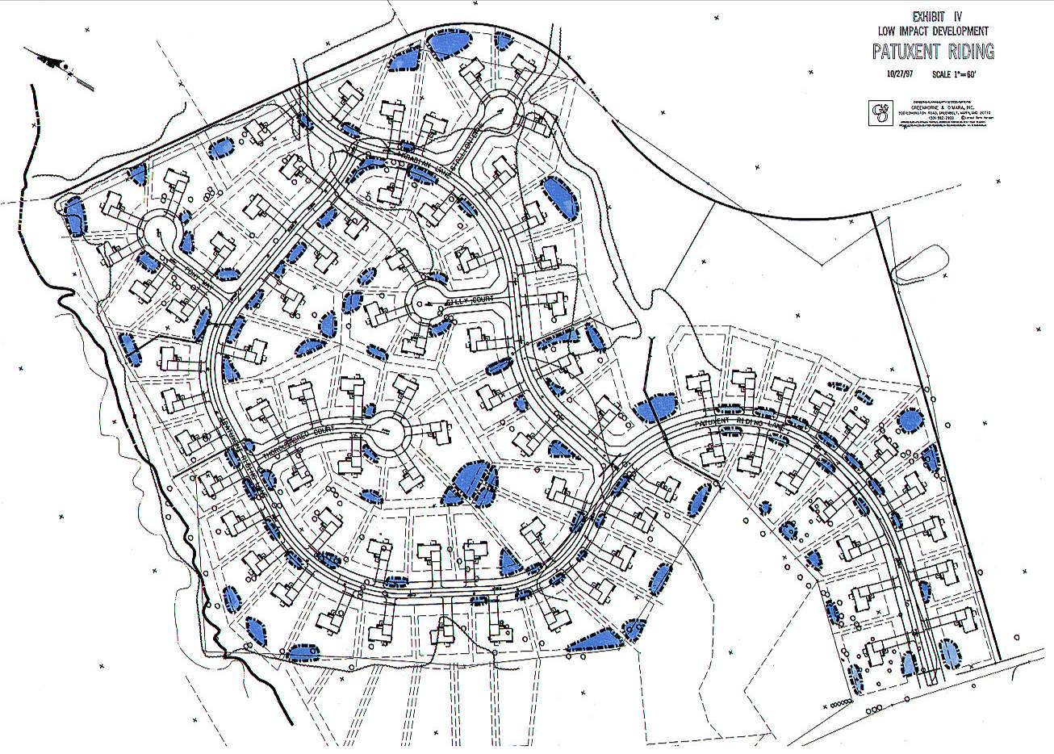
LID Development
Multiple Systems
Disconnected Decentralized Distributed Multi-functional

Slide 45
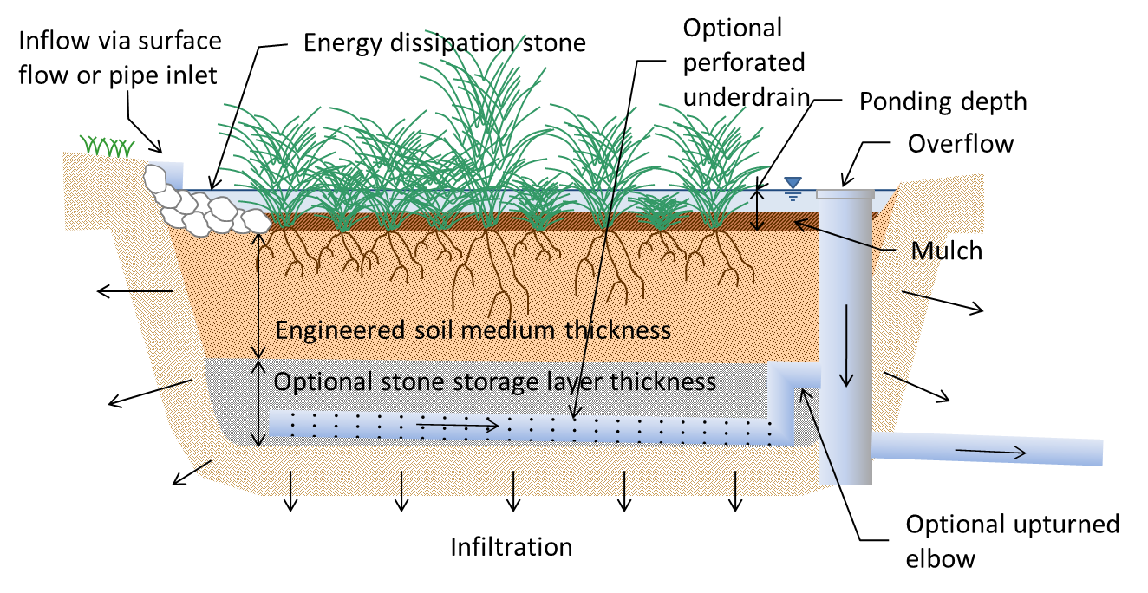
Bioretention

Slide 46
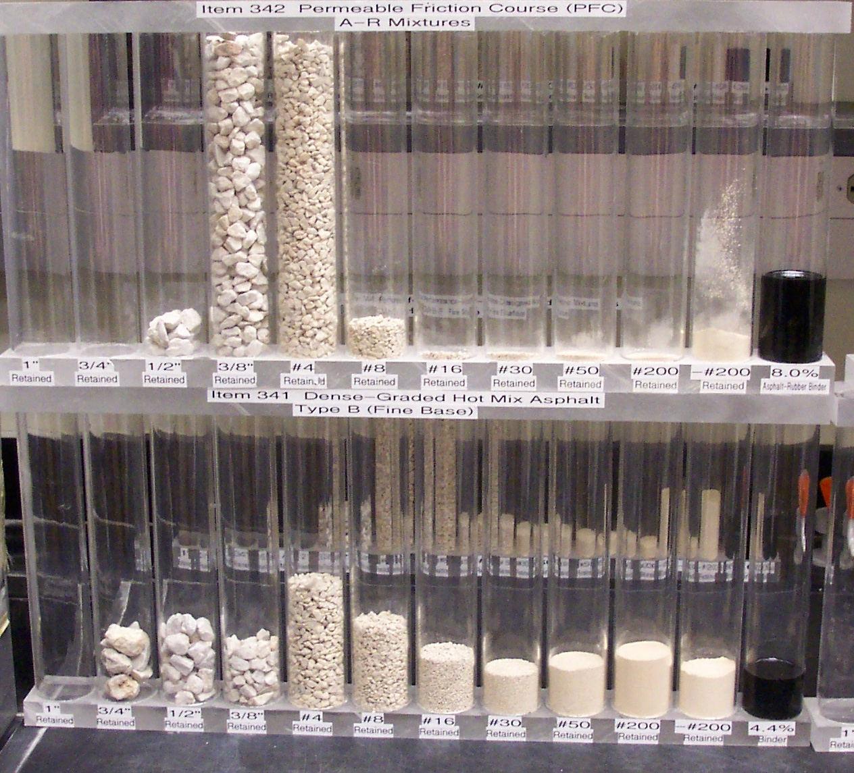
Porous Asphalt and Concrete
Porous Mix
Conventional Mix

Slide 47
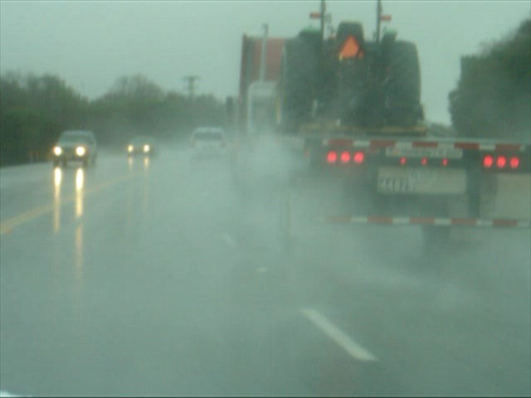
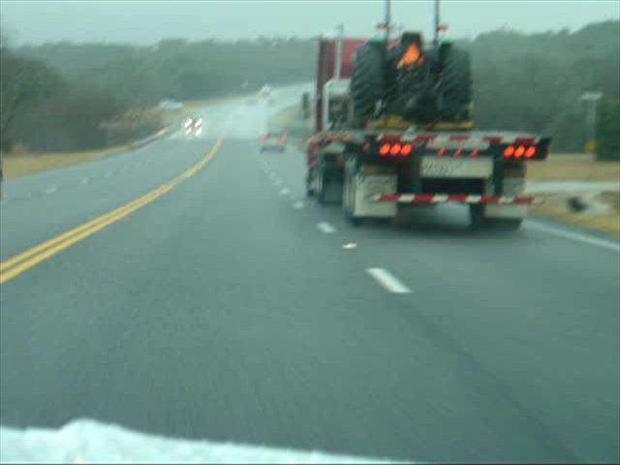
Splash and Spray
Conventional Asphalt
PFC

Slide 48
Water Quality at TX1
Constituent | Conventional Asphalt | PFC | Reduction % | p-value
TSS | 118 | 8.8 | 92 | 0.016
Total P | 0.13 | 0.07 | 48 | 0.047
Total Copper | 27 | 13 | 50 | 0.010
D. Copper | 6 | 10 | -77 | 0.045
Total Lead | 13 | 1 | 91 | 0.025
Total Zinc | 167 | 29 | 83 | 0.002
Dissolved Zinc | 47 | 22 | 53 | 0.139

Slide 49
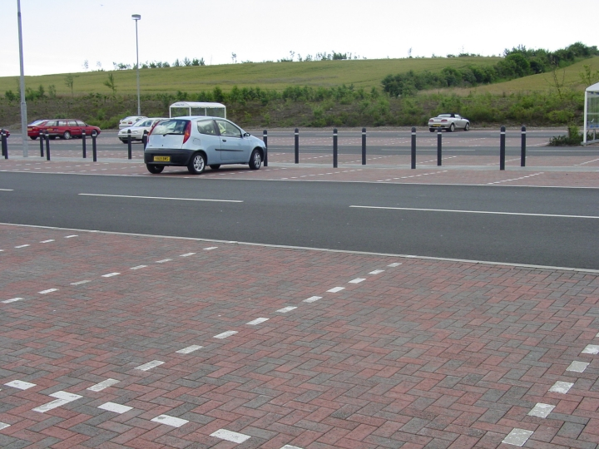
Porous Pavement only in Parking Stalls

Slide 50
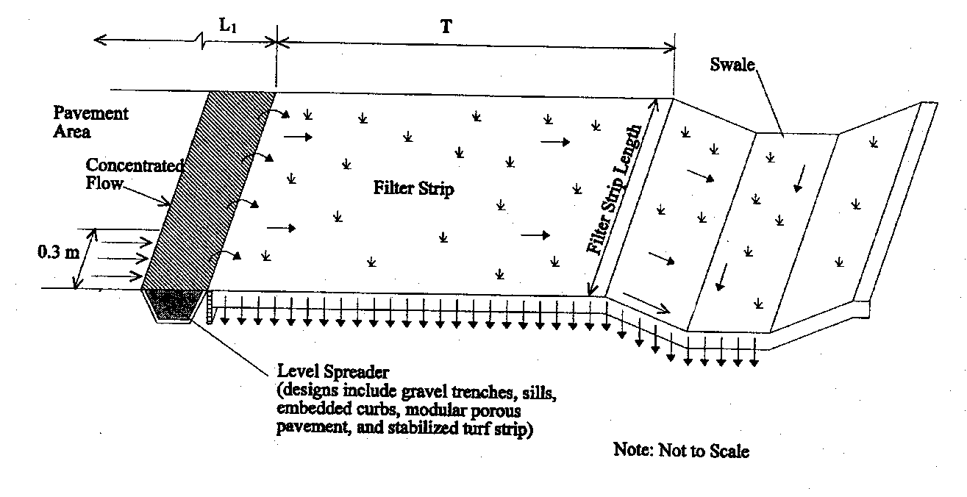
Schematic of Swale and Strip

Slide 51
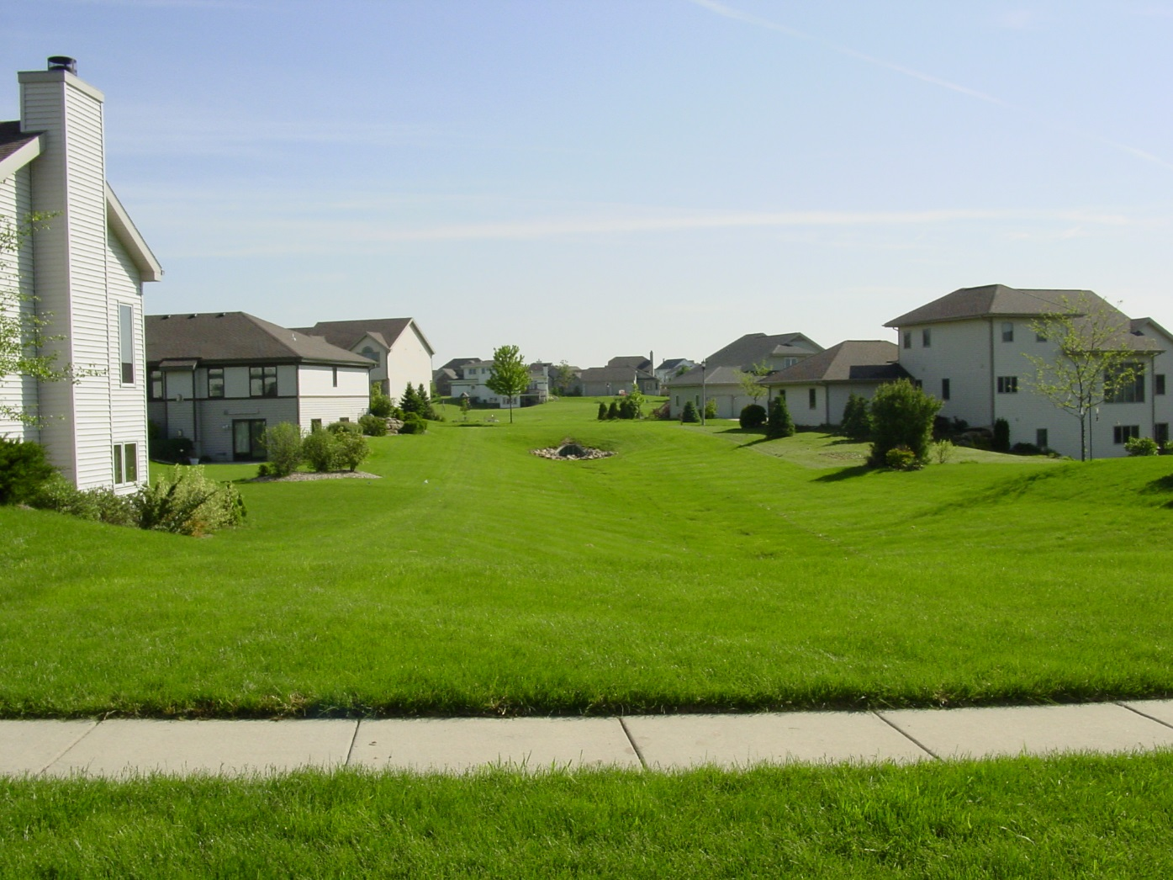

Slide 52
Vegetated Filter Strips

Slide 53
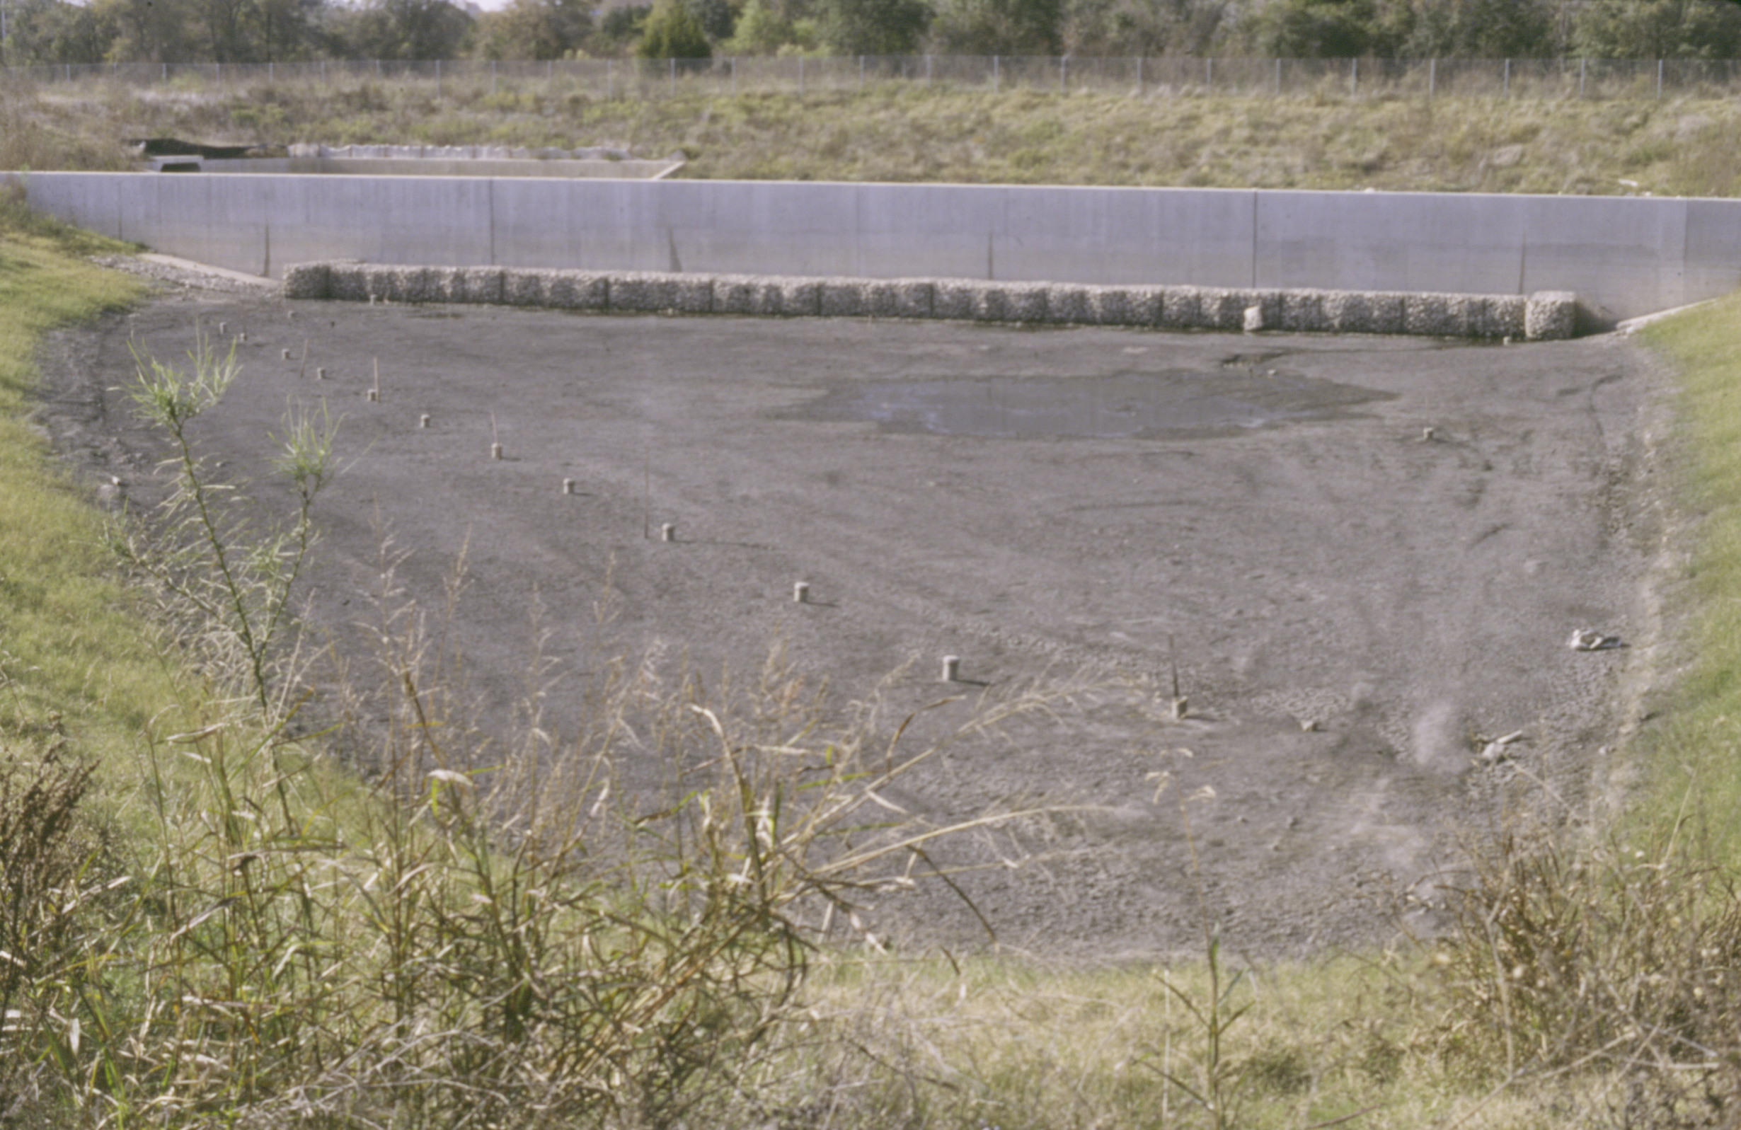
Austin Filter Bed

Slide 54
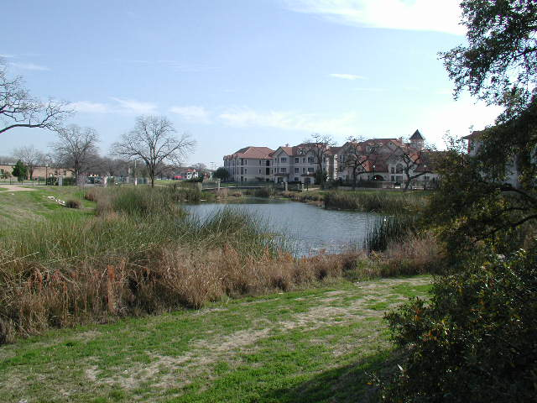
Central Park Wet Pond (TX)

Slide 55
