Slide 1
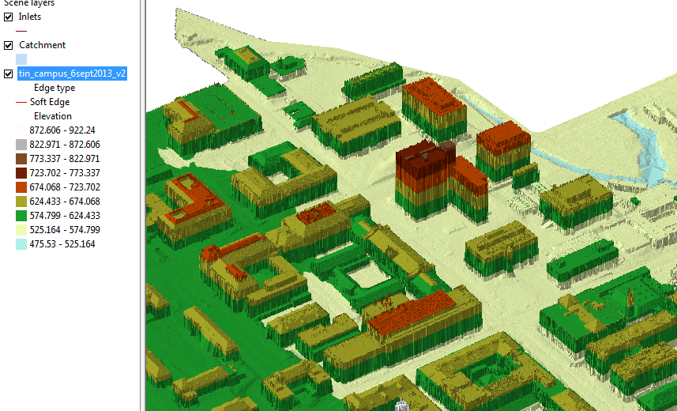
TIN of the North East part of campus
ECJ

Slide 2
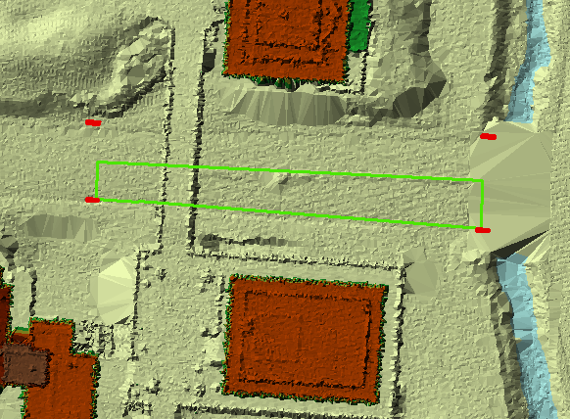
Airborne LIDAR coverage of Dean Keaton St and surroundings
CrossSection 56
Location

Slide 3
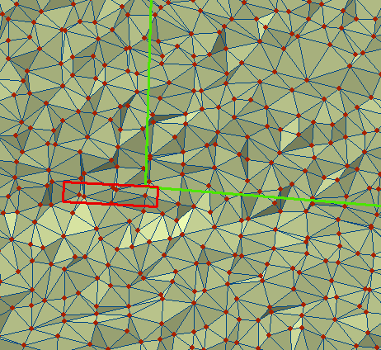
TIN of a portion of Dean Keaton St

Slide 4
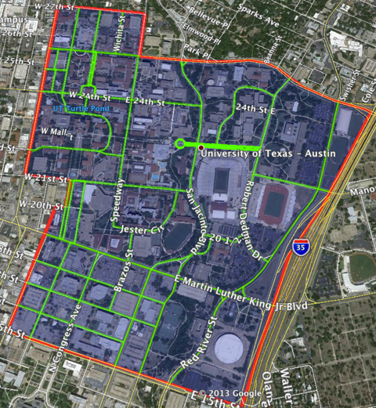
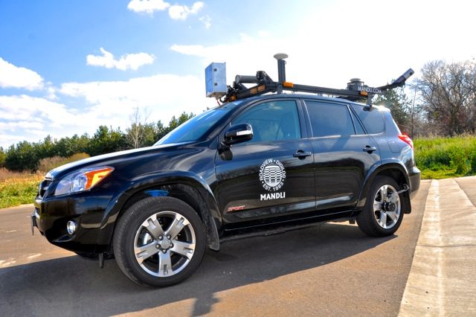
Vehicle-based LIDAR collection at UT-Austin
Mandli Communications

Slide 5
Dean Keaton St
CrossSection 56
Location

Slide 6
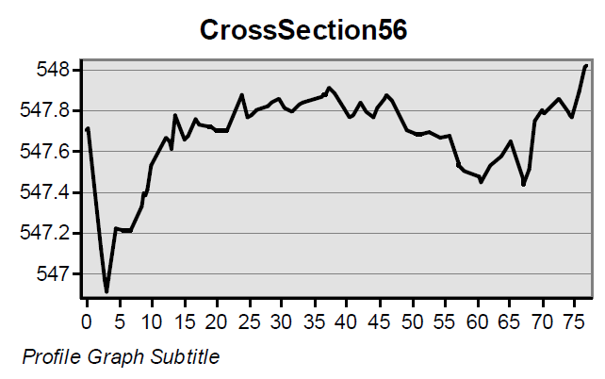
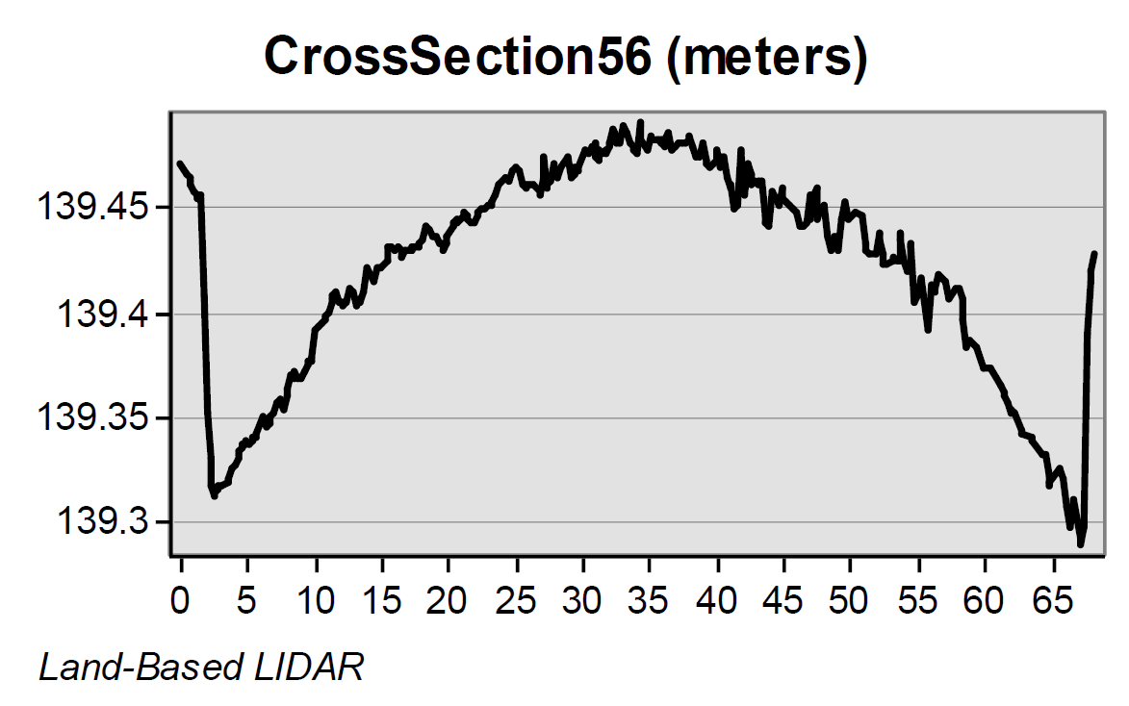
Road CrossSections from LIDAR
Location 5-6 is shown
in previous slides
Airborne LIDAR (ft)
(City of Austin data)
Its clear that the vehicle-based
LIDAR gives a better definition
of the road Cross-Section
Vehicle LIDAR (m) (Mandli Communications)

